Slide 1

MACHINE LEARNING-BASED FINANCIAL
FRAUD DETECTION SYSTEM
Detecting illicit Bitcoin transactions with Random Forest and a Graph Neural Network
ADEWOLE HABEEB ADEBOLA S122202011 Supervisor: Miss Saka B.A.
Department of Computer Science
College of Information and Communication Technology
Crescent University, Abeokuta
1

Slide 2
Introduction
The scale of the problem
2–5%
$154bn
<1%
of global GDP is laundered
every year (UNODC, 2011)
received by illicit crypto
addresses in 2025 (Chainalysis)
of transactions are illicit —
finding them is the hard part
Money laundering is how criminal proceeds are disguised so they can be spent in the legitimate economy. Cryptocurrency has made this easier: value moves globally, quickly and pseudonymously, without a bank in the middle.
But the blockchain is also an opportunity. Unlike banking data, which is locked inside private institutions, every Bitcoin transaction and every connection between transactions is permanently public — the complete transaction graph is available for analysis.
2

Slide 3
Introduction
From rules, to machine learning, to the network
1
Rule-based screening
Hand-written conditions flag transactions above a threshold. Transparent, but brittle: it only catches what someone already thought of, floods analysts with false alarms, and criminals learn to structure activity just below the limits.
2
Machine learning
A classifier learns the signature of illicit activity from labelled history instead of fixed rules. Stronger, but the standard formulation judges each transaction alone.
3
Graph-based learning
Laundering is a network crime — funds are layered through chains of transfers so no single step looks unusual. A graph neural network reasons over those connections, not just the transaction's own attributes.
This project builds Tracer: a system that scores real Bitcoin transactions with both approaches and delivers the results to a human analyst.
3

Slide 4
Statement of the Problem
!
Volume defeats manual review
Hundreds of thousands of Bitcoin transactions are recorded daily. No team of analysts can inspect them by hand.
!
Rules produce noise and are evaded
Fixed thresholds generate large volumes of false alarms that consume analyst capacity, and adversaries structure activity to stay just below them.
!
Isolated-transaction models are blind to the crime
Classifying each transaction on its own attributes discards the layering structure through which laundering is actually executed.
What is needed: a system that learns from data rather than fixed rules, incorporates the transaction network into its reasoning, screens every transaction automatically, and explains its decisions so analysts can act on them.
4

Slide 5
Aim and Objectives
AIM
To design and implement a machine learning-based financial fraud detection system that identifies illicit transactions in a real transaction network and supports analysts with automated screening, alerting and explainable results.
OBJECTIVES
1
Exploratory analysis of the datasets
Profile the PaySim synthetic mobile-money dataset and the Elliptic Bitcoin transaction dataset: size, structure, feature composition, label distribution, graph connectivity, and any data quality problems.
2
Build the fraud detection system
Prepare the data, train a Random Forest on the transaction features and a GraphSAGE graph neural network on the payment network, and deliver both through a web-based analyst console.
3
Test and evaluate the developed models
Measure accuracy, precision, recall, F1-score and AUC-ROC on a held-out test period, compare the models against each other and the published benchmark, and validate the application with an automated test suite.
5

Slide 6
Significance of the Study
01
02
Demonstrates the production architecture
Reproduces a published benchmark
Machine learning classification over a real transaction graph, combined with network analysis and delivered into an analyst's workflow — the same shape used by commercial platforms, built and validated at academic scale.
An empirical Random Forest versus GraphSAGE comparison on the Elliptic dataset under a leakage-free temporal protocol, matching the result reported by Weber et al. (2019).
03
04
Makes predictions explainable
Documents an honest methodology
Regulators and investigators cannot act on scores they cannot interrogate. Every prediction is attributed to the feature groups that produced it.
The move from synthetic data to a real transaction graph is recorded as it happened, as a realistic template for applied machine learning projects.
6

Slide 7
Related Works
Author(s) | Title | Key finding
Weber et al. (2019) | Anti-Money Laundering in Bitcoin: Experimenting with Graph Convolutional Networks for Financial Forensics | Introduced the Elliptic dataset. Random Forest was the strongest model at an illicit F1 of ≈0.79, ahead of the graph convolutional network.
Alarab, Prakoonwit & Nacer (2020) | Competence of Graph Convolutional Networks for Anti-Money Laundering in Bitcoin Blockchain | Interleaving graph convolutional and linear layers outperformed the original GCN configuration on the same dataset.
Pareja et al. (2020) | EvolveGCN: Evolving Graph Convolutional Networks for Dynamic Graphs | Using a recurrent network to evolve GCN weights across time steps beat the static GCN on evolving transaction graphs.
Motie & Raahemi (2024) | Financial Fraud Detection Using Graph Neural Networks: A Systematic Review | GNNs are consistently competitive with or superior to conventional baselines on relational fraud tasks; imbalance, drift and explainability remain open.
Common gap: these are model experiments. None delivers an operational system in which predictions are explained, monitored continuously and tracked to resolution.
7

Slide 8
Summary of the Work
The data and the three models
THE ELLIPTIC DATASET
THE MODELS
A labelled subgraph of the real Bitcoin blockchain, published by Elliptic Ltd. with the MIT-IBM Watson AI Lab.
Random Forest
200 decision trees voting on the transaction's own 165 features.
203,769
transactions (nodes)
GraphSAGE
234,355
payment flows (edges)
Two message-passing layers, hidden dimension 128. Learns from each transaction's two-hop neighbourhood in the payment graph.
165
features per transaction
Combined variant
49
time steps of ~2 weeks
Random Forest trained on the features plus the GraphSAGE embeddings.
46,564
labelled — 9.76% illicit
Trained on time steps 1–34 · tested on 35–49
77% of transactions carry no label — the models score them, but no ground truth exists.
8

Slide 9
Summary of the Work
Results on the held-out test period (time steps 35–49)
92.5%
71.6%
Precision
Recall
0.944
Best model:
Random Forest
AUC-ROC
Benchmark reproduced
Weber et al. (2019) report an illicit F1 of ≈0.79 for Random Forest under the same dataset and temporal protocol. This project reached 0.807.
Of 1,083 illicit transactions in the test period the Random Forest caught 776 and raised only 65 false alarms across 15,587 legitimate transactions. The recall shortfall coincides with a dark-market shutdown inside the test window — a documented case of concept drift.
9

Slide 10
Methodology
Iterative and incremental development, with CRISP-DM for the machine learning
ITERATION 1 · PaySim
ITERATION 2 · Elliptic
Synthetic mobile-money data. Established the pipeline, but contained no transaction network to analyse — which prompted the change of dataset.
Real Bitcoin transaction graph. The final system: both models, the analyst console, and the full evaluation.
THE PIPELINE
1
2
3
4
5
6
Explore
Prepare
Split
Balance
Train
Evaluate
Profile both
datasets
Encode labels,
drop identifiers
Temporal:
train 1–34
SMOTE on the
training set only
Random Forest
+ GraphSAGE
Test on
steps 35–49
Why split by time? A random split would put transactions from the same period — and even direct neighbours in the graph — on both sides, letting information leak from test into training. Training on the past and testing on the future is also how the system would actually be deployed.
10

Slide 11
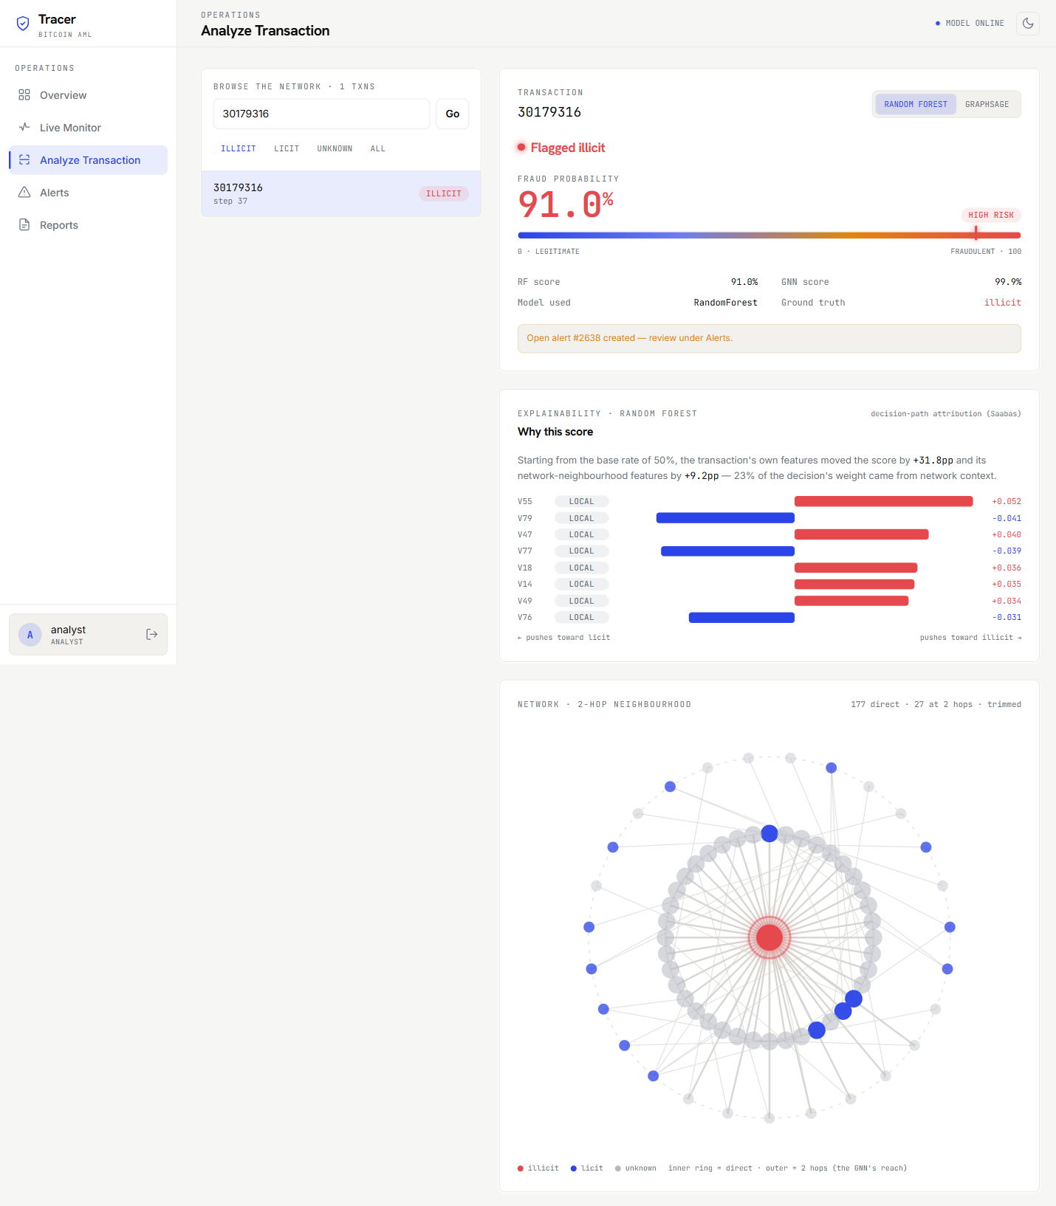
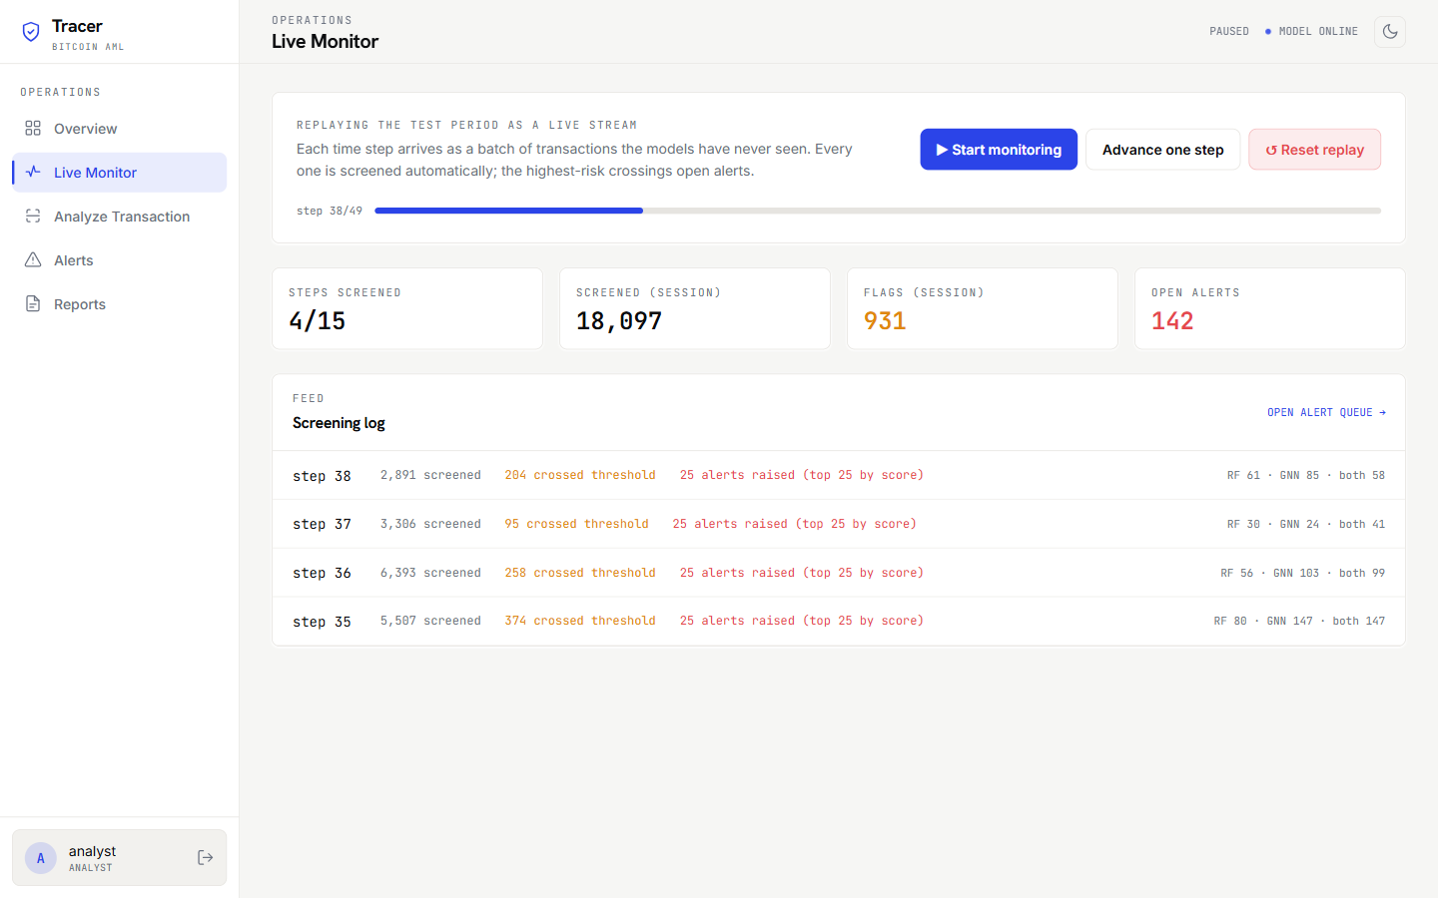
Implementation
A three-tier analyst console: React · Flask REST API · MySQL
Role-based access
Fraud Analyst and Administrator, enforced on the server.
Two-hop network view
Shows exactly the neighbourhood the graph model reasons over.
Per-decision explanations
Each score split into the transaction's own features versus its network context.
Analyze — risk score, both models, the two-hop payment network, and why the score came out that way
Continuous monitoring
Automatic screening with an alert budget that models analyst capacity.
Case management
Alerts carry notes through to resolution; activity exports as CSV.
Live Monitor — screens every transaction per time step and raises alerts automatically
Validated by 35 automated tests, all passing
11

Slide 12
Conclusion
1
The system works, and the result is verifiable
An illicit-class F1 of 0.807 on transactions the models had never seen, reproducing the benchmark published for this dataset.
2
Feature engineering and graph learning are complements
The Random Forest wins here because Elliptic's features already summarise each transaction's neighbours — and because the graph itself is sparse, at a mean of 2.3 connections per transaction.
3
Detection only matters when it reaches an analyst
Every prediction is explained, every high-confidence detection becomes a tracked case, and the transaction stream is screened continuously under a realistic capacity budget.
Thank you.
12

