Slide 1
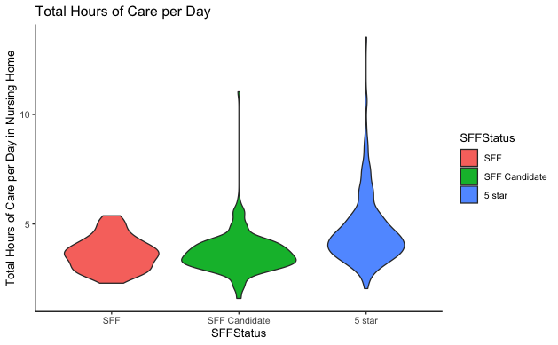
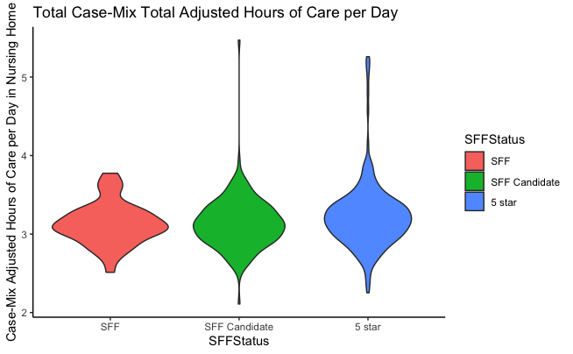
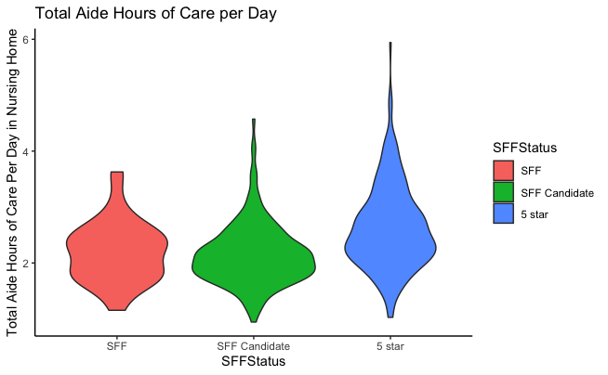
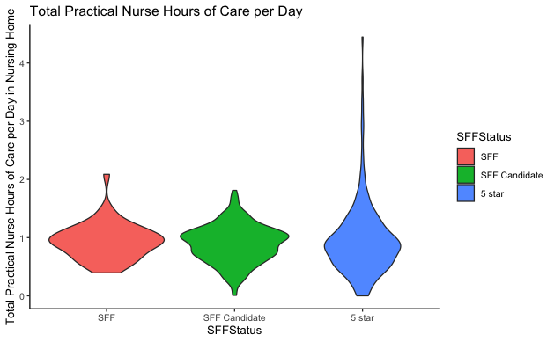
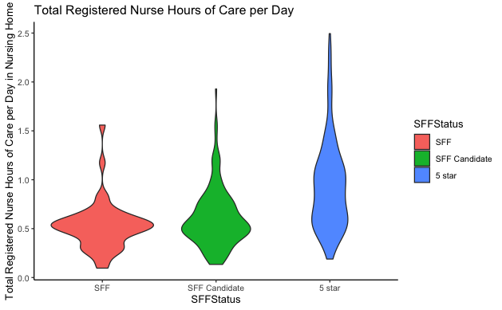
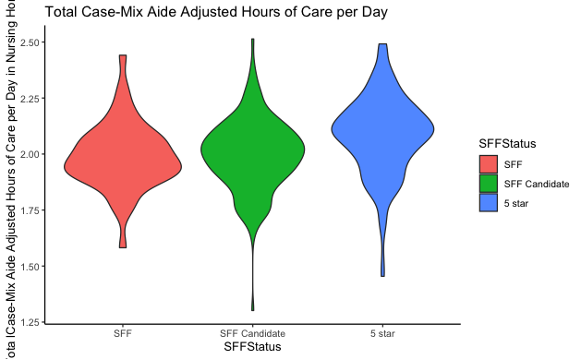
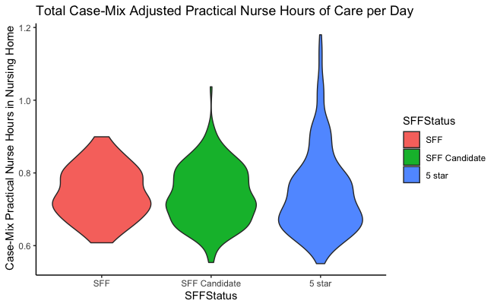
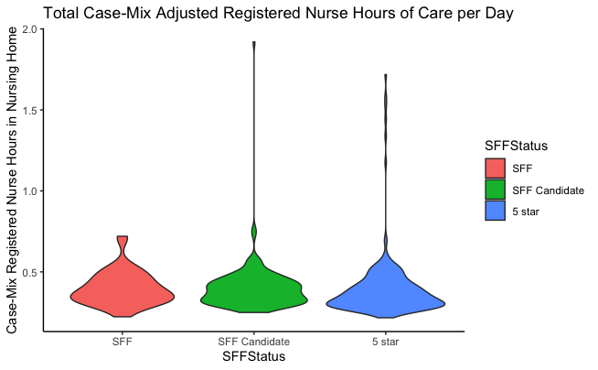
Special Focus Facilities and Candidates have similar staffing levels for many vital clinical staffing roles. High performing facilities employ more staff. There were no significant differences between SFF and SFFc in HPRD Aide F(2,5748)=380,p=.63, Practical Nurse F(2,5748)=1.1, p=.211, Case-Mix Practical Nurse F(2,5748)=19.57,p=.39, Case-Mix RN F(2,5748)=9.51,p=.91, Total HPRD F(2,5748)=472.6,p=.16.
Non-Cognitive Predictors of Student Success: A Predictive Validity Comparison Between Domestic and International Students
Non-Cognitive Predictors of Student Success: A Predictive Validity Comparison Between Domestic and International Students
Staffing Differences in Nursing Home Special Focus Facilities and Special Focus Facility Candidates
 | Group | Mean (SD) | Median | Range
Aide Hours Per Resident Day | 5-Star | 2.60(.64) | 2.48 | 0-5.94
 | Candidate | 2.19(.50) | 2.10 | 0.55-4.57
 | Special Focus Facility | 2.16(.44) | 2.13 | .94-3.62
Practical Nurse Hours per resident day | 5-Star | .91(.57) | .85 | 0-4.44
 | Candidate | .89(.30) | .91 | .00-1.88
 | Special Focus Facility | .92(.31) | .92 | .29-2.18
Registered Nurse hours per resident day | 5-Star | 1.05(.89) | .83 | .14-7.57
 | Candidate | .59(.52) | .51 | .00-6.15
 | Special Focus Facility | .49(.21) | .47 | .06-1.55
Total Hours Per Resident Day | 5-Star | 4.57(1.37) | 4.23 | 1.56-13.51
 | Candidate | 3.68(.80) | 3.61 | 1.6-11.03
 | Special Focus Facility | 3.58(.66) | 3.55 | 1.64-5.85
Case Mix Aide Hours per Resident Day | 5-Star | 2.09(.17) | 2.1 | 1.37-2.50
 | Candidate | 2.01(.14) | 2.02 | 1.30-2.51
 | Special Focus Facility | 1.98(.13) | 1.98 | 1.58-2.44
Case Mix Practical Nurse Hours per Resident Day | 5-Star | .75(.12) | .73 | .53-1.34
 | Candidate | .74(.07) | .73 | .55-1.04
 | Special Focus Facility | .73(.06) | .73 | .06-.89
Case Mix Registered Nurse Hours per Resident Day | 5-Star | .39(.20) | .34 | .21-1.90
 | Candidate | .37(.12) | .35 | .24-1.91
 | Special Focus Facility | .37(.08) | .35 | .22-.74
Total Case Mix Hours per Resident Day | 5-Star | 3.24(.44) | 3.20 | 2.18-5.49
 | Candidate | 3.13(.30) | 3.13 | 2.10-5.47
 | Special Focus Facility | 3.09(.23) | 3.08 | 2.51-3.77
Annie Rhodes, MS, Faika A. Zanjani, Ph.D., Thomas V. Caprio, MD, MPH, MS, Tracey Gendron, Ph.D., Anna Novak, MS, Leland Waters, Ph.D.
INTRO
Centers for Medicare and Medicaid Services designates "Special Focus Facilities" (SFF), nursing homes receiving special oversight for persistent quality problems. "Special Focus Facility Candidates" (SFFc) are nursing homes with quality problems that are designated as candidates to be future SFFs. Recent academic literature has not examined if SFF and SFFc have significant differences in staffing hours per resident day (HPRD).
METHODS
Methods: Nursing homes that were SFF (n=50) or SFFc (n=197) in 2020 were matched to 5-star nursing homes (n=247). Monthly staffing averages were aggregated, and two-way ANOVAs with Tukey Post Hoc were conducted to detect level differences in HPRD across the three facility groups
RESULTS
There was a significant difference between SFF and SFFc HPRD in Case-Mix Aide F(2, 5748)=187.6, p= < .005, and RN, F(2,5748)=323,p=.003 care. SFFc frequently, but not always had better staffing measures
DISCUSSION
Discussion: There is only a significant difference in staffing levels observed between SFF and SFFc for Aide staffing and RN staffing. This information supports researchers and policymakers in delineating the differences and similarities between SFF and SFFc.
FINANCIAL DISCLOSURE
None
Notes:
Notes:
In Powerpoint, click View > Guides
Keep text within gutter guides.
Author list: Don’t split names onto two lines (e.g., “Jimmy [break] Smith”). If that happens, use a new line, unless you need the space. Bold the first names of anybody who’s presenting in person.
Intro/methods/result: Do not drop below font size 28, but if you have extra space, jack up the font size until the space is full.
Do not use color in the sidebars except in graphs/figures. It’ll pull attention from the center and slow interpretation for passersby.

