Slide 1

TS
Modules

Slide 2
Contents:
Table of
What are Modules?
Benefits of Modular Programming!
Real-life ex. & FAQs
Syntax…

Slide 3
MODULES IN ONE LINE
Modules are a way to organize and encapsulate code into reusable, self-contained units by exporting and importing functionality between files.

Slide 4

CODING ACHI TOU CHAL RAHI THI THEN MODULES KYU?

Slide 5
BEFORE MODULES
Imagine maintaining thousands of lines of code in just ONE file.
It will be a nightmare to debug and find errors in a file that contains thousands of lines of code.
Before modules, naming conflicts was a big problem because when you declare lots of functions, variables, objs, arrays globally. You can not use the same name anywhere else. Like this:

Slide 6
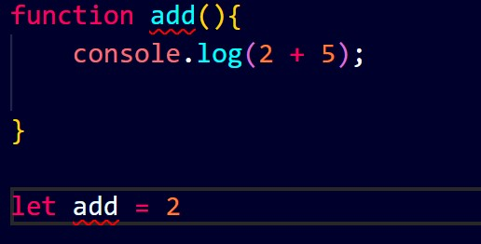

Slide 7
You can not use a name given to a global func, obj, arr, variable etc for any other.
4. Imagine when you are working in a big project and you have to use the a function or anything in of a file in some other file What you will do in that case, you will have to repeat the code multiple times.
5. Imagine that you want that people can access only those func, variable, objs, arrays that you want them to use or see.

Slide 8
THEN COMES MODULES IN GAME
Using modules you can break complex code into logical parts.
Using module you can encapsulate your i.e. can choose what to share what not.
You can avoid the naming conflict
When working on large projects you can use a functionality created in a file multiple times in many other files, avoiding data duplication/redundancy.

Slide 9
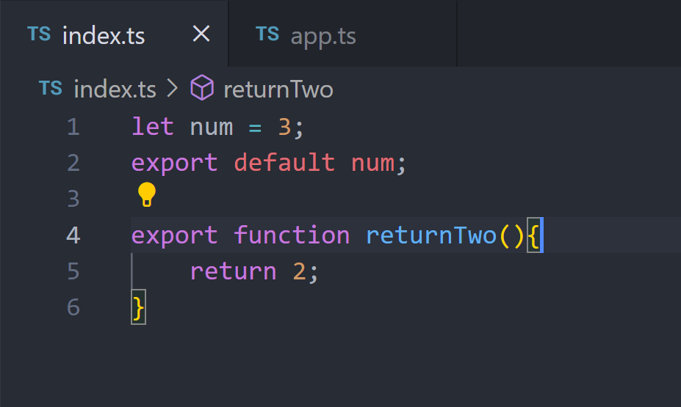

Slide 10
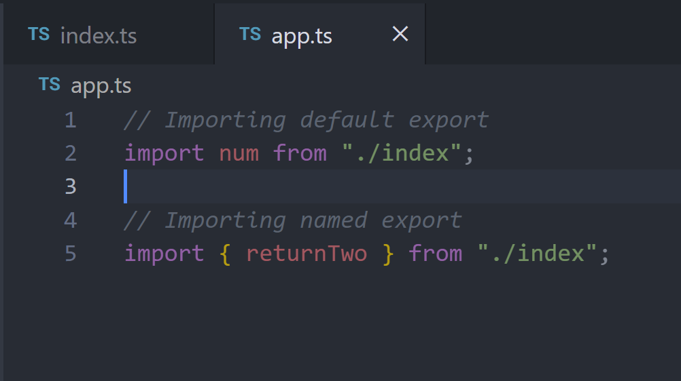

Slide 11
Key Takeaways:
`export` is used to make entities available outside the current module.
`import` is used to bring functionalities from other modules into the current module's scope.
Understanding export and import statements helps in organizing and reusing code effectively in TypeScript projects.

Slide 12
FAQs
Q1. How can TypeScript modules help in code organization and scalability?
Modules help keep your code organized by dividing it into smaller, reusable pieces. This makes it easier to manage and scale your projects as they grow.

Slide 13

FAQs
Q2. Difference between Default and Named Exports?
Default export is used for exporting a single entity per module, while named exports allow exporting multiple entities.

Slide 14
Phir Milenge!
Agar Sir ne ijazat di toh :)

