Slide 1
Modules TS

Slide 2
A module is a way to create a group of related variables, functions, classes, and interfaces, etc. Introduced in ES6.
Why Modules?
Helps organize large codebases into smaller, manageable parts.
Allows hiding implementation details and exposing only what's necessary.
Promotes code reuse across different parts of an application or between applications.

Slide 3
Benefits of Using Modules
Modules make our codebase more manageable by splitting it into smaller, more focused units.
As our application grows, modules help maintain order and prevent code clutter.
They facilitate teamwork by providing clear boundaries and reducing conflicts between developers' contributions.
Modules make it easier to maintain and update code, as changes are localized to specific modules rather than affecting the entire application.

Slide 4
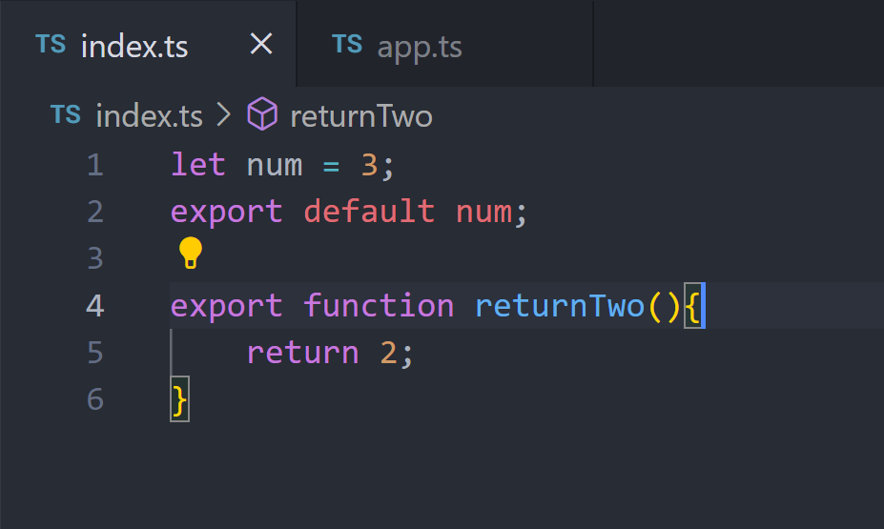

Slide 5
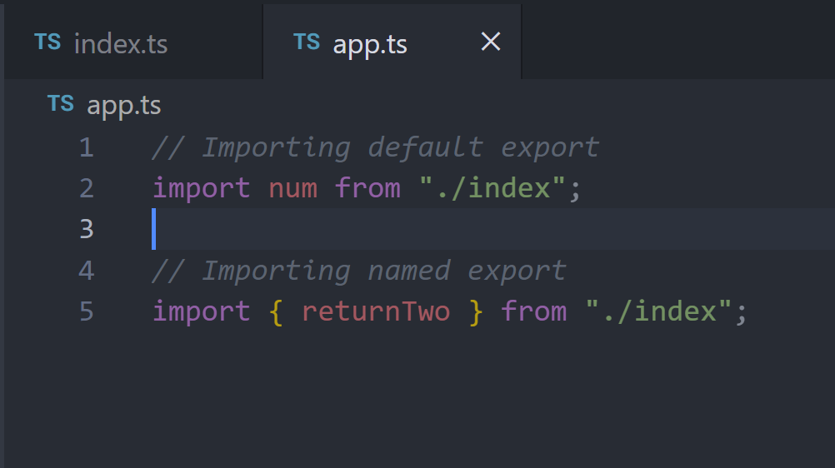

Slide 6
Key Takeaways:
`export` is used to make entities available outside the current module.
`import` is used to bring functionalities from other modules into the current module's scope.
Understanding export and import statements helps in organizing and reusing code effectively in TypeScript projects.

Slide 7
FAQs
Q1. How can TypeScript modules help in code organization and scalability?
Modules help keep your code organized by dividing it into smaller, reusable pieces. This makes it easier to manage and scale your projects as they grow.

Slide 8

FAQs
Q2. Difference between Default and Named Exports?
Default export is used for exporting a single entity per module, while named exports allow exporting multiple entities.

Slide 9
FAQs
Q3. How does TypeScript handle module dependencies?
TypeScript looks for modules using a method called module resolution. It follows specific rules to find and load modules based on your setup.

Slide 10
FAQs
Q4. What are the benefits of using TypeScript namespaces versus modules?
Namespaces: Used to group related code in a single file or across multiple files, but everything is in a global scope.
Modules: Provide better isolation and can be easily shared and reused in different files and projects. They help avoid conflicts by keeping code separate.

Slide 11
Thank You

