Slide 1
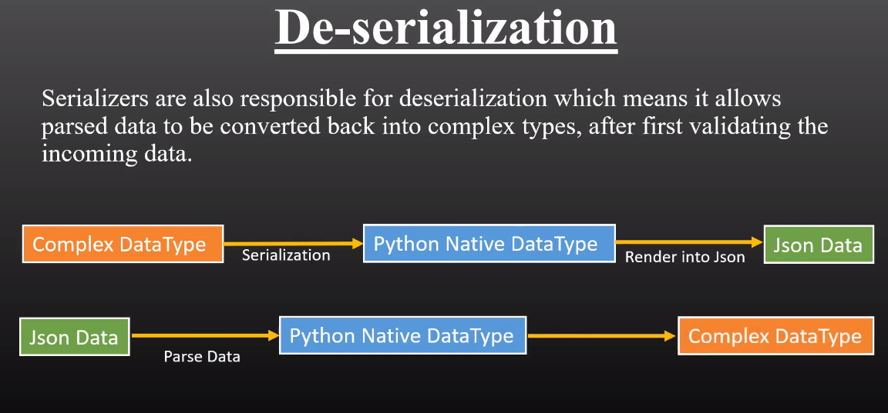
De-serializer
De-Serializer:

Slide 2
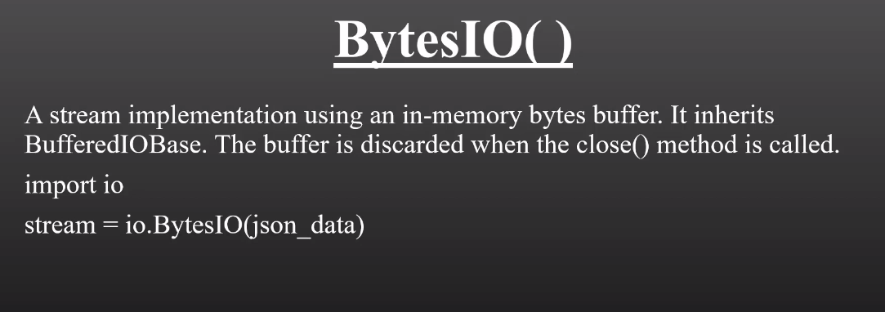
To change the JSON data into complex format, we had do these things:

Slide 3
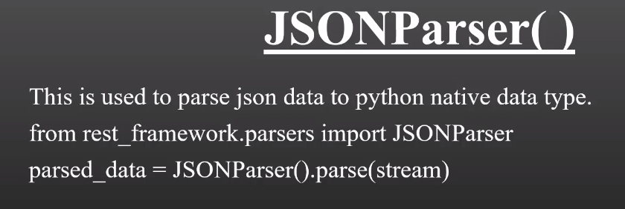

Slide 4
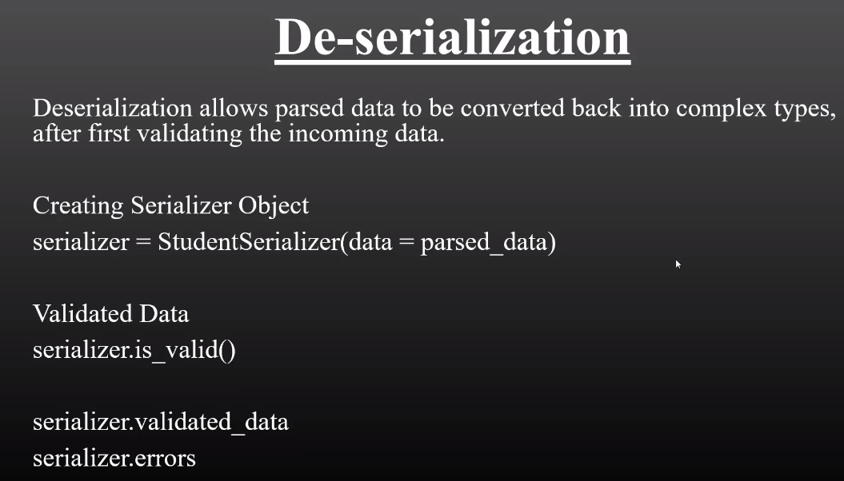

Slide 5


Slide 6
