Slide 1
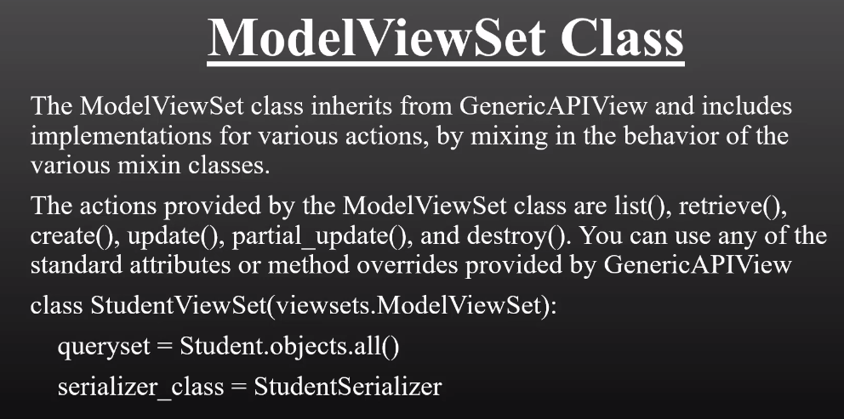
Model ViewSet

Slide 2
