Slide 1


Slide 2
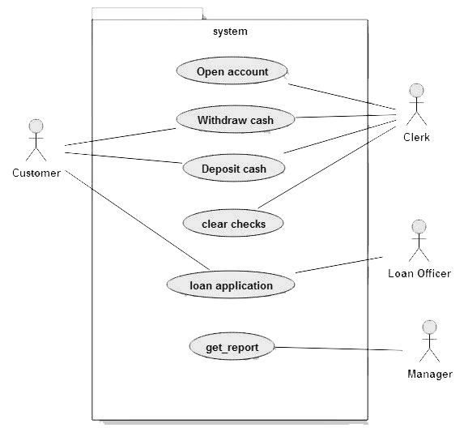
use case diagram for banking application

Slide 3
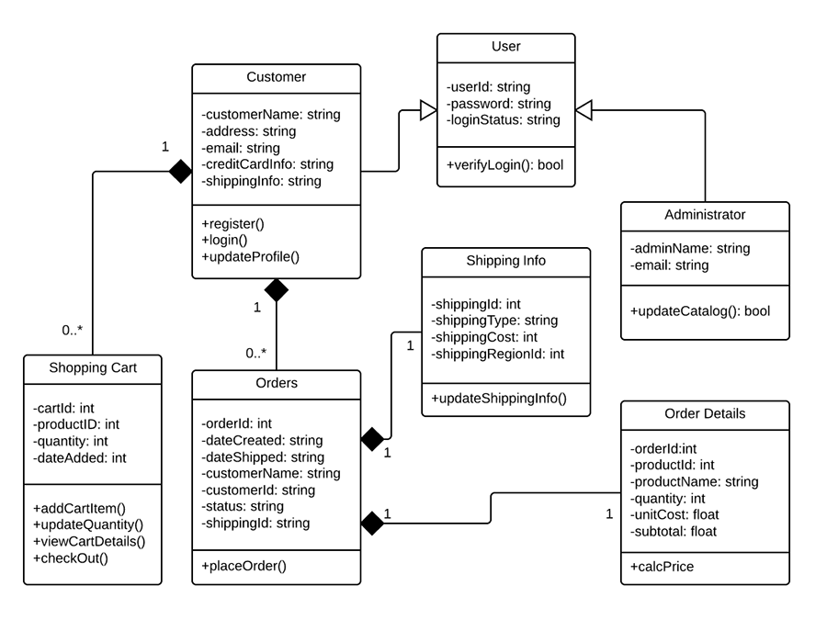
class diagram of online shopping

