Slide 1
Wireless Sensor Networks

Slide 2
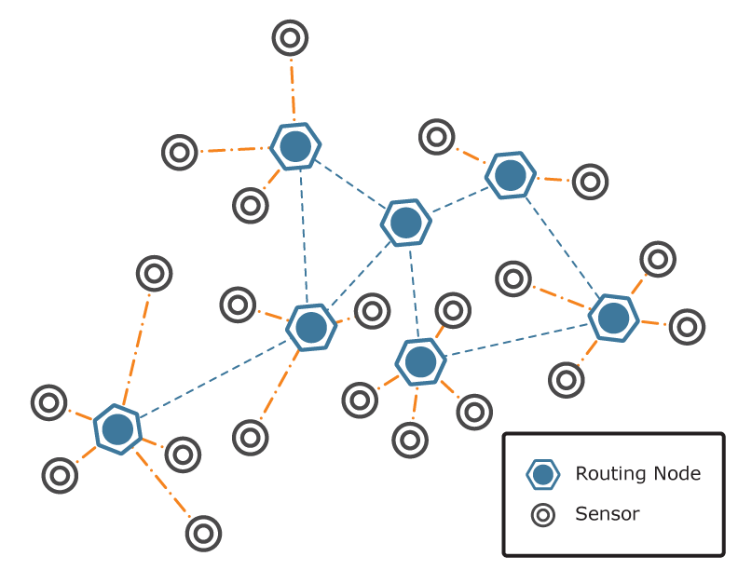
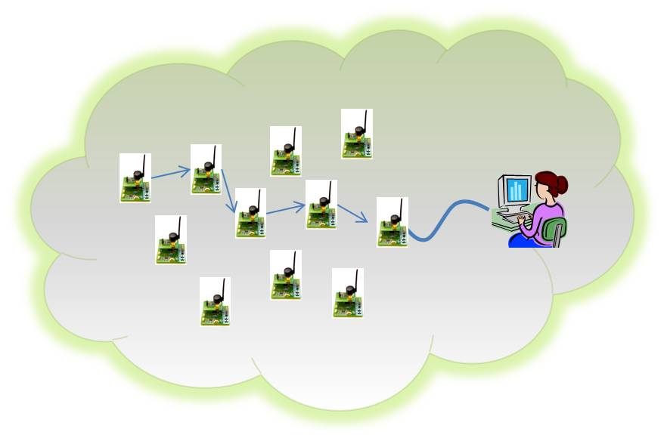
Definition
Wireless sensor networks (WSNs) consists of a large number of sensor nodes to monitor physical or environmental conditions.
It is consists of sensing (measuring), computing and communication elements. The results acquired by a regional network is provided to the administrator.
The administrator observe and react to events/phenomena in a specified environment. The administrator typically is a civil, governmental, commercial, or industrial entity.

Slide 3
For example a sensing node can sense the environment like:
Physical world (temperature, pressure, sound, wind direction and speed, illumination intensity)
Biological system (biological and chemical sensors for national security applications for example Air pollution monitoring, Water quality monitoring)

Slide 4
Applications
A wide-range of applications offered by WSN, some of these are environmental monitoring, industrial sensing, infrastructure protection, battlefield awareness and temperature sensing.
A short list of applications follows.
Military applications
Monitoring inimical forces
Monitoring friendly forces and equipment
Military-theater or battlefield surveillance
Targeting
Battle damage assessment
Nuclear, biological, and chemical attack detection
and more . . .

Slide 5
Environmental applications
Microclimates
Forest fire detection
Flood detection
Precision agriculture
and more . . .
Health applications
Remote monitoring of physiological data
Tracking and monitoring doctors and patients inside a hospital
Drug administration
Elderly assistance
and more . . .

Slide 6
Home applications
Home automation
Instrumented environment
Automated meter reading
and more . . .
Commercial applications
Environmental control in industrial and office buildings
Vehicle tracking and detection
Traffic flow surveillance
and more . . .

Slide 7
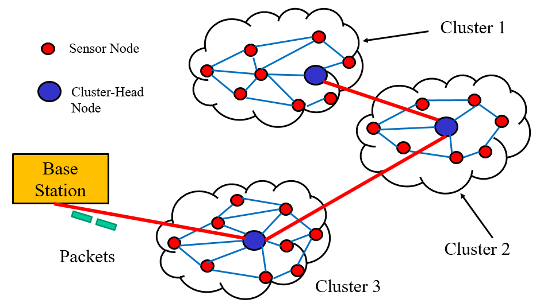
Infrastructure of Sensor Networks
The region being sensed is normally partitioned into equally loaded clusters of sensor nodes, as shown in Figure 2. A cluster in a sensor network resembles a domain in a computer network. In other words, nodes are inserted in the vicinity of a certain predefined region, forming a cluster. Different types of sensors can also be deployed in a region.
Figure 2. A sensor network and its clusters

Slide 8
In Figure 2, three clusters are interconnected to the main base station, each cluster contains a cluster head responsible for routing data from its corresponding cluster to a base station.
Cluster 1
Sensor Node
Cluster-Head Node
Base Station
Packets
Cluster 2
Cluster 3

Slide 9
The wireless sensor node is equipped with a limited power source, such as a battery or even a solar cell, where there is enough sun light exposure on the node. However, a solar cell may not be the best choice as a power supply, owing to its weight, volume, and expense. In some application scenarios, sensor-node lifetime depends on the battery lifetime.

Slide 10
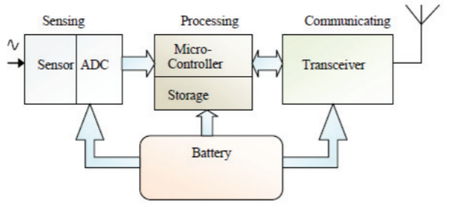
Components of a sensor node

Slide 11
Sensor Node Structure
Figure 3 shows a typical sensor node. A node consists mainly of 3 components: sensing unit, a processing unit and memory, a self-power unit.
Self-Power
Sensing unit
Processing unit
Memory
Self and remote testing
Sync and Timing
Transmitter/Receiver
Routing Table
Security unit
Fig.3 A typical wireless sensor node

Slide 12
Other supporting components are: wireless transceiver component, as well as a self- and remote-testing unit, a synchronizing and timing unit, a routing table, and security units.
Each node must determine its location. This task is carried out by a location-finding system based on the global positioning system (GPS).
Self-Power
Sensing unit
Processing unit
Memory
Self and remote testing
Sync and Timing
Transmitter/Receiver
Routing Table
Security unit

Slide 13
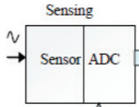
Sensing Unit
The sensing unit consists of a sensor and an analog-to-digital converter. A smart sensor node consists of a combination of multiple sensors.
The analog signals produced by the sensors, based on the observed event, are converted to digital signals by the converter and then fed into the processing unit.
Self-Power
Sensing unit
Processing unit
Memory
Self and remote testing
Sync and Timing
Transmitter/Receiver
Routing Table
Security unit

Slide 14
Processing and Memory Unit
The processing unit (associated with memory) performs certain computations on the data depending on how it is programmed, may send the resulting information out to the network.
The central processor determines what data needs to be analyzed, stored, or compared with the data stored in memory.
Self-Power
Sensing unit
Processing unit
Memory
Self and remote testing
Sync and Timing
Transmitter/Receiver
Routing Table
Security unit

Slide 15
Self-Power Unit
A sensor node is supposed to be mounted in a small physical unit, limiting space for the battery. Moreover, the random distribution of sensors makes it impossible to periodically recharge or exchange batteries.
In most types of sensor networks, the power unit in a sensor node is the most important unit of the node because the liveliness and existence of a node depend on the energy left in the node, and the routing in the sensor network is based on the algorithm that finds a path with the least energy.
Thus, it is essential to use energy-efficient algorithms to prolong the life of sensor networks. The main task of the sensor node is to identify events, to process data, and then to transmit the data. The power of a node is consumed mainly in the transmitter and receiver unit.
The sensor node can be supplied by a self-power unit battery, or solar cells

Slide 16
Communication Energy Model
IEEE standards as 802.11a, b, and g provide a wide range of data rates: 54, 48, 36, 24, 18, 12, 9, and 6 Mb/s. This range reflects the trade-off between the transmission range and data rate in a wireless communication channel.
An accurate energy model is crucial for the development of energy-efficient clustering and routing protocols. The energy consumption, E, for all components of the transceiver in watts is summarized as (considered for transmitter):
E = θ + ηωd^{n}

Slide 17
E = θ + ηωd^{n}
Where θ is the distance-independent term, that accounts for the overhead of the radio electronics and digital processing, and ηωd^{n} is the distance-dependent term, in which η represents the amplifier inefficiency factor, ω is the free-space path loss, d is the distance, and n is the environmental factor (pathloss exponent).

Slide 18
Although exploiting the multirate capabilities of wireless standards has never been proposed for sensor networks, this technique can decrease the transmission energy for smaller distance by switching to higher rates and keep in the transceiver on for a shorter period of time. In this case the energy in terms of Joule/bit reduces discretely as transmission distance shrinks:
;Where R is the rate in bits/sec.

Slide 19
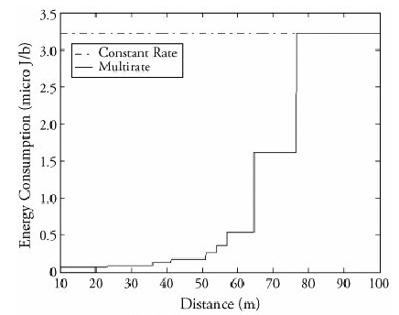
Fig. Energy consumption versus transmission distance for single-rate and multirate communication using IEEE 802.11g technology
Rate (Mb/s) | Maximum range (m) | Rate (Mb/s) | Maximum range (m)
1 | 100 | 18 | 51
2 | 76.5 | 24 | 41.25
6 | 64.5 | 36 | 36
9 | 57 | 48 | 23.1
12 | 54 | 54 | 18.75
Table: Expected data rate of IEEE 802.11g technology

Slide 20
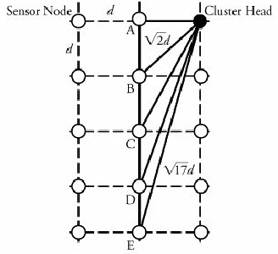
Example-1
Fig. shows an organization in which sensor nodes A, B, C, D, and E are placed d meters apart and tend to send their data packets to the cluster head (CH). Note that d is an application-dependent parameter and can be chosen based on the sensor's characteristics. Assume that standard 802.11g technology is used in an environment in which sensors are placed on average no more than 10 meters apart. Compare nodes' energy consumptions, using the Figure.
Fig. Cluster-head distances from sensor nodes A, B, C, D, and E in a two-dimensional model
With the choice of 10 meters for d in the 802.11g charts, if node B tries to use node A as a relay node and then sends data to the cluster head, the total energy of the chosen two-hop path is larger than the direct-transmission energy obtained as:

Slide 21
Also, for nodes C and D, there is no multihop path that can lead to better energy consumption than the direct communication path:
and

Slide 22
But if node E first sends the data to the immediate node D, total energy consumption will be less than the direct communication path:
Node E is 41.23 meters away from the cluster head. This shows that for nodes more than 41.23meters apart, direct transmission is no longer the best-possible communication method.

Slide 23
Multi-Hop Communication Efficiency
Considering the impact of real-world radio parameters and multi rate communication, we should reevaluate the effectiveness of multi hop communications. Since a multi rate communication reduces energy consumption for shorter distances by switching to higher data rates, multi hop communication can conserve energy. The traditional objective of multi hop communication is to divide the transmission distance into a number of hops, m, and to relatively conserve energy,

Slide 24
Clustering Protocols
Clustering Protocols specify the topology of the hierarchical non-overlapping cluster nodes.
An efficient Clustering Protocol ensures the creation of clusters with almost the same radius and cluster heads that are the best positioned in the cluster.
Since every node in a cluster network is connected to cluster head, route discovery among cluster heads is sufficient to establish a feasible route in the network.

Slide 25
Classification of Clustering Protocols
Clustering techniques can be either centralized or decentralized.
Centralized clustering algorithms require each sensor node to send its individual information, such as energy level and geographical position, to the central base station. Based on a predefined algorithm, a base station calculates the number of clusters, their sizes, and the cluster heads' positions and then provides each node with its newly assigned duty.

Slide 26
Decentralized clustering techniques create clusters without the help of any centralized base station. An energy-efficient and hierarchical clustering algorithm can be such a way whereby each sensor node becomes a cluster head with a probability of p and advertises its candidacy to nodes that are no more than k hops away from the cluster head.
The Low-Energy Adaptive Clustering Hierarchy (LEACH) algorithm and the Decentralized Energy-Efficient Cluster Propagation (DEEP) protocol are two examples of the decentralized clustering protocols and are explained next.

Slide 27
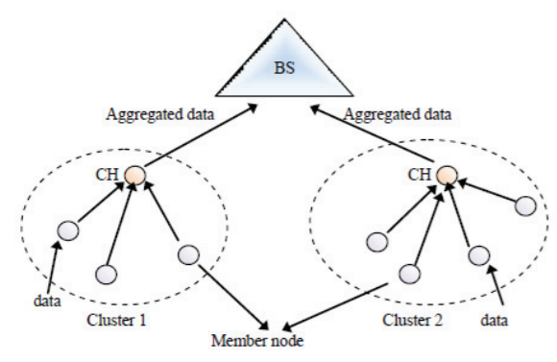
1. LEACH Clustering Protocol
The Low-Energy Adaptive Clustering Hierarchy (LEACH) is an application-specific protocol architecture that aims to prolong network lifetime by periodic re-clustering and change of the network topology. LEACH has (a) cluster setup phase and (b) steady phase.
Routing in LEACH

Slide 28
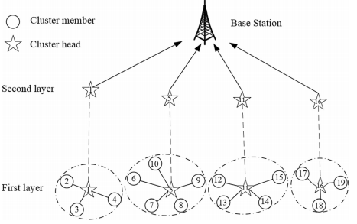

Slide 29
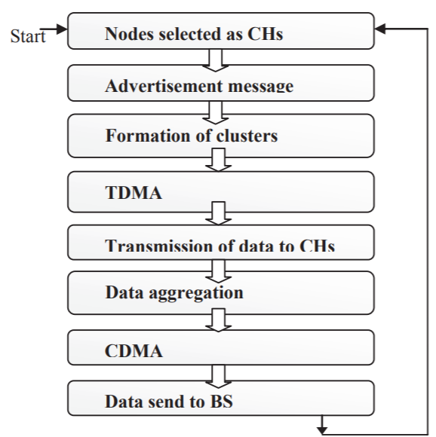
Flowchart of LEACH

Slide 30
(a) Cluster setup phase
At the start of each round r, a sensor node randomly chooses a number between 0 and 1 and then compares this number to a calculated threshold called T(n). If T(n) is larger than the chosen number, the node becomes a cluster head for the current round, otherwise the node listen to the broadcast of cluster head.
The value T(n) is calculated using the following formula:
r = 0 1 2 3 4 5 6 7 8 9 10 11 12 13 14 15
T_{n} = 0.0625 0.0667 0.0714 0.0769 0.0833 0.0909 0.1 0.1111 0.125 0.1429 0.1667 0.2 0.25 0.3333 0.5 1

Slide 31
r = 0:15;
p = 1/16;
Tn =p./(1-p*(mod(r,1/p)));
plot(r,Tn, 'b>-')
xlabel('r')
ylabel('T(n)')
grid on

Slide 32
mod(33, 16) = 1, mod(12, 16) =12, mod(40, 16) = 8 etc.
Example-1
If the number of nodes N = 80 and the number of CH is 5 then find T(n) for r = 0 and 1.
Here, p = 5/80 = 1/16
Taking, p = 1/16 and r = 0
T(n) = p/{1-p*(mod(r, 1/p))}
=(1/16)/{1- 1/16 *(mod(0, 16))
=(1/16)/{1- 1/16 *0)
=1/16
Taking, p = 1/16 and r = 1
T(n) = p/{1-p*(mod(r, 1/p))}
=(1/16)/{1- 1/16 *(mod(1, 16))
=(1/16)/{1- 1/16 *1)
=(1/16)/(15/16) =1/15

Slide 33
where p is the ratio of the total number of cluster heads to the total number of nodes, r is the number of rounds, and G is a set of nodes that have not been chosen as cluster heads till the last rounds.
For the first round (r = 0), T(n) is equal to p (for example p=1/16 = 0.0625), and nodes have an equal chance to become cluster head. As r gets closer to 1/p, T(n) increases, and nodes that have not been selected as cluster head in the last rounds have more chance to become cluster head.

Slide 34
Random number is less than T(n) for r = 0

Slide 35
Random number is less than T(n) for r = 1

Slide 36
Random number is less than T(n) for r = 2

Slide 37
After (1/p-1) = {1/(1/16)-1} = 15 rounds, T(n) is equal to 1, meaning that all the remaining nodes have been selected as cluster head. Thus, after r =1/p-1 rounds, all the nodes have had a chance to become a cluster head once.
Since being the cluster head puts a substantial burden on the sensor nodes, this ensures that the network has no overloaded node that runs out of energy sooner than the others.

Slide 38
After cluster heads are self-selected, they start to advertise their candidacy to the other sensor nodes.
When a node receives advertisements from more than one cluster-head, chooses the candidate whose associated signal is received with higher power. This ensures that sensor node chooses the closest candidates as cluster head.
Steady phase
In steady phase members of a cluster sends its data to cluster head and the cluster head transmit it to base station using single hop.

Slide 39
Setup phase algorithm
Start round r = 0
All the sensing node (SN) has probability of becoming cluster head (CH).
For round r, after node is elected as CH, it will start broadcasting ‘Hello’ message to nodes in a cluster.
Energy used to broadcast message is equal for all the cluster heads.
Initially, all the nodes those are not CH are supposed to keep their receiver ON to receive broadcasted message.
For round r, non-cluster head nodes will choose the cluster based on minimum energy criteria required to transmit/receive messages/data.
Random selection of CH will be done if more number of nodes declare themselves as CH.

Slide 40
Steady state phase Algorithm
Non-CH node informs CH about its presence in that cluster.
CH will have list of member in cluster due to Step - 1
CH schedules communication of non-CH nodes with itself based on TDMA.
The scheme is used to minimize power consumption in non-CH nodes. Transmitter is switched off (TDMA like GSM).
Data aggregation is done by CH after collecting data from non-CH nodes.
CH finally transmits the same to BS.

Slide 41
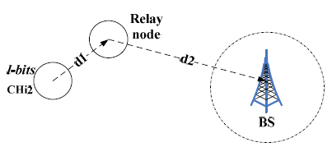
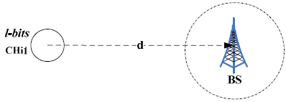
Limitation of LEACH algorithm
In cluster setup phase the position and energy of each node is not considered.
Cluster head uses single hop to communicate with the BS which may cause more energy consumption.
Random rotation of cluster head and the network constantly update the cluster result in excessive energy consumption.

Slide 42
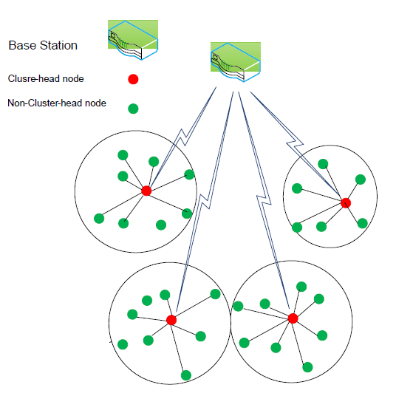
Fig. 1. LEACH

Slide 43
2. DEEP Clustering Protocol
The Decentralized Energy-Efficient Cluster Propagation (DEEP) protocol that establishes clusters with uniformly distributed cluster heads.
This protocol balances the load among all the cluster heads by keeping the clusters' radii fairly equal.
The protocol starts with an initial cluster head and forms new cluster-head candidates gradually by controlling the relative distance between a pair of cluster heads and the circular radius of each cluster.

Slide 44
A cluster head can be placed at the center of the cluster and cluster members can send the data packets directly to the cluster head without the need for any route set-up protocol.
In order to explain the details of this algorithm, control signals and protocol parameters need to be introduced:
Control signals: (1) cluster-head declaration signal or (2) cluster-head exploration signal
Membership search signal with control parameters: (1) declaration range (d_{r}), (2) exploration range (d_{r1}, d_{r2}), (3) minimum number of members (m_{n}), (4) the received signal energy (E_{rc1} and E_{rc2}).

Slide 45
DEEP forms clusters by starting with an initial cluster head which starts the cluster set-up phase by propagating cluster-head declaration signals within the range of d_{r}. At this point, sensor nodes that receive the declaration signal (with energy greater than E_{rc}) accept the corresponding cluster head as a leader.
d_{r2}
d_{r1}
d_{r}
CH
Region of cluster-head Exploration
(region between two concentric circles)
Region of cluster-head
declaration

Slide 46
Now, the initial cluster-head candidate propagates the cluster-head exploration signal. Only nodes that have never played the role of a cluster head and the received signal satisfies the inequality E_{rc1} < E_{r} < E_{rc2} i.e. nodes at a distance d_{r2} < d_{r} < d_{r1} are eligible to be new cluster head.
Note that E_{rc1} and E_{rc2} are fixed protocol parameters that can be pre calculated and stored in the sensor-node memory, using the following formula:
d_{r2}
d_{r1}
d_{r}
Received power
CH
Path-loss
Tranmitt power

Slide 47
After a new cluster-head candidate is assigned, it sends a declaration signal (like previous cluster head) within the range of d_{r} to find new cluster members.
d_{r2}
d_{r1}
d_{r}
CH
CH

Slide 48
If two cluster-head candidates can hear each other's declaration signal, they are too close to each other to be considered cluster-head candidates. Therefore, one of them is eliminated through a negotiation phase.
A node that receives a declaration signal from more than one candidate chooses the candidate whose associated signal is received with a higher power.
d_{r2}
d_{r1}
d_{r}
CH
CH

Slide 49
At this point, all confirmed cluster heads propagate exploration signals and search for new cluster-head candidates. Nodes that have already been chosen as cluster head or member ignore the cluster-head exploration or declaration signals.
d_{r2}
d_{r1}
d_{r}
CH
CH

Slide 50
Finally this advertisement (cluster-head exploration or declaration signals) process terminates automatically when all the nodes in the field belong to a cluster.
At this point, the algorithm might have produced some clusters with a very small number of members. Therefore, a cluster whose total number of members is smaller than the minimum number of members, m_{n}, is dissolved, and all its members, including its cluster head, initiate a membership-search signal.

Slide 51
Begin DEEP Clustering Algorithm
Initial cluster head finds cluster members by sending ‘cluster-head declaration’.
Initial cluster head finds new cluster-head candidates by sending ‘cluster-head exploration signal’.
Repeat: Cluster-head candidates that are placed on the (d_{r1}, d_{r2}) ring find cluster members.
Nodes that receive more than one cluster-head declaration choose the closest cluster head, based on the received signal energy.
Cluster-head candidates that receive a cluster-head declaration signal negotiate with the sender, and one of them gets eliminated.
Confirmed cluster heads send "cluster-head exploration" signals to find new cluster-head candidates(Go to step 4).
Finalize: If the number of members in a cluster is less than m_{n}, all the members find new clusters by sending the membership-search signal.
At the end, a node that has not received any control signal sends the membership-search signal.

Slide 52
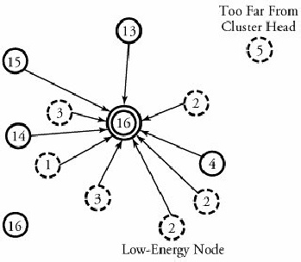
a. Intracluster Routing Protocols
A routing algorithm within a cluster can be either direct or multi-hop.
In a direct routing algorithm, the cluster head as the destination for all cluster nodes is located in the center of the cluster, so all nodes can communicate with the cluster head directly, as shown in Figure below.
Direct routing

Slide 53
The number associated with each node indicates a normalized value of the remaining energy in that node.
Note that in this figure, two nodes cannot reach the destination, as they are located far from it.

Slide 54
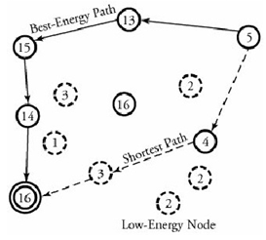
In a multihop routing algorithm, a node can face multiple hops in order to reach the destination. Figure below shows two paths from a node (node 5 is the source node) to a cluster-head node. One path involves the shortest distance in terms of hop counts; the other one uses the highest-energy route. The challenge here is to find the best path that suits the rapid and secure deployment of data.

Slide 55
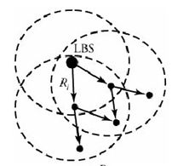
b. Intercluster Routing Protocols
Intercluster protocols are not typically different from the multihop ones for intradomain cases. Interdomain protocols are available for
Intercluster energy conscious routing (ICR)
Energy-aware routing (EAR)
Direct diffusion
Intercluster Energy-Conscious Routing (ICR)
ICR is a destination-initiated reactive routing protocol. This means that a destination, local base station (LBS), initiates an explicit route-discovery phase, which includes the propagation of an interest signal that floods throughout the network and establishes energy-efficient routes.
Figure 7. LBS starts route discovery by
generating interest signals

