Slide 1
Interfaces in Java
Lecture 12

Slide 2
Introduction to Interfaces
Definition: An interface in Java is a reference type, similar to a class, that contains abstract methods (methods without a body).
Purpose:
To achieve abstraction.
To provide a contract that must be followed by any class that implements the interface.

Slide 3
Key Features of Interfaces
Contains abstract methods (from Java 8, can have default and static methods).
A class can implement multiple interfaces.
Interfaces cannot have instance variables, only constants (public static final).
Provides multiple inheritance capabilities.

Slide 4
Interfaces Syntax
interface InterfaceName {
// Abstract method
void methodName();
// Default method
default void defaultMethod() {
System.out.println("Default method in interface");
}
// Static method
static void staticMethod() {
System.out.println("Static method in interface");
}
}

Slide 5
Implementing an Interface
interface Animal {
void makeSound(); // Abstract method
}
class Dog implements Animal {
public void makeSound() {
System.out.println("Dog barks");
}
}

Slide 6
Real-Life Example
Scenario: Payment System
Interface: PaymentGateway
Defines a contract for payment processing.
Implementing Classes:
CreditCardPayment
PayPalPayment

Slide 7
Real-Life Example
interface PaymentGateway {
void processPayment(double amount);
}
class CreditCardPayment implements PaymentGateway {
public void processPayment(double amount) {
System.out.println("Processing credit card payment of $" + amount);
}
}
class PayPalPayment implements PaymentGateway {
public void processPayment(double amount) {
System.out.println("Processing PayPal payment of $" + amount);
}
}
public class PaymentDemo {
public static void main(String[] args) {
PaymentGateway payment1 = new CreditCardPayment();
payment1.processPayment(100.00);
PaymentGateway payment2 = new PayPalPayment();
payment2.processPayment(200.00);
}
}

Slide 8
Advantages of Interfaces
Achieves abstraction.
Supports multiple inheritances.
Promotes loose coupling.
Provides a contract for implementing classes.

Slide 9
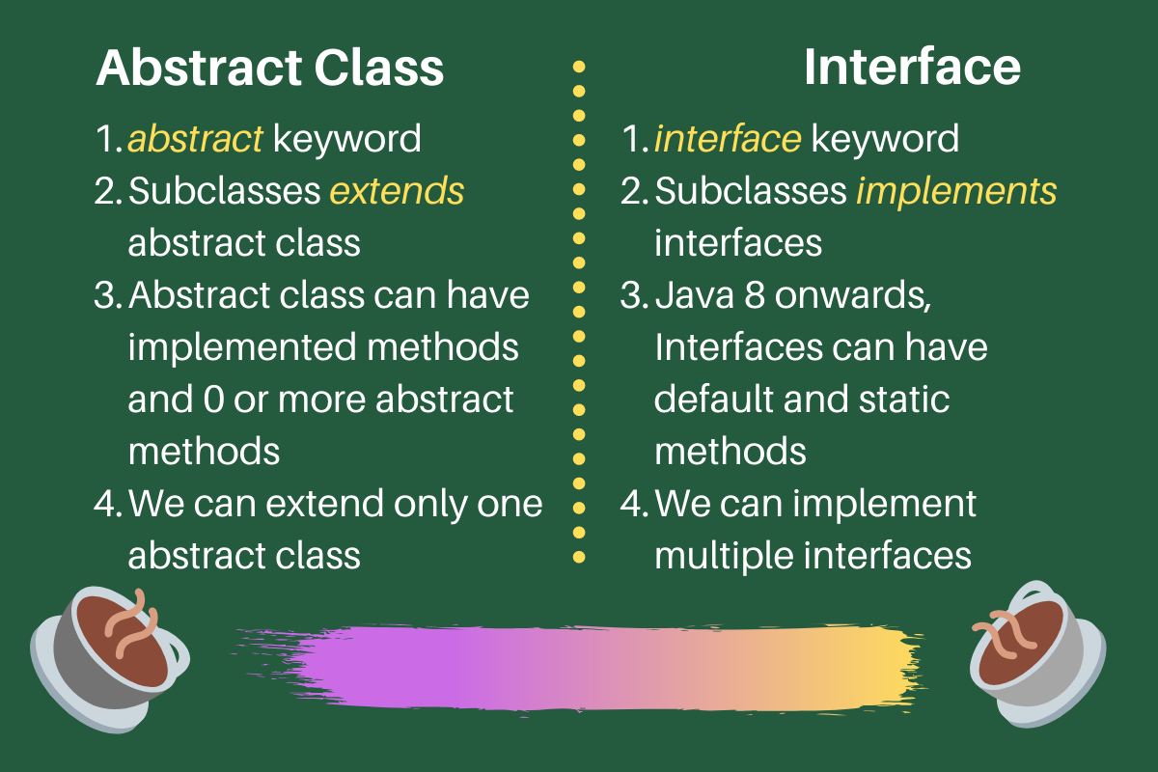
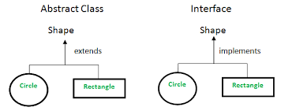
Interfaces vs Abstract Classes

Slide 10
Scenario-Based Question on Interfaces
You are tasked with designing a Home Automation System that controls various devices like Lights, Fans, and Air Conditioners. Each device can be turned on and off, but the specific way each device operates may differ. You need to create a system where new devices can be added in the future without changing the existing code.
Question:
Design an interface Device with methods turnOn() and turnOff(). Create classes Light, Fan, and AirConditioner that implement the Device interface. Demonstrate how the system can control all devices through the interface, ensuring loose coupling and flexibility for future additions.

Slide 11
Scenario-Based Question on Interfaces
// Define the interface
interface Device {
void turnOn();
void turnOff();
}
// Light class implementing Device
class Light implements Device {
public void turnOn() {
System.out.println("Light is turned ON");
}
public void turnOff() {
System.out.println("Light is turned OFF");
}
}
// Fan class implementing Device
class Fan implements Device {
public void turnOn() {
System.out.println("Fan is turned ON");
}

Slide 12
Scenario-Based Question on Interfaces
public void turnOff() {
System.out.println("Fan is turned OFF");
}
}
// AirConditioner class implementing Device
class AirConditioner implements Device {
public void turnOn() {
System.out.println("Air Conditioner is turned ON");
}
public void turnOff() {
System.out.println("Air Conditioner is turned OFF");
}
}

Slide 13
Scenario-Based Question on Interfaces
// Main class to demonstrate the system
public class HomeAutomation {
public static void main(String[] args) {
// Creating objects of different devices
Device light = new Light();
Device fan = new Fan();
Device airConditioner = new AirConditioner();
// Controlling devices through the interface
light.turnOn();
light.turnOff();
fan.turnOn();
fan.turnOff();
airConditioner.turnOn();
airConditioner.turnOff();
}
}

