Slide 1
GUI Components in Java
Lecture 15
Building Interactive User Interfaces

Slide 2
What is a GUI?
Definition: GUI (Graphical User Interface) allows users to interact with the application visually.
Key Features:
User-friendly
Visual elements for interaction

Slide 3
Key GUI Components in Java
Overview:
Labels
Buttons
Text Fields & Text Areas
Radio Buttons & Check Boxes
Combo Box & List View
Scroll Bars

Slide 4
Labels
Purpose: Display static text or images.
JLabel label = new JLabel("Welcome to Java GUI!");
Usage: Display instructions or messages.

Slide 5
Buttons
Purpose: Trigger actions when clicked.
JButton button = new JButton("Click Me");
Usage: Submit forms, trigger events.

Slide 6
Text Fields
Purpose: Allow single-line text input.
JTextField textField = new JTextField(20);
Usage: User input like names or email.

Slide 7
Text Areas
Purpose: Allow multi-line text input.
JTextArea textArea = new JTextArea(5, 20);
Usage: Collect larger input like comments or feedback.

Slide 8
Radio Buttons
Purpose: Select one option from a group.
JRadioButton radio1 = new JRadioButton("Option 1");
JRadioButton radio2 = new JRadioButton("Option 2");
Usage: Gender selection, preferences.

Slide 9
Combo Box
Purpose: Provide a dropdown menu for selecting options.
JComboBox<String> comboBox = new JComboBox<>(new String[] {"Option 1", "Option 2"});
Usage: Selecting a country, category.

Slide 10
List View
Purpose: Display a list of items for selection.
JList<String> list = new JList<>(new String[] {"Item 1", "Item 2"});
Usage: Multiple selections from a list.

Slide 11
Scroll Bars
Purpose: Allow scrolling for content that overflows.
JScrollPane scrollPane = new JScrollPane(textArea);
Usage: Navigating through long content.

Slide 12
Putting It All Together
import javax.swing.*;
public class GUIExample {
public static void main(String[] args) {
JFrame frame = new JFrame("GUI Example");
frame.setDefaultCloseOperation(JFrame.EXIT_ON_CLOSE);
frame.setSize(400, 300);
JLabel label = new JLabel("Enter Name:");
JTextField textField = new JTextField(15);
JButton button = new JButton("Submit");
frame.add(label);
frame.add(textField);
frame.add(button);
frame.setLayout(new java.awt.FlowLayout());
frame.setVisible(true);
}
}

Slide 13
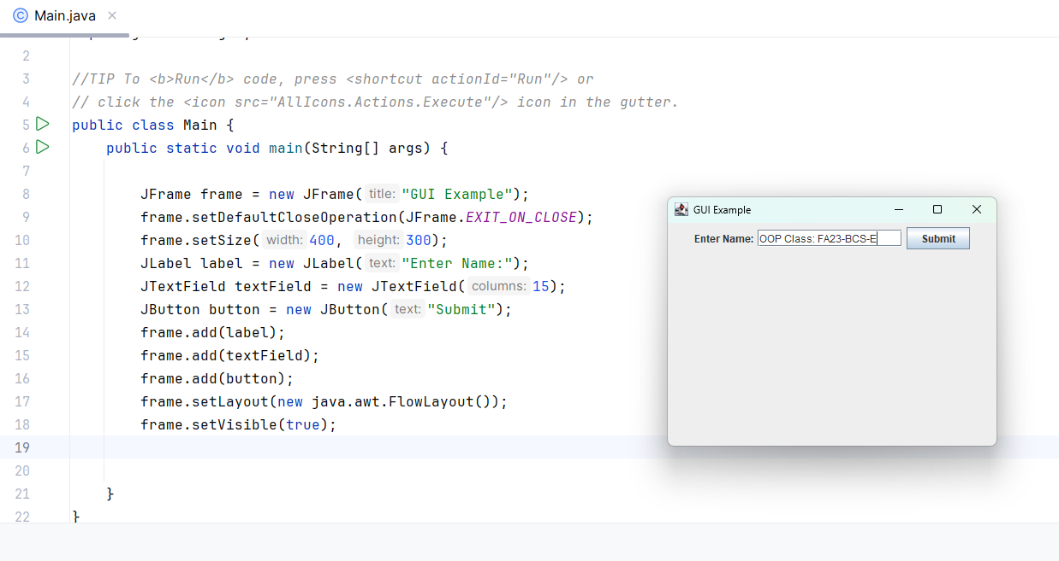
Output
import javax.swing.*;
public class GUIExample {
public static void main(String[] args) {
JFrame frame = new JFrame("GUI Example");
frame.setDefaultCloseOperation(JFrame.EXIT_ON_CLOSE);
frame.setSize(400, 300);
JLabel label = new JLabel("Enter Name:");
JTextField textField = new JTextField(15);
JButton button = new JButton("Submit");
frame.add(label);
frame.add(textField);
frame.add(button);
frame.setLayout(new java.awt.FlowLayout());
frame.setVisible(true);
}
}

