Slide 1
CSC 101 Introduction to Computing
Dr. Iftikhar Azim Niaz
ianiaz@comsats.edu.pk

Slide 2
Course Details
Course Code: CSC 101
Course Title: Introduction to Computing
Credit Hours: 2 + 1
Course Objectives:
This course is an introduction to a broad class of computer issues. It is designed for students who are not CS majors and who have had little or no previous experience with computers.

Slide 3
Course Outline - I
Introduction to computers and computing
Classification of computers
Elements of computers
Basic Computer Architecture
Control Unit
Arithmetic & Logical Unit (ALU operations)
Main Memory (ROM, RAM, Cache)
CPU Operations
The Registers
Input & Output Devices
Storage Media

Slide 4
Course Outline - II
Data Representation
Software Concepts; System Software
Operating Systems
Basic Input Output Systems (BIOS)
Disk Operating System; Windows 95/98/XP/2000
Application Software; User Designed Application Software.
Data Base Management Systems
Communication Systems
Security Issues; Threats to computers & communication systems; Computer Networks;
Internet; E-Commerce; Artificial Intelligence

Slide 5
Recommended Books
Textbook: P. Norton, Peter Norton's Introduction to Computers, 6th Ed., McGraw-Hill, New York, 2006.
Reference: W. Stallings, Computer Organization and Architecture , 8th Ed., Pearson Prentice Hall, New Jersey, 2010
Excellent World Wide Web address: to look up computer terminology online http://www.wikipedia.com, http://www.whatis.com
Excellent World Wide Web address: to search companies, products, and events
http://www.google.com, http://www.yahoo.com,
http://www.msn.com

Slide 6
Marks Distribution of course
Assignments ……….……… 15%
Quizzes ..…………….. 10%
Midterm .………….….. 25%
Final .……………… 50%
Notes:
This is tentative distribution, flexible enough to be changed

Slide 7
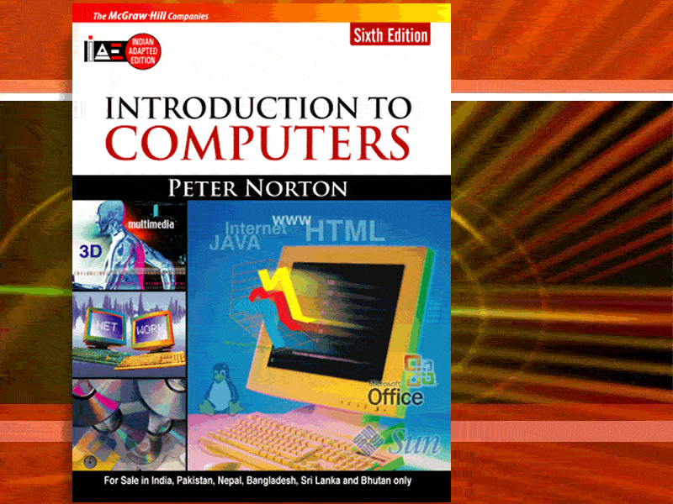
McGraw-Hill Technology Education
Copyright © 2005 by The McGraw-Hill Companies, Inc. All rights reserved.

Slide 8
Book Contents At a glance I
Chapter 1: Introducing Computer Systems
Lesson 1A: Exploring Computers and Their Uses
Lesson 1B: Looking Inside the Computer System
Chapter 2: Interacting with Your Computer
Lesson 2A: Using the Keyboard and Mouse
Lesson 2B: Inputting Data in Other Ways
Chapter 3: Seeing, Hearing, and Printing Data
Lesson 3A: Video and Sound
Lesson 3B: Printing
Chapter 4: Processing Data
Lesson 4A: Transforming Data into Information
Lesson 4B: Modern CPUs
Chapter 5: Storing Data
Lesson 5A: Types of Storage Devices
Lesson 5B: Measuring and Improving Drive Performance

Slide 9
Book Contents At a glance II
Chapter 6: Using Operating Systems
Lesson 6A: Operating System Basics
Lesson 6B: Survey of PC and Network Operating Systems
Chapter 7: Networks
Lesson 7A: Networking Basics
Lesson 7B: Data Communications
Chapter 8: Presenting the Internet
Lesson 8A: The Internet and the World
Lesson 8B: E-Mail and Other Internet Services
Chapter 9: Working in the Online World
Lesson 9A: Connecting to the Internet
Lesson 9B: Doing Business in the Online World
Chapter 10: Working with Application Software
Lesson 10A: Productivity Software
Lesson 10B: Graphics and Multimedia

Slide 10
Book Contents At a glance III
Chapter 11: Database Management
Lesson 11A: Database Management Systems
Lesson 11B: Survey of Database Systems
Chapter 12: Software Programming and Development
Lesson 12A: Creating Computer Programs
Lesson 12B: Programming Languages and the Programming Process
Chapter 13: Protecting Your Privacy, Your Computer, and
Your Data
Lesson 13A: Understanding the Need for Security Measures
Lesson 13B: Taking Protective Measures
Appendices
Appendix A: Creating Your own Web Page
Appendix B: Buying Your first Computers
Appendix C: Computer Viruses
Appendix D: History of Microcomputers

Slide 11
Accompanying Web Site
http://highered.mcgraw-hill.com/sites/0072978902/
Glossary
Online Topics
Appendix A (pdf files)
Appendix B Answers to Self Check Exercises
For each Chapter
Multiple Choice Questions
Power Point Presentations
Internet Exercises

Slide 12
A nice saying…
I keep 6 honest serving men.
They taught me all I knew.
Their names are:
WHAT and WHY and WHEN and HOW and WHERE and WHO.
(R. Kipling)
And believe me,
on the road of learning,
these are your best companions.

Slide 13
Lets Start the Course…

Slide 14
Chapter 1A
Introducing Computer Systems

Slide 15
Computers in Our World
Computers are everywhere
We can find them in pretty unlikely places
Family car
Home appliances
Alarm clock
Market

Slide 16
The Computer Defined
Black Box
Problem Solver
An Electronic device that converts data into information which is useful to people
Processing
Input
Output

Slide 17
Anatomy of a Computer
Every computer has four basic parts, or units:
an input unit such as the keyboard, that feeds information into the computer
a central processing unit (CPU) that performs the various tasks of the computer
an output unit , such as a monitor , that displays the results;
a memory that stores information and instructions.

Slide 18
Computer vs Human
Input - Five senses
Central Processing Unit (CPU) - brain
Output - Body Parts
Memory - Human memory
Hardware
Physical components
Software
Programs for operations and problem solving

Slide 19
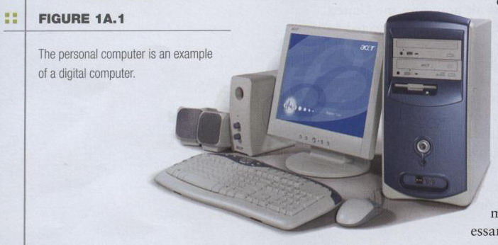
Modern Computers
Modern computers are digital
Word “by the numbers”
Break all types of information into tiny units
Use numbers to represent information
Two digits combine to make data (0, 1)

Slide 20
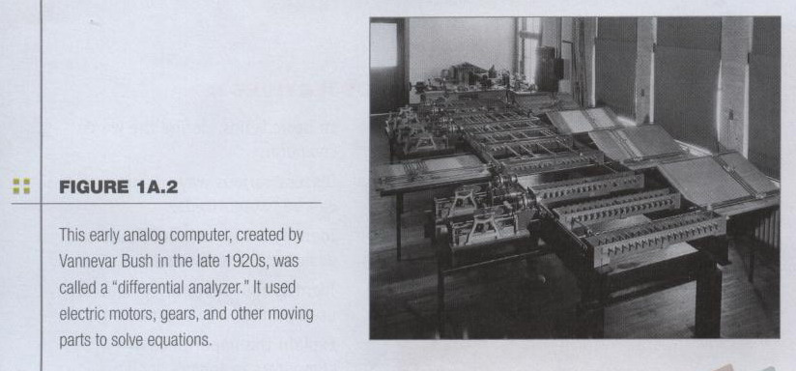
History of Computers
Older computers were analog
represent data as variable points along a continuous spectrum of values.
More flexible but not necessarily more precise and reliable
Notes:
Use mechanical devices, weighs several tons and using motors and gears to perform calculations

Slide 21
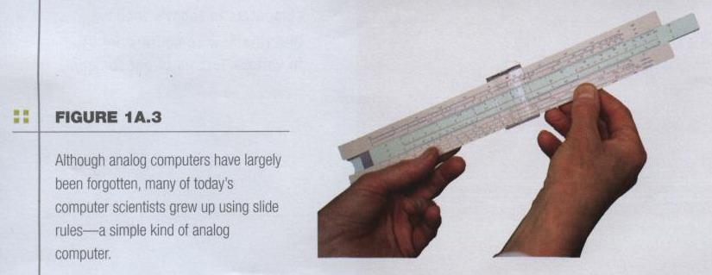
Slide Rule
Older computers were analog
A more manageable type -- the old-fashioned slide rule
Slide rules can be used for multiplication and division, squares, cubes, square roots, cubes roots, trig functions, and exponentials and logarithms

Slide 22
ABACUS
3000 BC: The first calculating device ABACUS was invented in Egypt .
The abacus is still in use in some countries especially China, Japan
Operations
Addition, subtraction, division and multiplication
Extract square root and cube root
User has to memorize certain rules

Slide 23
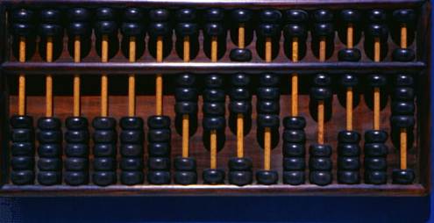
ABACUS
More information on
http://en.wikipedia.org/wiki/Abacus

Slide 24
Pascaline
1642: A Frenchman Blaise Pascal introduced the first mechanical calculating device.
Series of wheels with teeth which could be turned using hands
Used to handle 999,999.99
Perform both addition and subtraction.
More in notes below
Notes:
Pascaline, also called Arithmetic Machine, the first calculator or adding machine to be produced in any quantity and actually used. The Pascaline was designed and built by the French mathematician-philosopher Blaise Pascal between 1642 and 1644. It could only do addition and subtraction, with numbers being entered by manipulating its dials. Pascal invented the machine for his father, a tax collector, so it was the first business machine too (if one does not count the abacus). He built 50 of them over the next 10 years.

Slide 25
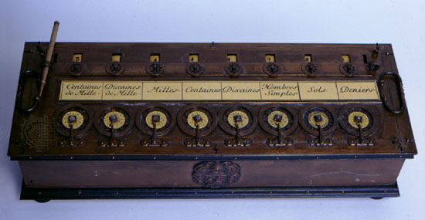
Pascaline

Slide 26
Difference Engine
1833: Charles Babbage
Professor of Mathematics
Cambridge University
With Assistance of Lady Augusta Ada Lovelace
developed a machine that could store information, calculate numbers and solve algebraic expression.

Slide 27
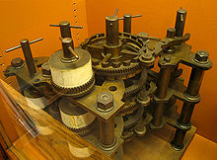
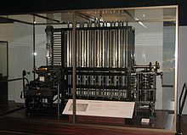
Difference Engine

Slide 28
Punched Card
1890: Herman Hollerith
American Inventor
developed devices that were able to read information which had been punched into cards automatically
developed a machine called the census machine
US Census Bureau.
Capable of reading numbers, characters, and also special symbols.
Notes:
A punched card (also punch card^{[1]} or punched-card^{[2]}) is a piece of card stock that stores digital data using punched holes. Punched cards were once common in data processing and the control of automated machines.
Census was Invented by Herman Hollerith, the machine was developed to help process data for the 1890 U.S. Census. Later models were widely used for business applications such as accounting and inventory control. It spawned a class of machines, known as unit record equipment, and the data processing industry.

Slide 29
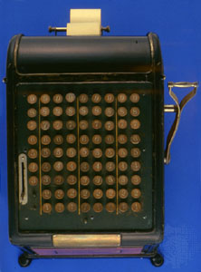
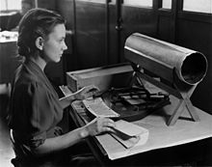
Punched Cards

Slide 30
Harvard Mark I
1944: Howard Aikens and Grace Hooper developed an electromechanical machine at IBM
Called Automatic Sequence Controlled Calculator (ASCC)
Called Mark I by Harvard University
Capable of reading numbers, characters, and also special symbols

Slide 31
Harvard Mark I
Built from Switches, Relays, rotating shafts and clutches
765,000 components
Hundred of meters of wires
Volume
Length (51ft) X Height (8 ft) x Depth (2 ft)
Weight 4500 kgs
Used decimal number systems

Slide 32
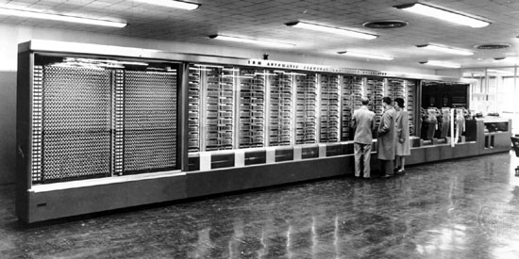
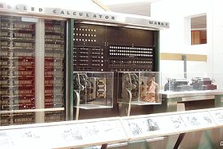
Harvard Mark I

Slide 33
ENIAC
1946 First general purpose electronic computer
Electronic Numerical Integrator And Computer (ENIAC)
Technology used
Vacuum tubes 17,468
Crystal Diodes 7,200
Relays 1,500
Transistors 70,000
Capacitors 10,000
Hand soldered joints 1 million

Slide 34
ENIAC
Weight 27 tons
Volume 100 ft (L) X 8 ft ( H) X 3 ft (D)
Covers 1800 sq. feet
Power consumption 150 kW
Uses punch cards
Averages 5,000 operations

Slide 35
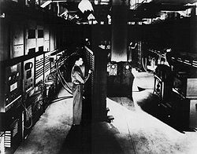
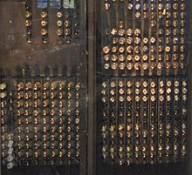
ENIAC

Slide 36
Manchester Mark I
1948
First stored program computer,
Based on Von Neumann architecture
Manchester Mark 1 , built in UK. Using valves ,
it can perform about 500 operations per second and has the first RAM .
It fills a room the size of a small office.

Slide 37
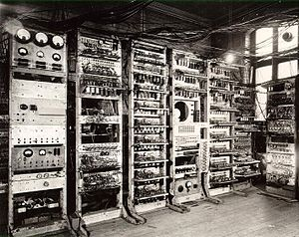
Manchester Mark I

Slide 38
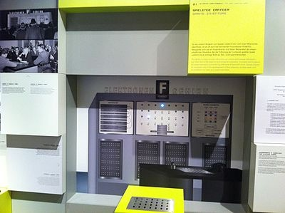
Ferranti Nimrod Computer
1951 : Early computer game , Nim
Played by Ferranti Nimrod computer at the Festival of Britain.

Slide 39
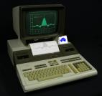
History of Microcomputers
1965 DEC PDP 8 produced in US
First commercially successful microcomputer,
Programmed Data Processor (PDP)
It sits on a desktop

Slide 40
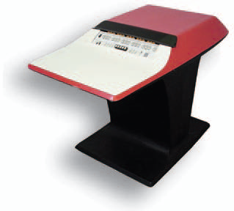
H 316 Kitchen Computer
1965 Honeywell corporation
First home computer
Costs $10,600

Slide 41

Intel 4004 Microprocessor
1971 Intel 4004, the world’s first commercially available microprocessor.
four-bit computer containing 2,300 transistors
can perform 60,000 instructions per second.
Designed for use in a calculator
Sells for $200

Slide 42
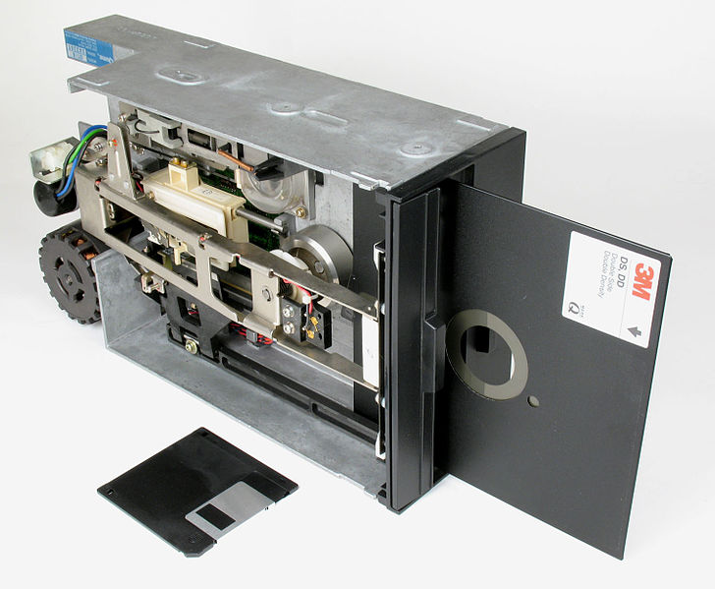
Floppy Disks
1972 : 5.25-inch floppy diskettes are introduced
providing a portable way
to store and move data from machine to machine.

Slide 43
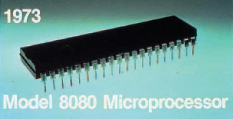
Intel 8008 Microprocessors
Intel announces the 8008 chip.
2-MHz, eight-bit microprocessor
can access 64 KB of memory
used a two-byte addressing structure
over 6000 transistors on one chip
can perform640,000 instructions per second.
Motorola introduces the 6800 microprocessor.
8 bit processor
used primarily in industrial and automotive devices.

Slide 44
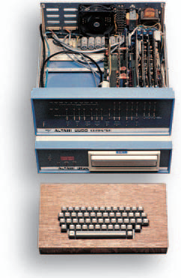
Altair 880
1975, first commercially available microcomputer
64 KB of memory
open 100-line bus structure.
sells for $397 in kit form or $439 assembled.

Slide 45
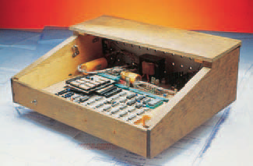
Apple I
1976 Steve Wozniak and Steve Jobs build the Apple I computer.
less powerful than the Altair, but also less expensive and less complicated.
Users must connect their own keyboard and video display, and
have the option of mounting the computer’s motherboard in any container they choose — whether a metal case, a wooden box, or a briefcase.

Slide 46

Commodore PET
1977 Mass produced personal computer,
Commodore PET (Personal Electronic Transactor ) appears.

Slide 47
Osborne I
1981 First portable computer, Osborne 1, produced.
At the size and weight of a sewing machine,
much less convenient than current portable computers.
weighs about 22 pounds
Two 5.25-inch floppy drives,
64 KB of RAM, and
a five-inch monitor but no hard drive.
based on the z80 processor, runs the CP/M operating system, and
sells for $1,795.
The Osborne 1 comes with WordStar (a word processing application) and Super-Calc (a spreadsheet application).
It is a huge success.

Slide 48
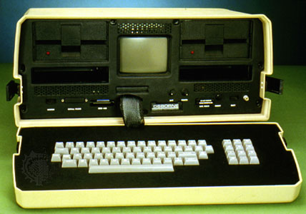
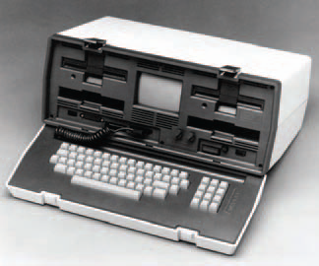
Osborne I

Slide 49
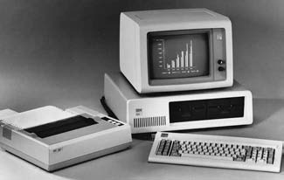
IBM PC
1981, IBM introduces the IBM-PC
4.77 MHz Intel 8088 CPU,
16 KB of memory,
a keyboard,
a monitor,
one or two 5.25-inch floppy drives, and
A price tag of $2,495

Slide 50
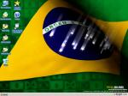
Apple
1984 Apple Macintosh computer becomes first successful personal computer with a mouse and easy to use Graphic User Interface (GUI).

Slide 51
Windows, Laser Jet
Intel releases the 80386 processor (also called the 386),
a 32-bit processor that can address more than four billion bytes of memory and performs 10 times faster than the 80286.
Aldus releases Page-Maker for the Macintosh,
the first desktop publishing software for microcomputers.
Microsoft announces the Windows 1.0 operating environment,
featuring the first graphical user interface for PCs mirroring the interface found the previous year on the Macintosh.
Hewlett-Packard introduces the LaserJet laser printer, featuring 300 dpi resolution.

Slide 52
Generation of Computers
Generation | Dates | Characteristic
1st | 1944-59 | Use Valves (Vacuum tubes) [ENIAC,ADVAC]
2nd | 1959-64 | Use transistors [IBM1920,CDC 3600]
3rd | 1964-75 | Large Scale Integrated Circuits [IBM 370]
4th | 1975-1980 | Very Large Scale Integrated Circuits [IBM 4341]
5th | Under development | “Artificial Intelligence” based computers [IBM LAPTOP,NOTEBOOK]

Slide 53
Summary
Course Outline
What is a computer?
Comparison of Computer with Human
History of Computers
Developments in Microcomputers

