Slide 1
CSC 101 Introduction to Computing Lecture 12
Mr. Khurram Nissar
khurramnissar@cuisahiwal.edu.pk
1

Slide 2
Objectives Overview
Define system software and identify the two types of system software
Describe the functions of an operating system
Summarize the startup process on a personal computer
Summarize the features of several stand-alone operating systems

Slide 3
System Software
System software consists of the programs that control or maintain the operations of the computer and its devices
Serves as the interface between the user, the application software, and the computer’s hardware.
Operating Systems
(sometimes called the platform) coordinates all activities among computer hardware resources
Utility Programs
allows a user to perform maintenance-type tasks, usually related to managing a computer, its devices, or its programs
Notes:
An operating system is software that manages computer hardware, software resources, and provides common services for computer programs. It acts as an intermediary between the computer hardware and the user, providing a user interface and managing the resources of the computer.

Slide 4
Operating System (OS)
OS is the computer's master control program
provides you with the tools (commands) that enable you to interact with the PC
When you issue a command, the OS translates it into code that the machine can use.
It ensures that the results of your actions are displayed on screen, printed, and so on.
Also acts as the primary controlling mechanism for the computer's hardware.

Slide 5
Operating System
Although an operating system can run from an optical disc and/or flash memory mobile media, in most cases, the operating system is installed and resides on the computer’s hard disk.
On handheld computers and many mobile devices such as smart phones, the operating system may reside on a ROM chip
Different sizes of computers typically use different operating systems because operating systems generally are written to run on a specific type of computer

Slide 6
Operating Systems
An operating system (OS) is a set of programs containing instructions that work together to coordinate all the activities among computer hardware resources
Start and shut down a computer
Provide a user interface
Manage programs
Manage memory
Coordinate tasks
Configure devices
Establish an Internet connection
Monitor performance
Provide utilities
Automatically update
Control a network
Administer security

Slide 7
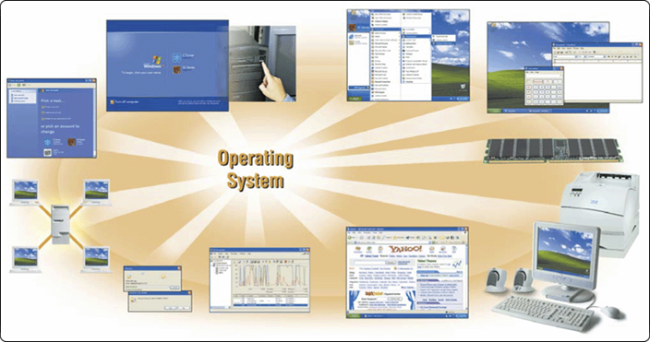
Operating System Functions (XP)
start the computer
provide a user interface
manage programs
administer security
manage memory
control a network
provide file management and other utilities
monitor performance
establish an Internet connection
schedule jobs and configure devices

Slide 8
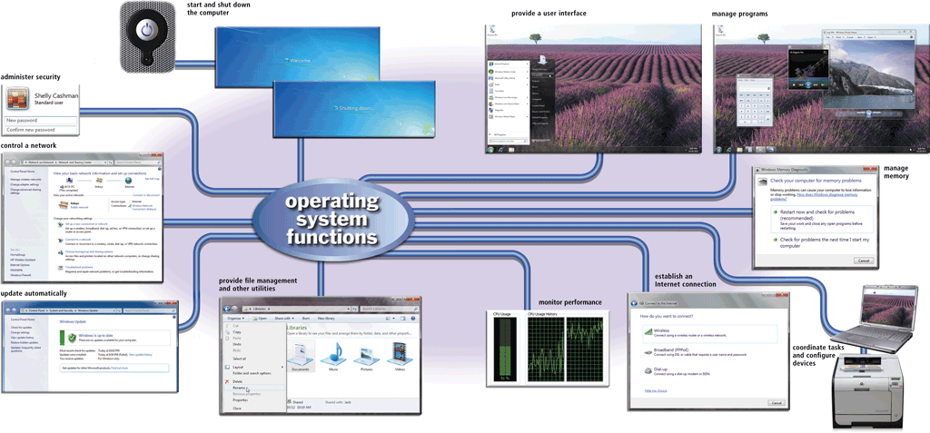
Operating Systems Functions (Windows 7)

Slide 9
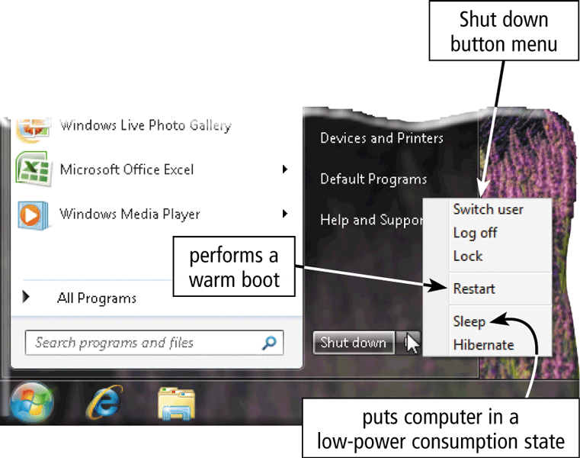
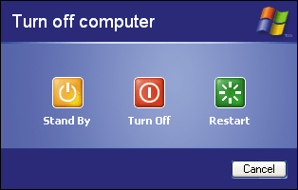
1. Start and Shutdown a Computer
The process of starting or restarting a computer is called booting
Cold Boot
Turning on a computer that has been powered off completely
Warm Boot
Using the operating system to restart a computer that is powered on

Slide 10
1. Start and Shutdown a Computer
Each time you boot a computer, the kernel and other frequently used operating system instructions are loaded, or copied, from storage into the computer’s memory (RAM).
The kernel is the core of an operating system
manages memory and devices
maintains the computer’s clock
starts programs, and
assigns the computer’s resources, such as devices, programs, data, and information.

Slide 11
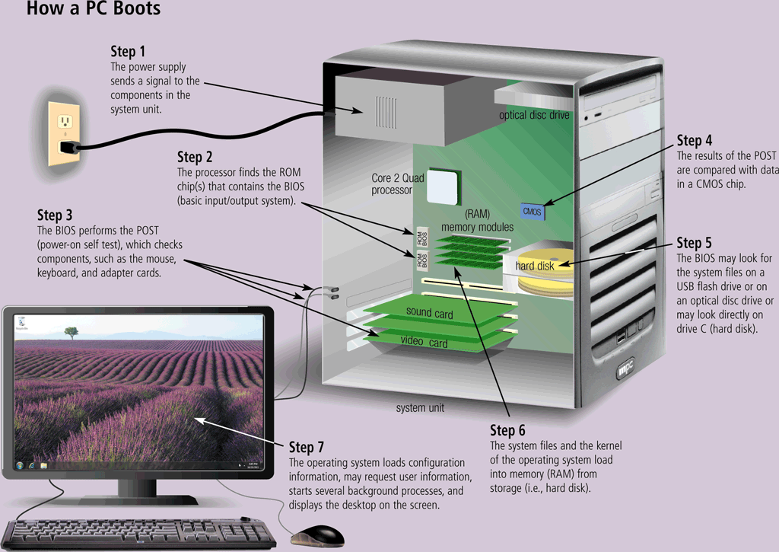
How a PC Boots

Slide 12
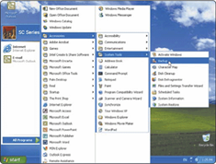
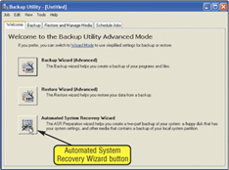
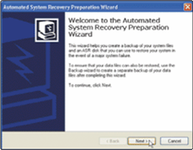
PC Boot
A boot drive is the drive from which your computer starts
You can boot from a boot disk
A recovery disk contains a few system files that will start the computer
Step 1. Click Start button on taskbar, point to All Programs on Start menu, point to Accessories on All Programs submenu, point to Systems Tools on Accessories submenu, and then point to Backup.
Step 2. Click Backup on Systems Tools submenu to open the Backup Utility window. (If Backup or Restore Wizard displays, click Advanced Mode link.) Point to Automated System Recovery Wizard button.
Step 3. Click Automated System Recovery Wizard button to create recovery disk. Follow the on-screen instructions and insert a diskette when prompted.

Slide 13
Shut Down Options
An operating system includes various shut down options
Sleep mode saves any open documents and programs to RAM, turns off all unneeded functions, and then places the computer in a low-power state
Hibernate saves any open documents and programs to a hard disk before removing power from the computer

Slide 14
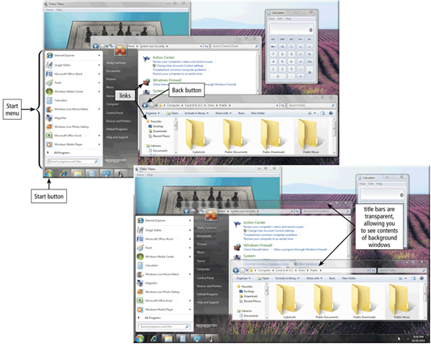
2. Providing a User Interface
A user interface controls how you enter data and instructions and how information is displayed on the screen
With a graphical user interface (GUI), you interact with menus and visual images such as icons and buttons

Slide 15
Graphical User Interface
Most common interface
Windows, OS X, some versions of Linux and Unix
Frees you from memorizing and typing text commands
Uses a mouse to control objects
Uses a desktop metaphor
Shortcuts open programs or documents
Open documents have additional objects
Task switching
Dialog boxes allow directed input
Notes:
Insider information
The first commercial GUI was the Xerox Star.
Teaching Tip
There are several types of dialog boxes. Any errors are displayed in a dialog box. This box is system modal - it requires a response before returning to the OS. Save and print boxes are application modal - The box must be dealt with before returning to the application. However, other OS tasks can be performed.

Slide 16
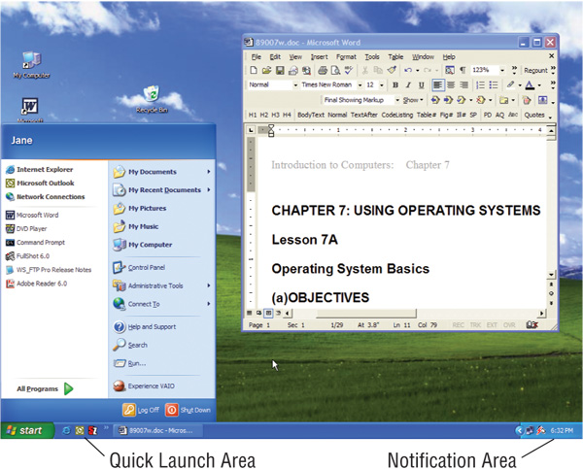
Graphical User Interface

Slide 17
Command Line Interface
Older interface
DOS, Linux, UNIX
With a command-line interface, a user uses the keyboard to enter data and instructions
User types commands at a prompt
User must remember all commands
Included in all GUIs
Notes:
Teaching tip
Demonstrate the command line interface in Windows by running cmd. In the command line interface use ping and ipconfig as commands that cannot be run in the GUI.

Slide 18
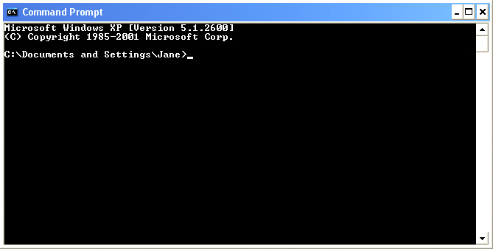
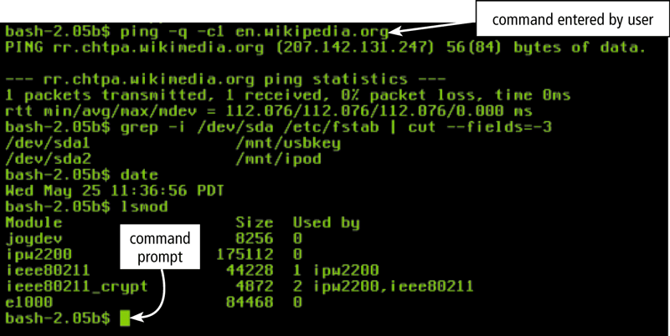
Command Line Interface

Slide 19
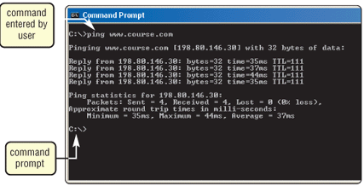
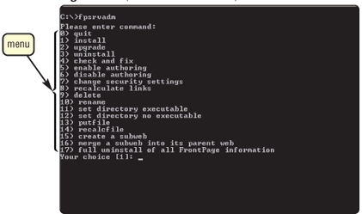
User Interface
Controls how you enter data and instructions and how information displays on screen
command-line interface
menu-driven interface

Slide 20
3. Manage Programs
How an Operating system handles programs directly affects your productivity
Single user and multiuser
Single tasking and multitasking
Preemptive multitasking
Multiprocessing

Slide 21
Single user/Single tasking OS
One user works on the system
Performs one task at a time
MS-DOS
Take up little space on disk
Run on inexpensive computers

Slide 22
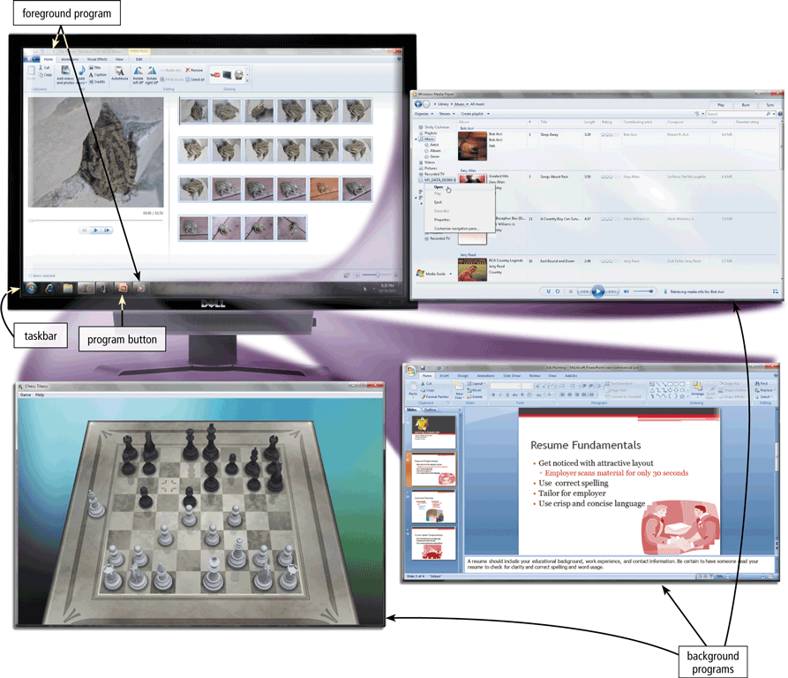
Single User Multitasking
Working on two or more programs that reside in memory at same time
Foreground contains program you are using
Background contains programs that are running but are not in use

Slide 23
Real Time Operating Systems
Very fast small OS
Built into a device
Respond quickly to user input
MP3 players, Medical devices

Slide 24
Single User Multitasking OS
User performs many tasks at once
Most common form of OS
Windows XP and OS X
Require expensive computers
Tend to be complex
Notes:
Teaching tip
It is true that multi-tasking operating systems are complex. However both XP and OS X make the multitasking process painless for the user.

Slide 25
Multi User / Multitasking OS
Enable two or more users to run programs simultaneously
Many users connect to one computer
Each user has a unique session
UNIX, Linux
Maintenance can be easy
Requires a powerful computer
Notes:
Teaching tip
Multi-user Multitasking OS's are found on supercomputers, mainframes and minicomputers. Through Linux, a PC can also support user sessions and terminal connections.

Slide 26
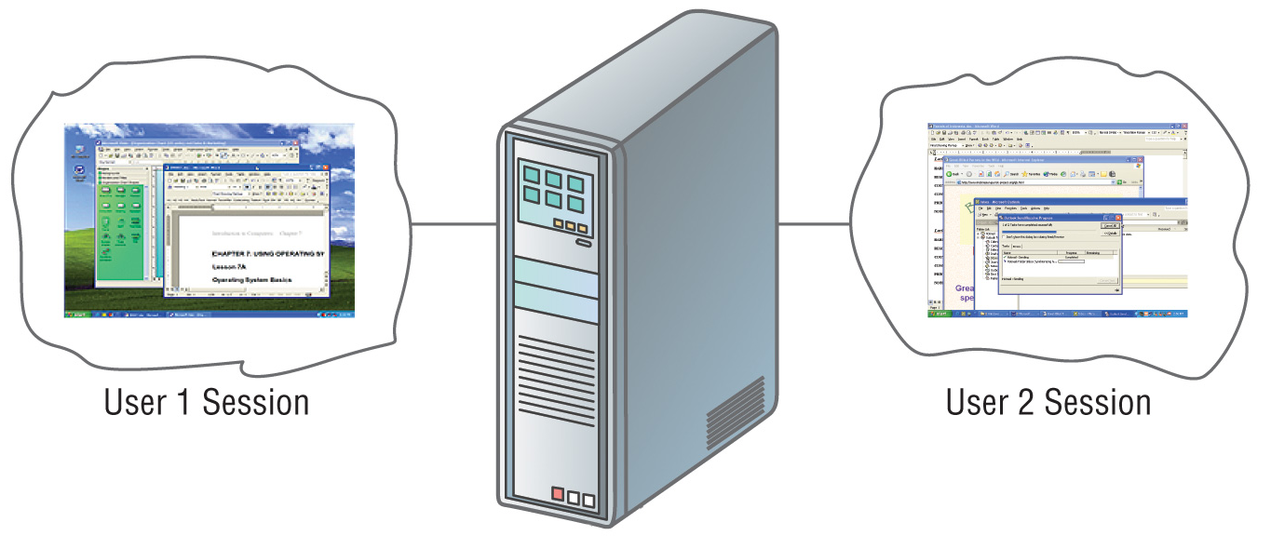
Multi user/Multi tasking OS

Slide 27
Other Program Management Features
Multiprocessing
Can support two or more processors running programs at the same time
Fault tolerant computer
Continues to operate when one of its components fails
Has duplicate components such as processor, memory and disk drives

Slide 28
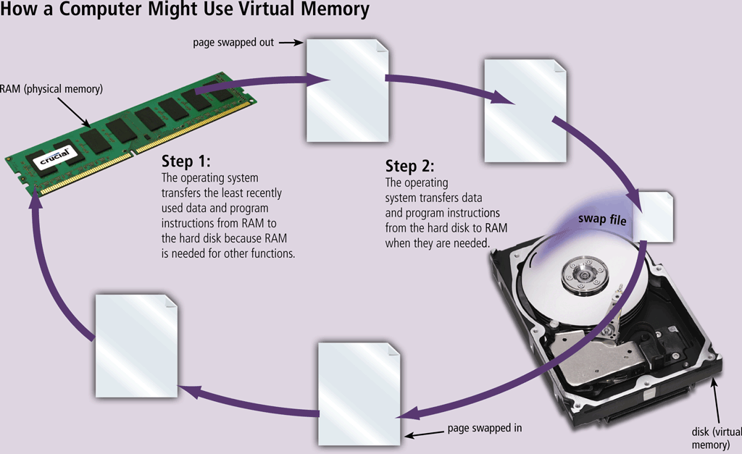
4. Manage Memory
Memory management optimizes the use of RAM
Virtual memory is a portion of a storage medium functioning as additional RAM
Notes:
Step 1. The operating system transfers the least recently used data and program instructions to disk because memory is needed for other functions.
Step 2. The operating system transfers data and program instructions from disk to memory when they are needed.

Slide 29
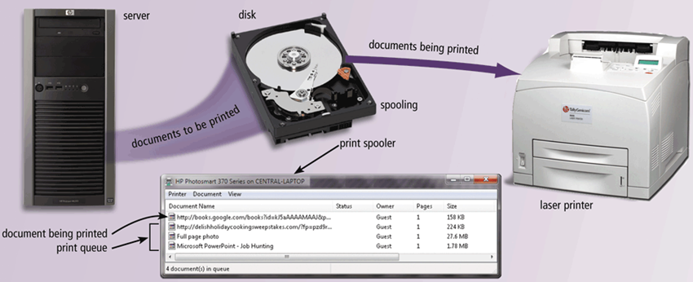
5. Coordinate Tasks
The operating system determines the order in which tasks are processed
Notes:
How does an OS schedule Jobs
Adjusts schedule based on job’s priority
A job is operation the processor manages
Receiving data from input devices
Processing instructions
Transferring items between storage and memory
Sending information to output devices
Spooling
Sending print jobs to buffer instead of directly to computers
Print jobs line up in queue

Slide 30
Configuring Devices
A device driver is a small program that tells the operating system how to communicate with a specific device
Plug and Play operating system automatically configures new devices as you install them

Slide 31
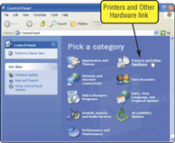
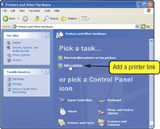
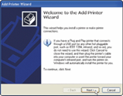
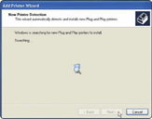
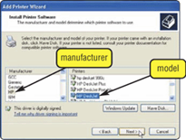
How do you install a device driver?
Step 3. Click Add a printer link. Follow on-screen instructions.
Step 4. Add Printer Wizard searches for Plug and Play printers on your computer. If it finds any such printers, it installs them.
Step 1. Open Control Panel window. Point to Printers and Other Hardware link.
Step 2. Click Printers and Other Hardware link. Point to Add a printer link.
Step 5. If Add Printer Wizard cannot find any Plug and Play printers, you can select type of printer you want to install. An on-screen prompt may ask you to insert floppy disk, CD-ROM or DVD-ROM that contains necessary driver files to complete the installation of printer.

Slide 32
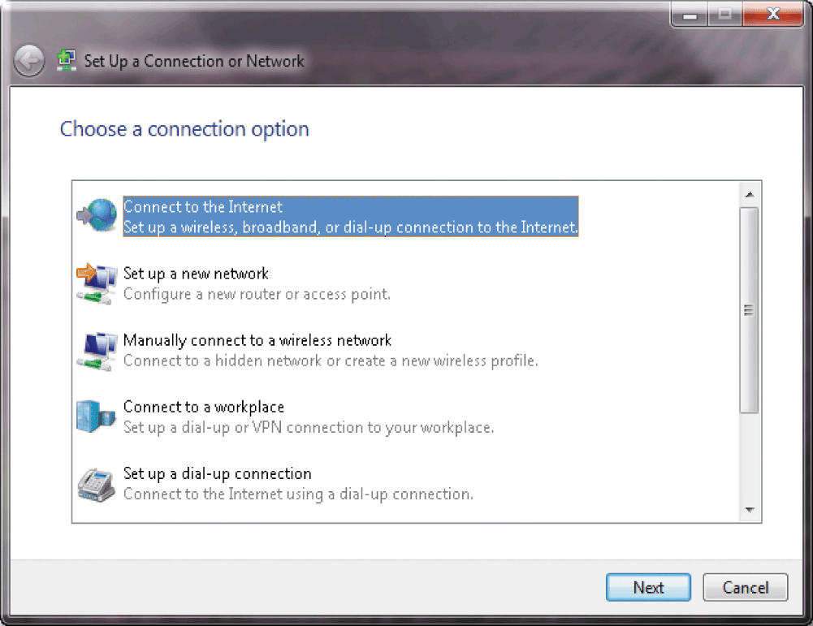
6. Setting up an Internet Connection
Operating systems typically provide a means to establish Internet connections

Slide 33
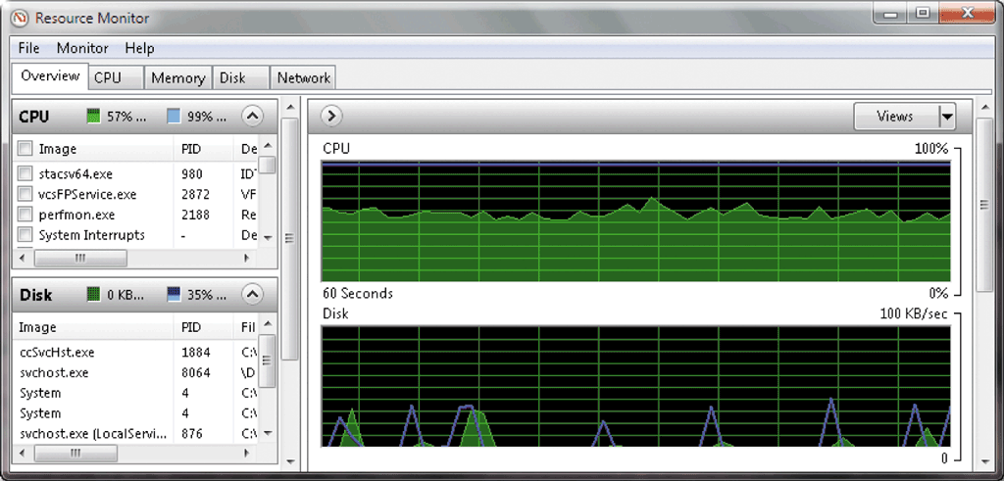
7. Performance Monitor
A performance monitor is a program that assesses and reports information about various computer resources and devices

Slide 34
Providing File Management
Operating systems often provide users with the capability of:
Managing files
Searching for files
Viewing images
Securing a computer
Uninstalling programs
Cleaning up disks
Defragmenting disks
Diagnosing problems
Backing up files and disks
Setting up screen savers

Slide 35
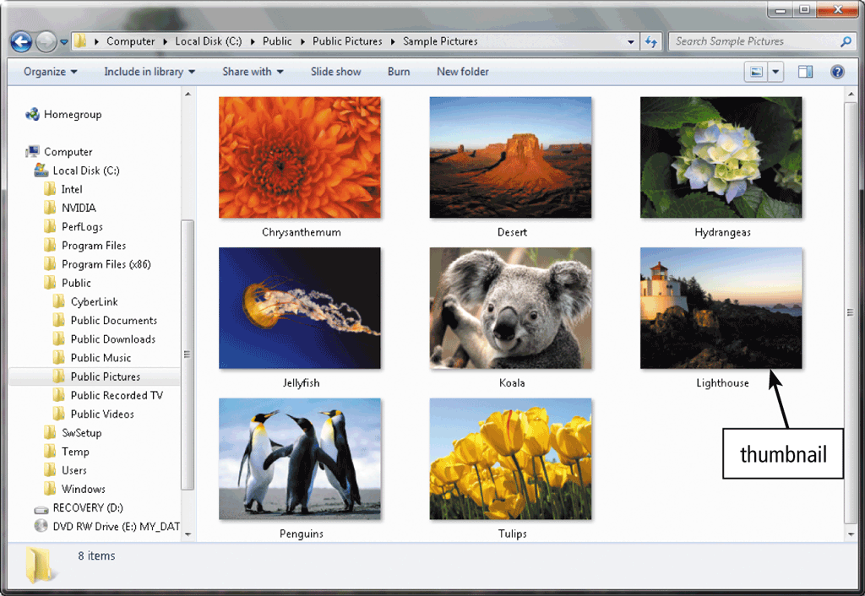
File Manager
A utility that performs functions related to file management
Displaying a list of files
Organizing files in folders
Copying, renaming, deleting, moving, and sorting files and folders
Creating shortcuts
35

Slide 36
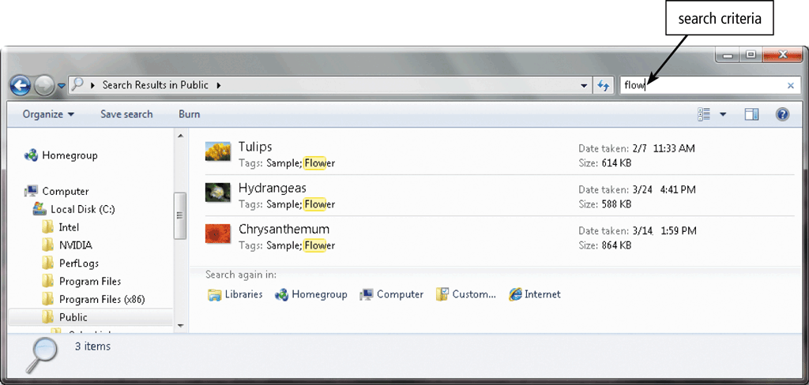
Search Utility
is a program that attempts to locate a file on your computer based on criteria you specify
36

Slide 37
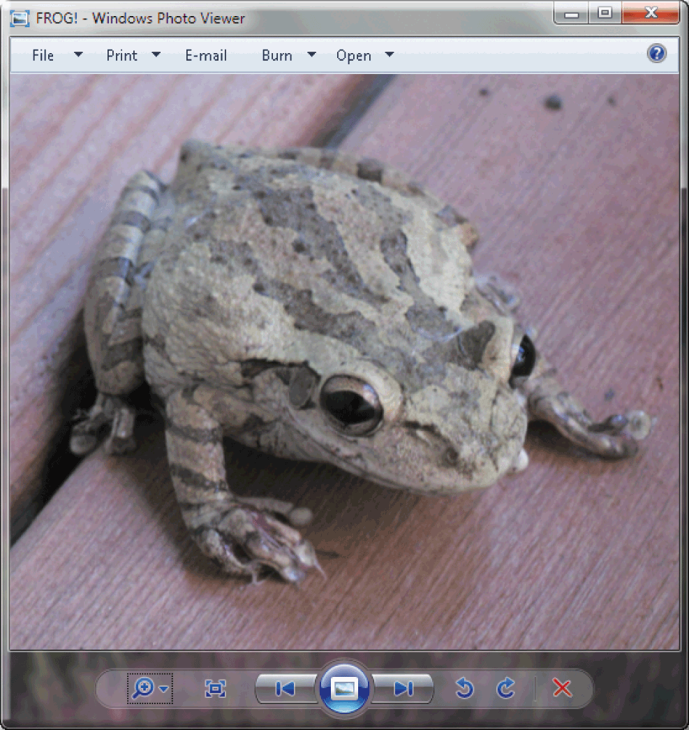
Image Viewer
allows users to display, copy, and print the contents of a graphics file
An uninstaller removes a program, as well as any associated entries in the system files
Windows XP uninstaller is in Add/Remove programs in control Panel
37

Slide 38
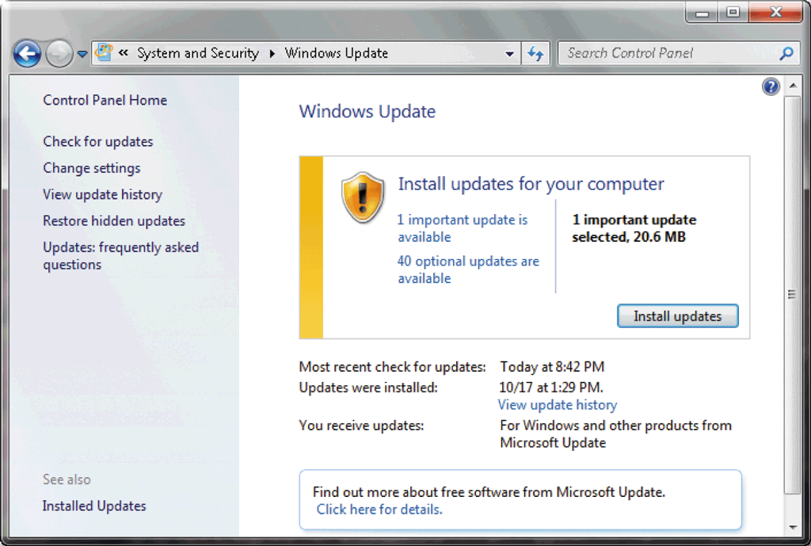
Operating System Functions
Automatic update automatically provides updates to the program

Slide 39
Operating System Functions
Some operating systems are designed to work with a server on a network
A server operating system organizes and coordinates how multiple users access and share resources on a network
A network administrator uses the server operating system to:
Add and remove users, computers, and other devices
Install software and administer network security

Slide 40
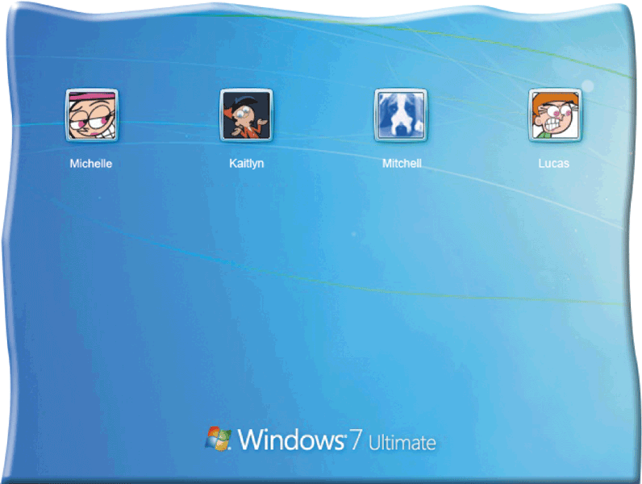
Operating System Functions
Each User has a account
A user name, or user ID, identifies a specific user
A password is a private combination of characters associated with the user name

Slide 41
Summary
System software
Operating systems
Functions of Operating System
Start and shut down
Providing a user interface
Managing programs
Managing memory
Coordinated tasks and Configure devices
Internet connection
Providing Utilities and automatic Update
41

