Slide 1
CSC 101 Introduction to Computing Lecture 14
1

Slide 2
Operating System Evolution
Over past 30 years, the evolution in OS has made PCs
easier to use and understand
more flexible and more reliable
Many of the first operating systems were device dependent and proprietary
A device-dependent program is one that runs only on a specific type or make of computer
Proprietary software is privately owned and limited to a specific vendor or computer model
Some OS still are device dependent

Slide 3
Operating System Evolution
A device-independent OS is one that run on computers provided by a variety of manufacturers
Advantage is you can retain existing application soft ware and data files even if you change computer models or vendors
As new versions of the OS are released, users upgrade their existing computers and mobile devices to incorporate features of the new version
Purchasing an OS upgrade usually costs less than purchasing the entire operating system
New versions of OS usually are backward compatible
Application software, by contrast, may or may not be upward compatible, meaning it may or may not run on new versions of the operating system

Slide 4
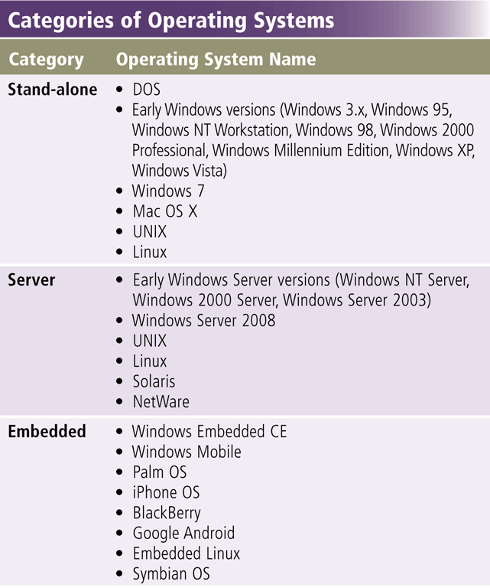
Types of Operating Systems
Windows Version Year Released
Windows 3.x 1990
Windows NT 3.1 1993
Windows 95 1995
Windows NT Workstation 4.0 1996
Windows 98 1998
Windows Millennium Edition 2000
Windows 2000 Professional 2000
Windows XP 2001
Windows XP SP2 2004

Slide 5
Stand Alone Operating Systems
Stand-alone OS is a complete OS that works on a desktop computer, notebook computer, or mobile computing device.
Some stand-alone OS are called Client OS because they also work in conjunction with a server operating system.
Client OS can operate with or without a network
DOS, Windows 3.x, Windows 95, Windows 98, windows 2000, Windows Vista, Windows XP, Windows 7, Mac OS X, Unix, Linux

Slide 6
Disk Operating System (DOS)
Single user single-tasking OS
Two popular version
PC DOS, which IBM released with its computers
MS DOS, which was used on millions of “IBM-compatible” PCs
Command line interface and completely text oriented
16-bit OS, Functions include
monitor support, disk input and output, keyboard control and internal functions related to program execution and file maintenance
Notes:
Teaching tip
Students often fail to see the value in older OS or applications. As an example, a metal fabrication plant in Pittsburgh PA is still using a program written in the early 70’s that calculates metal temperatures.

Slide 7
Disk Operating System (DOS)
Advantages
Requires small memory as it is small in size
Fast and powerful
Easy to use
Supports legacy applications
Weaknesses
Single user single task
No built-in support for networking
Manual Installation of device-drivers
Supports only 16 Bit programs
Address limited amount of Memory and storage
Command Line interface
Notes:
Teaching tip
Students often fail to see the value in older OS or applications. As an example, a metal fabrication plant in Pittsburgh PA is still using a program written in the early 70’s that calculates metal temperatures.

Slide 8
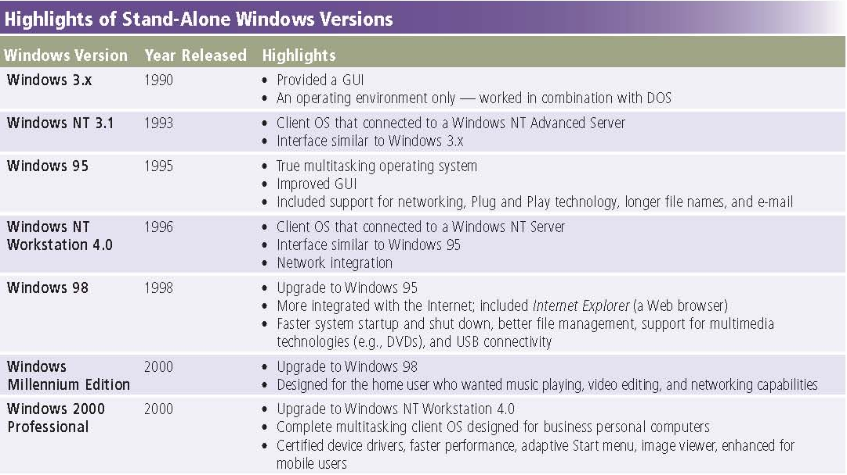
Microsoft Windows 1990 - 2000

Slide 9
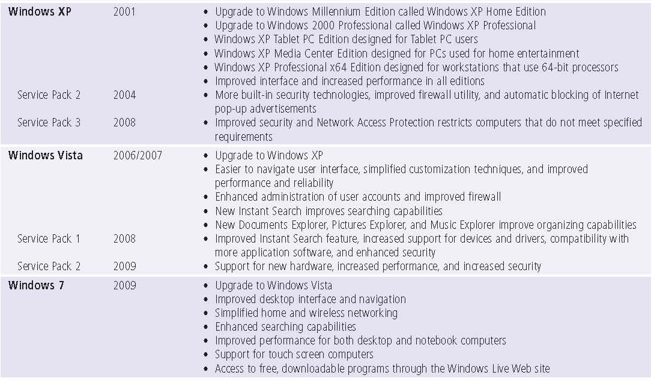
Microsoft Windows 2000 - 2009

Slide 10
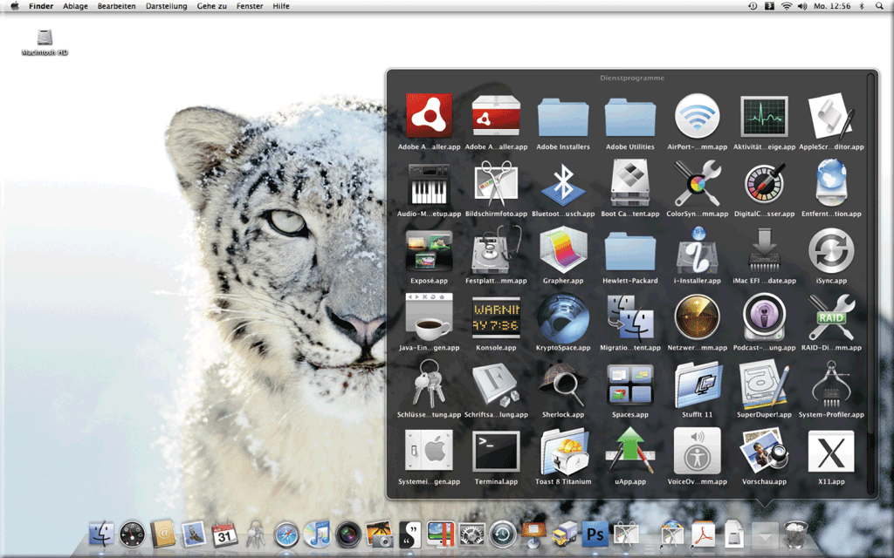
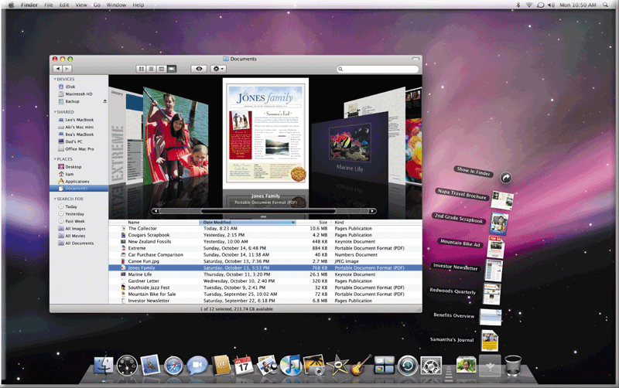
Macintosh OS X
The Macintosh OS has set the standard for operating system ease of use since 1984
Mac OS works only on Macintosh computers
Based on FreeBSD Linux
Small market share
Latest version is Mac OS X

Slide 11
Macintosh OS X
Very stable and easy to configure
Mac OS X includes these features:
New desktop search technology
Dashboard, a desktop area for mini-programs called widgets
Built-in, fast Web browser
Parental controls
Improved backup utility, called Time Machine
Accessibility interface reads e-mail messages
3-D personal video and audio conferencing
Filter to eliminate junk e-mail messages
Contact lists synchronized with Bluetooth enabled smart phone or other mobile device
Latest version of QuickTime to listen to music and view videos on the Internet
Easy networking of computers and devices
Windows network connection and shared Windows documents
Notes:
Teaching tip
OS X versions change often. Keep track of the most current and present this to the class. Visit www.apple.com/macosx/ to keep up to date. At press time the latest version was 10.4 Tiger.

Slide 12
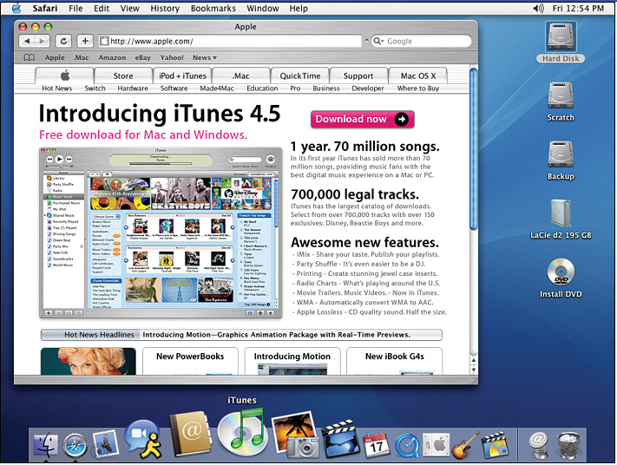
OS X Desktop

Slide 13
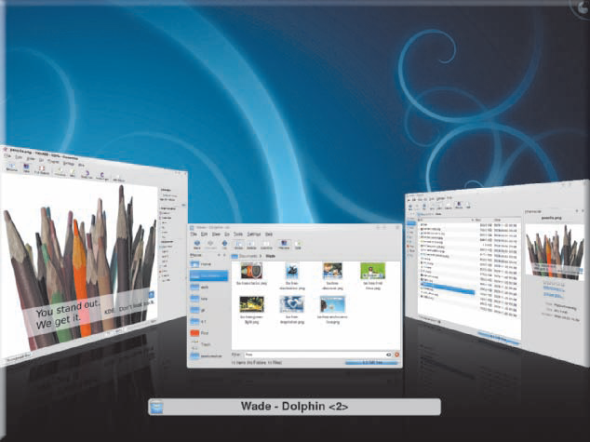
Unix
Runs on all computer types
32- or 64-bit
Very powerful, stable and fast
Command-line interface
Can cost thousands of dollars
Power users often work with UNIX because of its flexibility and power
Unix is a multitasking operating system developed in the early 1970s
Many versions of UNIX have a GUI

Slide 14
Unix
Composed of three parts Kernel, shell and the programs
Kernel is the hub of the Unix OS
Functions of kernel is to allocate memory and time to the programs.
handles system calls in response to storage of files and communication.
Shell acts as an interface between user and kernel.
done through small process which takes place when a user logs in
Program which has a control over the login checks for the correct user name and password of every user who tries to login.
In Unix OS, everything is either a process or a file.
A file can be considered as a collection of data which are created by the user by making use of text editors, running compilers etc.
A process can be considered as a program which is under execution and is identified by a unique processor identifier (PID).

Slide 15
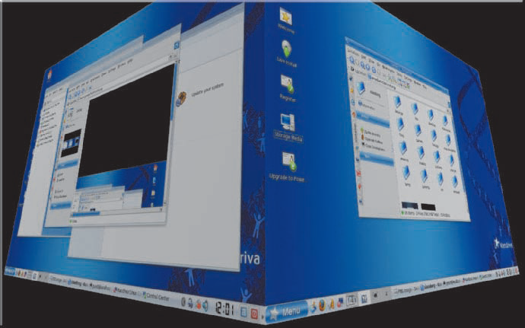
Linux
Open-source, popular, multitasking UNIX-type operating system
Free or inexpensive version of UNIX
32-bit OS
Very stable and fast
Most flavors are open source
X Windows GUI
Command line interface is available
Some versions of Linux have a GUI
Supports multiple users and multiple processors
Can run on nearly any computer and can support almost any type of application

Slide 16
Linux
Includes many free programming languages and utility programs.
Promoters of open source software state two main advantages:
users who modify the software share their improvements with others, and
customers can personalize the software to meet their needs.
Two most popular GUIs available for Linux are GNOME and KDE.
Some companies such as Red Hat market software that runs on their own distribution of Linux.
Many application programs, utilities, and plug-ins have Linux distributions, including OpenOffice.org, StarOffice, Mozilla, Yahoo! Messenger, RealPlayer, QuickTime, and Acrobat Reader

Slide 17
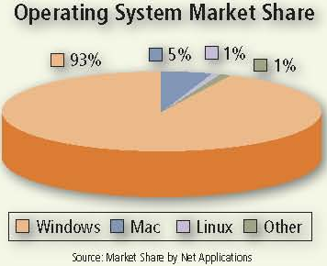
Market Share

Slide 18
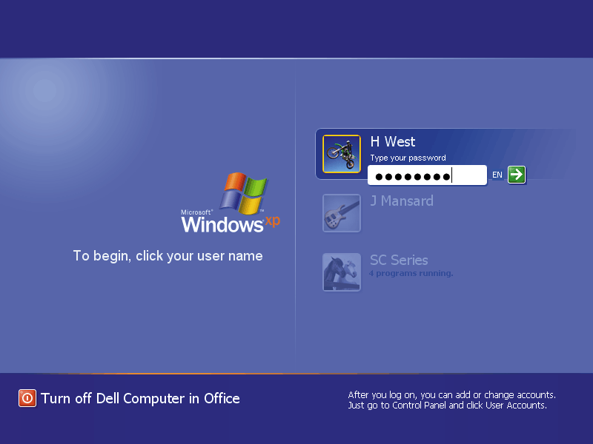
Network Operating System
Allows users to share printer, Internet access, files and programs on a network
Administrator security by establishing user name and password for each user
The “ other" computers are called client computers, and each computer that connects to a network server must be running client software designed to request a specific service

Slide 19
Network Operating Systems (NOS)
Fast and stable
Runs on servers
Multi-user and multitasking OS
32- or 64-bit
File and print sharing
Users access the same files
Hundreds of users use a printer
Different OS can interact
Windows Server 2000, 2003, 2008, Unix, Linux, Solaris, Novell Netware
19
Notes:
Insider Information
Plug and play was introduced by Apple Computers.

Slide 20
NOS Features
Data integrity
Backups copies data onto tape
RAID copies data onto other drives
Redundant Array of Inexpensive Disks
Relies on two or more hard drives
May speed access to data
Data security
Access to data can be restricted
Access to server resources is controlled
Audits can be kept

Slide 21
Networking OS – NT Server
Same core as NT Workstation
Security features for grouping and authenticating users and controlling their access to network resources
Multi user capability added
supports the use of many hard disks, working together to store huge amounts of data
RAID support included
can be configured to provide redundancy of data, writing the same data to multiple disks, so it is preserved in case one disk fails.
All these features make it possible for Windows NT Server to ensure disk and data security even in the event of a catastrophic failure of a hard disk

Slide 22
Windows 2000 Server
Same technology as 2000 workstation
Active Directory (AD)
Central database of server resources
Simplifies network management
Distributed programs supported
Server Standard Edition
Advanced Server Edition
Data Center Edition
It includes the Advanced Server features, plus support for SMP with up to 32 processors.
Notes:
Teaching tip
Spend some time describing how distributed applications can reduce network needs.

Slide 23
Windows 2003 Server
Designed to compete with UNIX
XP like interface
Better support for XP computers
MS .NET framework supported
Distributed programs are supported
Designed to support Web-based applications, large databases, ecommerce servers, and distributed applications, which are applications with parts that run on different computers, distributing the work and data across the network
Server Standard Edition
Data Center Edition

Slide 24
Windows 2008 Server
server operating system is based on the kernel (i.e. the core) of Windows Vista
offers increased reliability and flexibility in the server environment
Main features of Windows Server 2008
PowerShell new command line
User Interface like Windows Server 2003
“Bitlocker” for the complete encoding of the hard disk
Windows SharePoint services 3.0
Network Access Protection (NAP) to isolate unsafe clients
Windows Deployment Services (WDS)
Windows System Resource Manager (WSRM)
Windows Server Backup
Include Hyper-V, a virtualization technology

Slide 25
Windows 2008 Server
Windows Server 2008 Standard
capability of supporting up to a maximum of 4 GB RAM in its 32 bit version and 32 GB RAM in its 64 bit version.
supports up to 4 processors and a maximum of 12 server roles.
Windows Server 2008 Enterprise
capability of supporting up to a maximum of 64 GB RAM in its 32 bit version and 2 TB RAM in its 64 bit version.
Supports up to 8 processors and a maximum of 17 server roles.
Windows Server 2008 DataCenter
capability of supporting up to a maximum of 64 GB RAM in its 32 bit version and 2 TB RAM in its 64 bit version.
Depending upon hardware, it is capable of supporting up to 64 processors and a maximum of 17 server roles. It is used in computer Centers and Clusters.
Windows Web Server 2008
Capability of supporting up to a maximum of 4 GB RAM in its 32 bit version and 32 GB RAM in its 64 bit version.
Support only the Web Server role.
Windows Server 2008 for Itanium-Based Systems for computers with 64-bit processors that function as a Web server

Slide 26
Unix for Servers
Oldest NOS in widespread use
Stable secure and fast
Main OS for Internet and Web
Large organizations depend on UNIX for managing large databases shared by hundreds or thousands of users
capable of handling a high volume of transactions in a multiuser environment and working with multiple processors using multiprocessing
Many Web servers use UNIX as their operating system

Slide 27
Linux for Servers
Popular in small businesses
Cost-effective alternative to other operating systems for sharing files, applications, printers, modems, and Internet services
Stable, fast and inexpensive
large number of Linux servers hosting Web sites and performing other roles on the Internet
Some network servers use Linux as their operating system
Clients on the network can run Linux, UNIX, or Windows
Notes:
Insider information
The email service hotmail was originally hosted on Linux servers. Microsoft purchased Hotmail and moved it to Windows servers. It took Microsoft nearly a year to make Hotmail work as well on Windows as it did on Linux.

Slide 28
Solaris
a version of UNIX developed by Sun Microsystems, is a server OS designed specifically for e-commerce applications.
Manages high-traffic accounts and incorporates security necessary for Web transactions
Client computers often use a desktop program, such as GNOME desktop, that communicates with the Solaris OS

Slide 29
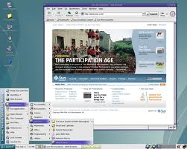
Solaris

Slide 30
Novell NetWare
Server OS designed for client/server networks.
Server portion that resides on the network server and
Client portion that resides on each client computer connected to the network
Supports open source software and runs on all types of computers from mainframes to personal computers.
Client computers also can have their own stand-alone OS such as a Windows, Mac OS, or Linux
Benefit is the long-term reliability of the product

Slide 31
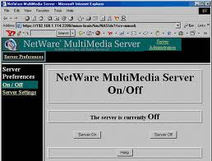
Novell Netware Desktop

Slide 32
Summary I
Operating System Evolution
Types of Operating Systems
Stand alone Operating Systems
DOS
Windows NT
Windows 9x (Windows 95, 98 ME)
Windows 2000
Windows XP, Windows Vista, Windows 7
Mac OS X
Unix
Linux
32

Slide 33
Summary II
Network Operating Systems
Features
Windows NT Server
Windows 2000 Server
Windows 2003 Server
Windows 2008 Server
Unix for Servers
Linux for Servers
Solaris
Novell Netware
33

Slide 34
Recommended Websites
https://en.wikipedia.org/wiki/Operating_system
https://en.wikipedia.org/wiki/Microsoft_Windows
https://en.wikipedia.org/wiki/Unix
https://en.wikipedia.org/wiki/Mac_OS_X
https://en.wikipedia.org/wiki/Linux
https://en.wikipedia.org/wiki/List_of_operating_systems
https://en.wikipedia.org/wiki/IOS
https://en.wikipedia.org/wiki/NetWare
https://en.wikipedia.org/wiki/Mobile_operating_system
34

