Slide 1
CSC 101 Introduction to Computing Lecture 16
Mr. Khurram Nissar
khurramnissar@cuisahiwal.edu.pk
1

Slide 2
Last Lecture Summary I
Data and Information
Database and DBMS
Data integrity, Garbage In Garbage Out (GIGO)
Quality of Valuable Information
Accuracy, Verifiable, timely, Organized
Accessible, Useful, Cost-effective
Hierarchy of Data
Character, Field, Record, File, Database
Common Field Data Types
Text, Numeric, Auto Number, Currency, Counter
Date, Memo, Logical, Hyperlink, Object, Attachment
2

Slide 3
Last Lecture Summary II
File Maintenance
Adding, Modifying and Deleting Records
Validation Checks
Alphabetic / Numeric, Range
Consistency, Completeness, Check Digit
File Processing
Disadvantages
Database Approach
Advantages
Flat File Databases
Relational Databases
3

Slide 4
Objectives Overview
Discuss the functions common to most database management systems
Explain how to access Web databases
Identify database design guidelines and discuss the responsibilities of database analysts and administrators
Describe characteristics of relational, object-oriented, and multidimensional databases

Slide 5
The DBMS
Is a program, or collection of programs, that allows any number of users to access and modify the data in a database
Allows
Entering data
Updating, deleting, backup,
Querying data, sorting
Printing reports
Supports thousands of users
Includes tools to protect the data

Slide 6
Creating Tables
first determine what kind of data will be stored in each table
List the necessary fields
Steps to define a field
Descriptively name the field
Specify the field type
Alphanumeric, numeric, logical, date, binary, memo
Determine the field size

Slide 7
Database Dictionary
A data dictionary contains data about each file in the database and each field in those files
For each file, it stores details
file name, description, the file’s relationship to other files, and the number of records in the file
For each field, it stores details
field name, description, field type, field size, default value, validation rules and the field’s relationship to other fields
metadata (meta means more comprehensive)
Contains details about data
also contains data about programs and users
keep track of who accessed data and when they accessed it
crucial backbone to a DBMS
only skilled professionals should update the contents

Slide 8
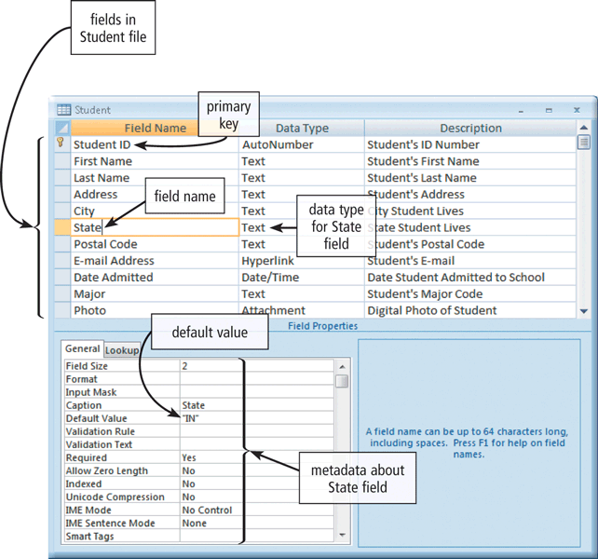
Database Dictionary
DBMS uses the data dictionary to perform validation checks
When users enter data, the data dictionary verifies that the entered data matches the field’s data type
allows users to specify a default value for a field
Displaying a default value reduces the possibility of errors. A user typically can override a default value if it does not apply for a certain record

Slide 9
Entering data into a table
Users type data into a field
Data must be entered accurately
Constraints help to verify data
process can have more pitfalls especially if it is being carried out by someone other than the table’s designer
Forms are typically used for data entry to make it easier
A form is nothing more than a custom view of the table that typically shows one record at a time and includes special controls and labels that make data entry less confusing

Slide 10
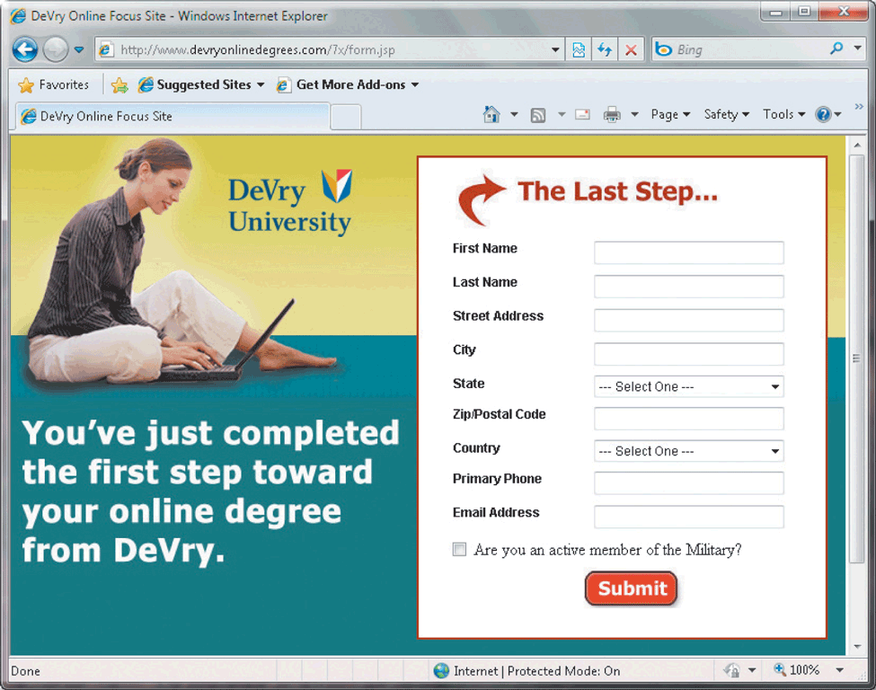
Form
A form is a window on the screen that provides areas for entering or modifying data in a database
Present one record to the user

Slide 11
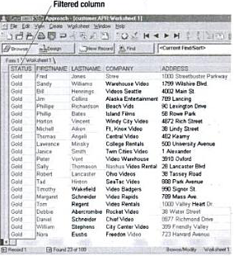
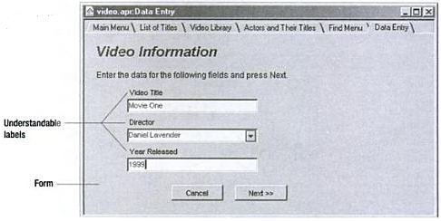
Viewing Records
Datasheet view shows all records
Filters can limit the records shown
Display only records matching a criteria
Forms allow viewing one record

Slide 12
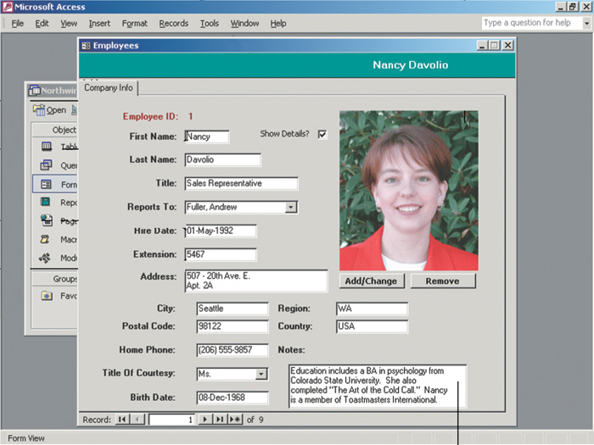
Viewing Records via Forms

Slide 13
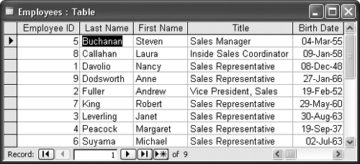
Sorting Records
Arranges records according to the contents of one or more fields
Order records based on a field
Multiple sub sorts resolve ‘ties’
Several types of sorts
Alphabetic
Numeric
Chronological
Ascending
Descending

Slide 14
Generating Reports
Printed information extracted from a database
Assembled by gathering data based on user-supplied criteria
can range from simple lists of records to customized formats for specific purposes, such as invoices
Can calculate data
Calculate data per row
Calculate for entire table
Pictures and formatting can be included

Slide 15
Reports
Includes tools to summarize data
layout can be customized with objects representing fields and other controls

Slide 16
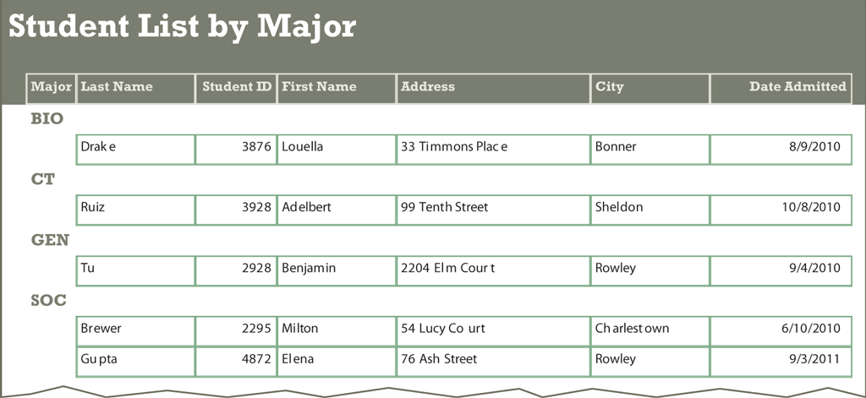
Report Generator
A report generator allows users to design a report on the screen, retrieve data into the report design, and then display or print the report
can use selected data and criteria to carry out automated mathematical calculations as the report is printed

Slide 17
Querying a Database
A query language consists of simple, English-like statements that allow users to specify the data to display, print, or store
Each query language has its own grammar and vocabulary
Statement that describes desired data
List of fields can be modified
Uses of querying
Find data
Calculate values per record
Delete records
Most important DBMS skill
Notes:
Teaching tip
Page 432 and 433 show examples of the different querying languages.

Slide 18
Query Languages
All DBMS use a query language
Most DBMS modify the language
Structured Query Language (SQL)
Most common query language
xBase
Query language for dBase systems
Query by example (QBE)
Interface to SQL or xBase
Interactive query design

Slide 19
Query Examples
SQL
Select FirstName, LastName, Phone
From tblPhoneNumbers
Where LastName=“Norton”;
xBase
Use tblPhoneNumbers
List FirstName, LastName, Phone
For LastName=“Norton”

Slide 20
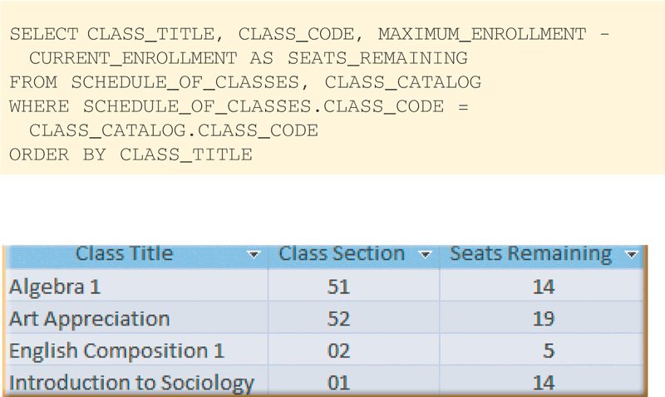
Structured Query Language (SQL)
Query language that allows users to manage, update, and retrieve data
SQL statement
SQL statement results

Slide 21

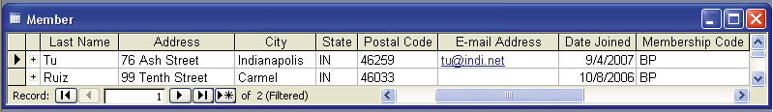
Database Query
Query by example (QBE) provides a GUI to assist users with retrieving data
Program retrieves records that match criteria entered in form fields
criteria
Query results

Slide 22
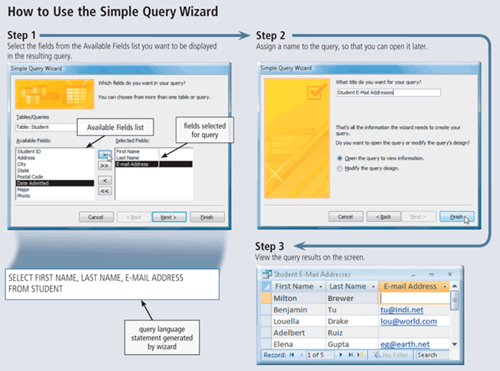
Use of Simple Query Wizard

Slide 23
Data Security
A DBMS provides means to ensure that only authorized users access data at permitted times
Access privileges define activities that specific user or group of users can perform
Read-only privileges - user can view data, but cannot change it
Full-update privileges -user can view and change data
principle of least privilege policy, where users’ access privileges are limited to the lowest level necessary to perform required tasks

Slide 24
Backup and Recovery
A DMBS provides a variety of techniques to restore the database to a usable form in case it is damaged or destroyed
Backup
Log
Recovery utility
Continuous backup

Slide 25
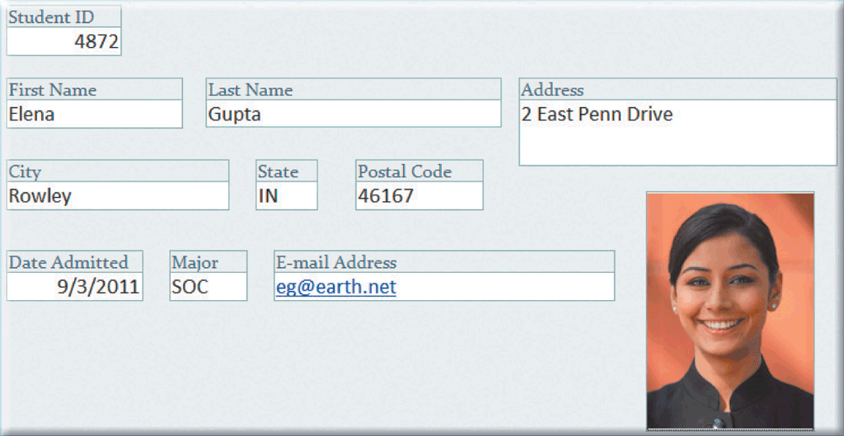


Backup and Log
Backup is a copy of the entire database
Log is a listing of activities that change database contents
DBMS places three items in log:
before image
actual change, and
after image
also might store who made the change, when it was made, and from which computer it was made.
before image
change
after image

Slide 26
Recovery Utility
Uses logs and/or backups to restore database when it is damaged or destroyed
Rollforward— DBMS uses log to re-enter changes made to data-base since last save or backup
Also called forward recovery
Rollback— DBMS uses log to undo any changes made to database during a certain period of time
Also called backward recovery
Continuous backup is a backup plan in which all data is backed up whenever a change is made.
Can cost more than other backup strategies but is growing in popularity because of its benefits
Provides recovery of damaged data in a matter of seconds.

Slide 27
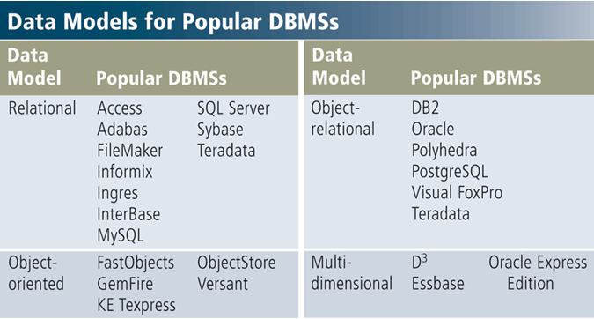
Data Model for Popular DBMS
A data model consists of rules and standards that define how the database organizes data
Defines how users view organization of data

Slide 28
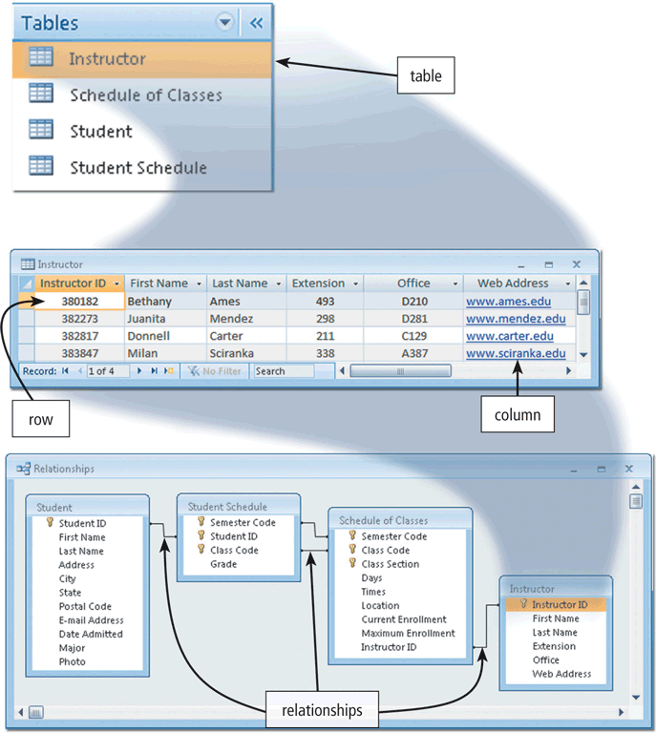
Relational Databases
stores data in tables that consist of rows and columns
Each row has a primary key
Each column has a unique name
Stores data relationships
A relationship is a link within the data
can set up a relationship between tables at any time

Slide 29
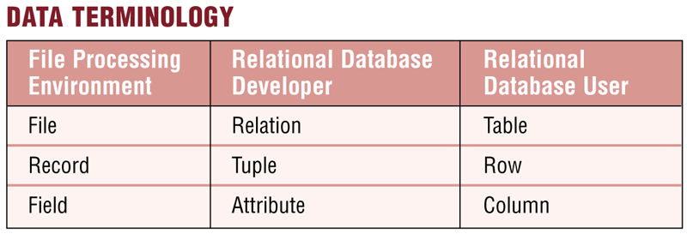
Data Terminology
A relational database uses terms different from a file processing system.

Slide 30
Object-Oriented Databases (OODB)
stores data in objects
Objects is item that contains data as well as actions that read or process data
Advantages
Can store more type of data
Can access data faster
Allow programmers to reuse objects
Stores unstructured data more efficiently e.g. photos, audio, video, documents
When users query an object oriented database, the results often are displayed more quickly than the same query of a relational database

Slide 31
Examples of OO Databases
Multimedia Database
Store images, audio clips and/or video clips
Computer-aided design (CAD) database
Store data about engineering, architectural and scientific design
Hypermedia database
Contains text, graphics, video and sound
Groupware databases
Store documents such as schedules, calendars, manuals, memos and reports
Hypertext databases
Contain link to other documents
Web databases
Contains link to e-form on web pages

Slide 32
GIS database
Although GIS database data sometimes is created from hard copy maps that are digitized using special software, much of the data is collected by teams who drive from location to location and record the data by hand.
Satellite imagery also can be used to collect data from locations worldwide.
Some computer databases developed by government and nongovernment agencies are able to feed data directly into a GIS database

Slide 33
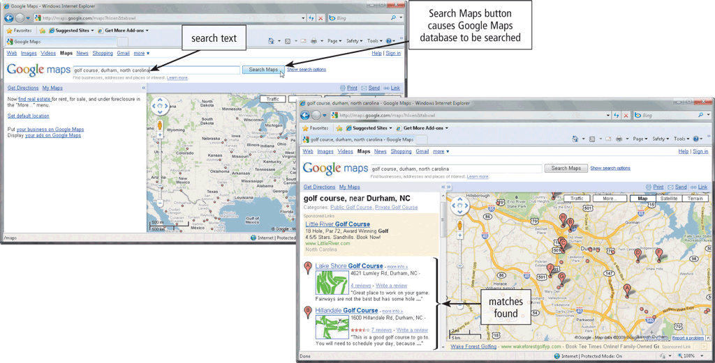
Object Oriented Databases - GIS
This Web application allows you to view the contents of a GIS database

Slide 34
Multidimensional Databases
Can store data in more than two dimensions of data
Sometimes known as a hypercube allow users to analyze any view of data
Can consolidate data much faster than a relational database
Typically does not process and summarize large numbers of records efficiently
Users obtain summarized results very quickly
No standard query language exists for multidimensional databases.
Each database uses its own language. Most are similar to SQL

Slide 35
Data Warehouse
A data warehouse is a huge database that stores and manages the data required to analyze historical and current transactions
Uses multidimensional databases
Quick and efficient way to access large amounts of data
typically has a user-friendly interface, so that users easily can interact with its data
Often, the database is distributed.
Data in a distributed database exists in many separate locations throughout a network or the Internet
Data is accessible through a single server
Data’s location is transparent to the user, who usually is unaware that the data is stored in multiple servers.
Often uses a process called data mining to find patterns and relationships among data
Data mart is smaller version of data warehouse

Slide 36
Web Databases
Databases on the Web allow you to:
Some Web databases are collaborative databases, where users store and share photos, videos, recordings, and other personal media with other registered users
Shop for products or services
Buy or sell stocks
Search for a job
Make airline reservations
Register for college classes
Check semester grades

Slide 37
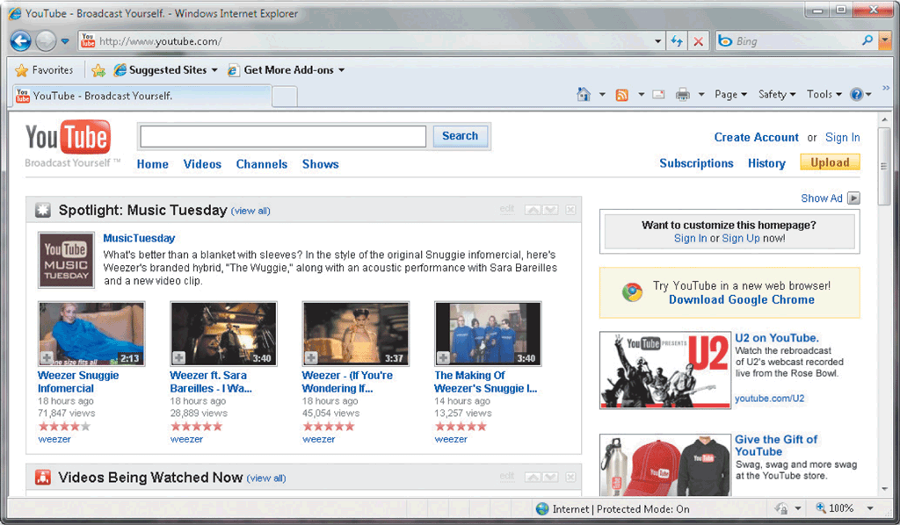
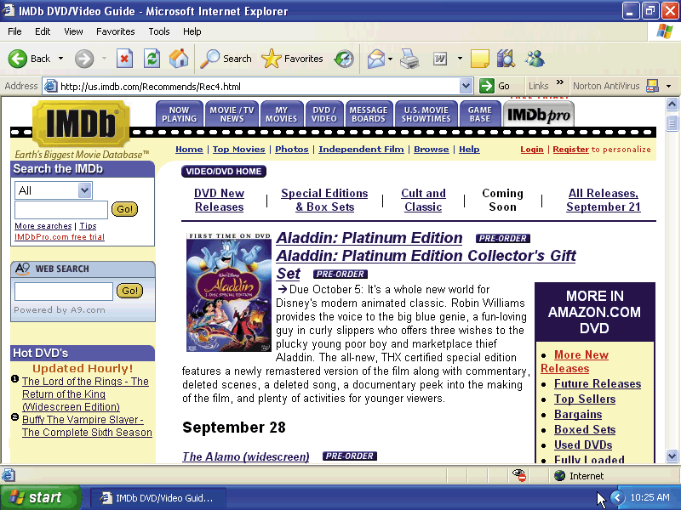
Web Databases
Database you access through the Web by filling in a form on a Web page
Usually resides on a database server, a computer that stores and provides access to a database

Slide 38
Common Corporate DBMS
Oracle
Most popular enterprise-level DBMS
Very flexible storage system
Can be very complex
Platform independent
Offers a wide range of solutions
DB2
Suit of applications to assist with data mining, analysis and integration, data warehousing
Platform independent
Only database using pure SQL

Slide 39
Common Corporate DBMS
Microsoft SQL Server
Fastest growing DBMS
Only runs on Microsoft platforms
Eight different versions exist
Extremely scalable architecture
Software can grow with the data
MySQL
Leading DBMS for Linux
Very inexpensive
Features are those needed in business
Often faster than other DBMS
Platform independent

Slide 40
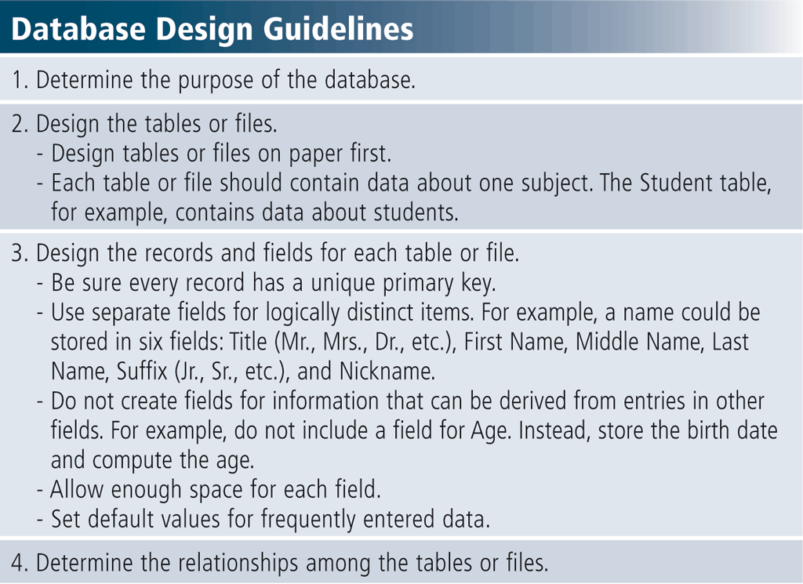
Database Design Guidelines
It is important to have a carefully designed database

Slide 41
Database Administration
Database analysts and administrators are responsible for managing and coordinating all database activities
Database Analyst (DA)
Focuses on meaning and usage of data. Decides on proper field placement, defines data relationship, and identifies users’ access privileges
Database Administrator (DBA)
Creates and maintains the data dictionary, manages security, monitors performance, and checks backup and recovery procedures

Slide 42

Role of Employee as User
Employees should learn how to use the data in the database effectively
Interact with database
Identify new data for the database
Maintain the database
Users can take part in designing the database that will help them achieve those goals

Slide 43
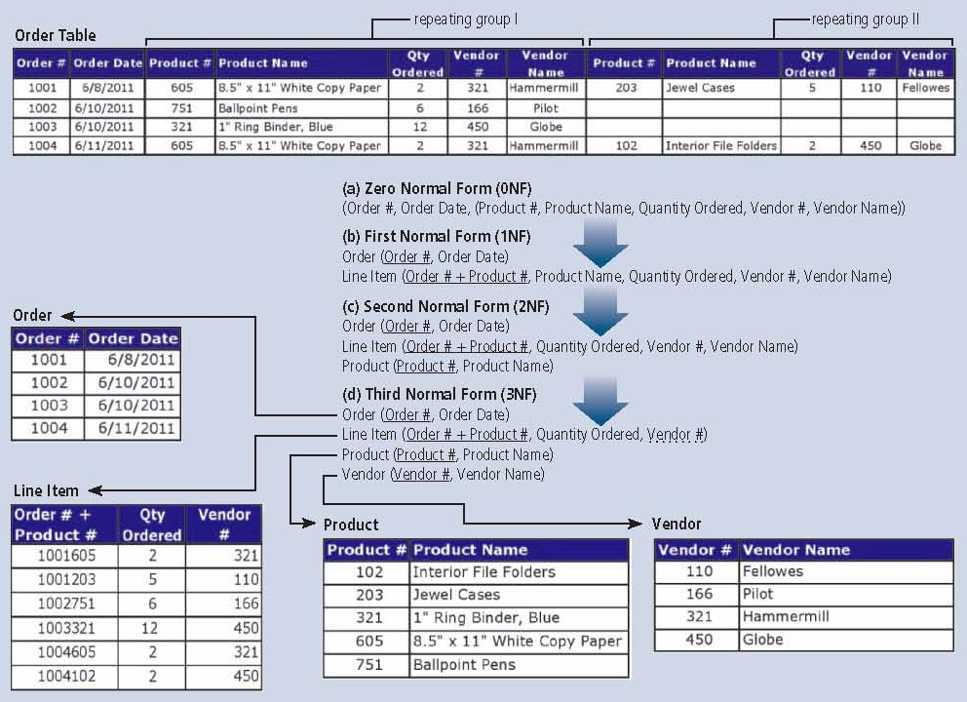
Ensuring Data Consistency
Normalization is a process designed to ensure the data within the relations (tables) contains the least amount of duplication

Slide 44
Enterprise Software
Enterprise definitions
Systems throughout the entire organization
Very large scale computer systems
Historically found on mainframes
Modern enterprise runs on PC servers
Suite of programs
Handles thousands of users at once
Access to millions of records
Looks and acts like a DBMS
Distributed applications
Software installed on several machines
Data stored on several machines
Data placed closest to appropriate users
Work load is balanced among machines

Slide 45
Enterprise Software
Tiers
Software between user and data
Tiers control one part of enterprise
Two tier systems
Data storage
Client interface
Three tier systems
Add calculation
There is no limit to the tiers

Slide 46
Enterprise Software
Meet the needs of many users
Applications are very complex
Support many types of users
Supports many different nationalities
Must support large data flow
Electronic document Management
Tracks and organizes documents
Keeps related ideas together
Aids in facilities management
Collaboration between team members
Database tracks all changes

Slide 47
Disconnected Datasets
Connections are given a copy of data
Connection to database is broken
But user can spend as long as he wants viewing the dataset
Portion of database user has requested
After modification, a new brief connection is established with the server and the review is submitted
Reduces the number of open connections
Reduces the data flow needs
May result in different versions of data
Notes:
Teaching tip
You can demonstrate disconnected databases in action. Have your entire class access www.crucial.com. Walk through the wizard with the computer models in your classroom. Most likely, your students will have several different prices for the same product. More information on disconnected databases can be found at www.devguru.com/features/tutorials/DisconnectedRecordsets/tutDisconnRS.html.

Slide 48
Databases at Work
Required in nearly every business
Can automate tasks
Increases business efficiency
Knowledge discovery
Technique of databases
Generates questions for the database
Those you did not think to ask
Data mining
Type of knowledge discovery
Searches for trends and patterns
Makes predictions on events
Supplies ideas for improving business

Slide 49
Databases at Work
Internet uses
Commercial websites use databases
Supply image and price information
Specialty databases exist online
Search engines track links
Databases for individuals
Manage aspects of your life
Organizes hobbies for school
Microsoft Access is the most popular
Notes:
Teaching tip
Access a few specialty databases in class to demonstrate their power. An excellent example is terraserver.Microsoft.com.

Slide 50
Summary I
Working with DBMS
Creating Tables, Data dictionary
Entering , Viewing and sorting records
Forms and Report generator
Querying a Database
SQL, QBE, xBase
Data Security,
Backup and Recovery
Data Model
50

Slide 51
Summary II
Relational Databases
Object Oriented Databases
Types of OO databases, GIS database
Multidimensional Databases
Data warehouse
Web Databases
Common RDBMS
Database Design Guidelines, Normalization
Database Administration
Enterprise Software
51

