Slide 1
CSC 101 Introduction to Computing Lecture 17
Mr. Khurram nissar
khurramnissar@cuisahiwal.edu.pk
1

Slide 2
Network Definition
Many organizations quickly learned the importance of connecting PCs
Data communications—the electronic transfer of information between computers—became a major focus of the computer industry.
Set of technologies that connects computers
Allows communication and collaboration between users
information they share can be much more than text documents
Internet is one big Example

Slide 3
Networks
A network is a collection of computers and devices connected together via communications devices and transmission media
Advantages of a network include:
Facilitating communications
Sharing hardware
Sharing data and information
Sharing software
Transferring funds

Slide 4
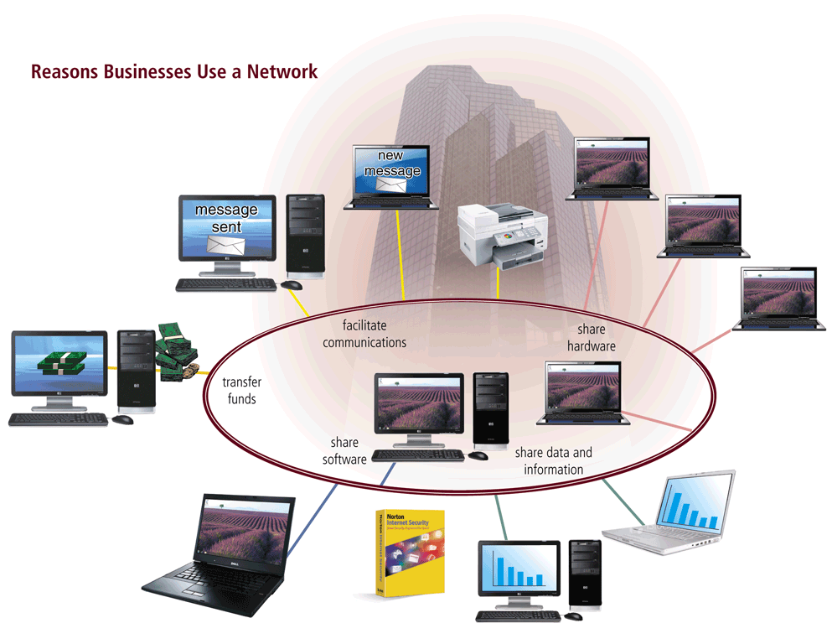
Network

Slide 5
Communications
Computer communications describes a process in which two or more computers or devices transfer data, instructions, and information
Sending device — initiates instruction to transmit data, instructions, or information
Communications device — connects the sending device to the communications channel
Communications channel — media on which data, instructions, or information travel
Communications device — connects the communications channel to the receiving device
Receiving device — accepts transmission of data, instructions, or information

Slide 6
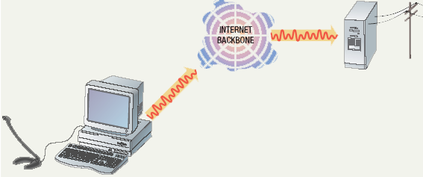
Uses of Commuter Communications
Personal communication
Email
Instantaneous communication
Conferencing
Videoconferencing
Audio-conferencing
Voice over IP
Phone communication over network wires
Pure VoIP
VoIP to POTS (plain old telephone service
Notes:
Teaching tip
It is fun if you can setup a teleconference in your classroom. Students get to learn how to join or create the conference. Additionally, they learn how to participate. Finally, students have fun, especially with shared whiteboards.

Slide 7
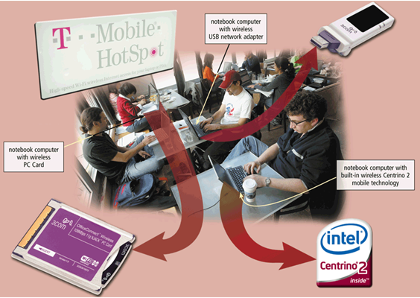
Uses of Computer Communications
Wireless Internet access points allow people to connect wirelessly to the Internet from home, work, school, and in many public locations using notebook computers, smart phones, handheld game consoles, or other devices
Hot Spot and
Mobile Wireless Networks

Slide 8

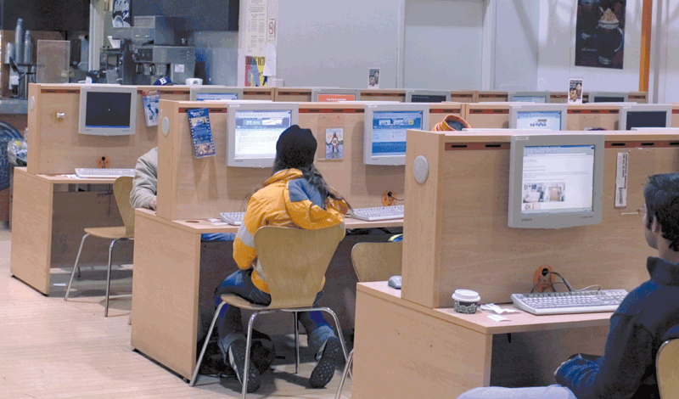
Uses of Computer Communications
A cybercafé is a coffeehouse, restaurant, or other location that provides personal computers with Internet access to its customers
Some are free and some take charges

Slide 9
Uses of Computer Communications
A Global Positioning System (GPS) is a navigation system that consists of one or more earth-based receivers that accept and analyze signals sent by satellites in order to determine the GPS receiver’s geographic location
GPS receivers are:
Built into many mobile devices
Available as a handheld device
Available with new vehicles

Slide 10
Uses of Computer Communications
Collaboration software includes tools that enable users to share documents via online meetings and communicate with other connected users
Online meetings
Web conferences
Document management systems

Slide 11
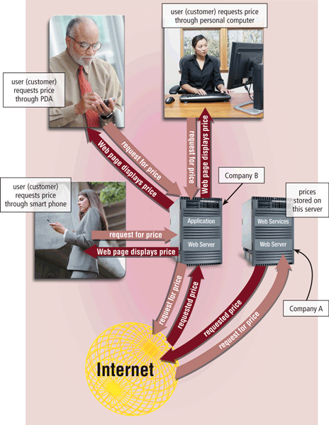
Uses of Computer Communications
Web services enable programmers to create applications that communicate with other remote computers over the Internet or on an internal business network
A mashup is a Web application that combines services from two or more sources

Slide 12
Common Network Types
Local Area Network (LAN)
Wide Area Network (WAN)
Metropolitan Area Network (MAN)
Campus Area Network (CAN)
Client-Server Network
Peer-to-Peer Network
Notes:
Teaching tip
Use a real world example to describe an organization with interconnected LANs.

Slide 13
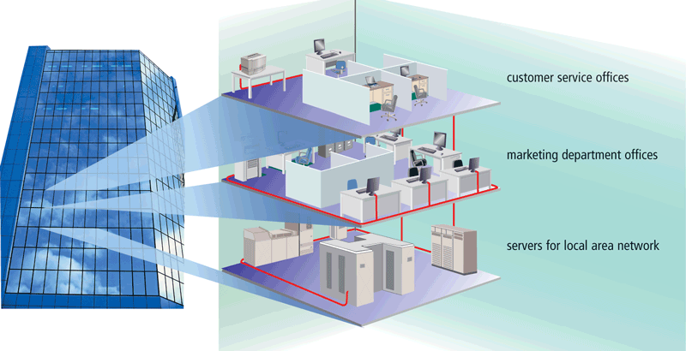
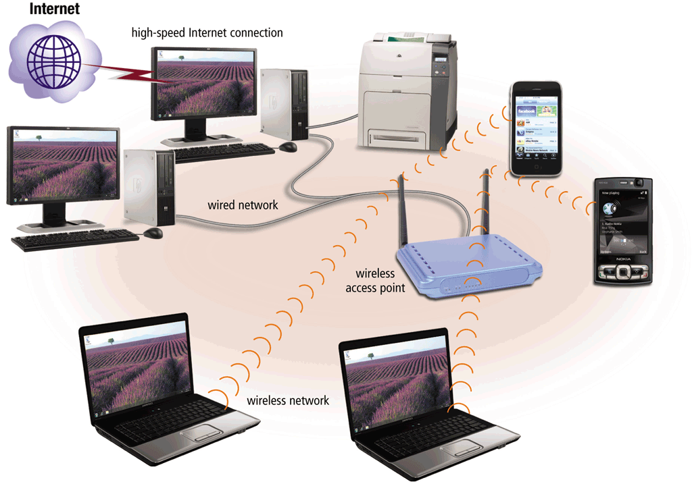
Network
A Local Area Network (LAN) is a network that connects computers and devices in a limited geographical area
A wireless LAN(WLAN) is a LAN that uses no physical wires

Slide 14
Local Area Network (LAN)
Each computer or device on the network is called a node
nodes are connected via cables, infrared links, or wireless media
Contains printers, servers and computers
Systems are close to each other
Contained in one office or building
not a system that connects to the public environment (such as the Internet) using phone or data lines.
Organizations often have several LANS
Notes:
Teaching tip
Use a real world example to describe an organization with interconnected LANs.

Slide 15
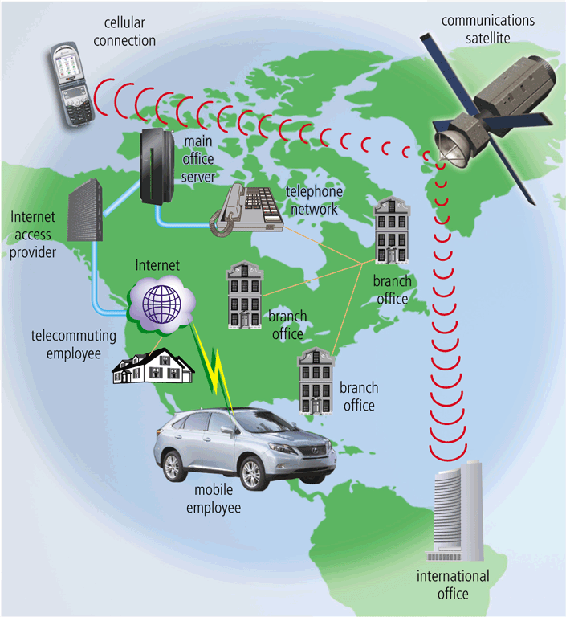
Network
A Wide Area Network (WAN) is a network that covers a large geographical area
Two or more LANs connected
Typically use public or leased lines
Phone lines
Cables
Radio Waves
Communication satellite
The Internet is a WAN

Slide 16
Metropolitan Area Network (MAN)
A high-speed network that connects LANs in a metropolitan area such as a city or town and handles the bulk of communications activity across that region.
Typically includes one or more LANs, but covers a smaller geographic area than a WAN.
A MAN usually is managed by a consortium of users or by a single network provider that sells the service to the users.
Local and state governments, for example, regulate some MANs.
Telephone companies, cable television operators, and other organizations provide users with connections to the MAN

Slide 17
Campus Area Network (CAN)
Follows the same principles as a LAN only on a larger and more diversified scale
A LAN in one large geographic area
Resources related to the same organization
Each department shares the LAN
With a CAN, different campus offices and organizations can be linked together
Some university departments or organizations might be linked to the CAN even though they already have their own separate LANs.

Slide 18
Personal Area Network (PAN)
Very small scale network
Range is less than 2 meters
Cell phones, PDAs, MP3 players
PANs can be used for communication among the personal devices themselves (intrapersonal communication), or for connecting to a higher level network and the Internet (an uplink)
A PAN may also be carried over wired computer buses such as USB and FireWire
Notes:
Insider information
PAN is very new. Few devices support PAN. High end cell phones include Bluetooth technology. Once the technology matures, Bluetooth will allow the creation of a PAN.

Slide 19
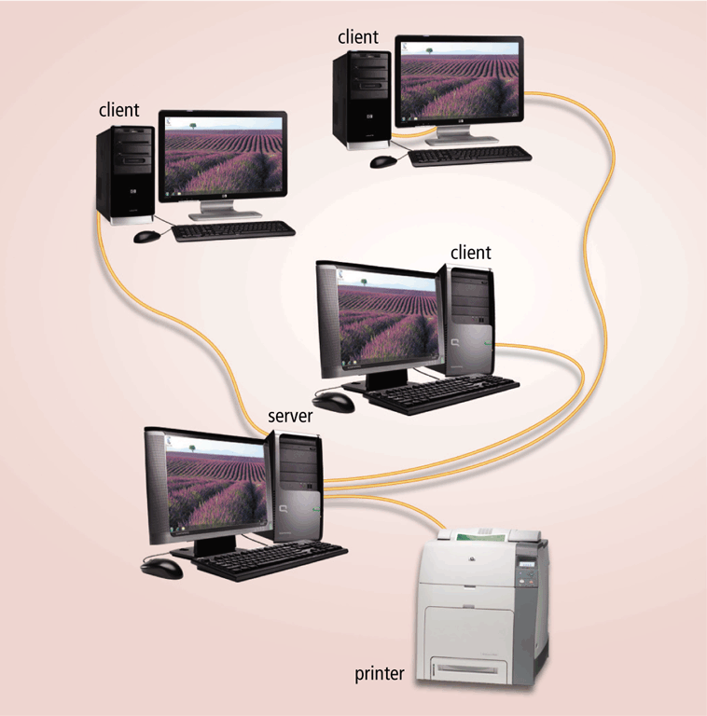
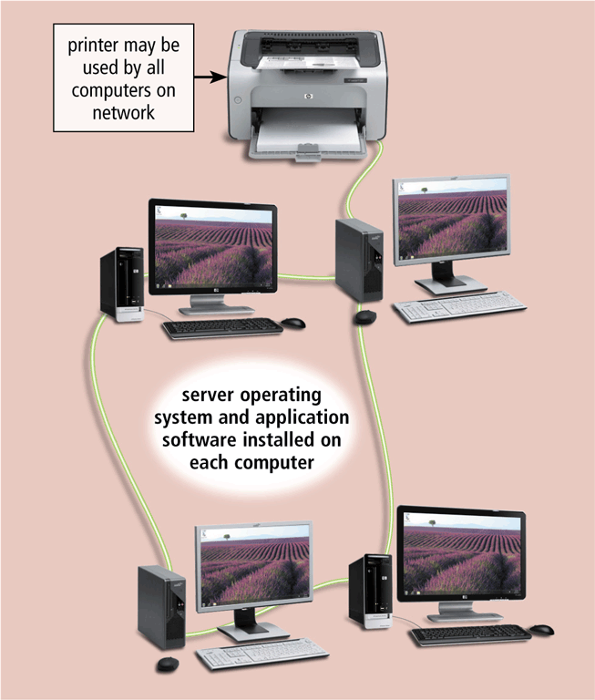
Network Architecture
The design of computers, devices, and media on a network is sometimes called the network architecture
In client/server network one or more computers act as server and others computers or clients access server for some services
Client/server network
Peer-to-peer network

Slide 20
Server Based Network
A node is a processing location that can be a PC or some other device such as a networked printer
Usually, server-based networks include many nodes and one or more servers
server control nodes access to the network's resources
Users gain access by logging in
Server is the most important computer
Notes:
Teaching tip
Spend a few minutes here discussing password policies. Describe why it is important not to give out a password. Also describe why longer, more complicated passwords are important.

Slide 21
Client-Server Network
Nodes and servers share data roles
Nodes are called clients
Servers are used to control access
requires special software for the nodes and the server
Database software
Access to data controlled by server
Server is the most important computer
Require a person to serve as a network administrator because of the large size of the network

Slide 22
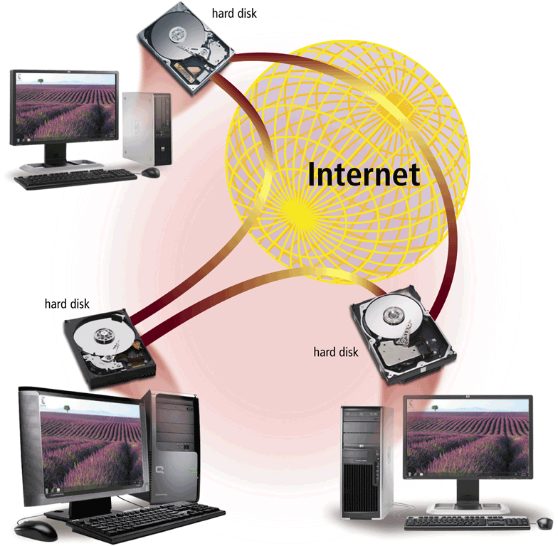
Network
P2P describes an Internet network on which users access each other’s hard disks and exchange files directly over the Internet
Each computer, or peer, has equal capabilities

Slide 23
Peer-to-Peer Network
All nodes are equal
Nodes access resources on other nodes
Each node controls its own resources
Most modern OS allow P2PN
Distributing computing is a form
Notes:
Teaching tip
Discuss how users managing their own security settings can be bad.

Slide 24
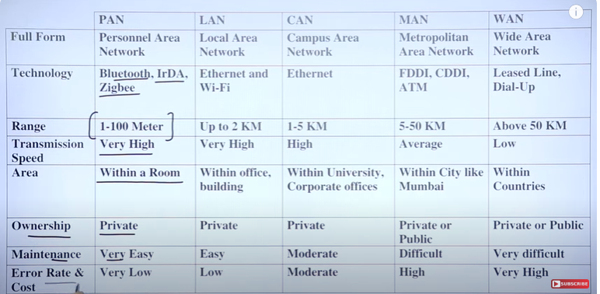
Comparison charts
Notes:
Teaching tip
Discuss how users managing their own security settings can be bad.

Slide 25
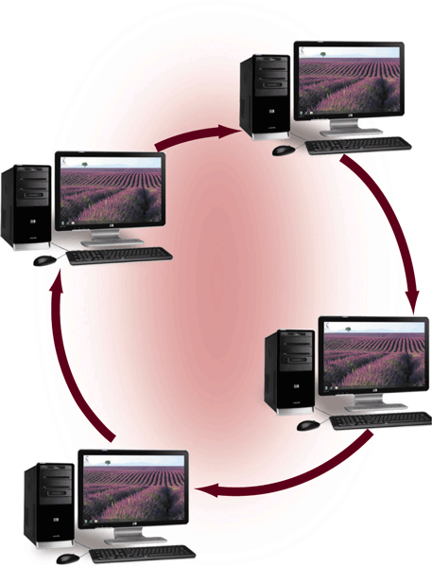
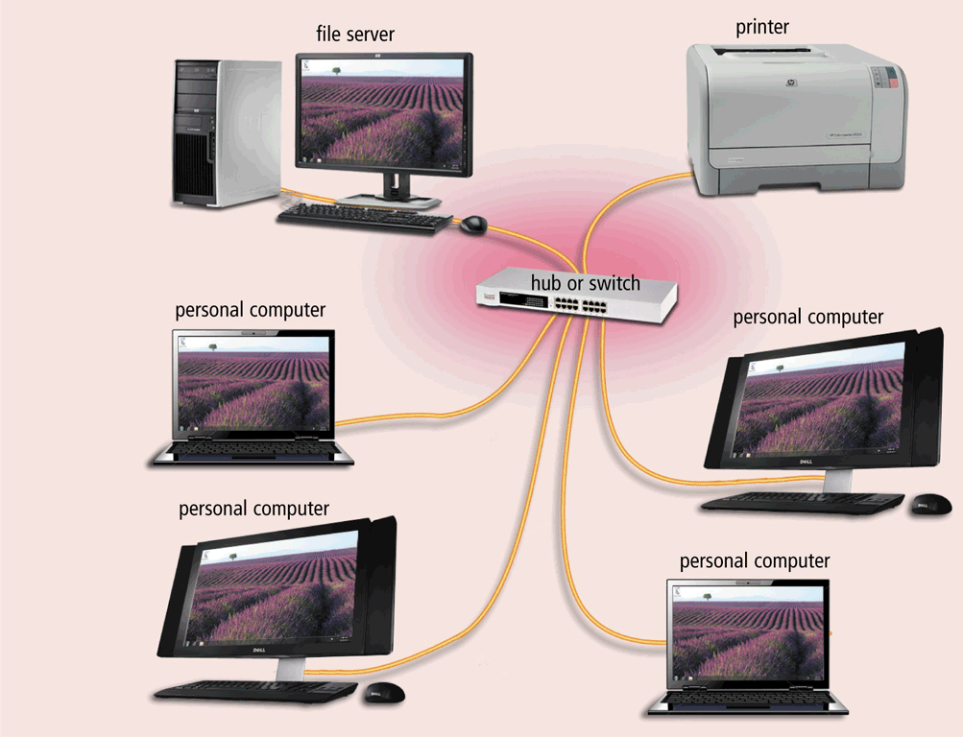
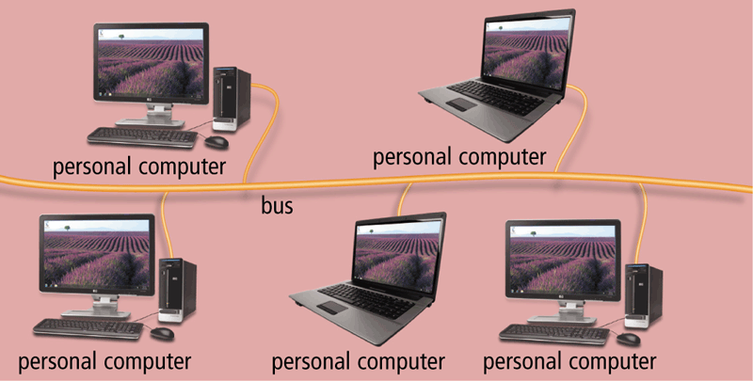
Network
A network topology refers to the layout of the computers and devices in a communications network
Choice affects
Network performance
Network size
Network collision detection
Ring network
Star network
Bus network

Slide 26
Bus Topology
Also called linear bus
One wire connects all nodes
Terminator ends the wires
Advantages
Easy to setup
Small amount of wire
Disadvantages
Slow
Easy to crash
Notes:
Teaching tip
Pages 352 and 353 have diagrams of each network topology
What is bus topology?
Bus topology is a type of network topology in which all devices are connected to a single cable called a "bus." This cable serves as a shared communication medium, allowing all devices on the network to receive the same signal simultaneously.
How does bus topology work?
In a bus topology, all devices on the network are connected to a single cable, with each device using a connector to tap into the cable. When a device sends a signal, it is broadcast to all other devices on the network, and each device receives the signal and decides whether to act on it based on its own unique address.
What are the advantages of using bus topology?
One advantage of using bus topology is that it is easy to install and requires less cable than other types of network topologies. Also, bus topology can be used to connect many devices, making it ideal for small to medium-sized networks.
What are the disadvantages of using bus topology?
One major disadvantage of bus topology is that it is vulnerable to cable failures. If the bus cable is damaged or severed, the entire network will be affected. Additionally, bus topology is not well-suited for use in large networks, as the signal quality degrades over longer distances.

Slide 27
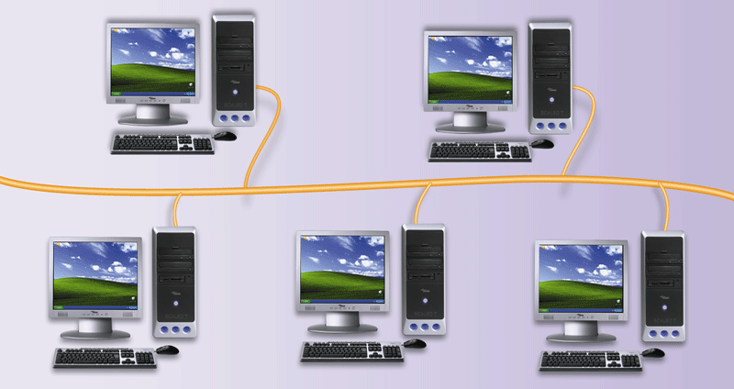
Bus Networks
All computers and devices connect to central cable, or bus

Slide 28
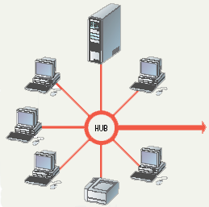
Star Topology
All nodes connect to a hub
Packets sent to hub
Hub sends packet to destination
Advantages
Easy to setup
One cable can not crash network
Disadvantages
One hub crashing downs entire network
Uses lots of cable
Most common topology
Notes:
What is a star network?
A star network is a local area network (LAN) topology in which all nodes -- personal computers (PCs), workstations or other devices -- are directly connected to a common central computer that is often referred to as a hub. Therefore, a star network is often referred to as a hub-and-spoke network topology.
Every workstation connected to the hub is indirectly connected to each workstation using the hub as an intermediary device. Star networks are typically deployed at the access layer of enterprise networks. The access layer uses a centralized network switch to connect all endpoints to the rest of the LAN.
How does a star network work?
Because a star network uses a centralized hub, that hub is responsible for controlling communications between devices. However, there are different ways that a central hub can manage these communications. For example, an Ethernet hub is a network device that simply listens to a communication destined for a device on a different spoke and then retransmits -- or broadcasts -- the message out to all spokes. This is the simplest form of a network hub, as it only must repeat the message to all other connected spokes. But this method can become inefficient quickly, as each communication is sent out to all spokes, as opposed to only the spoke the message was intended for.

Slide 29
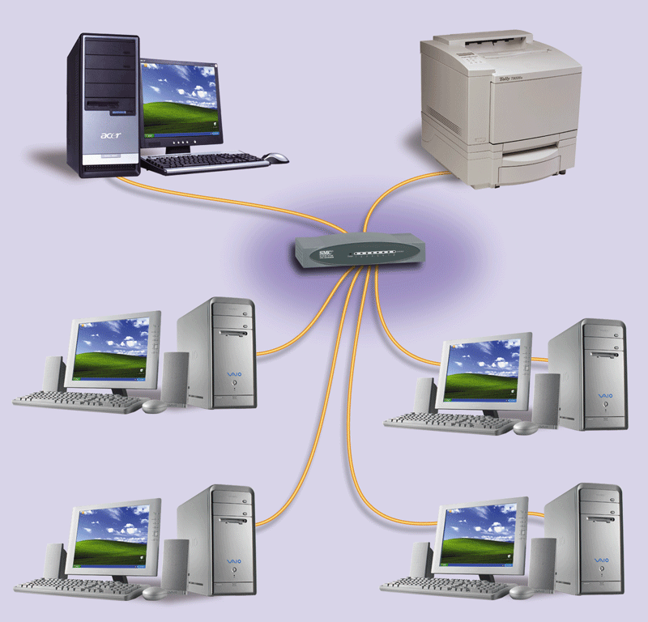
Star Network
All devices connect to a central device, called hub
All data transferred from one computer to another passes through hub

Slide 30
Ring Topology
Nodes connected in a circle
Tokens used to transmit data
Nodes must wait for token to send
Advantages
Time to send data is known
No data collisions
Disadvantages
Slow
Lots of cable

Slide 31
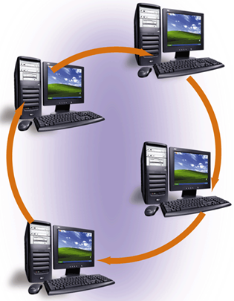
Ring Network
Cable forms closed ring, or loop, with all computers and devices arranged along ring
Data travels from device to device around entire ring, in one direction
Notes:
What is ring topology?
Ring topology is a type of network configuration where devices are connected in a circular manner, forming a closed loop. In this setup, each device is connected to exactly two other devices, creating a continuous pathway for data transmission. This means that data travels in only one direction around the ring, passing through each device until it reaches its destination.
How does ring topology work?
In a ring topology, data is transmitted from one device to the next in a sequential manner. When you send data from your device, it travels to the next device in the ring, and that device passes it along to the next device until it reaches the intended recipient. Each device in the ring acts as a repeater, regenerating and retransmitting the data, ensuring that it continues to flow around the ring.
What are the advantages of using ring topology?
One advantage of a ring topology is that it provides equal access to all devices on the network. Since data travels in a circular path, each device has an equal opportunity to send and receive data. Additionally, ring networks can handle high data loads more efficiently because each device has dedicated time slots to transmit data, reducing the chances of collisions.
Can you give examples of devices that use ring topology?
Sure, token ring and fiber distributed data interface (FDDI) are examples of network technologies that use a ring topology. Token ring was commonly used in older computer networks, while FDDI was primarily used for high-speed fiber optic networks. These technologies are not as prevalent today, as other topologies like Ethernet have become more popular.

Slide 32
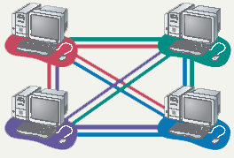
Mesh Topology
All computers connected together
Internet is a mesh network
Advantage
Data will always be delivered
Disadvantages
Lots of cable
Hard to setup
Notes:
What is Mesh Topology?
In a mesh topology, every node is connected to every other node in the network. This provides redundant paths between nodes and allows for every node to act as a router. A mesh topology is therefore very fault tolerant – if one link fails, there are alternate routes that can be taken.
Advantages of Mesh Topology
There are several advantages that mesh topology has over other network topologies:
It is very fault tolerant. If one node in the network goes down, the rest of the nodes can still communicate with each other.
All nodes in a mesh network have a dedicated connection to every other node in the network. This means that there is no single point of failure and the network can continue to operate even if one node fails.
Disadvantages of Mesh Topology
However, there are also some disadvantages to mesh topology.
It can be expensive to implement because each node needs its own dedicated connection to every other node in the network. This can make mesh topology impractical for large networks.
Mesh topology can be complex to configure and manage

Slide 33
Summary
Types of Networks
LAN
WAN
MAN
Client Server
Peer-to-Peer
Network Topologies
Bus
Star
Ring
Mesh
33

