Slide 1
CSC 101 Introduction to Computing Lecture 18
Mr. Khurram Nissar Khurramnissar.edu.pk
1

Slide 2
Network Media
Media refers to the means used to link a network's nodes together
communications channel is the transmission media on which data, instructions, or information travel in a communications system.
Choice impacts
Speed
Security
Size

Slide 3
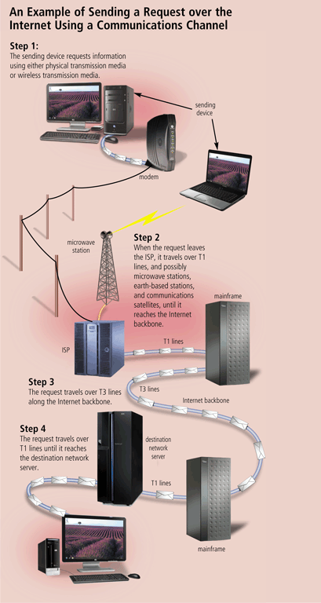
Communication Channel
The amount of data that can travel over a communications channel sometimes is called the bandwidth
Latency is the time it takes a signal to travel from one location to another on a network
Transmission media are materials capable of carrying one or more signals
Broadband media transmit multiple signals simultaneously

Slide 4
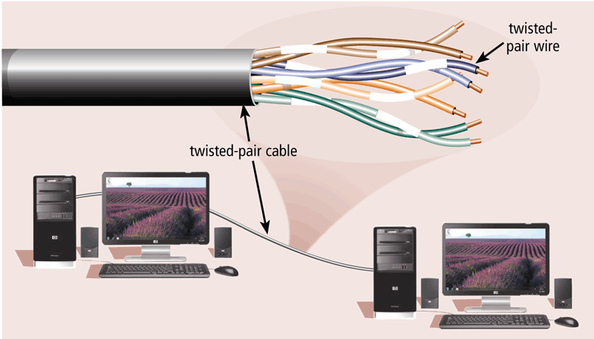
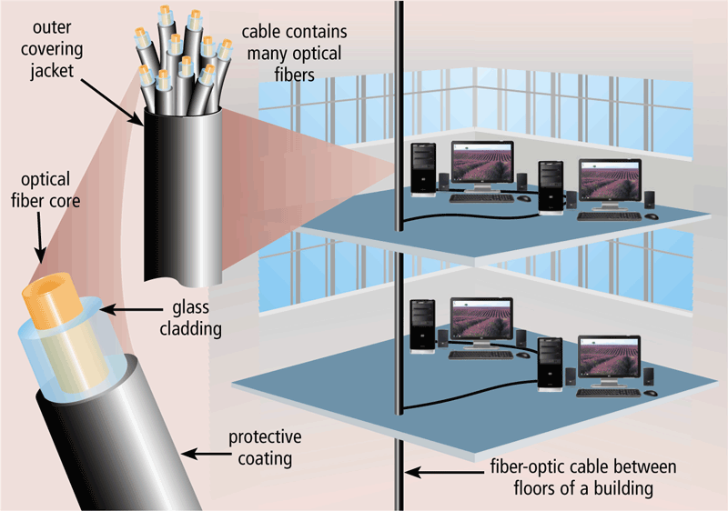
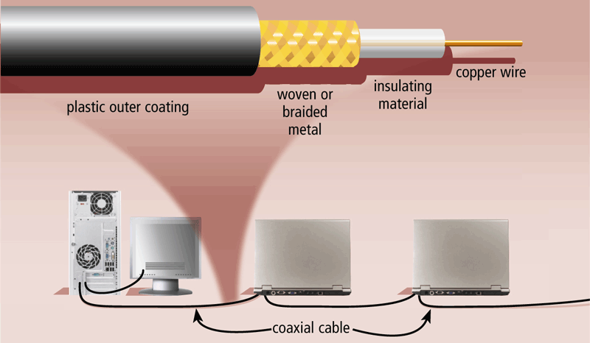
Physical Transmission Media
Twisted-pair cable
Fiber-optic cable
Coaxial cable

Slide 5
Physical Transmission Media
Twisted Pair is used for telephone systems and network cabling
Coaxial cable is often used for cable television wiring
Fiber optic cable is capable of carrying significantly more data at faster speeds than wire cables.
Less susceptible of interference (noise) and therefore more secure
Smaller size (thinner and lighter)

Slide 6
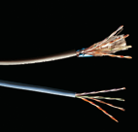
Twisted Pair Cable
Most common LAN cable
Called Cat5 or 100BaseT
Four pairs of copper cable twisted
May be shielded from interference
Speeds range from 1 Mbps to 1,000 Mbps
Notes:
Insider information
Interference is usually electrical. Magnets, solar flares or electronic devices generate interference.

Slide 7
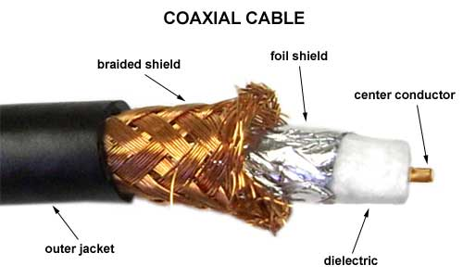
Coaxial Cable
Similar to cable TV wire
One wire runs through cable
Shielded from interference
Speeds up to 10 Mbps

Slide 8
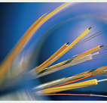
Fiber-optic Cable
Data is transmitted with light pulses
Glass strand instead of cable
Immune to interference
Very secure
Hard to work with
Speeds up to 100 Gbps
Notes:
Teaching tip
Remind students that bps is bits per second. Gbps then is billion bits per second.

Slide 9
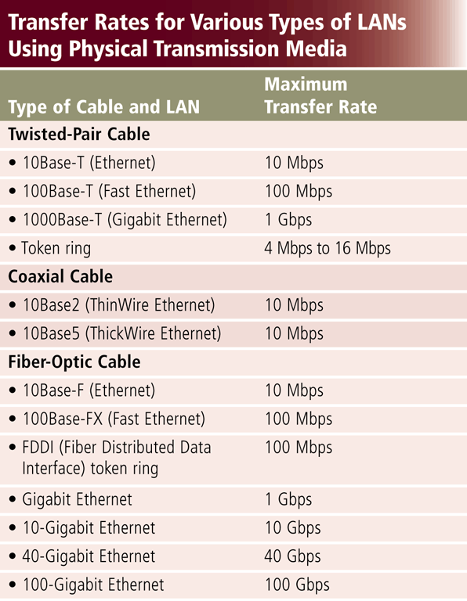
Physical Transmission Media
Wire, cable, and other tangible materials used to send communications signals

Slide 10
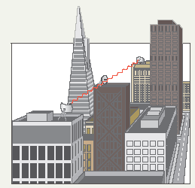
Wireless Media
Data transmitted through the air
LANs use radio waves
WANs use microwave signals
Easy to setup
Difficult to secure
Notes:
Teaching tip
Now is the time to briefly discuss 802.11 standards. A full discussion of 802.11 is covered in the next section.

Slide 11
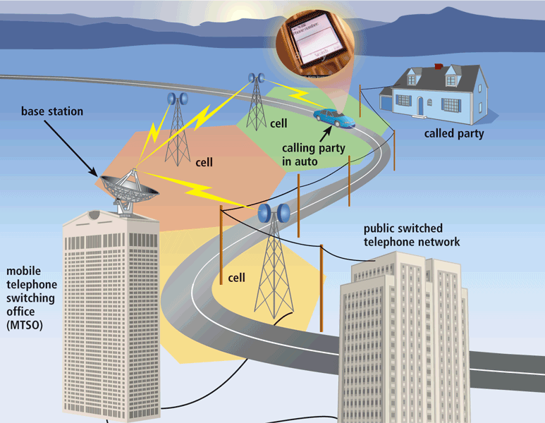
Wireless Transmission Media
Broadcast Radio distributes radio signals over long and short distances
Cellular radio is a form of broadcast radio that is used widely for mobile communications

Slide 12
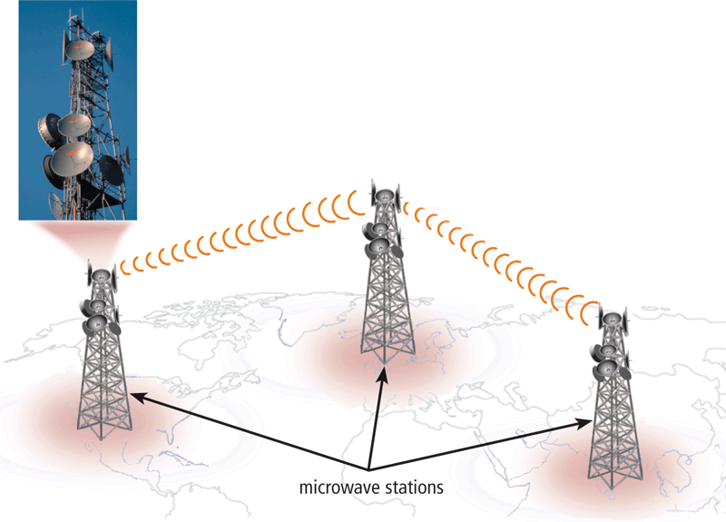
Wireless Transmission Media
Microwaves are radio waves that provide a high-speed signal transmission
A microwave station is an earth-based reflective disk used for microwave communications.
It must transmit in straight line with no obstructions

Slide 13
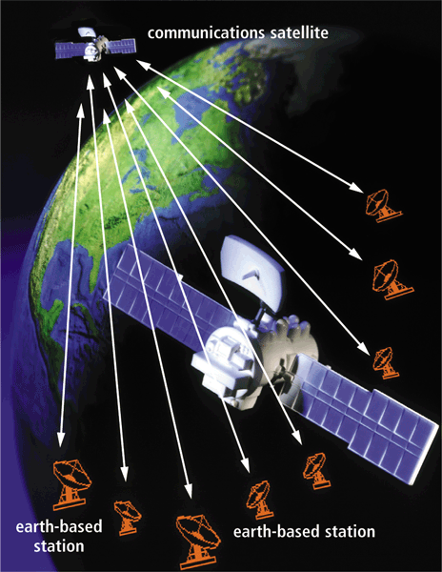
Wireless Transmission Media
A communications satellite is a space station that receives microwave signals from an earth-based station, amplifies it, and broadcasts the signal over a wide area

Slide 14
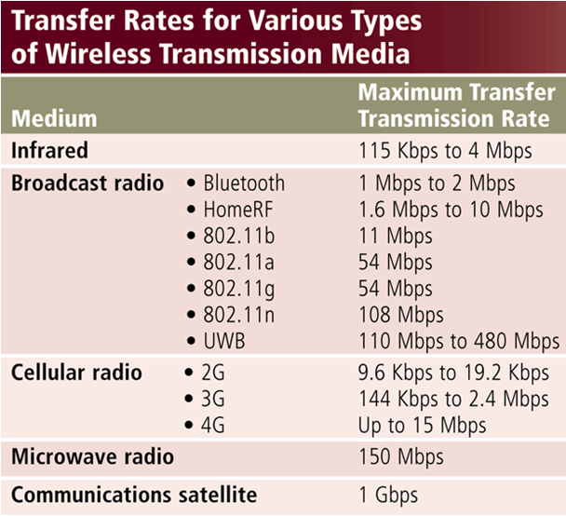
WirelessTransmission Media
Used when inconvenient, impractical, or impossible to install cables
Includes Bluetooth and IrDA

Slide 15
Network Linking Devices
Connect nodes in the network
Cable runs from node to device
Crossover cable connects two computers

Slide 16

Network Interface Cards
Network adapter
Connects node to the media
Unique Machine Access Code (MAC)
Notes:
Insider Information
The Xerox Corporation controls the assignment of Ethernet addresses to NIC manufacturers.

Slide 17
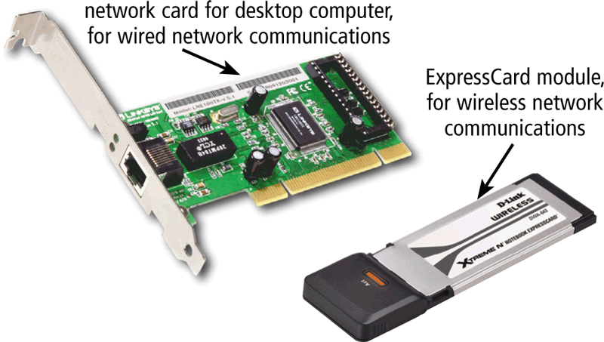
Communication Devices
A network card (NIC) enables a computer or device to access a network
Available in a variety of styles
Wireless network cards often have an antenna

Slide 18
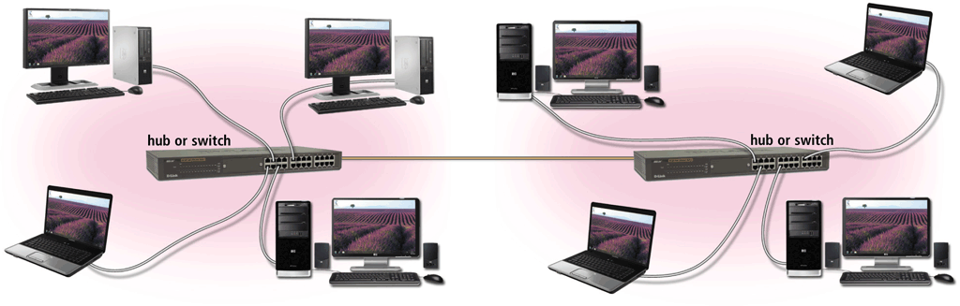
Communication Devices
A hub or switch connects several devices in a network together
Device that provides central point for cables in network

Slide 19
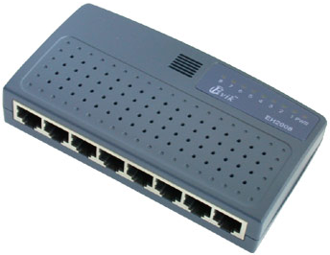
Hubs
Center of a star network
All nodes receive transmitted packets
Slow and insecure

Slide 20
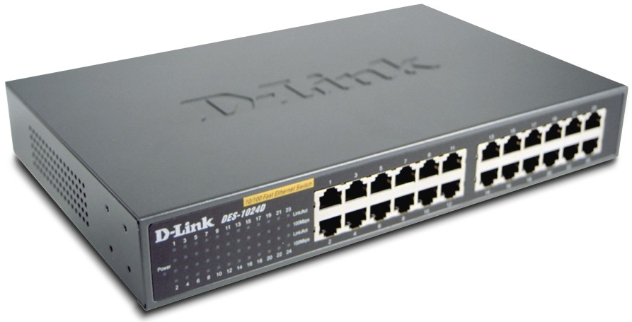
Switches
Replacement for hubs
Only intended node receives transmission
Fast and secure
Notes:
Insider information
Twisted pair networks cannot achieve higher than 10 Mbps using a hub. Switches are necessary to achieve 100 Mbps or higher.

Slide 21
Bridge
Connects two or more LANs together
Packets sent to remote LAN cross
Other packets do not cross
Segments the network on MAC addresses

Slide 22

Router
Connects two or more LANs together
Packets sent to remote LAN cross
Network is segmented by IP address
Connect internal networks to the Internet
Need configured before installation
Notes:
Discussion point
Ask who in the class has high speed Internet. Then determine if anyone is sharing this to the rest of the house or dorm. If they are, see if they can describe the setup. Most likely, the sharing is done with a router.

Slide 23
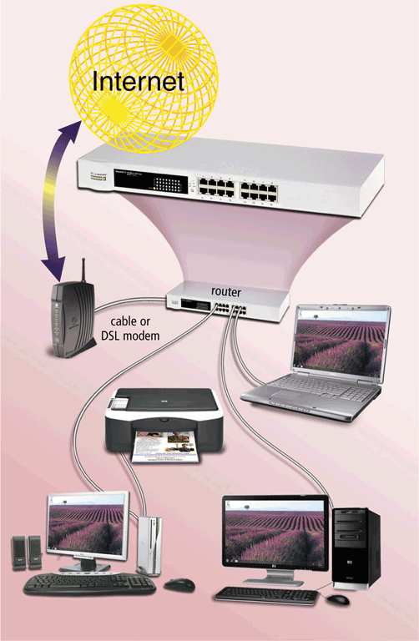
Communication Devices
A router connects multiple computers or other routers together and transmits data to its correct destination on a network
Routers forward data on Internet using fastest available path
Many are protected by a hardware firewall

Slide 24
Gateway
Connects two dissimilar networks
Connects coax to twisted pair
Most gateways contained in other devices

Slide 25
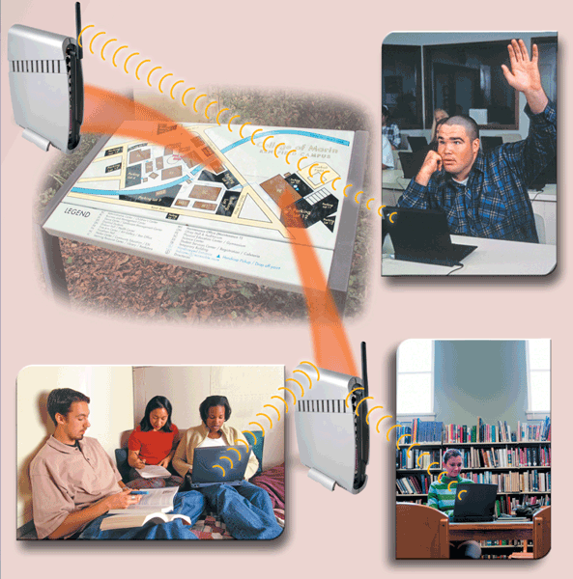
Communication Devices
A wireless access point is a central communications device that allows computers and devices to transfer data wirelessly among themselves or to a wired network

Slide 26
Network Cabling
Cabling specifications
Bandwidth measures cable speed
Typically measured in Mbps
Maximum cable length
Connector describes the type of plug

Slide 27
Network Protocols
Language of the network
Rules of communication
Error resolution
Defines collision and collision recovery
Size of packet
Naming rules for computers
Notes:
Network protocols break larger processes into discrete, narrowly defined functions and tasks across every level of the network. In the standard model, known as the Open Systems Interconnection (OSI) model, one or more network protocols govern activities at each layer in the telecommunication exchange. Lower layers deal with data transport, while the upper layers in the OSI model deal with software and applications.
To understand how network protocols function, it's crucial to understand the workings of the seven layers of the OSI model:
Physical layer. The physical layer is the initial layer that physically connects two interoperable systems. It controls simplex or duplex modem transmissions and transfers data in bits. Additionally, it oversees the hardware that connects the network interface card (NIC) to the network, including the wiring, cable terminators, topography and voltage levels.
Data-link layer. The data-link layer is responsible for the error-free delivery of data from one node to another over the physical layer. It's also the firmware layer of the NIC. It puts datagrams together into frames and gives each frame the start and stop flags. Additionally, it fixes issues brought on by broken, misplaced or duplicate frames.
Network layer. The network layer is concerned with information flow regulation, switching and routing between workstations. Additionally, it divides up datagrams from the transport layer into error-free and smaller datagrams.
Transport layer. The transport layer transfers services from the network layer to the application layer and breaks down data into data frames for error checking at the network segment level. This also ensures that a fast host on a network doesn't overtake a slower one. Essentially, the transport layer ensures that the entire message is delivered from beginning to end. It also confirms a successful data transmission and retransmitting of the data if an error is discovered.
Session layer. The session layer establishes a connection between two workstations that need to communicate. In addition to ensuring security, this layer oversees connection establishment, session maintenance and authentication.
Presentation layer. The presentation layer is also known as the translation layer because it retrieves the data from the application layer and formats it for transmission over the network. It addresses the proper representation of data, including the syntax and semantics of information. The presentation layer is also in charge of managing file-level security and transforming data to network standards.
Application layer. The application layer, which is the top layer of the network, oversees relaying user application requests to lower levels. File transfer, email, remote login, data entry and other common applications take place at this layer.

Slide 28
Network Communication Standards
Ethernet
Token ring
TCP/IP
Wi-Fi
Bluetooth
IrDA

Slide 29
Network Communication Standards
Ethernet is a network standard that specifies no computer controls when data can be transmitted
The token ring standard specifies that computers and devices on the network share or pass a special signal (token)
TCP/IP is a network standard that defines how messages are routed from one end of a network to another

Slide 30

Ethernet
Very popular cabling technology
10 Base T, 10Base2, 10Base5
Maximum bandwidth 10 Mbps
Maximum distances100 to 500 meters

Slide 31
Fast Ethernet
Newer version of Ethernet
Bandwidth is 100 Mbps
Uses Cat5 or greater cable
Sometimes called 100Base T
Requires a switch
Notes:
Teaching tip
Point out that the speed of the cable is the number before the word Base.

Slide 32
Gigabit Ethernet
High bandwidth version of Ethernet
1 to 10 Gbps
Cat 5 or fiber optic cable
Video applications

Slide 33
Token Ring
Uses shielded twisted pair cabling
Bandwidth between 10 and 25 Mbps
Uses a multiple access unit (MAU)
Nodes communicate when they have the token
Popular in manufacturing and finance

Slide 34
TCP/IP
Transmission Control Protocol/Internet Protocol
Most popular protocol
Machines assigned a name of 4 numbers
IP address
209.8.166.179 is the White House’s web site
Dynamic Host Configuration Protocol
Simplifies assignment of IP addresses
Required for Internet access
Notes:
Teaching tip
Have students determine IP addresses for the computer. On 2000/XP enter ipconfig /all. Windows 98 and back enter winipcfg.

Slide 35
Communication Software
Communication software consists of programs that
Help user establish a connection to Internet, other network and another computer
Help users manage the transmission of data, instructions and information
Provide an interface for users to communicate with one another

Slide 36
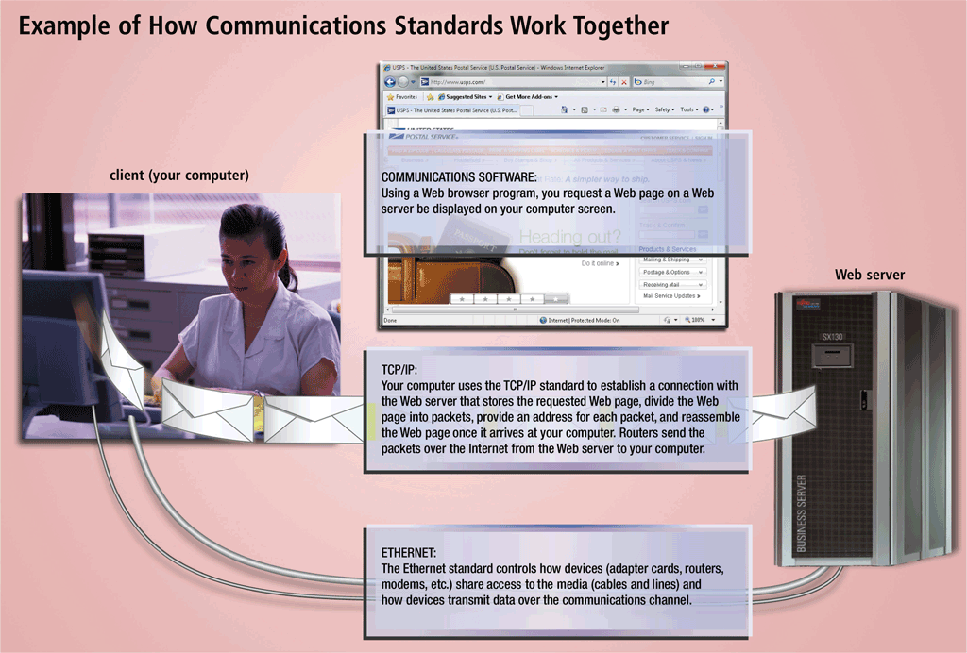
Network Communication Standards

Slide 37
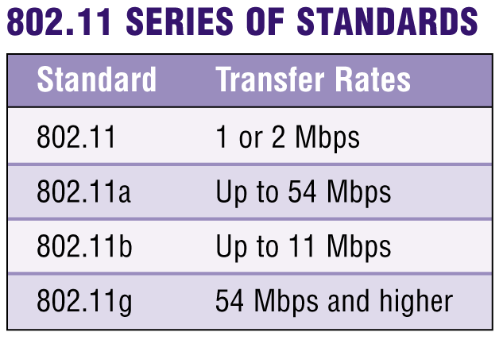
Network Communications Standards
What are TCP/IP and 802.11?
TCP/IP (Transmission Control Protocol/Internet Protocol) technology transmits data by breaking it up into small pieces, or packets
Commonly used for Internet transmissions
802.11 is family of standards for wireless LANs

Slide 38
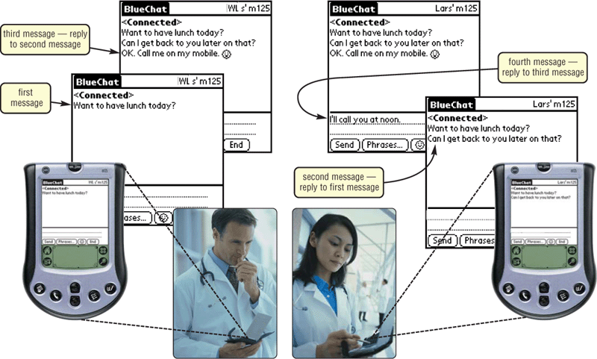
Network Communications Standards
What is Bluetooth?
Short-range radio waves transmit data between Bluetooth devices

Slide 39
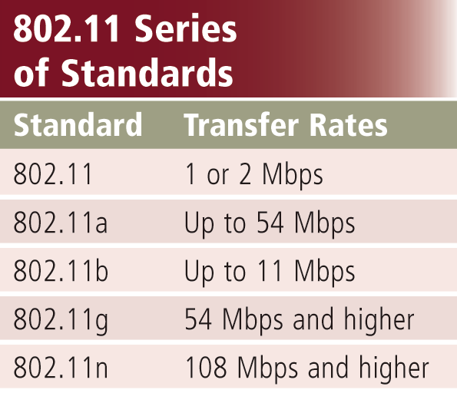
Network Communication Standards
Wi-Fi identifies any network based on the 802.11 standard that facilitates wireless communication
Sometimes referred to as wireless Ethernet

Slide 40
Network Communication Standards
Bluetooth defines how two Bluetooth devices use short-range radio waves to transmit data
UWB (ultra-wideband) specifies how two UWB devices use short-range radio waves to communicate at high speeds
IrDA transmits data wirelessly via infrared (IR) light waves
RFID uses radio signals to communicate with a tag placed in or attached to an object, animal, or person

Slide 41
Modem
Modulator/Demodulator
Modulator converts digital to analog
Speed measured in bits per second (bps)
Current fastest speed is 56 Kbps
Quality of phone lines dictates speed
V.92 is the current modem standard
Several modem types
Internal
External
Voice
Fax
Notes:
Insider information
The Federal Communications Commission (FCC) limits modem speed over an analog line to 53Kbps.
Teaching tip
Determine what your local ISPs support. If your ISPs do not support V.92, suggest to your students to purchase a V.90 modem. They will likely save $10 on the purchase and see no performance difference.

Slide 42

Modem Uses
Connection to the Internet
File transfer
Uploading
Downloading
Notes:
Teaching tip
Draw a diagram showing the Internet ‘above’ the client computer to illustrate where the names come from.

Slide 43
Communication Devices
A digital modem sends and receives data and information to and from a digital line
A DSL Modem is an external device in which one end connects to a telephone line and the other end connects to a port on the system unit
DSL modem
Cable modem

Slide 44
Digital Data Connections
Broadband connection
Any data connection faster than 56 Kbps
Common in business
Becoming popular in home installations

Slide 45
Digital Data Connections
T lines
High-capacity voice/data lines
Used to control phone and data
Several variants
T1 transmits at 1.544 Mbps
T3 transmits at 44.736 Mbps
Notes:
Teaching tip
More information on T lines can be found at ckp.made-it.com/t1234.html.

Slide 46
Digital Data Connections
DSL technologies
Digital Subscriber Line
Popular with home users
Speeds range from 100 Kbps to 30 Mbps
Asymmetrical DSL (ADSL)
Upload speed slower than download speed
Symmetrical DSL (SDSL)
Requires a DSL modem
Notes:
Teaching tip
The website www.dslreports.com provides unbiased information regarding DSL providers.

Slide 47
Wireless Networks
Benefits
No cable to pull
Mobile devices access network resources
Mobility and flexibility for office workers
Notes:
Discussion point
Wireless networks have drawbacks. Direct your students to discover some of these drawbacks including security, speed and complexity.

Slide 48
Wireless Networks
Wireless 802.11
Also called Wi-Fi
IEEE standard
Institute of Electronic and Electrical Engineers
Several versions
802.11b connects up to 11Mbps
802.11g connects up to 56Mbps
Use the same type of devices

Slide 49

Wireless Networks
Wireless Access Point
Center of a wireless network
WAPS combined cover a larger area
Distance to WAP determines bandwidth
Range is 50 to 150 meters
Extension points can extend range

Slide 50
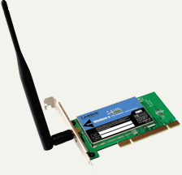
Wireless Networks
Wireless Adapters
Used by devices to connect
Includes signal strength software
Notes:
Teaching tip
Spend a little time here describing a home solution to share a broadband connection using a wireless solution. Describe products, security concerns and WAP placement.

Slide 51
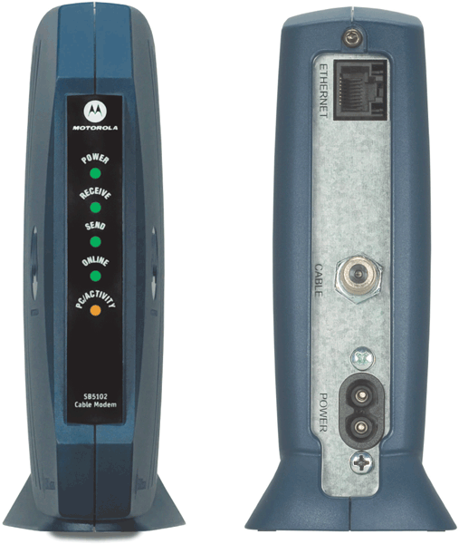
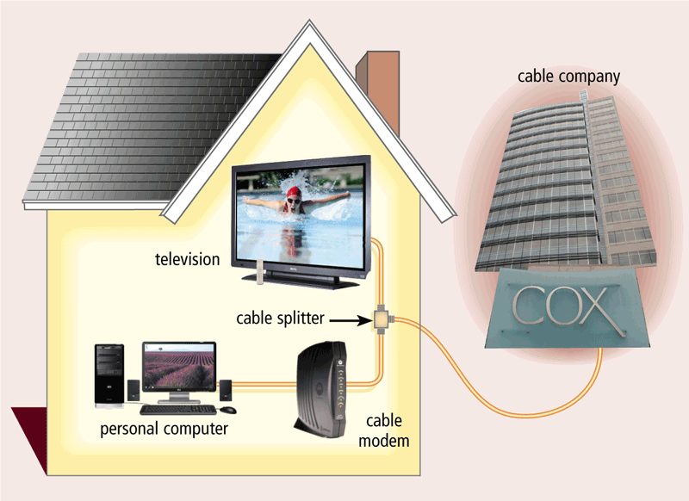
Communication Devices
Cable Modem
Sends and receives data over cable television network
Much faster than dial-up modem or ISDN
Sometimes called a broadband modem

Slide 52
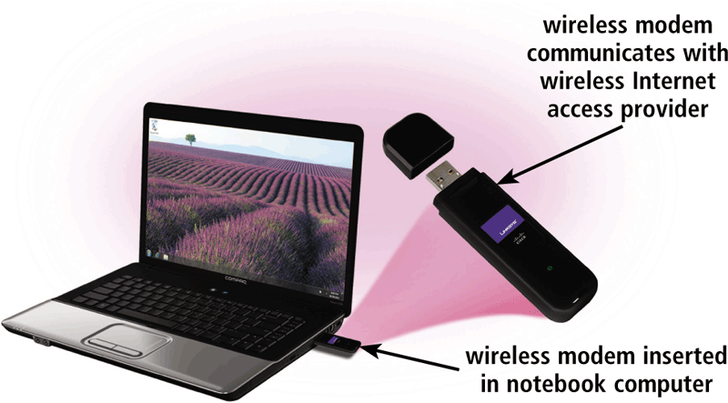
Communication Devices
A wireless modem uses the cell phone network to connect to the Internet wirelessly from a notebook computer, a smart phone, or other mobile device
Typically use the same waves used by cellular telephones

