Slide 1
CSC 101 Introduction to Computing Lecture 20
Mr. Khurram Nissar
khurramnissar@cuisahiwal.edu.pk
1

Slide 2
System Development
System development is a set of activities used to build an information system
A system is a set of components that interact to achieve a common goal. Businesses uses many types of systems
An information system (IS) is a collection of hardware, software, data, people, and procedures that work together to produce quality information
System development activities are grouped into phases, and is called the system development life cycle (SDLC)

Slide 3
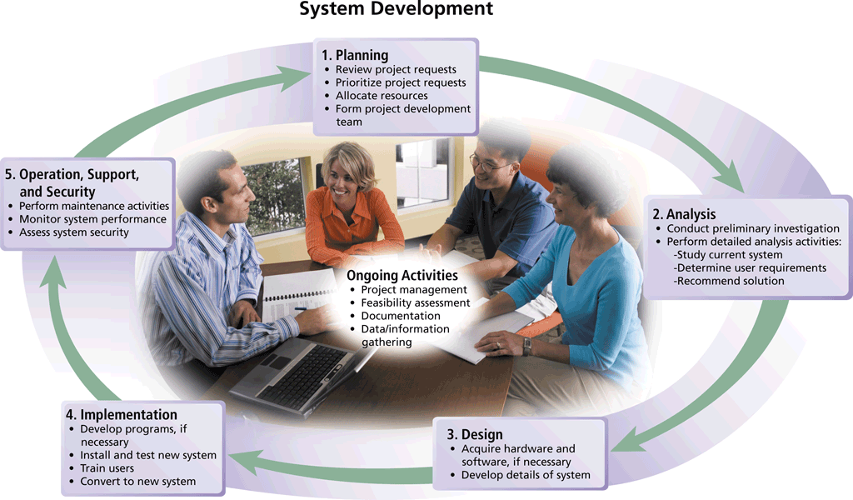
System Development Life Cycle SDLC
Notes:
Figure 12-1

Slide 4
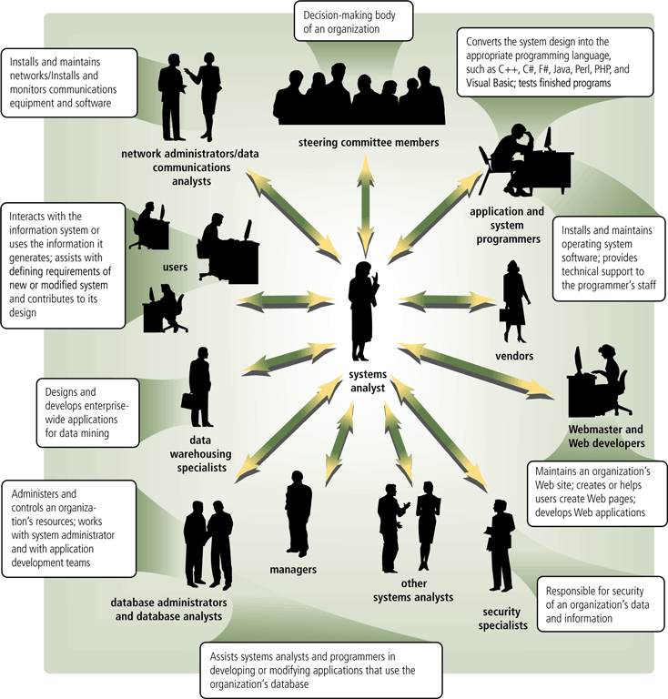
System Development
System development should involve representatives from each department in which the proposed system will be used
System analyst is responsible for designing and developing information system
coordinator between user and IT professionals
Notes:
Figure 12-2

Slide 5
On Going Activities
Project management is the process of planning, scheduling, and then controlling the activities during system development
To plan and schedule a project efficiently, the project leader identifies:
Project scope
Required activities
Time estimates for each activity
Cost estimates for each activity
Order of activities
Activities that can take place at the same time

Slide 6
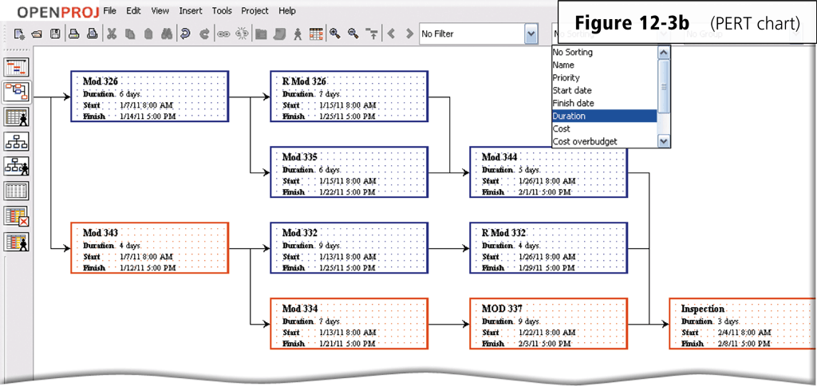
PERT Chart
A Program Evaluation and Review Technique (PERT) chart also can be used for planning and scheduling time
Notes:
Figure 12-3b

Slide 7
On Going Activities
Feasibility is a measure of how suitable the development of a system will be to the organization
A project that is feasible at one point during system development might become infeasible at a later point
Thus, systems analysts frequently reevaluate feasibility during the system development project.
Operational feasibility
Schedule feasibility
Technical feasibility
Economic feasibility

Slide 8
On Going Activities
Documentation is the collection and summarization of data and information
Includes reports, diagrams, programs, and other deliverables
A project notebook contains all documentation for a single project
Users and IT professionals refer to existing documentation when working with and modifying current systems
All documentation be well written, thorough, consistent, and understandable
Maintaining up-to-date documentation should be an ongoing part of system development

Slide 9

On Going Activities
Project team need accurate and timely data and information for many reasons
They must keep a project on schedule, evaluate feasibility, and be sure the system meets requirements
During system development, members of the project team gather data and information using several techniques
Review documentation
Observe
Survey (Questionnaire)
Interview
JAD Sessions (Focus group)
Research
Notes:
Figure 12-4

Slide 10
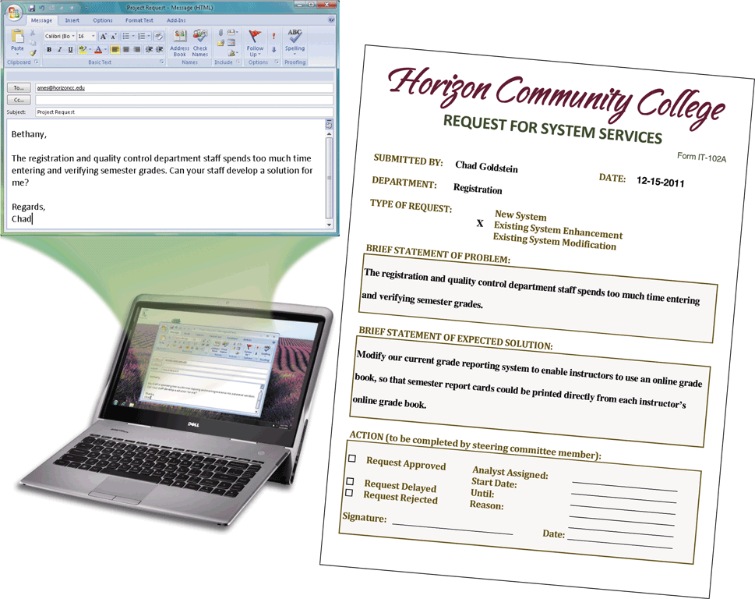
Project Request
Project Request is a formal request for new or modified information system
Notes:
Figure 12-5

Slide 11
1. Planning Phase
The planning phase for a project begins when the steering committee receives a project request
Four major activities are performed:
Review and approve the project requests
Prioritize the project requests
Allocate resources
Form a project development team

Slide 12
2. Analysis Phase
The analysis phase consists of two major activities:
Conduct a preliminary investigation
Perform detailed analysis
Determines and defines the exact nature of the problem or improvement
Interview the user who submitted the request
Study how the current system works
Determine the users’ wants, needs, and requirements
Recommend a solution

Slide 13

2. Analysis Phase
Preliminary Investigation
Determine exact nature of problem or improvement and whether it is worth pursuing
Findings are presented in feasibility report, also known as a feasibility study
Notes:
Figure 12-6

Slide 14
2. Analysis Phase
Detailed Analysis – sometimes called logical design
Study how current system works
Determine user’s wants, needs, and requirements
Recommend solution
Analysts develop the proposed solution without regard to any specific hardware or software
Analysts make no attempt to identify the procedures that should be automated and those that should be manual
analysts use all of the data and information gathering techniques

Slide 15
2. Analysis Phase
Process modeling (structured analysis and design) is an analysis and design technique that describes processes that transform inputs into outputs
Entity-relationship diagrams
Data flow diagrams
Project dictionary

Slide 16
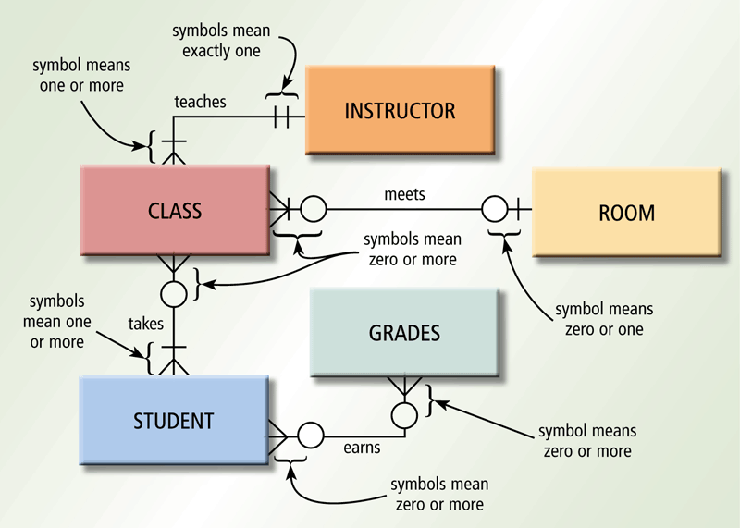
2. Analysis Phase
An entity-relationship diagram (ERD) is a tool that graphically shows the connections among entities in a system
Entities are objects in the system that have data
Entity names usually are nouns written in all capital letters.
Each relationship describes a connection between two entities
Notes:
Figure 12-7

Slide 17
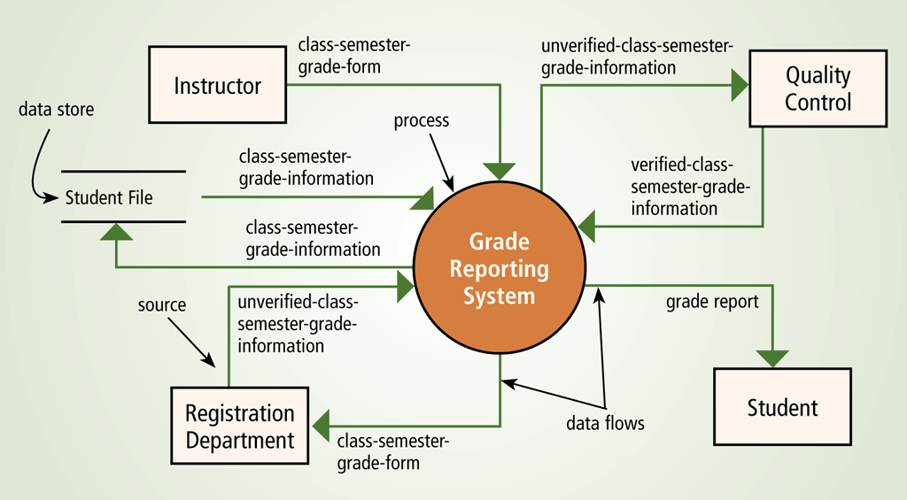
2. Analysis Phase
A data flow diagram (DFD) is a tool that graphically shows the flow of data in a system
Data flows
Processes
Data stores
Sources
Top level context diagram, identifies only the major process
lower-level DFDs contain sub processes
Notes:
Figure 12-8

Slide 18
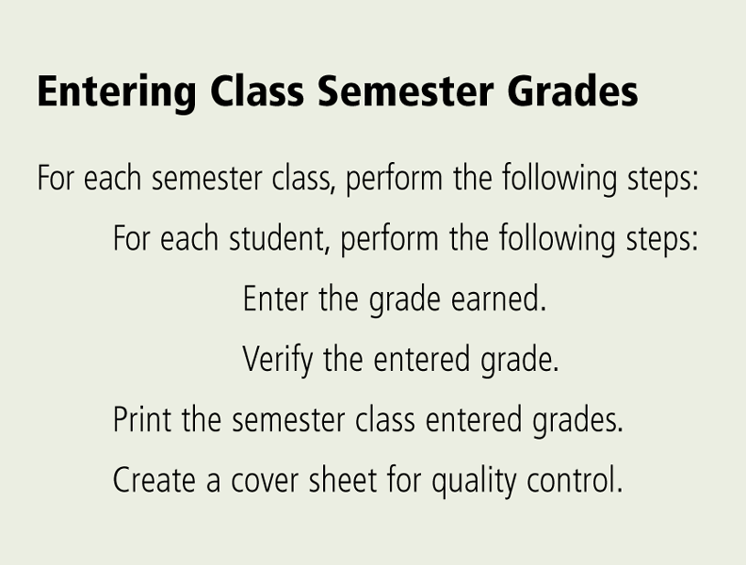
2. Analysis Phase
The project dictionary contains all the documentation and deliverables of a project
Helps keep track of huge amount of details in system. Various techniques to enter items in it.
Explains every item
found on DFDs
and ERDs.
Structured English is a style of writing that describes the steps in a process
Notes:
Figure 12-9

Slide 19
2. Analysis Phase
A decision table is a table that lists a variety of conditions and the actions that correspond to each condition
A decision tree also shows conditions and actions, but it shows them graphically

Slide 20
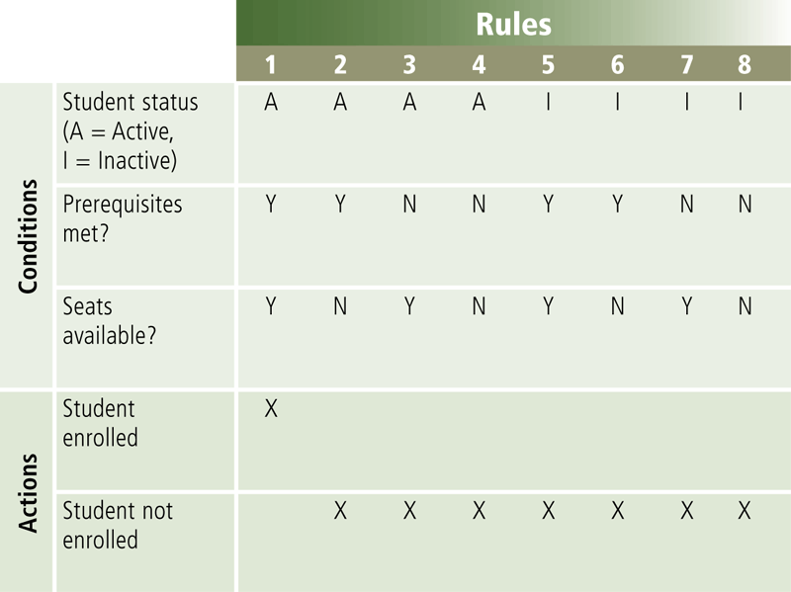
2. Analysis Phase
Decision table
Notes:
Figure 12-10

Slide 21
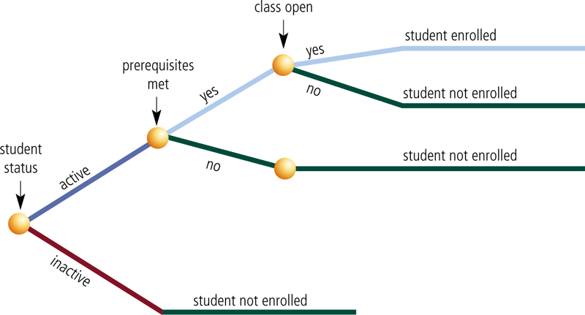
2. Analysis Phase
Decision tree
Notes:
Figure 12-11

Slide 22
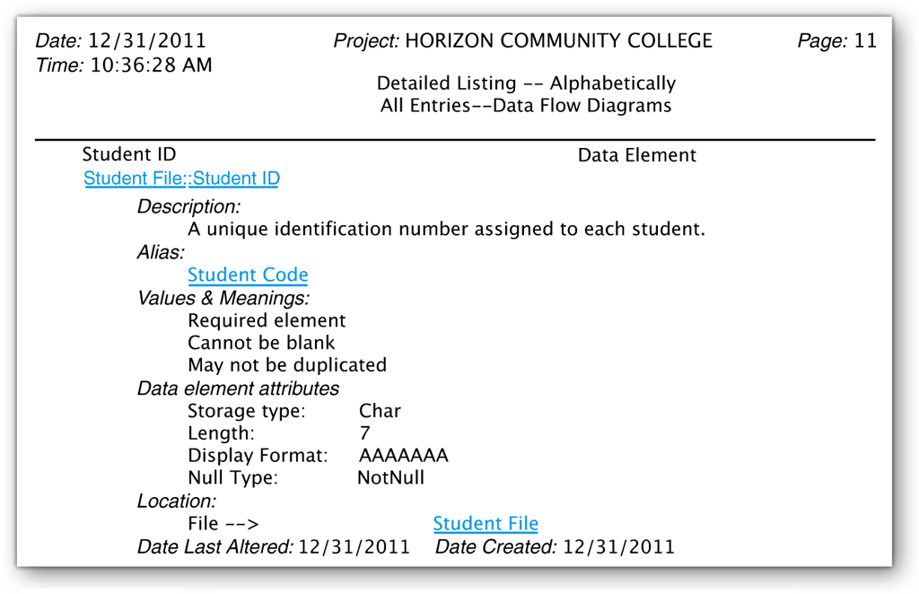
2. Analysis Phase
The data dictionary stores the data item’s name, description, and other details about each data item
Some DBMSs automatically generate the data dictionary. For others, the systems analyst creates the data dictionary
Notes:
Figure 12-12

Slide 23
2. Analysis Phase
Object modeling combines the data with the processes that act on that data into a single unit, called an object
UML (Unified Modeling Language) has been adopted as a standard notation for object modeling and development
UML includes 13 different diagrams
Each diagram conveys a view of the system
Two diagrams include:
Use case diagram
Class diagram

Slide 24
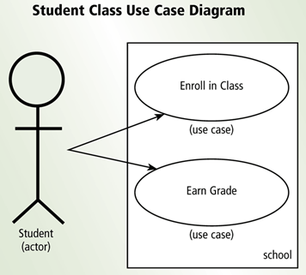
2. Analysis Phase
A use case diagram graphically shows how actors (users) interact with the information system
Diagrams are considered easy to understand
an ideal tool for communicating system requirements with users
An actor is a user or other entity such as a program.
The function that the actor can perform is called the use case
Notes:
Figure 12-13

Slide 25
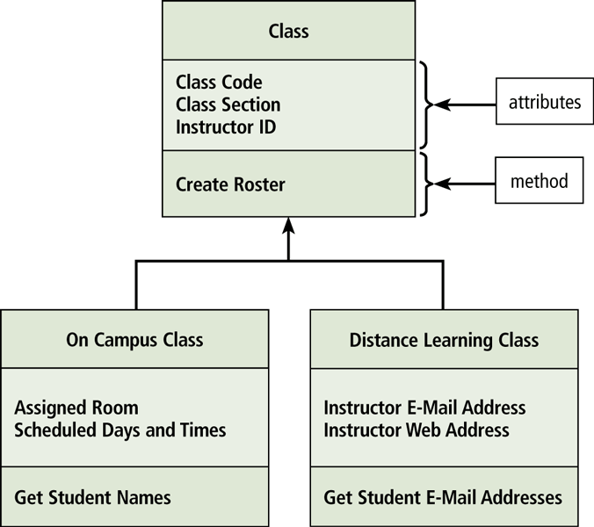
2. Analysis Phase
A class diagram graphically shows classes and subclasses in a system
Each class can have one or more subclasses
Subclasses use inheritance to inherit methods and attributes of higher levels
Notes:
Figure 12-14

Slide 26
2. Analysis Phase
The system proposal assesses the feasibility of each alternative solution
Recommends the most feasible solution for the project, which often involves modifying or building on the current system.
The steering committee discusses the system proposal and decides which alternative to pursue
Packaged software
Custom software
Outsourcing

Slide 27
Possible Solutions
Modify the existing system
Buy Packaged software – prewritten software available for purchase
Horizontal market software – meets needs of many companies
Vertical market software – designed for a particular industry
Develop own custom software – software developed at user’s request
Outsource – have outside source develop software

Slide 28
3. Design Phase
The design phase consists of two major activities
Acquire hardware and software
Develop all of the details of the new or modified information system

Slide 29
3. Design Phase
To acquire the necessary hardware and software:
Identify technical specifications
Solicit vendor proposals
Test and evaluate vendor proposals
Make a decision
Use research techniques such as e-zines
RFQ, RFP, or RFI is sent to potential vendors or VARs
Various techniques are used to determine the best proposal
Systems analyst makes recommendation to steering committee

Slide 30
3. Design Phase
The next step is to develop detailed design specifications
Sometimes called a physical design because it specifies hardware and software components for automated procedures
Database design
Input and output design
Program design
Architectural design

Slide 31
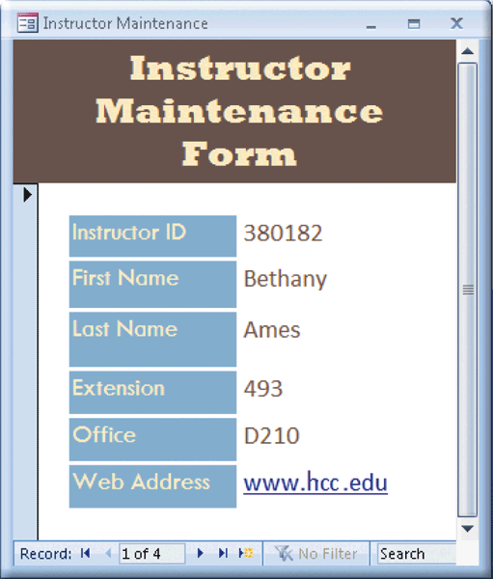
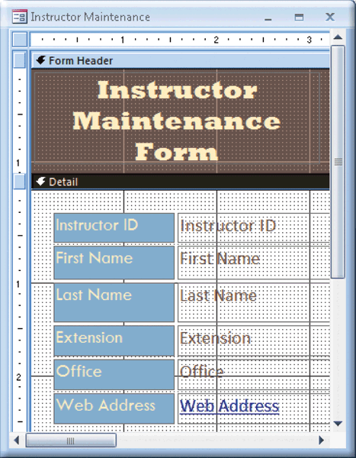
3. Design Phase
Systems analysts typically develop two types of designs for each input and output
Mockup
Layout chart
Notes:
Figure 12-18 Figure 12-19

Slide 32
3. Design Phase
A prototype (proof of concept) is a working model of the proposed system
Prototypes have inadequate or missing documentation
Users tend to embrace the prototype as a final system
can be an effective tool if the development team and the users discipline themselves to follow all system development activities
Should not eliminate or replace activities rather, it should improve the quality of these activities
Beginning a prototype too early may lead to problems

Slide 33
Computer-Aided Software Engineering
CASE tools are designed to support one or more activities of system development
CASE tools sometimes contain the following tools:
Project repository
Graphics
Prototyping
Quality assurance
Code generator
Housekeeping
Notes:
Project repository—Stores diagrams, specifications, descriptions, programs, and other deliverables
Graphics—Enables drawing of diagrams
Prototyping—Creates models of proposed system
Quality assurance—Analyzes deliverables for accuracy
Code generators—Create actual computer programs from design specifications
Housekeeping—Establishes user accounts and provides backup and recovery functions

Slide 34
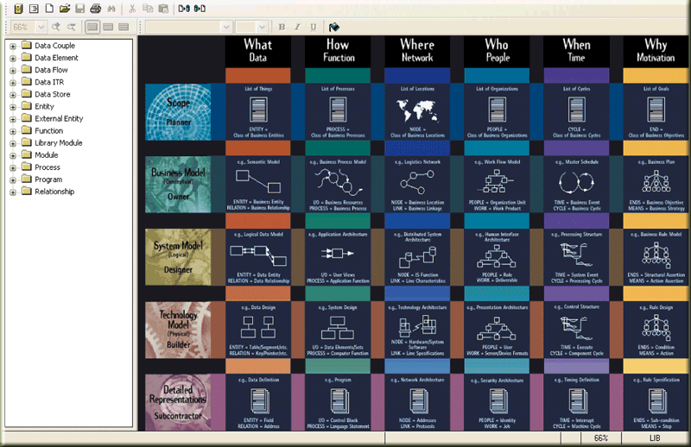
Case Tools
Notes:
Figure 12-20

Slide 35
3. Design Phase
Many people should review the detailed design specifications
An inspection is a formal review of any system development deliverable
A team examines the deliverables to identify errors
Step-by-step review by project team and users of any system development cycle deliverable
Used to review detailed design specifications before they are given to programming team
Identifies any errors and allows IT personnel to correct them
Used throughout entire system development cycle to review a variety of deliverables

Slide 36
4. Implementation Phase
The purpose of the implementation phase is to construct the new or modified system and then deliver it to users
Develop programs
Install and test the new system
Train users
Convert to the new system

Slide 37
4. Implementation Phase
The program development life cycle follows these steps:
Analyze the requirements
Design the solution
Validate the design
Implement the design
Test the solution
Document the solution
1
2
3
4
5
6
Notes:
Programmers write programs from specifications

Slide 38
4. Implementation Phase
Various tests should be performed on the new system
Systems analysts and users develop test data so that they can perform various tests.
The test data should include both valid (correct) and invalid (incorrect) data.
When valid test data is entered, the program should produce the correct results. Invalid test data should generate an error.
Unit test
Verifies that each individual program or object works by itself
Systems test
Verifies that all programs in an application work together properly
Integration test
Verifies that an application works with other applications
Acceptance test
Checks the new system to ensure that it works with actual data

Slide 39


4. Implementation Phase
Training involves showing users exactly how they will use the new hardware and software in the system
One-on-one sessions
Classroom-style lectures
Web-based training
Notes:
Figure 12-21

Slide 40
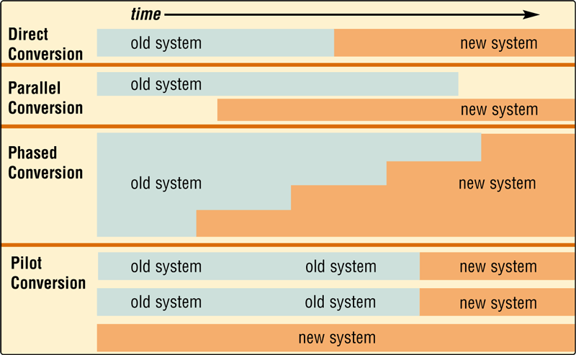
4. Implementation Phase
One or more of four conversion strategies can be used to change from the old system to the new system
Notes:
Figure 12-22

Slide 41
5.Operation, Support, and Security Phase
The purpose of the operation, support, and security phase is to provide ongoing assistance for an information system and its users after the system is implemented
Perform maintenance activities
Monitor system performance
Assess system security

Slide 42
5.Operation, Support, and Security Phase
A computer security plan should do the following:
Summarizes in writing all of the safeguards that are in place to protect a company’s information assets
Identify all information assets of an organization
Identify all security risks that may cause an information asset loss
For each risk, identify the safeguards that exist to detect, prevent, and recover from a loss

