Slide 1
CSC 101 Introduction to Computing Lecture 3
Dr. Iftikhar Azim Niaz
ianiaz@comsats.edu.pk

Slide 2
Last Lecture Summary I
Developments in Microcomputers
From 1984 to 2008
Intel, AMD, Motorola, IBM, Apple, Microsoft
Internet
Computer for Individual Use
Desktop Computers
Workstations
Notebook computers
Tablet computers
Handheld computers
Smart phone

Slide 3
Last Lecture Summary II
Computer for Organizations
Network servers
Mainframes
Minicomputers
Supercomputers
Computers in Society
Home
Education
Small business
Industry
Government
Health Care

Slide 4
Looking Inside Computer System
Most people believe that computers must be extremely complicated devices, because they perform such amazing tasks
Computer is a collection of parts, which are categorized according to the kinds of work they do
Glimpse inside a standard desktop computer
How these components work together and allow you to interact with the system

Slide 5
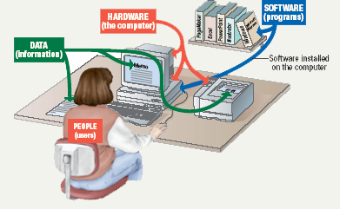
Parts of the Computer System
Computer systems have four parts
Hardware
Software
Data
User

Slide 6
Hardware
Mechanical devices in the computer
Anything that can be touched
e.g. printer, keyboard, PDA etc.
consists of interconnected electronic devices that you can use to control the computer’s operation, input, and output.
generic term device refers to any piece of hardware

Slide 7
Software
Set of instructions that makes the computer perform tasks
Tell the computer what to do
Also called a program
Thousands of programs exist
Some for computer’s own use
Some for the service of the user
Reason majority of the people would want to purchase a computer
E-mail, type letters, play games etc.

Slide 8
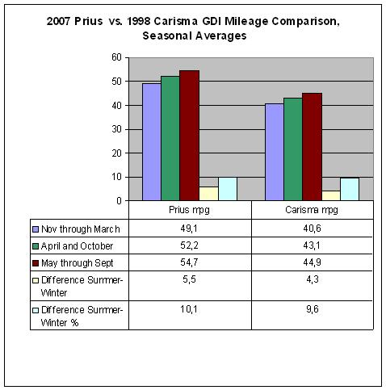
Data
Pieces of information / individual facts
By themselves do not make much sense
Computers organize and present data
Notes:
Teaching tip
A good exercise to relate the importance of making data meaningful is to list some random numbers on the board. Then ask what they mean. Without a title, the numbers have no meaning. Once a title is presented, the numbers make sense.

Slide 9
Users
People operating the computer
Most important part
Tell the computer what to do
User less computers?
people still design, build, program, and repair computer systems.

Slide 10
Information Processing Cycle
Converts data into information
Data
The raw facts and figures that are processed into information
Information
Data that has been summarized or otherwise manipulated for use in decision making
Processing / Computation
Input
Output
Notes:
Data vs Information
Data is a collection of facts, while information puts those facts into context.
While data is raw and unorganized, information is organized.
Data points are individual and sometimes unrelated. Information maps out that data to provide a big-picture view of how it all fits together.
Data, on its own, is meaningless. When it’s analyzed and interpreted, it becomes meaningful information.
Data does not depend on information; however, information depends on data.
Data typically comes in the form of graphs, numbers, figures, or statistics. Information is typically presented through words, language, thoughts, and ideas.
Data isn’t sufficient for decision-making, but you can make decisions based on information.
Example: Example of data is student test score. Example of information is average score of class that is derived from given data.

Slide 11
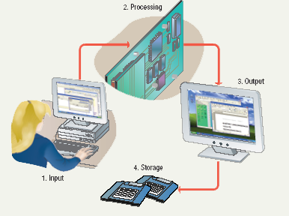
Steps to Process Data
Input
Processing
Output
Storage
Notes:
Teaching tip
It is helpful to walk through a simple program to demonstrate the cycle. I often use a simple arithmetic problem to show this cycle.

Slide 12
Steps to Process Data
Input
Computer accepts data from some source
Processing
Computers processing components perform actions on the data based on instructions from user or program
Output
Computer conveys result to user.
Text, numbers, graphic, image, video, sound
Optional
Storage
Permanently store result on some medium
Optional
Notes:
Input
In this step, the raw data is converted into machine readable form and fed into the processing unit. This can be in the form of data entry through a keyboard, scanner or any other input source.
Data Processing
In this step, the raw data is subjected to various data processing methods using machine learning and artificial intelligence algorithms to generate a desirable output. This step may vary slightly from process to process depending on the source of data being processed (data lakes, online databases, connected devices, etc.) and the intended use of the output.
Output
The data is finally transmitted and displayed to the user in a readable form like graphs, tables, vector files, audio, video, documents, etc. This output can be stored and further processed in the next data processing cycle.
Storage
The last step of the data processing cycle is storage, where data and metadata are stored for further use. This allows for quick access and retrieval of information whenever needed, and also allows it to be used as input in the next data processing cycle directly.

Slide 13
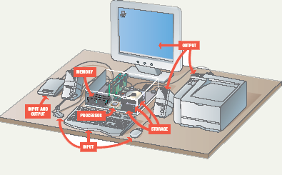
Essential Computer Hardware
Computers use the same basic hardware
Hardware categorized into four types
Processor
Memory
Input and Output
Storage

Slide 14
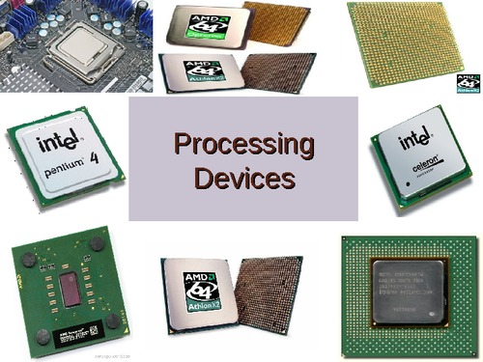
Processing Devices
Processing
The procedure that transforms raw data into useful information
To perform this transformation, the computer uses two components:
The Processor and
Memory

Slide 15
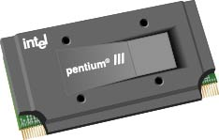
Processor
Brain of the Computer
Processor chip
A tiny piece of silicon that contains millions of miniature electronic circuits.
Processor chip
Notes:
A processor (CPU) is the logic circuitry that responds to and processes the basic instructions that drive a computer. The CPU is seen as the main and most crucial integrated circuitry (IC) chip in a computer, as it is responsible for interpreting most of computers commands. CPUs will perform most basic arithmetic, logic and I/O operations, as well as allocate commands for other chips and components running in a computer.

Slide 16
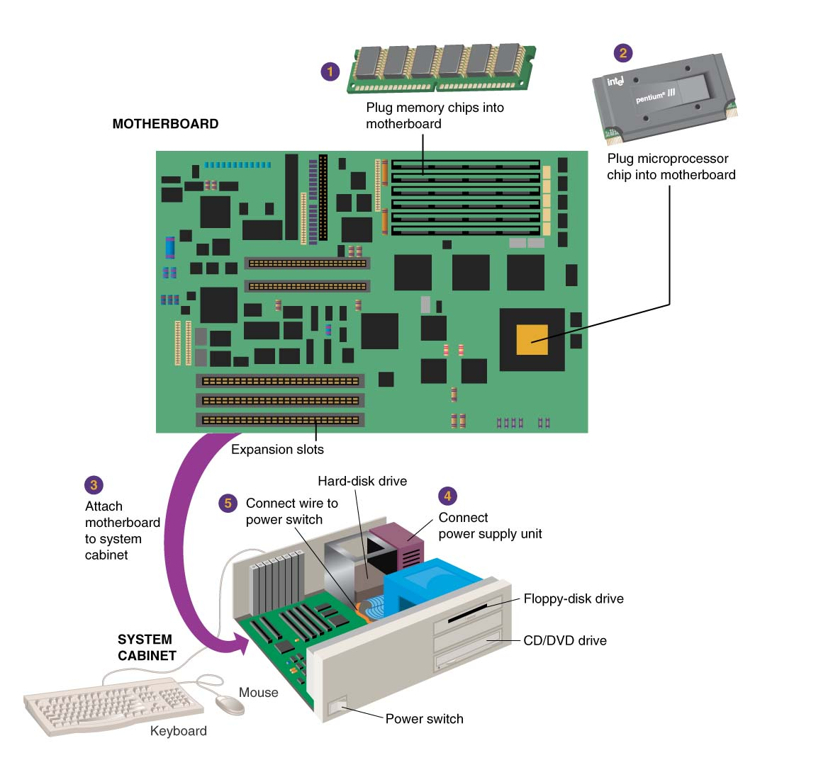
How does everything connect?
Motherboard
Notes:
Motherboard - the main circuit board in the computer.
Everything else attaches to the motherboard through connections called ports.

Slide 17
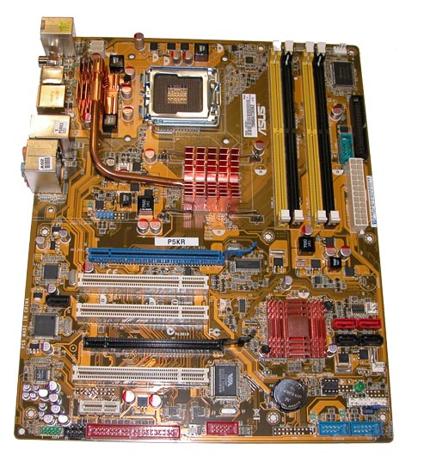
Motherboard
Main printed circuit board in the computer
Everything connects to the motherboard
Expansion slots - “plugs” on the motherboard for expanding the PC’s capabilities via additional circuit boards

Slide 18
Processor
Carries out instructions from the program
Manipulate the data
Most computers have several processors
Central Processing Unit (CPU)
Secondary processors
Processors made of silicon and copper

Slide 19
Memory
memory is one or more sets of chips that store data and/or program instructions, either temporarily or permanently.
Memory is a critical processing component in any computer
Two most important types
Random access memory (RAM) and
Read-Only memory (ROM).
work in very different ways and perform distinct functions
Notes:
In a computer, memory is one or more sets of chips that store data and/or program instructions, either temporarily or permanently. Memory is a critical processing component in any computer Personal computers use several different types of memory, but the two most important are called random access memory (RAM) and read-only memory (ROM). These two types of memory work in very different ways and perform distinct functions.

Slide 20
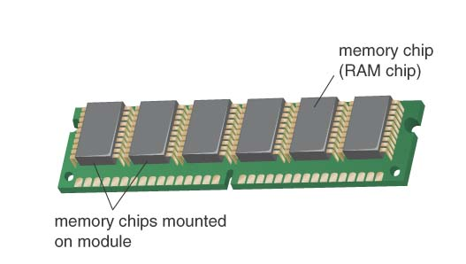
Random Access Memory
Also known as RAM or memory
Represent primary storage or temporary storage.
Hold data before processing and information after processing.
Volatile
More RAM results in a faster system
In MBs or GBs
RAM
Notes:
Memory chips:
Also known as RAM (Random Access Memory).
Represent primary storage or temporary storage.
Hold data before processing and information after processing.
Random Access Memory
The most common type of memory is called random access memory (RAM). As a result, the term memory is typically used to mean RAM. RAM is like an electronic scratch pad inside the computer. RAM holds data and program instructions while the CPU works with them. When a program is launched, it is loaded into and run from memory. As the program needs data, it is loaded into memory for fast access. As new data is entered into the computer, it is also stored in memory—but only temporarily. Data is both written to and read from this memory. (Because of this, RAM is also sometimes called read/write memory.)
Like many computer components, RAM is made up of a set of chips mounted on a small circuit board (see Figure 1B.9).
RAM is volatile, meaning that it loses its contents when the computer is shut off or if there is a power failure. Therefore, RAM needs a constant supply of power to hold its data. For this reason, you should save your data files to a storage device frequently, to avoid losing them in a power failure. (You will learn more about storage later in this chapter.)
RAM has a tremendous impact on the speed and power of a computer. Generally, the more RAM a computer has, the mote it can do and the faster it can perform certain tasks. The most common measurement unit for describing a computers memory is the byte—the amount of memory it takes to store a single character such as a letter of the alphabet or a numeral. When referring to a computer's memory, the numbers are often so large that it is helpful to use terms such as kilobyte (KB), megabyte (MB), gigabyte (GB), and terabyte (TB) to describe the values
(see Table 1B.1).

Slide 21
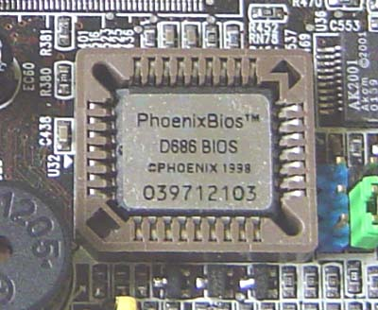
Read Only Memory
Also called ROM
Nonvolatile
Permanent storage of programs
Holds the computer boot directions
Typically in KBs
ROM
Notes:
Memory chips:
Also known as RAM (Random Access Memory).
Represent primary storage or temporary storage.
Hold data before processing and information after processing.
Read-Only Memory
Unlike RAM, read-only memory (ROM) permanently stores its data, even when the computer is shut off. ROM is called nonvolatile memory because it never loses its contents. ROM holds instructions that the computer needs to operate. Whenever the computer's power is turned on, it checks ROM for directions that help it start up, and for information about its hardware devices.

Slide 22
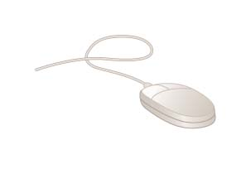
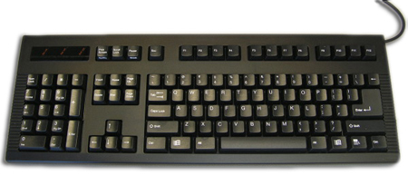
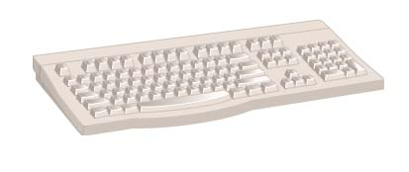
Input
Input hardware - devices that allow people to put data into the computer in a form that the computer can use
Allows the user to interact
Input devices accept data
Keyboard
Mouse
22
Notes:
Input - whatever is put into (“input”) a computer system.
Input hardware - devices that allow people to put data into the computer in a form that the computer can use.
Mouse - an input device that is used to manipulate objects viewed on the computer display screen.
Keyboard - an input device that converts letters, numbers, and other characters into electrical signals readable by the processor.
FACTOID (to accompany hyperlink for Keyboard): Most keyboards were designed with a right-handed computer user in mind. However, approximately 10% of the population is left-handed. Some manufacturers produce keyboards especially for the left-handed computer user. One Web site that offers such keyboards for sale is thelefthand.com. Notice the differences in the left-hand keyboard pictured on their site. The numeric pad has been moved from its normal position on the right-hand side of the keyboard to the left-hand side. Similarly, the arrow keys along with the help, home, page up, page down, etc., keys that are normally adjacent to the numeric pad have been moved to the left-hand side of the keyboard. These two changes would allow a left-handed user to do frequent operations such as numeric data-entry and up/down, left/right movements on the screen with his or her dominant hand—the left one.
FACTOID on mouse: A computer mouse may provide one, two, three or more buttons, depending on which system software it is to be used with. Most use two buttons since that is the minimum number needed for working with the popular Microsoft Windows operating system.

Slide 23
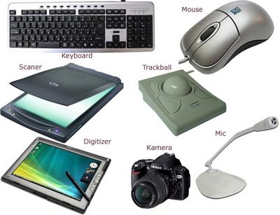
Other Input Devices
Track ball or touch pad
Joystick
Scanners
Digital Camera
Microphone
Webcam
Digitizer
23
Notes:
Input - whatever is put into (“input”) a computer system.
Input hardware - devices that allow people to put data into the computer in a form that the computer can use.
Mouse - an input device that is used to manipulate objects viewed on the computer display screen.
Keyboard - an input device that converts letters, numbers, and other characters into electrical signals readable by the processor.

Slide 24
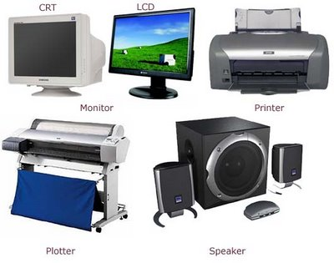
Output
Output devices return processed data to the user or to another computer system.
Most common
Monitor
Printer
Speaker
Some devices are input and output
Touch screens
Notes:
Teaching tip
It is helpful to have examples of input and output devices in class. Stories of obscure input output devices are typically well received by the students.

Slide 25
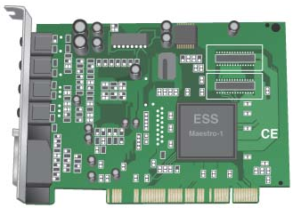
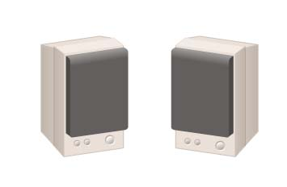
Output
Sound Card
Coverts audio signal from digital to analog and vice versa
Both Input and Output device
Speakers
the devices that play sounds transmitted as electrical signals from the sound card.
Notes:
Output hardware - devices which translate info processed by the computer into a form that humans can understand.
Peripheral device - any component or piece of equipment that expands a computer’s input, storage, and output capabilities.
Sound card - enhances the computer’s sound-generating capabilities by allowing sound to be output through speakers.

Slide 26
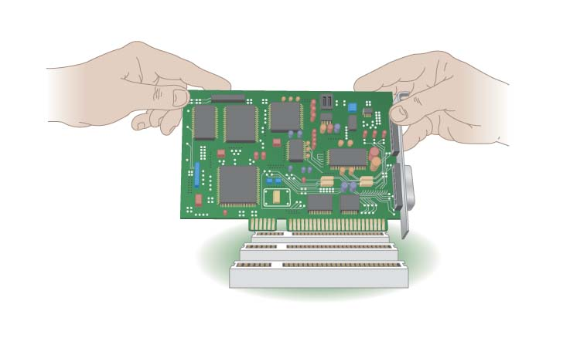
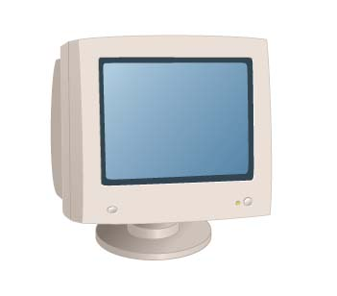
Output
Video card
converts the processor’s output information into a video signal that can be sent through a cable to the monitor
Monitor
the display device that takes the electrical signals from the video card and forms an image using points of colored light on the screen

Slide 27
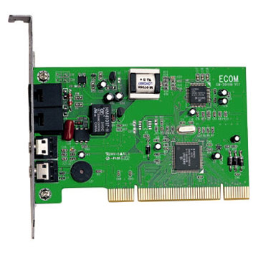
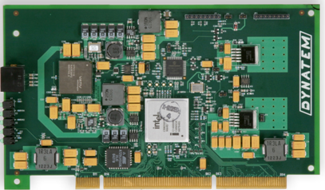
Communication Devices
Modem
a device that sends and receives data over telephone lines to and from computers..
Network Interface Cards (NIC)
Controls the flow of data on a network link

Slide 28
Storage Devices
Hold data and programs permanently
Electronic file cabinet
Difference between storage and memory
More capacity in storage
Contents are retained in storage even the power is off
Storage is much cheaper
Access speed is slow
Notes:
Storage Devices
A computer can function with only processing, memory, input, and output devices. To be really useful, however; a computer also needs a place to keep program files and related data when they are not in use. The purpose of storage is to hold data permanently, even when the computer is turned off.
You may think of storage as an electronic file cabinet and RAM as an electronic worktable. When you need to work with a program or a set of data, the computer locates it in the file cabinet and puts a copy on the table. After you have finished working with the program or data, you put it back into the file cabinet. The changes you make to data while working on it replace the original data in the file cabinet (unless you store it in a different place).
Novice computer users often confuse storage with memory. Although the functions of storage and memory arc similar; they work in different ways. There arc three major distinctions between storage and memory:
» There is more room in storage than in memory, just as there is more room in a file cabinet than there is on a tabletop.
» Contents are retained in storage when the computer is turned off, whereas programs or the data in memory disappear when you shut down the computer.
» Storage devices operate much slower than memory chips, bur storage is much cheaper than memory.
There are two main types of computer storage: magnetic and optical.

Slide 29
Types of Storage Devices
Magnetic storage
Optical storage

Slide 30
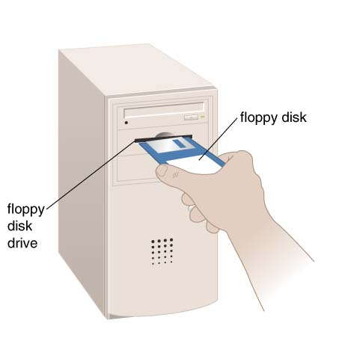


Magnetic Storage
Most common
Floppy disk
stores data on removable 3.5-inch-diameter diskettes.
Typical Capacity 1.4MB
Zip Disk
stores data on floppy-disk cartridges with 70-170 times the capacity of the standard floppy
Floppy disk
Zip disk
Notes:
Magnetic Storage
There are many types of computer storage, but the most common is the magnetic disk. A disk is a round, flat object that spins around its center. (Magnetic disks are almost always housed inside a case of some kind, so you can’t see the disk itself unless you open the case.) Read/write heads, which work in much the same way as the heads of a tape recorder or VCR, are used to read data from the disk or write data onto the disk.
The device that holds a disk is called a disk drive. Some disks are built into die drive and are not meant to be removed; other kinds of drives enable you to remove and replace disks . Most personal computers have at least one nonremovable hard disk (or hard drive). In addition, there is also a diskette drive, which allows you to use removable diskettes (or floppy disks). The hard disk serves as the computer’s primary filing cabinet because it can store far more data than a diskette can contain. Diskettes are used to load data onto the hard disk, to trade data with other users, and to make backup copies of the data on the hard disk.

Slide 31
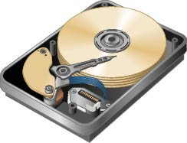
Hard disk drive
Storage device that stores billions of characters of data on a non-removable disk platter.
Capacity 40GB-750GB or even more in TBs

Slide 32
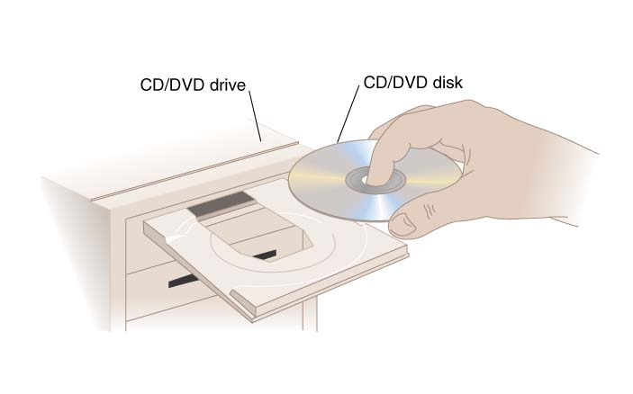
Optical Storage
CD (Compact Disk) drive
a storage device that uses laser technology to read data from optical disks.
700MB for CD
DVD
4.7 to 17 GB
Notes:
FACTOID: Many people who have to travel often for work like to take along their laptop computers so that they can make good use of their time while flying in an airplane, waiting at airports, etc. The advent of DVD players in laptops made this an even more attractive alternative, as travelers could carry along a DVD movie for their own personal entertainment. More and more desktop and tower microcomputers are beginning to feature DVD players as well, which further blurs the distinction between a computer and a television. One company that has taken advantage of this increase in computer-based DVD players (accompanied by a similar increase in home-entertainment DVD players) is netflix.com. This WWW-based business is an online substitute for a video rental store. Netflix members pay a fixed amount per month for as many movie DVDs as they can order, watch, and return (in prepaid mailing envelopes) to the company.

Slide 33
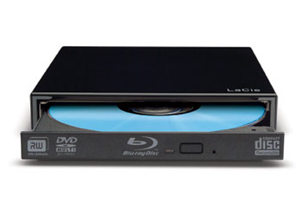
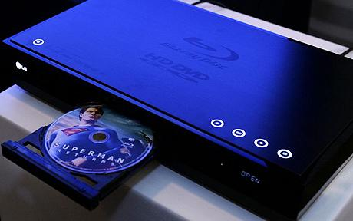
Blu Ray
optical disc storage
high-definition video and data storage.
same physical dimensions as standard DVDs and CDs.
120 mm in diameter and
1.2 mm thick
More storage capacity
25 – 50 GB (single and double layer
100 – 128 GB (triple and quad layer

Slide 34
Storage Capacity
1 byte - 1 character of data.
1 kilobyte – 2¹⁰ bytes/char; 1,024 characters.
1 megabyte - 2²⁰ bytes/char 1,048,576 characters.
1 gigabyte - more than 1 billion characters.
1 terabyte - more than 1 trillion characters.

Slide 35
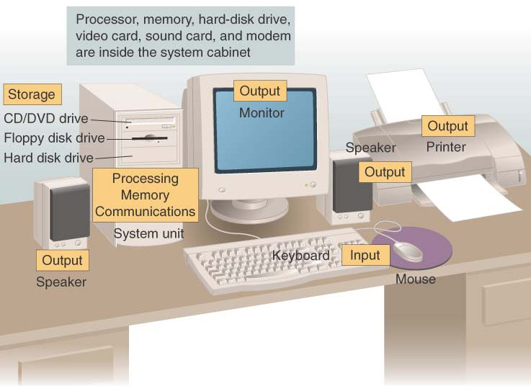
Put all the hardware together and…

Slide 36
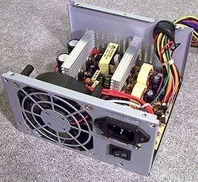
Power
What is Left? Power
Inside system cabinet

Slide 37
Software Runs The Machine
Tells the computer what to do
Reason people purchase computers
Two types
System software
Application software

Slide 38
System Software
Most important software
controls the computer’s hardware
Operating system
tells the computer how to use its own components.
Windows XP
Network operating system (OS)
allows computers to communicate and share data across a network
Windows Server 2003
Utility
makes the computer system easier to use or performs highly specialized functions.
Norton Utilities
Notes:
System Software
System software is any program that controls the computer’s hardware or that can be used to maintain the computer in some way so that it runs more efficiently. There are three basic types of system software:
» An operating system tells the computer how to use its own components. Examples of operating systems include Windows, the Macintosh Operating System, and Linux (see Figure IB . 15). An operating system is essential for any computer; because it acts as an interpreter between the hardware, application programs, and the user When a program wants the hardware to do something, it communicates through the operating system. Similarly, when you want the hardware to do something (such as copying or printing a file), your request is handled by the operating system.
» A network operating system allows computers to communicate and share data across a network while controlling network operations and overseeing the network’s security.
Examples of Network operating system are windows server, unix and linux based NOS
» A utility is a program that makes the computer system easier to use or performs highly specialized functions. Utilities are used to manage disks, troubleshoot hardware problems, and perform other tasks that the operating system itself may not be able to do.
Utilities are programs that help maintain and optimize a computer's performance.
Examples of utility programs include file managers, virus scanners, and disk defragmenters.

Slide 39
Application Software
Accomplishes a specific task
Most common type of software
Word processors
Spreadsheet
Database Management
Presentation
Graphics
Multimedia authoring
Entertainment and Education
Games
Web Design tools and web browsers
Notes:
Application software, often referred to as "apps" or simply "applications," is a category of software designed for specific tasks or functions to help users perform various activities on their computers, smartphones, or other devices. These applications are created to meet user needs and are diverse, ranging from productivity tools to entertainment, and more.

Slide 40
Computer data
Fact with no meaning on its own
Stored using the binary number system
Data can be organized into files
A file is simply a set of data that has been given a name.
A file that the user can open and use is often called a document.
Notes:
Chapter 5 in the text explores data processing in greater detail.
Figure 1B.5 shows data in binary format.

Slide 41
Computer Users
User’s Role depends on ability
Setup the system
Install software
Running the Programs
Manage files
Maintain the system
Notes:
Teaching tip
Most computer problems are caused by user error. Given this fact, it is fun here to teach the student the acronym PEBKAC the Problem Exists Between Keyboard And Chair. A little humor can break up the lecture monotony.

Slide 42
User less Computers
Run with no user input
Automated systems
A car's on board computer
Home appliances
Washers and dryers
Security systems
Navigation systems
Typically controlled by their own operating systems
Notes:
Teaching tip
Most computer problems are caused by user error. Given this fact, it is fun here to teach the student the acronym PEBKAC the Problem Exists Between Keyboard And Chair. A little humor can break up the lecture monotony.
User less computers refer to computer systems that do not have a direct human user interface, and their primary function doesn't involve human interaction. These systems are designed to perform specific tasks or services autonomously without requiring direct human input. They are often used in the background to support various operations, infrastructure, or automation.

Slide 43
Summary
Parts of the Computer System
Hardware, Software, Data, People
Information Processing Cycle
Input, Processing, Output, Storage
Computer Hardware
Processor, Memory, Motherboard
Input Devices Output devices
Storage Devices
Computer Software
Computer Users

