Slide 1
CSC 101 Introduction to Computing Lecture 5
Dr. Iftikhar Azim Niaz
ianiaz@comsats.edu.pk

Slide 2
Last Lecture Summary I
Using Keyboard and Mouse
Keyboard
Keyboard Layout
Five Groups of Keys
Alphanumeric, Numeric Keypad, Function, Modifier, Cursor movement
Special Purpose keys
Internet and multimedia controls
How keyboard works
Dvorak and other non-standard keyboard layouts

Slide 3
Last Lecture Summary II
Mouse
Types of Mouse
Mechanical mouse
Optical Mouse
Interacting with the Mouse
Five techniques
pointing, clicking, double-clicking, dragging, and right-clicking
Track Ball
Track Pad
Track Point

Slide 4
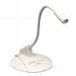
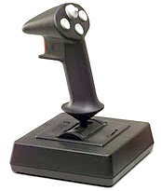

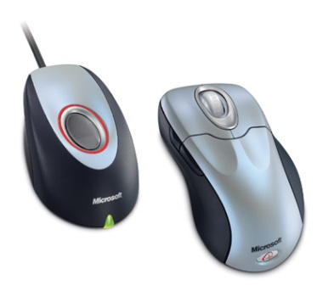
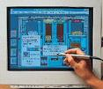

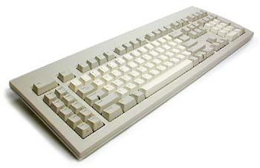

Few Basics: Input Devices
Mouse
Keyboard
Joystick
Light pen
Bar Code Reader
Tablet
Camera
Microphone

Slide 5
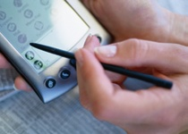
Devices for the Hand - Pen
Tablet PCs, PDA
Pen used to write data
Pen used as a pointer
Handwriting recognition is difficult
On screen keyboard
Not used for inputting large volume of data
Notes:
Teaching tip
Microsoft has a demonstration of the tablet PC pen based input. Point your browser to http://www.microsoft.com/windowsxp/tabletpc/evaluation/tours/default.mspx and follow the tours.

Slide 6
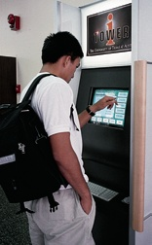
Touch Screens
accept input by allowing the user to place a fingertip directly on the computer screen
Use sensors to detect touch
Well suited for simple applications
ATM
Public information kiosk
Notes:
Discussion point
Discuss the information kiosks at local malls. Many offer limited Internet access. Have students discuss what could happen to the computers if the malls were to provide keyboards to the mall shoppers.

Slide 7
Touch Screens
work well in environments where dirt or weather would render keyboards and pointing devices useless, and
where a simple, intuitive interface is important.
Touch screens have become common in
fast-food restaurants,
department stores,
drugstores, and supermarkets
Notes:
Discussion point
Discuss the information kiosks at local malls. Many offer limited Internet access. Have students discuss what could happen to the computers if the malls were to provide keyboards to the mall shoppers.
Touch screens accept input by allowing the user to place a fingertip directly on the computer screen, usually to make a selection from a menu of choices. Most touchscreen computers use sensors on the screen’s surface to detect the touch of a finger, but other touch screen technologies are in use, as well.
Touch screens work well in environments where dirt or weather would render keyboards and pointing devices useless, and where a simple, intuitive interface is important. They are well-suited for simple applications, such as automated teller machines or public information kiosks (see Figure 2B.4). Touch screens have become common in fast-food restaurants, department stores, drugstores, and supermarkets, where they are used for all kinds of purposes, from creating personalized greeting cards to selling lottery tickets.

Slide 8
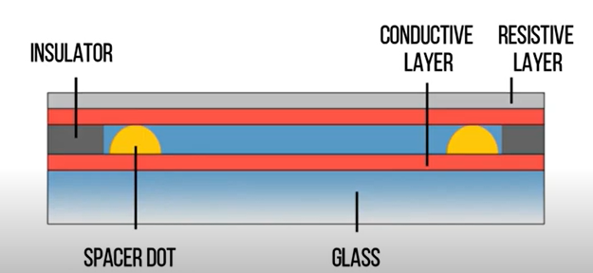
Types of Touch Screens
Resistive
Operates based on the principle of electrical resistance.
Consists of two layers with a gap filled with spacer dots.
Detects touch by measuring changes in resistance when the top layer is pressed, causing it to make contact with the bottom layer
Capacitive
Notes:
Resistive touchscreens consist of two layers of polyethylene terephthalate (PET) with ITO coated on each layer . The two layers of PET are separated by an air gap and spacer dots. The bottom PET layer is placed on top of an insulating substrate usually made of glass. A protective layer of hard coating is placed on top of the other PET layer. When a finger presses onto the touchscreen, the action causes the top and bottom ITO layers to physically come in contact, which signifies a finger touchdown. Resistive touchscreens come in 4-, 5-, 6-, and 8-wire variants, which offer different degrees of durability and noise suppression.

Slide 9
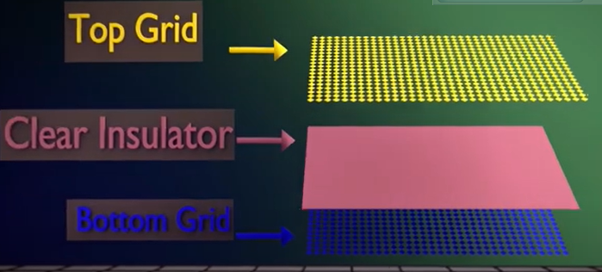
Types of Touch Screens
Capacitive
Operates based on the principle of capacitance.
Has a single layer or multiple layers of conductive material.
Detects touch by measuring changes in the capacitance at the touch point when a conductive object (like a finger) approaches or touches the screen.
Notes:
Operating Principle:
Electrodes are formed in a matrix, and adjacent electrodes are capacitively coupled to each other.When a conductive material such as a finger approaches the electrodes, capacitive coupling is generated between the finger and the electrodes, and the change in the capacitive coupling value between the electrodes is detected as the touch position

Slide 10

Game Controllers
Enhances gaming experience
Provide custom input to the game
Modern controllers offer feedback
Two broad Categories
Joystick
Game pad
Notes:
Teaching tip
Microsoft’s Force Feedback joysticks vibrate. In driving games, when the player hits another car, the joystick will vibrate.

Slide 11
Joystick
Around for long time
Can be used other than games
enable the user to “ fly” or “ drive” through a game, directing a vehicle or character
popular in racing and flying games
One variant is the racing game controller, which includes an actual steering wheel
some racing game controllers even include foot pedals and gearshifts
Notes:
Teaching tip
Microsoft’s Force Feedback joysticks vibrate. In driving games, when the player hits another car, the joystick will vibrate.

Slide 12
Game Pad
is a small, flat device that usually provides two sets of controls— one for each hand.
extremely flexible and are used to control many kinds of games
If you do not have a joystick, you can use a game pad to control most racing and flying games.
Many computer games still provide support for a mouse or keyboard, so a dedicated game controller is not always required
Notes:
Teaching tip
Microsoft’s Force Feedback joysticks vibrate. In driving games, when the player hits another car, the joystick will vibrate.

Slide 13
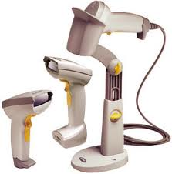
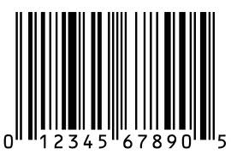
Optical Input Devices
Allows the computer to see input
Bar code readers
Converts bar codes to numbers
UPC Universal Product Code
Computer find number in a database
Works by reflecting light
Amount of reflected light indicates number
Notes:
Insider information
For more information on the UPC code and a searchable database, visit http://www.upcdatabase.com/. A working UPC is 071662000240, which represents a 24 count box of Crayola Crayons.

Slide 14
MICR (Magnetic Ink Character Recognition)
technology used for processing and identifying printed characters, primarily numbers and special symbols, that are printed with magnetic ink.
Magnetic Ink Usage
Character Set
Banking and Finance
Security and Accuracy
Notes:
What is MICR (magnetic ink character recognition)?
MICR (magnetic ink character recognition) is a technology invented in the 1950s that's used to verify the legitimacy or originality of checks and other paper documents. Special ink, which is sensitive to magnetic fields, is used to print certain characters on the original documents.
MICR, which is pronounced as mick-er, is commonly used by banks and other financial institutions to accelerate the processing and clearance of checks. Retailers also often use MICR readers to minimize their exposure to check fraud.

Slide 15
OMR (Optical Mark Recognition)
technology used for scanning and processing documents with multiple-choice questions or checkboxes
Usage in Surveys and Assessments
Specialized Forms
High-Speed Scanning
Efficiency and Accuracy
Notes:
Optical mark recognition (OMR) collects data from people by identifying markings on a paper. OMR enables the hourly processing of hundreds or even thousands of documents. For instance, students may remember completing quizzes or surveys that required them to use a pencil to fill in bubbles on paper (seen to the right). A teacher or teacher's aide would fill out the form, then feed the cards into a system that grades or collects data from them..

Slide 16
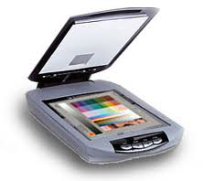
Image Scanners
Converts printed media into electronic
Reflects light on the image
Sensors read the intensity
Filters determine color depths
Notes:
Teaching tip
Spend a few minutes here discussing computer screen colors. A good website to look at colors is http://www.radok.com/web-safe-colors_rgb.html. To demonstrate how computers generate color, use the custom color creator in Paint.

Slide 17
How an Image is Scanned
A light source is moved across a printed page
The light bounces off the page and is passed through a lens
And onto the light sensitive diodes which converts light to electricity. There are usually 300-600 diodes per inch.
A circuit board converts the electricity to numbers and send the information to the computers
Notes:
Teaching tip
Spend a few minutes here discussing computer screen colors. A good website to look at colors is http://www.radok.com/web-safe-colors_rgb.html. To demonstrate how computers generate color, use the custom color creator in Paint.

Slide 18
Color Scanners
use filters to separate the components of color into the primary additive colors (red, green, and blue) at each point
Red, Green, and Blue (RGB) are primary additive colors because they can be combined to create any other color
The image scanner is useful because it translates printed images into an electronic format that can be stored in a computer’s memory
Notes:
Teaching tip
Spend a few minutes here discussing computer screen colors. A good website to look at colors is http://www.radok.com/web-safe-colors_rgb.html. To demonstrate how computers generate color, use the custom color creator in Paint.

Slide 19
Optical Character Recognition (OCR)
Converts scanned image into editable text
Image is stored in the computer’s memory as a bitmap.
The output of OCR is machine-readable text, which can be edited, searched, and analyzed digitally.
OCR is widely used in document digitization, data entry automation, and text extraction for various industries.
Notes:
Teaching tip
Many companies ask for a plaintext resume. This is a resume, typed in Courier or other easy to read font, with no formatting. The intent is to allow the company to scan the resume for future searching. OCR technology makes this possible. For more information, see the website http://www.quintcareers.com/scannable_resumes.html.
Optical character recognition or optical character reader (OCR) is the electronic or mechanical conversion of images of typed, handwritten or printed text into machine-encoded text, whether from a scanned document, a photo of a document, a scene photo (for example the text on signs and billboards in a landscape photo) or from subtitle text superimposed on an image (for example: from a television broadcast).

Slide 20
Optical Character Recognition (OCR)
Each letter is scanned
Letters are compared to known letters
Best match is entered into document
Rarely 100% accurate
Notes:
Teaching tip
Many companies ask for a plaintext resume. This is a resume, typed in Courier or other easy to read font, with no formatting. The intent is to allow the company to scan the resume for future searching. OCR technology makes this possible. For more information, see the website http://www.quintcareers.com/scannable_resumes.html.

Slide 21
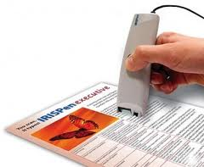
Scanner types
Handheld scanners
more portable but typically require multiple passes to scan a single page
Flatbed scanners
offer higher-quality reproduction than do handheld scanners and
can scan a page in a single pass
Notes:
Teaching tip
Many companies ask for a plaintext resume. This is a resume, typed in Courier or other easy to read font, with no formatting. The intent is to allow the company to scan the resume for future searching. OCR technology makes this possible. For more information, see the website http://www.quintcareers.com/scannable_resumes.html.

Slide 22
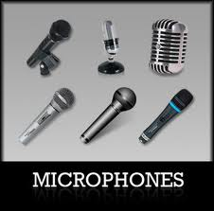
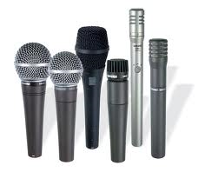
Audiovisual Input Devices
Microphones
Used to record speech
Speech recognition
“Understands” human speech
Allows dictation or control of computer
Matches spoken sound to known phonemes
Enters best match into document
Notes:
Insider information
Two common products are IBM’s Via Voice and Scansoft Dragon NaturallySpeaking. More information for ViaVoice can be found at http://www-306.ibm.com/software/voice/viavoice/. More information regarding Dragon is located at http://www.scansoft.com/naturallyspeaking/.

Slide 23
Speech Recognition
demand for translating spoken words into text
Translating voice to text is a capability known as speech recognition (or voice recognition).
With it, you can dictate to the computer instead of typing, and you can control the computer with simple commands
translates Phonemes into text or commands
Notes:
Insider information
Two common products are IBM’s Via Voice and Scansoft Dragon NaturallySpeaking. More information for ViaVoice can be found at http://www-306.ibm.com/software/voice/viavoice/. More information regarding Dragon is located at http://www.scansoft.com/naturallyspeaking/.

Slide 24
Other type of Audio Input
Computers can accept many kinds of audio input
Sound card with the appropriate plugs
a compact disc
a tape player
a radio or
even a record player
If the audio source outputs sounds in the form of analog, sound card must convert the analog signals into digital code so the computer can store and use it.
Notes:
Insider information
Two common products are IBM’s Via Voice and Scansoft Dragon NaturallySpeaking. More information for ViaVoice can be found at http://www-306.ibm.com/software/voice/viavoice/. More information regarding Dragon is located at http://www.scansoft.com/naturallyspeaking/.

Slide 25
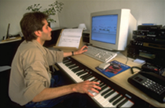
Musical Instrument Digital Interface (MIDI)
Connects musical instruments to computer
Digital recording or playback of music
Musicians can produce professional results

Slide 26
Video Input
With growth of multimedia and the Internet, computer users are adding video input capabilities to their systems in great numbers
Applications such as video conferencing enable people to use full-motion video images
Videos are commonly used in presentations and on Web pages

Slide 27
Video Camera and Webcam
video cameras used with computers digitize images by breaking them into individual pixels
pixel is one or more dots that express a portion of an image
Each pixel’s color and other characteristics are stored as digital code
With Webcam the user can “capture” images of himself or herself while working at the computer

Slide 28
Digital Cameras
portable, handheld devices that capture still images
digitizes the image
compresses it, and
stores it on a special memory card.
user can then copy the information to a PC, where the image can be edited, copied, printed, embedded in a document, or transmitted to another user

Slide 29
Digital Cameras
Digital cameras have become standard equipment for designers of all kinds.
In Web page design,digital cameras enable designers to shoot a subject and quickly load the images onto their computers.
This process saves the step of acquiring existing photographs or developing and printing film-based photos—which must be scanned into the computer.
Designers can update a Web site’s illustrations quickly and regularly using digital cameras.
Graphic designers can edit and enhance digital photographs in innumerable ways, using photo-editing software

Slide 30
Summary
Alternate Input devices
Devices for the hand
Pen, Touch Screens
Game controllers
Joystick Game pad
Optical Input Devices
Audio Input devices
Video input devices

Slide 31
Recommended Websites
https://en.wikipedia.org/wiki/Repetitive_strain_injury
https://en.wikipedia.org/wiki/Carpal_tunnel_syndrome

