Slide 1
CSC 101 Introduction to Computing Lecture 6
Mr. Khurram Nissar
khurramnissar@cuisahiwal.edu.pk

Slide 2
Last Lecture Summary II
Alternate Input devices
Devices for the hand
Pen, Touch Screens
Game controllers
Joystick Game pad
Optical Input Devices
Bar Code Reader, Image Scanners, OCR
Audio Input devices
Microphone, Sound Card, MIDI
Video input devices
Video Camera, Web Cam, Digital Camera

Slide 3
Output Devices
Display screens were uncommon till 1960’s
Now, computers can communicate information to you in several ways
Reading, Seeing, watching and listening
Modern display and sound systems
computers are easier to use
data is easier to manage, and
information is easier to access
Monitors and Sound Systems

Slide 4
Outline
Two most commonly used types of computer monitors.
How a CRT monitor displays images?
Two types of flat-panel monitors and explain their differences.
Various characteristics for comparing monitors.
How data projectors are used?
How a computer outputs sound?

Slide 5
Monitors
Most common output device
Connects to the video card or controller
Two types
Cathode Ray Tube (CRT)
Flat-panel
Categorized by color output
Monochrome
One color with black background
Grayscale
Varying degrees of gray
Color
Display 4 to 16 million colors

Slide 6
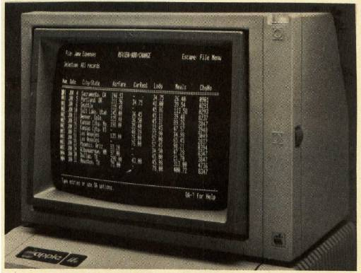
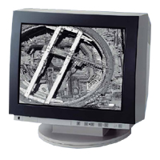
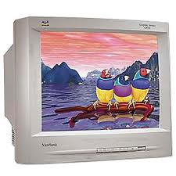
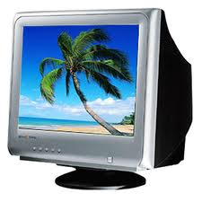
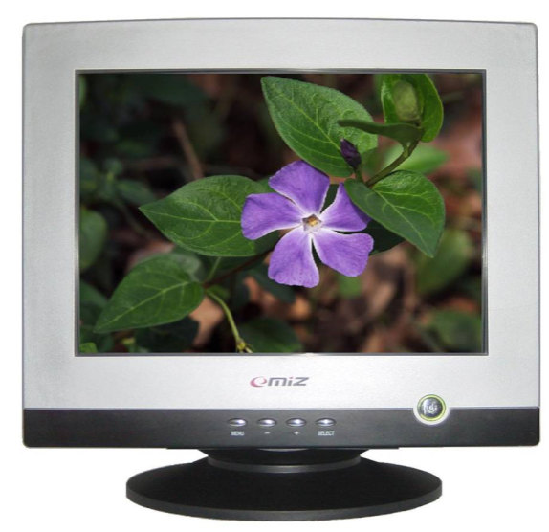
Cathode Ray Tube (CRT)
Most common type of monitor

Slide 7
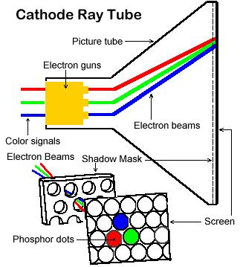
How CRT creates an image
Electron gun shoots streams of electrons towards the screen.
Magnetic yoke guides the streams of electrons across and down the screen.
Phosphors dots on the back of the screen glow when the electron beams hit them.
Notes:
How CRT monitor works?
Near the back of a monitor's housing is an electron gun. The gun shoots a beam of electrons through a magnetic coil (sometimes called a yoke), which aims the beam at the front of the monitor The back of the monitor’s screen is coated with phosphors, chemicals that glow when they are struck by the electron beam. The screen’s phosphor coating is organized into a grid of dots. The smallest number of phosphor dots that the gun can focus on is called a pixel. Each pixel has a unique address, which the computer uses to locate the pixel and control its appearance. Some electron guns can focus on pixels as small as a single phosphor dot.
Actually, the electron gun does not just focus on a spot and shoot electrons at it. It systematically aims at every pixel on the screen, starting at the top left corner and scanning to the right edge. Then it drops down a tiny distance and scans another line, as shown in Figure 3A.6.
Like human eyes reading the letters on a page, the electron beam follows each line of pixels across the screen until it reaches the bottom of the screen. Then it starts over. As the electron gun scans, the circuitry driving the monitor adjusts the intensity of each beam. In a monochrome monitor, the beam's intensity determines whether a pixel is on (white) or off (black). In the case of a grayscale monitor the beam's intensity determines how brightly each pixel glows.

Slide 8
CRT Color
Phosphor dots arranged in triads
Red, green, and blue dots
Three colors blend to make colors
Varying the intensity creates new colors
Notes:
Teaching tip
Unless your students have spend a lot of time with HTML or graphics colors, they will have a hard time grasping how RGB values work. The best methods are to show them various colors and then let them experiment. The website www.lynda.com/hue.html provides decimal-value examples of RGB values. Once the students have seen different colors, open MS Paint and let the students develop their own colors. Challenge them to build pink, orange, brown and any of their favorite colors
In cathode-ray tube (CRT) terms, a triad is a group of 3 phosphor dots coloured red, green, and blue on the inside of the CRT display of a computer monitor or television set

Slide 9
CRT Disadvantages
Very large
Very heavy
Use a lot of electricity
Notes:
Advantages of CRT :
Less expensive than other display technology
Fast response time
It can operate at any resolution, geometry and also for aspect ratio without the need for rescaling the image
Highest pixel resolutions generally available
They produce more colours
CRT also suitable for use even in dim or dark light
Produce a very dark black and grayscale and are the reference standard for all professional calibrations
Easily increases the monitor's brightness by reflecting the light
Fast response times and no motion artifacts
Disadvantages of CRT :
Big back and take up space on a desk
Not suitable for very bright environments because less bright than LCD
They are large, heavy and bulky
Consume a lot of electricity and also produce a lot of heat
Geometrical error at edges
Flickering at 50-80 Hz
Harmful DC and AC electric and magnetic fields

Slide 10
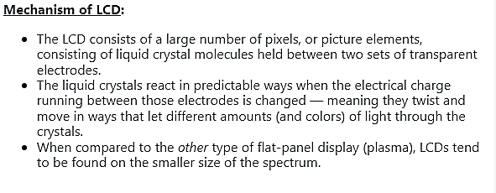
Liquid Crystal Display (LCD)
Commonly found on laptops
LCDs use a substance called liquid crystals, which are special molecules that can change their orientation when subjected to an electric current. These liquid crystals are sandwiched between two layers of glass or plastic.

Slide 11
Drawbacks of LCD
Image can be difficult to see in bright light
Smaller viewing angle
Must sit directly in front of screen
More expensive than CRT
Notes:
Insider information
The limited viewing angle can be an advantage. For high security systems, low viewing angles stop casual glances at the screen.

Slide 12
Plasma Display Panel (PDP)
Utilizes small cells containing electrically charged ionized gases called fluorescent lamps
Advantages
Better picture quality
Wider viewing angles
Less visible motion blur
Disadvantages
Screen burn-in
Uses more electricity than LCDs
Notes:
Plasma displays are created by sandwiching a special gas (such as neon or xenon) between two sheets of glass. When the gas is electrified via a grid of small electrodes, it glows. By controlling the amount of voltage applied at various points on the grid, each point acts as a pixel to display an image

Slide 13
Comparing Monitors
Monitors impacts user effectiveness
Monitors should have
Crisp text
Clear graphics
Adjustable controls
Clear edges
Comparison specifications
Size
Resolution
Refresh rate
Dot Pitch

Slide 14
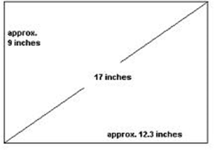
Size of Monitor
Measured in inches
Measured diagonally
Actual size
Distance from corner to corner
Viewable size
Useable portion of the screen
As a rule of thumb, buy the largest monitor you can afford.
17 Inch Monitor
Notes:
Teaching tip
It is helpful to draw the relationship between viewable and actual size.

Slide 15
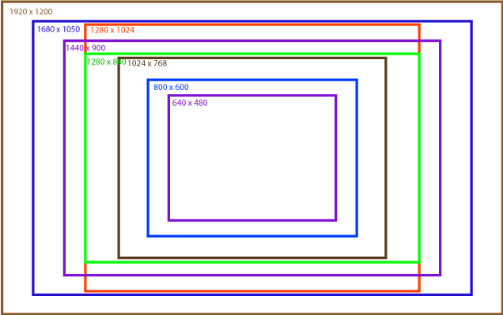
Resolution
Refers to sharpness of image
Number of pixels on the screen
Higher number creates sharper images
Lower number creates smaller images
Notes:
What is resolution? Resolution refers to the number of pixels a screen can show. The higher the number of pixels a screen can show, the sharper the image quality is.
Insider information
Many CRT’s are capable of supporting several resolutions. LCD monitors in contrast often can only support one or two resolutions. The reason are the transistors on the LCD cannot move, while the electron gun on the CRT can simply aim for a smaller pixel.
If you are in a computer class, stop and have students adjust their resolution on the screen. The simplest method is to right click the desktop and select properties. Click the settings tab, and adjust the slider. As the students are experimenting, have a student answer why larger resolution numbers make smaller images. The answer is higher resolutions draw with smaller pixels.

Slide 16
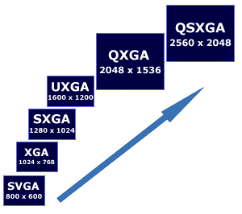
Various Screen Resolution
Color Graphics Adapter (CGA)
300 X 200
Enhanced Graphic Adapter (EGA)
640 X 350
Video Graphic Array (VGA)
640 x 480

Slide 17
Refresh Rate
Number of time the screen is redrawn
Measured in Hertz (Hz)
Modern equipment sets this automatically
This is the monitor refreshing the pixels.
The camera films faster than the eye can see, which is why the refresh is noticeable.
Notes:
Refresh rate is the number of times per second that a raster-based display device displays a new image. A higher number of hertz or a higher refresh rate means you get more pictures per second adequately which makes an increasingly smoother picture display on the screen. More refresh rate essentially causes you to get a smoother gameplay or video quality, which matters incredibly when gaming.
Insider information
Whenever a TV camera films a computer monitor, the monitor seems to have a line moving up the screen. This is the monitor refreshing the pixels. The camera films faster than the eye can see, which is why the refresh is noticeable.

Slide 18
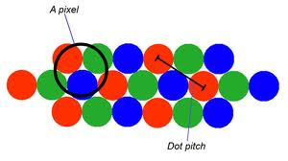

Dot Pitch
Distance between the same color dots
Ranges between .15 mm (fine) and .40 mm
Smaller creates a finer picture
Should be less than .22
Notes:
Smaller the dot pitch, crisper the image is.

Slide 19
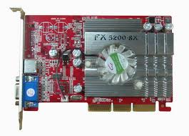
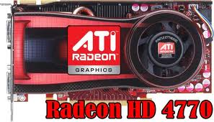
Video Cards
Device between the CPU and monitor
Better cards result in better output
Removes burden of drawing from CPU
Have their own processor and RAM
Modern cards have up to 8GB VRAM
Capable of rendering 3D images
ATI’s Radeon and NVIDIA’s GeForce
Notes:
Insider information
The two leading video card families are ATI’s Radeon and NVIDIA’s GeForce line. Both offer exceptional graphics cards ranging from $50 to $600.

Slide 20
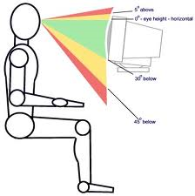
Ergonomics and Monitors
Eyestrain
Fatigue of the eyes
Steps to avoid
Choose a good monitor
Place the monitor 2 – 3 feet away
Center of screen below eye level
Avoid reflected light
Notes:
Eyestrain is a common condition that occurs when your eyes get tired from intense use, such as while driving long distances or staring at computer screens and other digital devices. Eyestrain can be annoying.

Slide 21
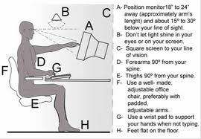
Ergonomics and Monitors
1

Slide 22
Electronic Magnetic field (EMF)
Generated by all electronic devices
EMF may be detrimental to health
Steps to avoid
Keep the computer at arms length
Take frequent breaks
Use an LCD monitor
Notes:
The main effect of radiofrequency electromagnetic fields is heating of body tissues. There is no doubt that short-term exposure to very high levels of electromagnetic fields can be harmful to health.
Teaching tip
Point out to the students that no conclusive study exists that directly list EMF as a cause of cancer, reduced muscle tone or reduced brain function. For more information see http://www.hhs.gov/ and search for EMF.

Slide 23
Data Projectors
Replaced overhead and slide projectors
Project image onto wall or screen
LCD projectors
Most common type of projector
Small LCD screen
Very bright light
Require a darkened room

Slide 24
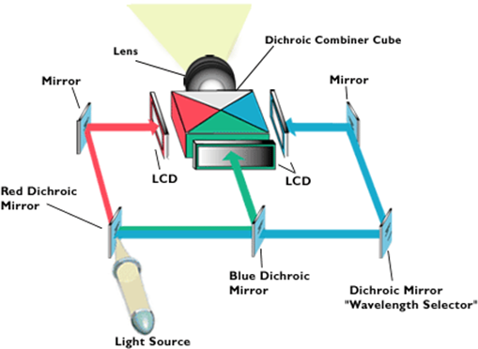
LCD Projectors
A series of mirrors control the display
May be used in a lighted room

Slide 25
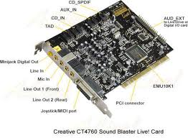
Sound Systems
Integral part of the computer experience
Capable of recording and playback

Slide 26
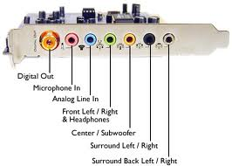
Sound Cards
Device between the CPU and speakers
Converts digital sounds to analog
Can be connected to several devices
Modern cards support Dolby Surround Sound
Notes:
Insider Information
Sound Blaster is the primary manufacturer of sound cards. Exceptional models start at around $30.00.

Slide 27

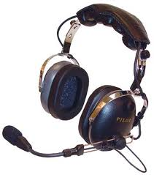
Headphones and Headsets
Replacement for speakers and microphones
Offer privacy
Does not annoy other people
Outside noise is not a factor
Headsets have speakers and a microphone
Notes:
Insider information
The PS2 game SOCOM II Navy Seals includes a USB headset to allow verbal communication with other team members.

Slide 28
Summary
Output Devices
Monitors
CRT, LCD, PDP
Comparing Monitors
Size
Resolution
Refresh rate
Dot pitch

Slide 29
Summary
Video Cards
Ergonomics and Monitors
Electronic Magnetic Field (EMF)
Data Projectors
LCD Projector
Speakers and Sound Systems
Sound Cards
Headphone and Headsets

Slide 30
Recommended Websites
http://www.lynda.com/resources/hexpalette/hue.html
https://en.wikipedia.org/wiki/Plasma_display
https://en.wikipedia.org/wiki/LED_display
https://en.wikipedia.org/wiki/Video_card
http://www.tech-faq.com/how-lcd-projectors-work.html

