Slide 1
CSC 101 Introduction to Computing Lecture 7
Mr. Khurram Nissar
khurramnissar@cuisahiwal.edu.pk

Slide 2
Last Lecture Summary I
Output Devices
Monitors
CRT, LCD, PDP
Comparing Monitors
Size
Resolution
Refresh rate
Dot pitch

Slide 3
Last Lecture Summary II
Video Cards
Ergonomics and Monitors
Electronic Magnetic Field (EMF)
Data Projectors
LCD Projector
Speakers and Sound Systems
Sound Cards
Headphone and Headsets

Slide 4
Putting Digital Content in Hands
Most computer users can’t imagine working without a printer
Printers give you something you can
touch, carry, and share with others.
Printed documents are essential in most workplaces, where people must share
reports, budgets,books, and other types of information.
Three types of printers are popular
dot matrix, ink jet, and laser

Slide 5
Outline
Three most commonly used types of printers.
Four criteria to be considered when evaluating printers.
How an image is created by
Dot matrix printer
Ink Jet
Laser
Four types of high-quality printing devices commonly used in business.

Slide 6
Commonly Used Printers
Impact printers
Generate output by striking the paper
Uses an inked ribbon
Most common
Dot Matrix
Line Printer and Band Printers
Non-impact printers
Use methods other than force
Tend to be quiet and fast
Most Common
Ink jet and Laser
Notes:
Impact printers create pictures and figures by hitting a device such as a wheel or a print hammer against an inked ribbon.
Impact printers are slower than non impact printers
Non-impact printers create figures and pictures without any connection between the printing device and the paper.
Non impact printers are faster than impact printers

Slide 7
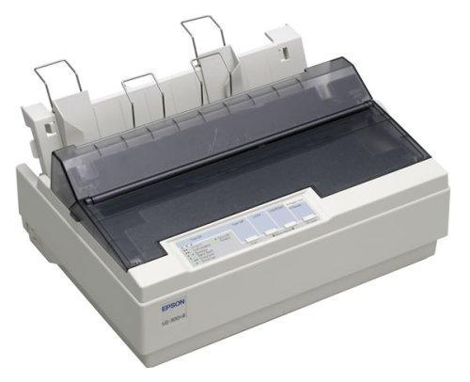
Character Printers
Dot matrix printer
Daisy wheal printer
Notes:
Teaching Tip
Figure 4B.5 on page 163 provides an excellent rendering of how the print head works. Be sure to refer to the image as you teach.

Slide 8
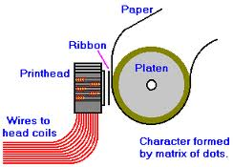
Dot Matrix Printer
Can produce sheets of plain text very quickly
Used to print to multi-sheet pages
Printing on wide-sheet paper
Print head strikes inked ribbon
Speed measured in characters per second (CPS)
Notes:
Teaching Tip
Figure 4B.5 on page 163 provides an excellent rendering of how the print head works. Be sure to refer to the image as you teach.

Slide 9
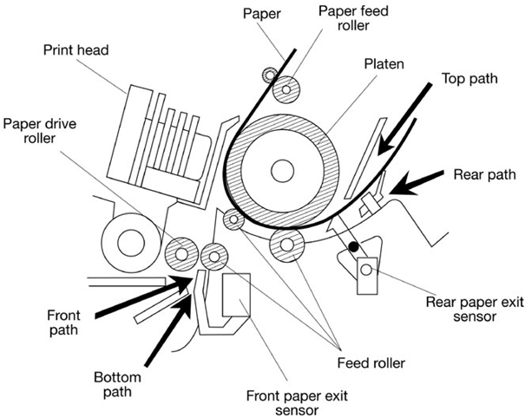
Dot Matrix Printer Parts

Slide 10
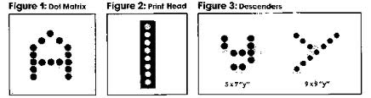
Dot Matrix Printhead Mechanism
Print head Mechanism
which contains a cluster (or matrix) of short pins arranged in one or more columns.
Printer can push any of the pins out in any combination.
By pushing out pins in various combinations, the print head can create alphanumeric characters
Forms a character by creating a series of dots.
Notes:
Teaching Tip
Figure 4B.5 on page 163 provides an excellent rendering of how the print head works. Be sure to refer to the image as you teach.

Slide 11
How Image is created?
When pushed out from the duster, the protruding pins’ ends strike a ribbon
which is held in place between the print head and the paper.
When the pins strike the ribbon, they press ink from the ribbon onto the paper.
More pins that a print head contains, the higher the printer’s resolution
Slowest dot matrix printers create 50 to 70 cps
Fastest more than 500 cps

Slide 12
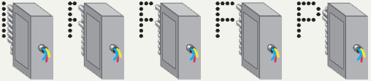
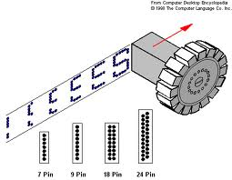
How Image is created?

Slide 13
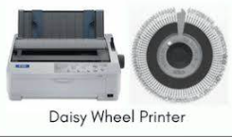
Daisy Wheel Printers
"daisy wheel" as its printing mechanism. This wheel has spokes radiating from its center, with each spoke containing a raised character or symbol.
When a character needs to be printed, the wheel rotates to position the correct character, and then the printer strikes it against an inked ribbon and paper, leaving an impression.

Slide 14
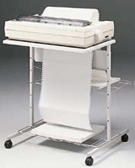
Line Printers
Special type of impact printer.
Uses a special wide print head that can print an entire line of text at one time
Do not offer high resolution but are incredibly fast;
Fastest can print 3,000 lines of text per minute.
Notes:
A line printer prints one entire line of text before advancing to another line. Most early line printers were impact printers
Line printers are mostly associated with unit record equipment and the early days of digital computing, but the technology is still in use. Print speeds of 600 lines per minute^{[3]} (approximately 10 pages per minute) were achieved in the 1950s, later increasing to as much as 1200 lpm. Line printers print a complete line at a time and have speeds in the range of 150 to 2500 lines per minute.

Slide 15
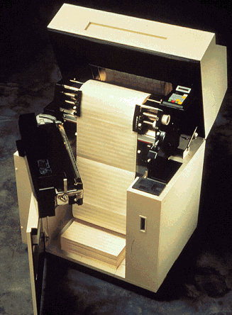
Band Printers
a rotating band embossed with alphanumeric characters.
machine rotates the band to the desired character then a small hammer taps the band, pressing the character against a ribbon.
Very fast and very robust.
Can generate 2,000 lines of text per minute
Notes:
band printer (belt printer) A type of impact line printer in which the font – characters and timing marks – is etched on a steel band. The operating principle, involving horizontal movement of the font, is similar to that of the earlier chain printer and train printer. Although demonstrated in the mid-1960s it was 1972 before machines with satisfactory print quality and band life were available. Band printers have price/performance advantage over drum (or barrel) printers; any mistiming of the impact on a horizontal-font machine results in a change in the space between characters, which is less noticeable than the vertical displacement that occurs with mistiming in a drum printer.

Slide 16
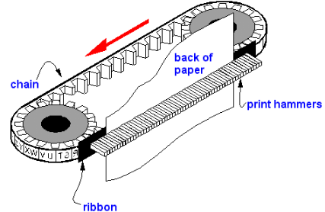
Chain Printers
Chain printers use a rotating chain as their printing mechanism. This chain contains character shapes or symbols, and each character is positioned on a link of the chain..
Notes:
An obsolete type of solid-font line printer in which the font was etched or engraved on small plates linked together to form a chain. The chain was connected around two sprocket wheels so that the straight part of the chain between the wheels ran parallel to the paper and spanned the line to be printed.

Slide 17
Impact Printers Advantages
can print on multi-part stationery
make carbon-copies.
Lowest printing cost per page
As the ink is running out, the printout gradually fades rather than suddenly stopping partway through a job.
Able to use continuous paper rather than requiring individual sheets, making them useful for data logging.
Good, reliable workhorses ideal for use in situations where printed content is more important than quality.
Ink ribbon also does not easily dry out

Slide 18
Impact Printers Disadvantages
Creates noise when the pins or typeface strike the ribbon to the paper.
Can only print lower-resolution graphics, with limited color performance, limited quality, and lower speeds compared to non-impact printers.
Single-sheet paper may have to be wound in and aligned by hand, which is relatively time-consuming
When printing labels on release paper, they are prone to paper jams

Slide 19
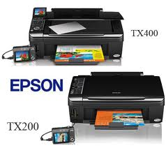
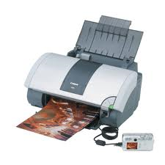
Ink Jet Printers
Non-impact printer
Inexpensive home printer
Sprays ink onto paper
Speed measured in pages per minute (ppm)
Quality expressed as dots per inch (dpi)
Notes:
Insider information
Nearly all of the electronics for the printer is kept in the ink cartridge. Thus, when the cartridge is replaced the printing components of the printer are replaced. Refilling cartridges is OK, but should not be reused more than 2-3 times.
An inkjet printer is a computer peripheral that produces hard copies of a text document or photo by spraying droplets of ink onto paper.
A typical inkjet printer can produce color printing copies with a resolution of 1200 x 1440 dpi. This is high enough for printing photos larger than 5 x 7 inches, however, for a project requiring high print quality on a larger scale, there are inkjet printers that provide up to 5760 x 1440 dpi.

Slide 20
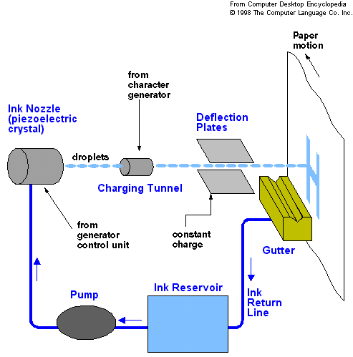
Working of Ink Jet Printer
Notes:
How do inkjet printers work?
In the inkjet printing mechanism, the print head has several tiny nozzles, also called jets. As the paper moves past the print head, the nozzles spray the ink onto it, forming the characters and images.

Slide 21
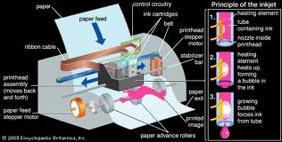
Ink Jet Printer Working

Slide 22
Ink Jet Printer
Color output common using CMYK
Cyan, Magenta, yellow, black
Expensive maintenance is rare
Ink cartridge need to be changed
one cartridge for color printing and a separate black-only cartridge for black-and-white printing
often used to print pictures taken with a digital camera

Slide 23
Ink Jet Printer Advantages
Quieter in operation than impact dot matrix
Can print finer, smoother details through higher print head resolution
Photographic-quality printing are widely available.
Practically no warm up time, and
Lower cost per page.
Notes:
Advantages of Inkjet Printer
High-Quality Prints – Inkjet printers produce high-quality prints that are sharp, clear and vibrant, making them great for printing photos, graphics, and other types of visual content.
Versatile – Inkjet printers can print on a variety of paper types and sizes, including glossy photo paper, cardstock, and even fabric, making them a versatile option for printing a wide range of documents.
Affordable – Inkjet printers are relatively inexpensive to purchase and operate, making them a cost-effective option, especially for personal or home use.
Low noise level – Inkjet printers are less noisy than other types of printers, which can be an advantage in a quiet home or office environment.
Networking capability – Many inkjet printers come with built-in networking capabilities, this means that they can connect to the internet and can be accessed by multiple users. This makes it perfect for home use where multiple people need to access the printer.

Slide 24
Ink Jet Printer Disadvantages
(Original) ink is often very expensive.
Many "intelligent" ink cartridges contain a microchip that communicates the estimated ink level to the printer;
lifetime of inkjet prints produced by aqueous inks is shorter than those produced with solvent-based inkjets
Because the ink is water-soluble, care must be taken with inkjet-printed documents to avoid drop of water
nozzles are prone to clogging
Notes:
Disadvantages of Inkjet Printer
High cost of ink – Inkjet printers use ink cartridges that need to be replaced over time, and they can be expensive, especially if you print frequently or in high volumes.
Prone to clogging – Inkjet printers are more prone to clogging than other types of printers, this can happen if the printer is not used frequently or if the ink cartridges are not replaced on time.
Limited paper handling – Inkjet printers are not well-suited for printing on cardstock, labels, or other types of thicker paper.
Not durable – Inkjet printers have many moving parts and are not built to withstand heavy use, which means they are often less durable than other types of printers.
Limited color options – Inkjet printers are not as good at reproducing color as laser printers, if you’re looking to print color photos or graphics, a laser printer may be a better option.

Slide 25
Laser Printer
Non-impact printer
Works on a similar process as photocopier
Laser is at the heart of these printers.
Produces high quality documents
Color or black and white
Speed measured in pages per minute
Quality expressed as dots per inch
Notes:
Insider information
The laser printer works on a similar process to a photocopier. The first photocopier as we know it today was invented in Astoria NY in 1938 by Chester Carlson and Otto Kornei.
Like a photocopier, laser printers read the electronic data from your computer and beam this information onto a drum inside the printer, which builds up a pattern of static electricity. This attracts a dry powder called toner onto the paper which is then fused using heated rollers.

Slide 26
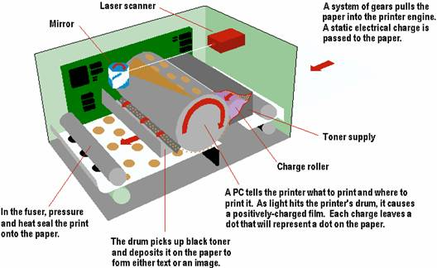
How Laser Creates an Image

Slide 27
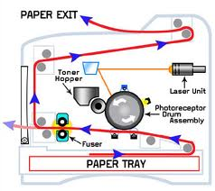
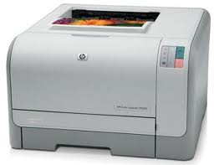
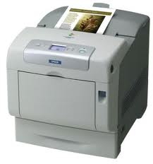
Laser Printer Technology

Slide 28
Laser Color Printing
Works like a single-color model, except that the process is repeated four times and a different toner color is used for each pass.
Four colors used are the same as in the color ink jet printers
Cyan
Magenta
Yellow and
Black.

Slide 29
Laser Printing
Black color printers typically can produce 4 -16 ppm.
For printing graphics, the output can be a great deal slower.
Most have resolutions of 300 or 600 dpi, both horizontally and vertically, but some high-end models have resolutions of 1,200 or 1,800 dpi.
Price starts from Rs. 6,000increases dramatically along with speed and resolution.
Require new toner cartridges after a few thousand pages,

Slide 30
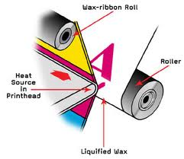
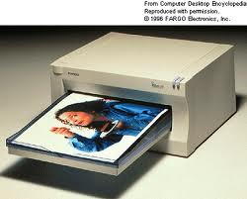
Thermal Wax Printer
Produces bold color output
Color generated by melting wax
Colors do not bleed
Operation costs are low
Output is slow

Slide 31
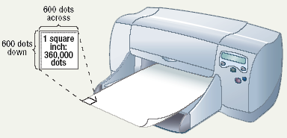
Comparing Printers
Determine what you need
Determine what you can spend
Image quality
dpi
Initial cost
Cost of operating
Speed

Slide 32
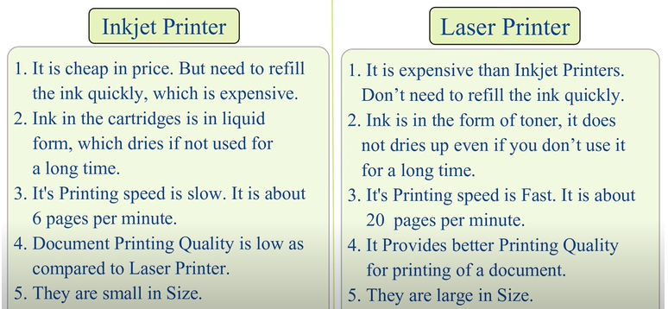

Slide 33
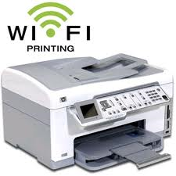
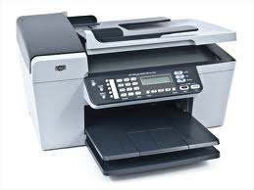
All-In-One Peripherals
Scanner, copier, printer, Fax and e-mail
Popular in home offices
Prices are very reasonable

Slide 34
High-Quality Printers
Special purpose printers
Used by a print shop
Output is professional grade
Prints to a variety of surfaces

Slide 35
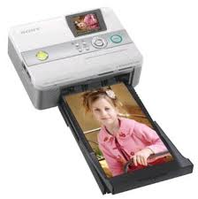
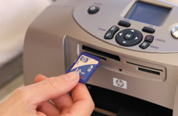
Photo Printers
Produces film quality pictures
Prints very slow
Prints a variety of sizes
Some do not need a computer
Notes:
A photo printer is usually an inkjet printer, although it can be a thermal dye printer, which has the ability to print high-quality digital photos and other vibrant color projects. The appeal of being able to print pictures instantly, along with the drop in digital camera prices, has enticed many people to purchase a photo printer. Prior to that, these types of printers were larger, more expensive and generally used only by professionals

Slide 36
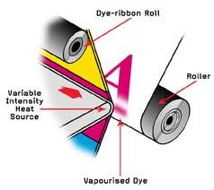
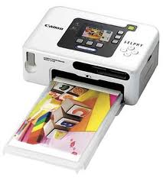
Dye Sublimation Printer
Produces realistic output
Very high quality
Color is produced by evaporating ink
Operation costs are high
Output is very slow
Notes:
What is Dye Sublimation Printing?
It’s the chemistry behind dye sublimation that makes it the correct technique for printing on polyester and polyester resin coated products. Using a wide-format inkjet printer, dye-sub inks are printed on a special transfer paper. From there, the ink is heat transferred from the paper onto a fabric by using a heat press. The ink changes from a solid to a gas (hence the term “sublimation”) and enters the polyester fibers.
The polymers in the polyester bond when heated, which allows the graphics to quickly become permanently embedded into your materials. As a heated gas, the ink becomes fully infused into the fabric instead of just printed on the surface, resulting in long-lasting, high-quality products.
Compared to inkjet printing on other materials like paper or vinyl, dye sublimation is a more involved process since it involves multiple steps. But don’t worry. With the right knowledge, dye sublimation can be an enjoyable and profitable business. Here’s what you need to know to get started:

Slide 37
Solid Ink Printer
Excellent Print Quality
Less wastage
Less sensitive to changes in media
Third-party compatible solid-ink can be used

Slide 38
Solid Ink Printer - Advantages
utilizes solid ink sticks
After the ink stick is loaded into the printing device, it is melted and used to produce images on paper in a process similar to offset printing.
sticks are non-toxic and safe to handle.

Slide 39
Solid Ink Printer - Disadvantages
Print durability
Power consumption
Excessive ink usage
Odor
clogged print Heads
High-speed moving parts
Ultraviolet resistance
Lamination

Slide 40
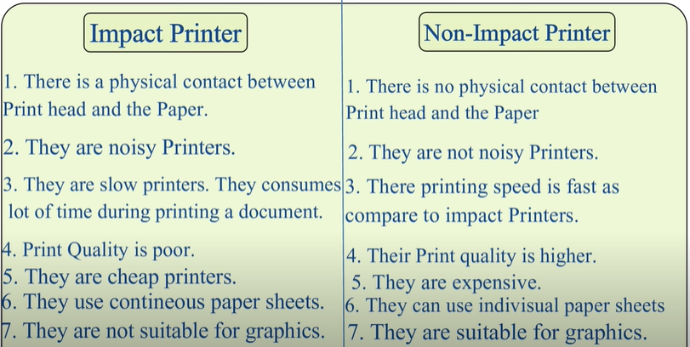

Slide 41
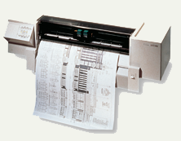
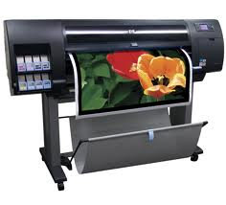
Plotters
Large high quality blueprints
Older models draw with pens
Operational costs are low
Output is very slow
Notes:
A plotter is a machine that produces vector graphics drawings. Plotters draw lines on paper using a pen, or in some applications, use a knife to cut a material like vinyl or leather. In the latter case, they are sometimes known as a cutting plotter

Slide 42
Flatbed Plotter
Flatbed plotters consist of a flat, horizontal surface where the paper or other printing material is placed.
Above this surface, there is a movable carriage that holds the plotting device, which is typically a pen or a cutting tool.
The carriage can move in both the X and Y axes, allowing precise positioning of the plotting instrument.

Slide 43
Drum Plotters
Drum plotters consist of a rotating drum, which serves as the plotting surface.
The paper or other printing material is attached to this drum, and it rotates as the plotter operates.
The drum's rotation allows for precise movement of the paper in both the X and Y axes.

Slide 44
Care and Feeding of Printers
Always read the owner’s manual for instructions
Unplug the printer
Remove the paper
Always place computer at airy place
Clean the outside surfaces with a dry or damp cloth
Use compatible paper with your printer
Don't overfill the paper tray

Slide 45
Summary
Impact Printers and Non Impact Printers
Impact Printers
Dot Matrix,
Line Printers,
Band Printers
Impact Printer Advantages and disadvantages
Non Impact Printers
Ink jet , Laser , All-in-One Peripherals
Comparing Printers

Slide 46
Summary
High Quality Printers
Photo printer
Thermal printer
Dye Sublimation
Solid Ink
Plotter
Care and Feeding of Printers

Slide 47
Recommended Websites
https://en.wikipedia.org/wiki/Category:Impact_printers
https://en.wikipedia.org/wiki/Inkjet_printers
https://en.wikipedia.org/wiki/Laser_printer
https://en.wikipedia.org/wiki/Thermal_transfer_printer
https://en.wikipedia.org/wiki/Dye-sublimation_printer
https://en.wikipedia.org/wiki/Solid_ink
https://en.wikipedia.org/wiki/Plotter

