Slide 1
CSC 101 Introduction to Computing Lecture 9
Mr. Khurram Nissar
khurramnissar@comsats.edu.pk
1

Slide 2
Last Lecture Summary
Number System
Decimal
Binary
Octal
Hexadecimal
Number conversion
2

Slide 3
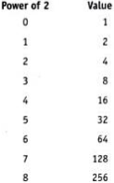
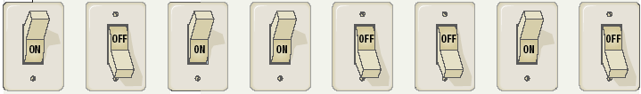
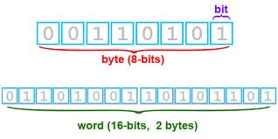
Bits and Bytes
Binary numbers are made of bits
Bit represents a switch
A byte is 8 bits
Byte represents one character
3

Slide 4
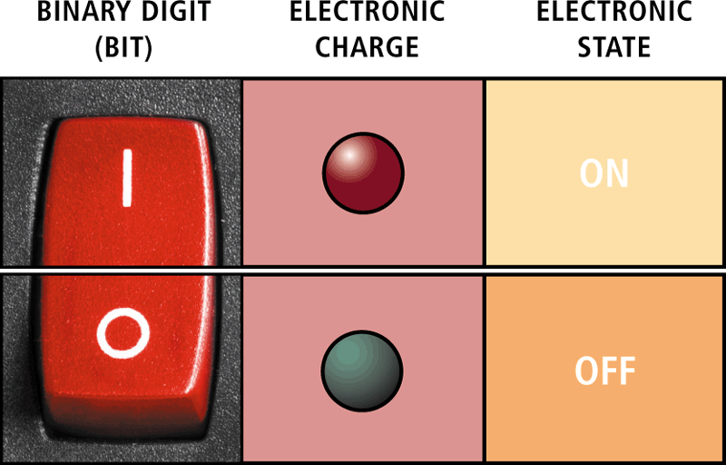
Bit and Byte
4

Slide 5
Text Codes
Converts letters, numbers, special symbols into binary numbers
Standard codes necessary for data transfer
Same combinations of numbers to represent the same individual pieces of data
Four most popular codes
EBCDIC
ASCII
Extended ASCII
Unicode
5
Notes:
Insider information
Windows XP, Mac OS X and newer flavors of Linux are fully Unicode compatible.

Slide 6
EBCDIC
Extended Binary Coded Decimal Interchange Code
8-bit code to represent 256 symbols
Still used in IBM mainframes and mid range computers
Rarely used in PCs
6
Notes:
Insider information
Windows XP, Mac OS X and newer flavors of Linux are fully Unicode compatible.

Slide 7
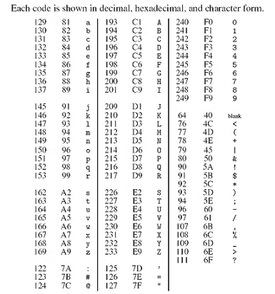
EDCDIC
7

Slide 8
ASCII
American Standard Code for Information Interchange
Most popular and widely used character set
Used to represent English symbols
7-bit code to represent 128 characters
From 0 to 127
33 are non-printing control characters (now mostly obsolete)
95 printable characters including space (invisible graphic character)
8
Notes:
Insider information
Windows XP, Mac OS X and newer flavors of Linux are fully Unicode compatible.

Slide 9
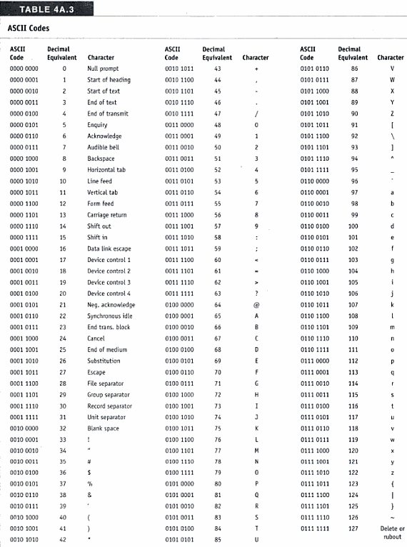
ASCII Codes
9

Slide 10
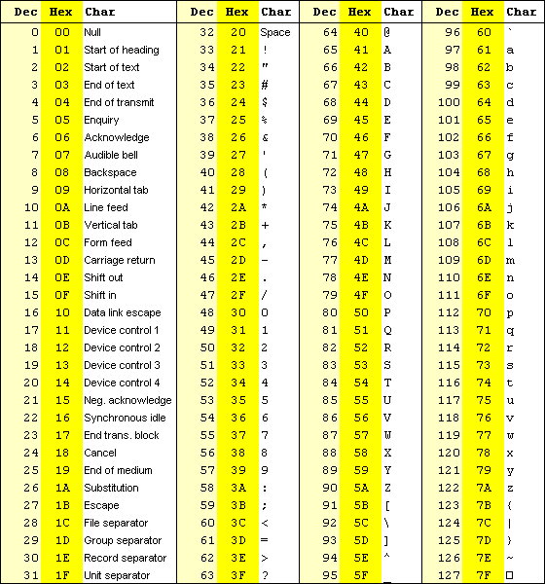
ASCII Code
10

Slide 11
Extended ASCII
8-bit code that specifies the characters for values from 128 to 255.
First 40 symbols represent pronunciation and special punctuation symbol
128 to 167
Remaining are for graphics and other symbols
11
Notes:
Insider information
Windows XP, Mac OS X and newer flavors of Linux are fully Unicode compatible.

Slide 12
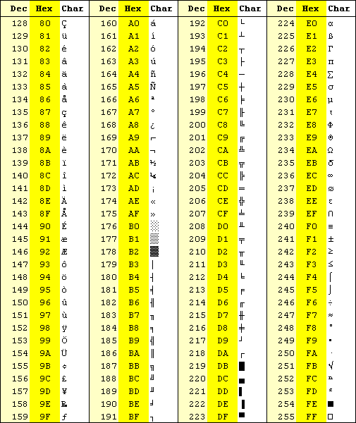
Extended ASCII Code
12

Slide 13
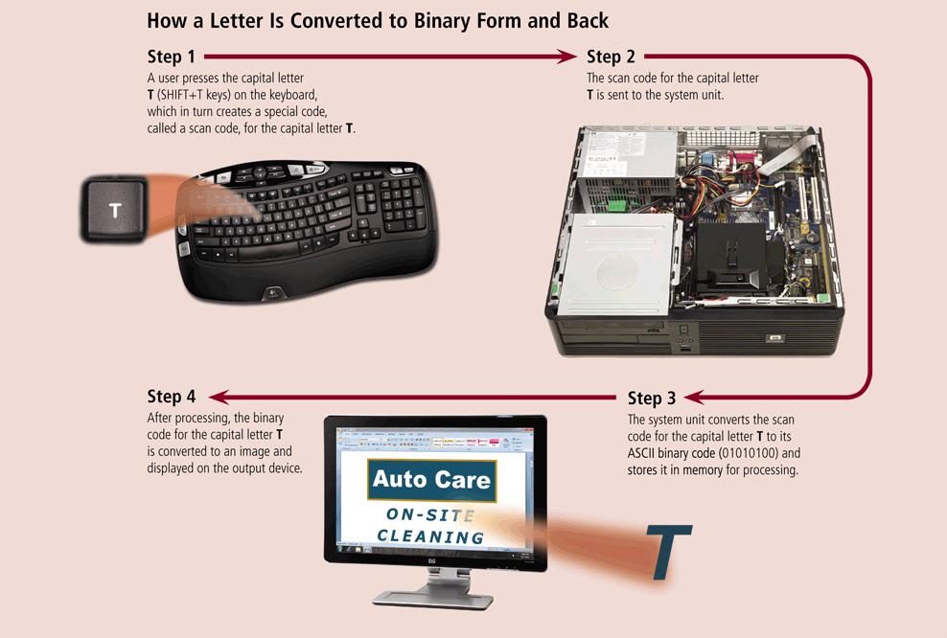
Letter Conversion to Binary
13

Slide 14
Unicode
Unicode Worldwide Character Standard provides up to 4-bytes—32 bits
Can represent more than 4 billion characters or symbols
2³² = 1,073,741,832
Enough for every unique character and symbol in the world
Chinese, Korean and Japanese Languages
Codes for special mathematical and scientific symbols
First 256 characters are same as ASCII
Current version (Jan 2012) is 6.1
Contains 110,181 characters from 100 different languages and scripts
14
Notes:
Insider information
Windows XP, Mac OS X and newer flavors of Linux are fully Unicode compatible.

Slide 15
Binary Arithmetic
Similar to arithmetic in decimal number system
Operations performed
Addition
Subtraction
Multiplication
Division

Slide 16
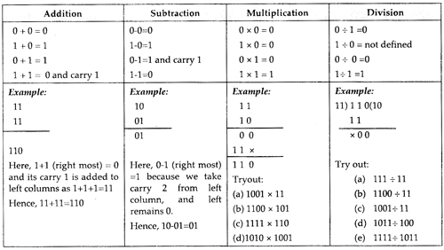
Binary Arithmetic
i

Slide 17
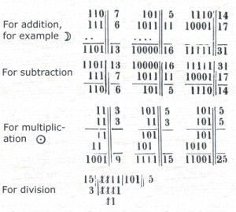
Binary Arithmetic
i

Slide 18
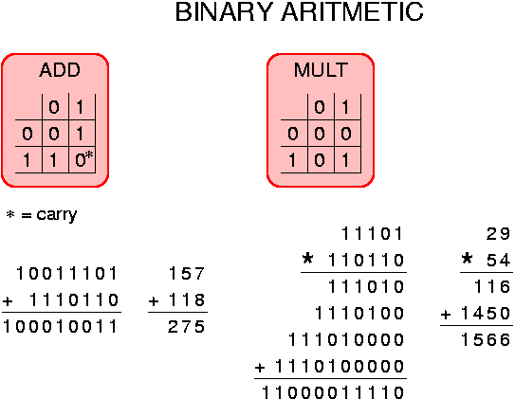
Binary Arithmetic
i

Slide 19
Boolean Algebra
Describes the relationship between the inputs and outputs of a digital circuit
George Boole, an English Mathematician in 1854 proposed the basic principles of algebra
Uses Variables and operations
Boolean variable has only two possible values
0 or 1 or False or True
Basic Logical operations are
AND, OR and NOT

Slide 20

Basic Logical Operations
AND operation
yields true in case when both of its operands are true
OR operation
yields true in case when either or both of its operands are true
NOT operation
Used to invert the value of its operand

Slide 21
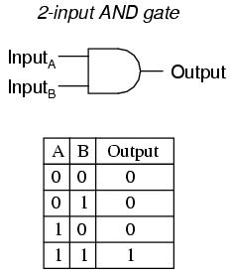
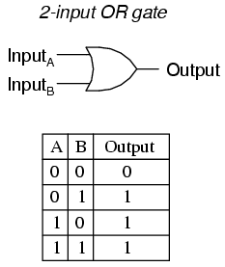
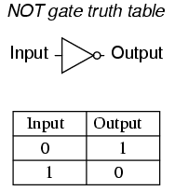
Logical Operations
Truth Table is a list of all possible input values and the output for each input combination

Slide 22
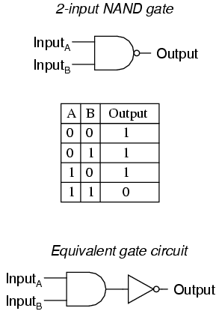
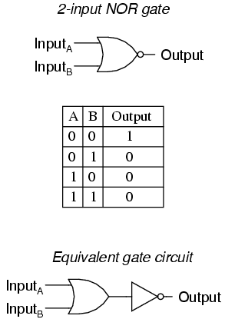
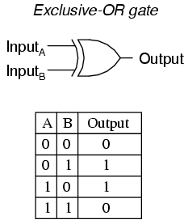
Logical Operations

Slide 23
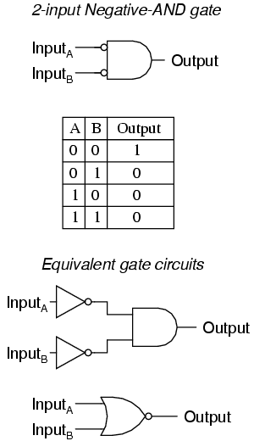
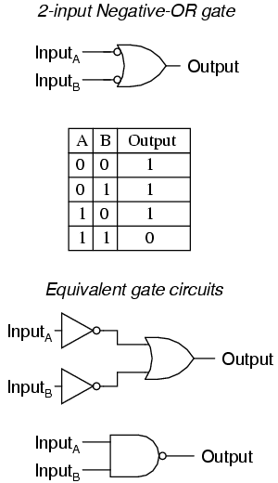
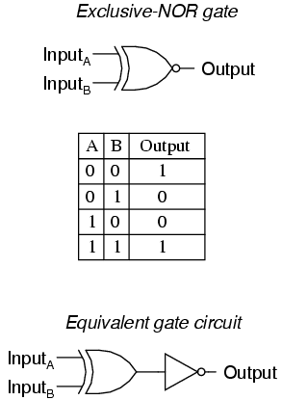
Logical Operations

Slide 24
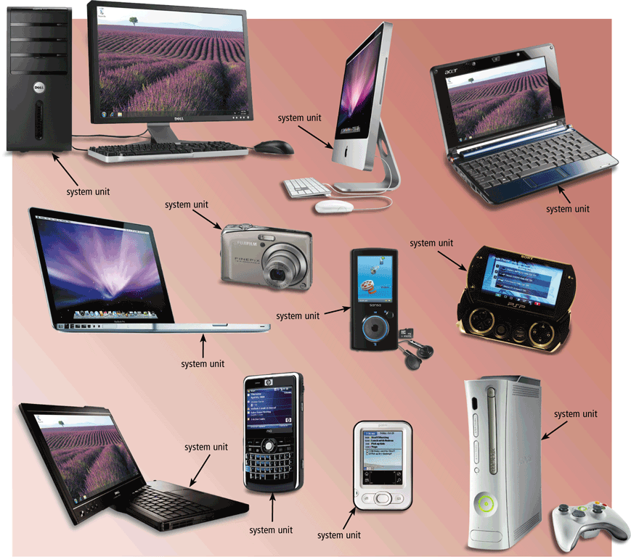
The System Unit
The system unit is a case that contains electronic components of the computer used to process data
24

Slide 25
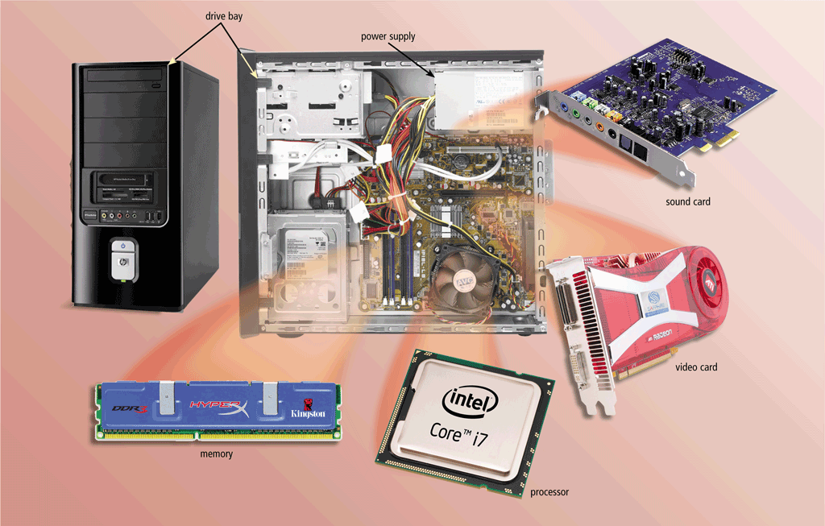
The System Unit
The inside of the system unit on a desktop personal computer includes:
Drive bay(s)
Power supply
Sound card
Video card
Processor
Memory
25

Slide 26
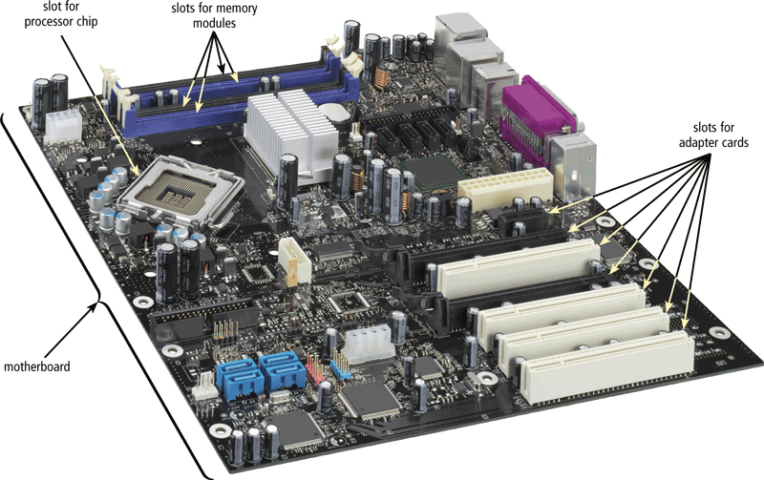
The System Unit
The motherboard is the main circuit board of the system unit
A computer chip contains integrated circuits (IC)
26

Slide 27
Structure - Top Level
Computer
Peripherals
Central
Processing
Unit
Main
Memory
Computer
Systems
Interconnection
Input
Output
Communication
lines

Slide 28
Structure - The CPU
CPU
Computer
Arithmetic
and
Login Unit
I/O
Registers
System
Bus
CPU
Internal CPU
Interconnection
Memory
Control
Unit

Slide 29
Structure - The Control Unit
Control Unit
CPU
ALU
Sequencing
Login
Internal
Bus
Control
Unit
Control Unit
Registers and
Decoders
Registers
Control
Memory

Slide 30
CPU
Central Processing Unit
Brain of the computer
Control unit
Controls resources in computer
Instruction set
Arithmetic logic unit
Simple math operations
Comparisons
Logic operations
Registers
30
Notes:
The CPU is the brain of a computer, containing all the circuitry needed to process input, store data, and output results.
The CPU is constantly following instructions of computer programs that tell it which data to process and how to process it. Without a CPU, we could not run programs on a computer.
For example, a simple calculator program might instruct the CPU to take two numbers, 2 and 2, add them, and send back the result.
The CPU can process those instructions easily, thanks to a control unit that knows how to interpret program instructions and an Arithmetic Logic Unit (ALU) that knows how to add numbers. With the control unit and ALU combined, the CPU can process much more complex programs than a simple calculator.
The Control Unit
All the computer’s resources are managed from the control unit. Think of the control unit as a traffic signal directing the flow of data through the CPU, as well as to and from other devices. The control unit is the logical hub of the computer
The CPU's instructions for carrying our commands are built into the control unit. The instructions, or instruction set, list all the operations that the CPU can perform. Each instruction in the instruction set is expressed in microcode—a series of basic directions that tell the CPU how to execute more complex operations

Slide 31
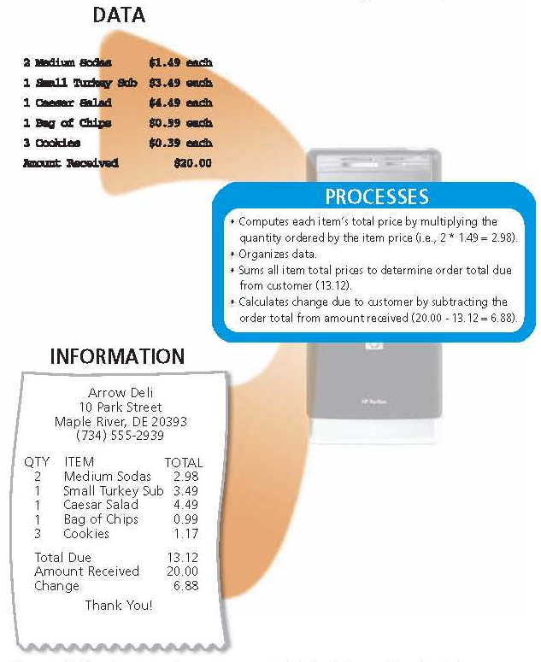
Function of CPU
31

Slide 32
ALU Operations
Registers
32
Notes:
Teaching tip
Table 4A.4 on page 190 lists the operations handled by the common ALU.

Slide 33
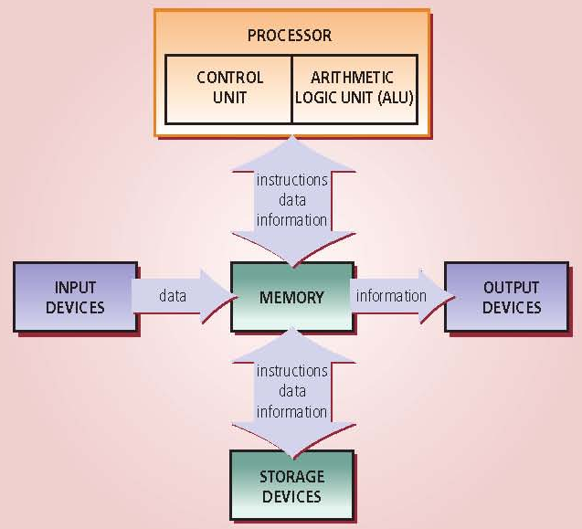
Movement of Instruction and Data
33

Slide 34
Machine Cycle
Steps by CPU to process data
Instruction cycle
CPU fetches the instruction
Decodes the instruction
Execution cycle
CPU performs the instruction
Stores the result (sometimes required)
Million Instructions per second (MIPS)
Billions of cycles per second (BIPS)
34
Notes:
Insider information
More pipelines mean a faster and more efficient CPU. The current fastest CPU on the market, the Apple G4 has 80 pipelines!
1. Fetching. Before the CPU can execute an instruction, the control unit must retrieve (or fetch) a command or data from the computer's memory.
2. Decoding. Before a command can be executed, the control unit must break down (or decode) the command into instructions that correspond to those in the CPU’s instruction set.
At this point, the CPU is ready to begin the execution cycle: 1. Executing. When the command is executed, the CPU carries out the instructions in order by converting them into microcode.
2. Storing. The CPU may be required to store the results of an instruction in memory (but this condition is not always required). Figure 4A.7 shows the result of the sound being played

Slide 35
Machine Cycle
Instruction cycle
Execution cycle
35
Notes:
Insider information
More pipelines mean a faster and more efficient CPU. The current fastest CPU on the market, the Apple G4 has 80 pipelines!

Slide 36
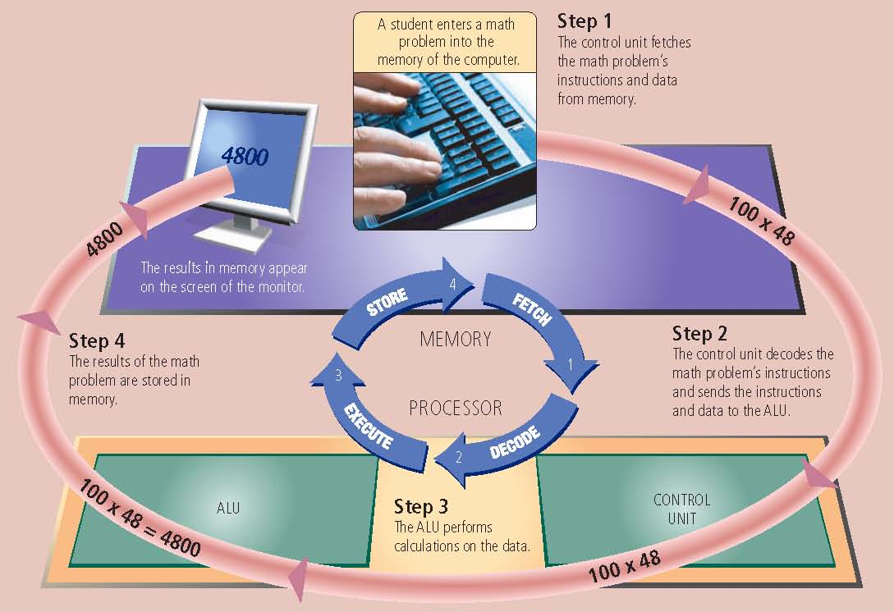
Steps In a Machine Cycle
36

Slide 37
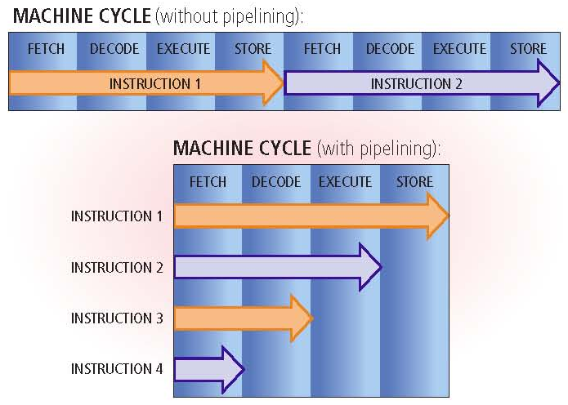
Machine Cycle Pipelining
Pipelining
Processor begins fetching a second instruction before it completes the machine cycle for the first instruction
37

Slide 38
Summary
How Computer Stores Data
Text Codes
EBCDIC, ASCII, Extended ASCII and Unicode
Binary Arithmetic
Boolean Algebra
Central Processing Unit (CPU)
Control Unit and ALU
Machine Cycle
38

