Slide 1
Student Tracking System and Online Attendance
Internal: Team Members:
Miss Saba Ahsan Muhammad Habib Yousuf (2016-CE-091)
Bushra Alam (2016-CE-042)
Shumail Javed (2016-CE-039)
Syed Qasim Athar (2016-CE-199)

Slide 2
Introduction
Many institutions today, face problems of keeping large attendance records.
Further, to keep students record manually is time taking and proportional of taking a chance with it.
Hence, Student tracking system and online attendance is a great replacement of usual systems in which all the records are updated and stored on to the application as well as the database.
It minimizes all kinds of risks that were possible before.

Slide 3
Software Design
We have designed our software in such a way that is easy to use for both the parents and teachers.
We have designed our front end and back end using Visual studio.
For data base using SQL Server and web server is IIS.
We used RFID Technology in our system.

Slide 4
Literature
The significance of this system for our society lies as under. When students enter into school their location is tracked and their parents can observe.
By online attendance school staff don’t need to be worry about attendance accuracy any more. Online student record updates, important notices i.e. parents will remain well-informed about their children status.
This system can be used in any educational institution.

Slide 5
Hardware
Two RFID Devices are used for this project.
For sureing reliablety we ZKT branded device on client demand.
Therefore, it has it’s integrated software application i.e. to be installed first and then linked with our software.

Slide 6
Events Management
First we issued the letter head from PIES to the FYP team.
All software and hardware requirements are gathered and discussed in detail.
2-3 meetings are held with the school head and management.

Slide 7
FRONTEND DEVELOPMENT
For this we have used a combination of languages i.e. Asp.net javascript, HTML and CSS.
Three main modules are in this project:
Admin
Student
Staff

Slide 8
DFD Diagrams (Data Flow Diagram)
Admin
Staff
Student

Slide 9
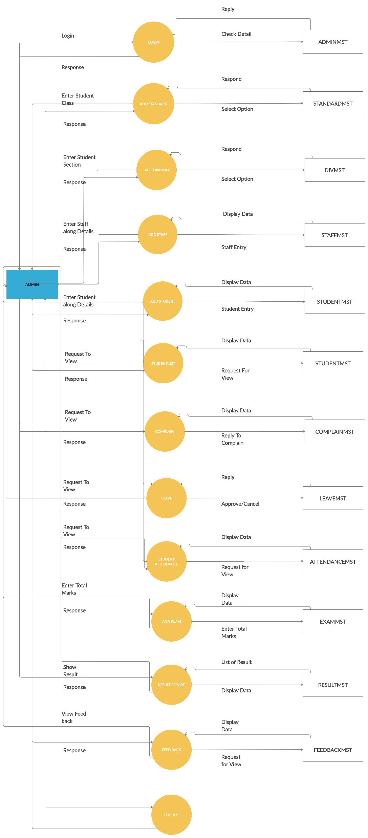

Slide 10
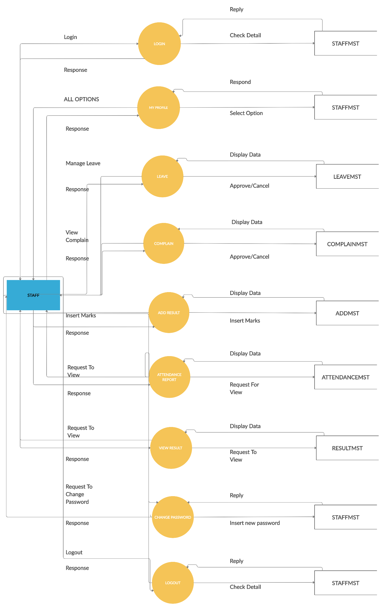

Slide 11
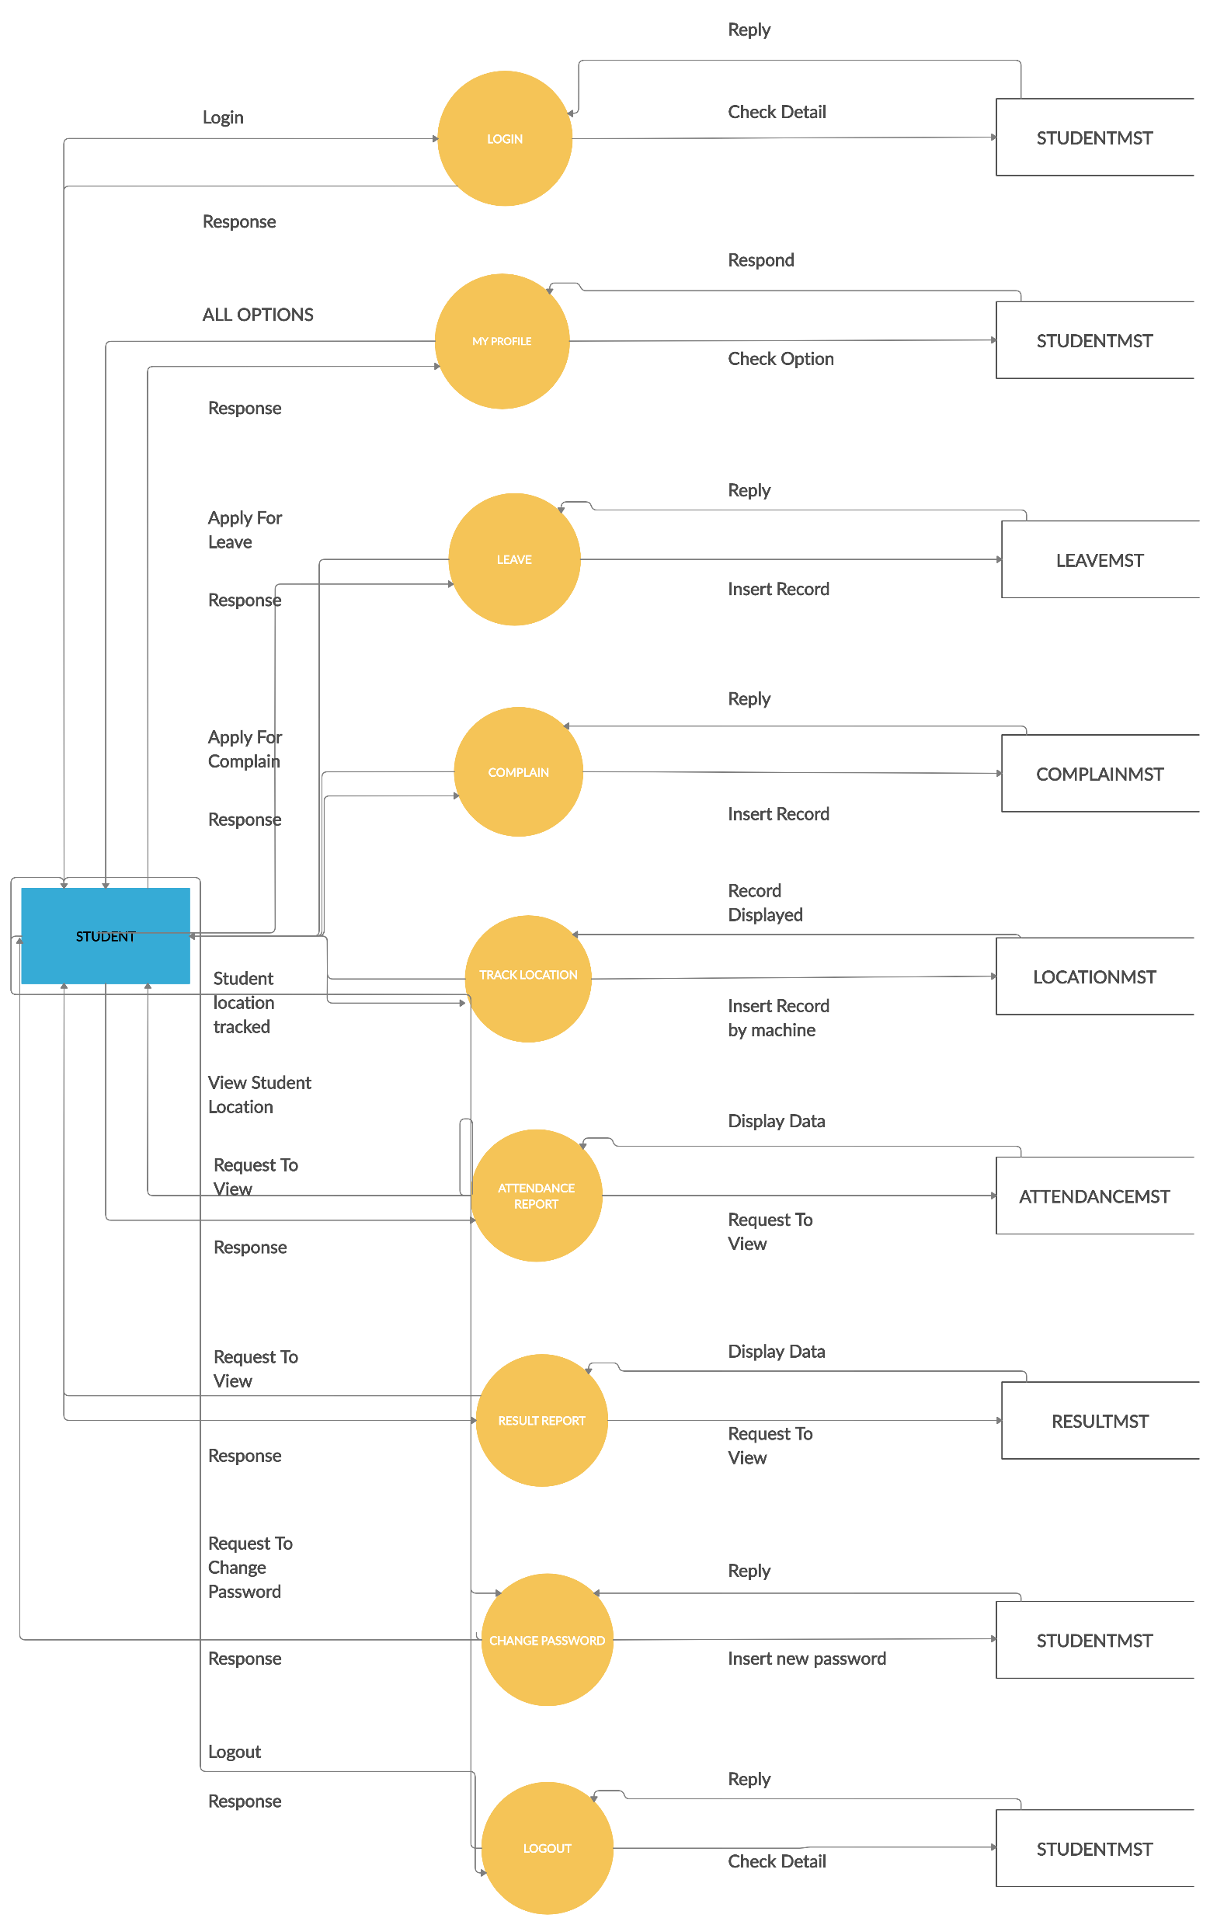

Slide 12
Research Paper
Some main headings include:
Abstract
Introduction
Related Work
Systems Comparison
System Diagram

Slide 13
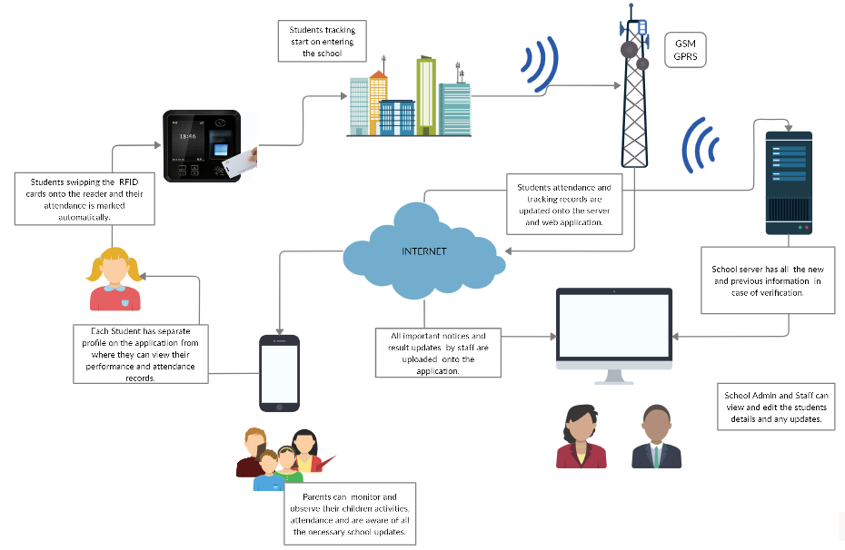
System Diagram

Slide 14
Collect Resources
Check device Quality (Brand device)
Buying of Hardware
(ZKTect) RFID Attendance And Tracking devices.

Slide 15
Testing
During the development process, testing will be done to ensure all modules are built correctly.
Application integration testing has been done after we have built all elements and then it combined into the application.

Slide 16
Hardware Testing
Configuration of devices.
Therefore, it has it’s integrated software application i.e. to be installed first and then linked with our software.
Check hardware integration.

Slide 17
Thank You!

