Slide 1

OWASP Juice Shop Security
Assessment Findings Presentation

Slide 2
Prepared for: DEPI grad project
Team:
Habiba hosam
Sohila mohamed
Mohamed Ayman
Mohamed AbdelBasit

Slide 3
1. Introduction
Overview of OWASP Juice Shop
A deliberately insecure web application designed for security training & testing.
Contains a wide range of vulnerabilities (OWASP Top 10, API flaws, business logic bugs).
Used for penetration testing, CTFs, and security awareness.
Objective of This Assessment
Identify security weaknesses in authentication, authorization, data exposure, and business logic.
Demonstrate real-world attack scenarios.

Slide 4
Key Findings & Exploits
A. Authentication & Authorization Issues
Admin Account Compromise Finding: Default admin credentials (admin@juice-sh.op:admin123) were guessable.
Impact: Full control over the application, user data access, and privilege escalation.
Exploit:
Logged in as admin and accessed sensitive functionalities.
Weak Password Reset Mechanism Finding: Password reset for Jim & Bender could be abused without SQLi.
Impact: Account takeover via insecure reset logic.
Exploit:
Used Forgot Password feature with manipulated parameters.
CSRF (Cross-Site Request Forgery) Finding: Actions (e.g., password change, reviews) lacked anti-CSRF tokens.
Impact: Attackers could force users to perform unintended actions.
User Enumeration Finding: Different error messages for valid/invalid users during login.
Impact: Attackers could identify registered emails (e.g., bender@juice-sh.op).

Slide 5
B. Injection & Data Exposure
DOM-Based XSS Finding: Unsanitized user input in search fields led to JavaScript execution.
Impact: Session hijacking, defacement, malware delivery.
SQL Injection (SQLi) Bypass Finding: Login bypass via ' OR 1=1 -- payload.
Impact: Unauthorized access to any account.
Data Leakage (Confidential Documents & Email Leaks) Finding:
Exposed /ftp directory with sensitive files (e.g., acquisitions.md).
Developer backup file (www.zip) leaked source code.
Impact: Source code analysis → More vulnerabilities discovered.
SSRF (Server-Side Request Forgery) Finding: Manipulated requests to fetch internal server data.
Impact: Internal network reconnaissance, AWS metadata access.

Slide 6
C. Business Logic Flaws
Deluxe Fraud Finding: Modified API requests to upgrade account to "Deluxe" for free.
Exploit: Changed POST request parameter ("isDeluxe": true).
Basket Manipulation Finding: Negative quantities or pricing manipulation in cart.
Impact: Free purchases, revenue loss.
Repetitive Registration Finding: Multiple accounts with the same email (e.g., test@test.test).
Impact: Spam, abuse of promotions.
GDPR Violations Finding:
Access to user feedback without consent.
Forgotten /administration panel exposed PII.
Impact: Legal repercussions under GDPR.

Slide 7
D. Miscellaneous Vulnerabilities
CAPTCHA Bypass Exploit: Reused CAPTCHA tokens or disabled JavaScript.
File Upload Bypass Finding: Uploaded malicious files via Poison Null Byte (shell.php%00.jpg).
Impact: Remote code execution (RCE).
Security Misconfigurations Deprecated APIs (/encryptionkeys).
Exposed access.log → Leaked user IPs & activities.
Easter Egg & Bjoern's Pet Finding: Hidden features (e.g., /#/score-board) exposed internal scoring.

Slide 8
Risk Impact
Low Severity (★) Challenges
Examples:
Dom XSS
Find the Hidden Score Board
Error Handling
Repetitive Registration
Data Exposure (Confidential Document)
Impact:
These issues represent minor security flaws or informational exposures.
May assist attackers in reconnaissance but rarely cause direct damage.
Dom XSS might expose small interactions, but with limited impact.
Error messages or hidden content might help map the app but not compromise it directly.
GDPR or document exposure at this level typically signals mild misconfigurations.

Slide 9
Medium Severity (★★) Challenges
Examples:
Login Admin
Admin Section
Five Star Feedback
View Basket
Password Strength
Deprecated Interface
Empty User Registration
Meta Geo Stalking
Security Policy (Misc)
Impact:
Moderate vulnerabilities that may enable limited misuse or exposure.
Broken access controls in admin or feedback sections may allow role confusion or privilege misuse.
Weak password enforcement increases account takeover risks.
Deprecated features and missing security policies can indicate poor maintenance.
Location-based exposure (geo stalking) or empty form validation weaknesses can support targeted attacks or bypasses.

Slide 10
High Severity (★★★) Challenges
Examples:
Login Bender
Login Jim
Reset Jim Password
Forged Review
Manipulate Basket
Forged Feedback
Upload File
Upload Type
Pay Back Time
CAPTCHA Bypass
Admin Registration
Deluxe Fraud
Bjoern's Favourite Pet
Impact:
Significant flaws that may lead to data manipulation, account takeover, or security control evasion.
Forged actions (feedback, reviews) can affect business integrity.
Upload and CAPTCHA bypasses open paths for malware, automation, or privilege escalation.
Reused login flows or password resets can allow attackers to compromise specific users.
Fraud challenges highlight real-world abuse potential (e.g., loyalty program exploitation).

Slide 11
Critical Severity (★★★★+) Challenges
Examples:
Reset Bender Password (5★ - No SQLi or Forgot Flow)
Email Leak (5★)
SSRF Vulnerability (6★)
Access Log
Poison Null Byte
Allowlist Bypass
GDPR Data Theft
Forgotten Developer Backup
Database Schema
Impact:
Critical risks with potential for full system compromise or data exfiltration.
SSRF can access internal services or metadata APIs in cloud environments.
Resetting passwords through unintended flows may bypass all authentication.
Developer backups and schema leaks often contain sensitive configurations or credentials.
GDPR Data Theft risks financial and reputational damage due to compliance failures.
Null Byte and allowlist bypasses often break core security boundaries.

Slide 12
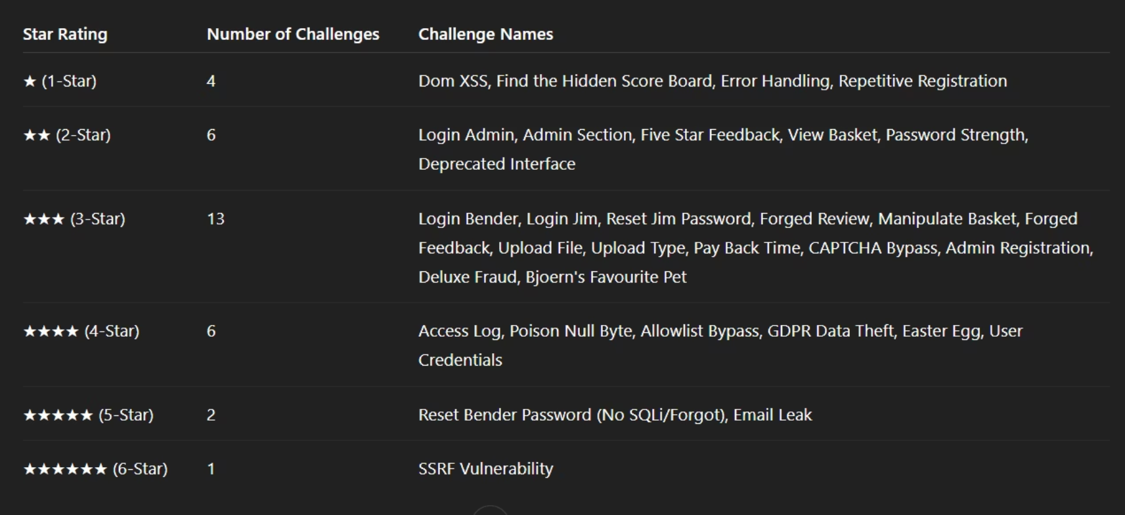
groups the challenges by star rating

Slide 13
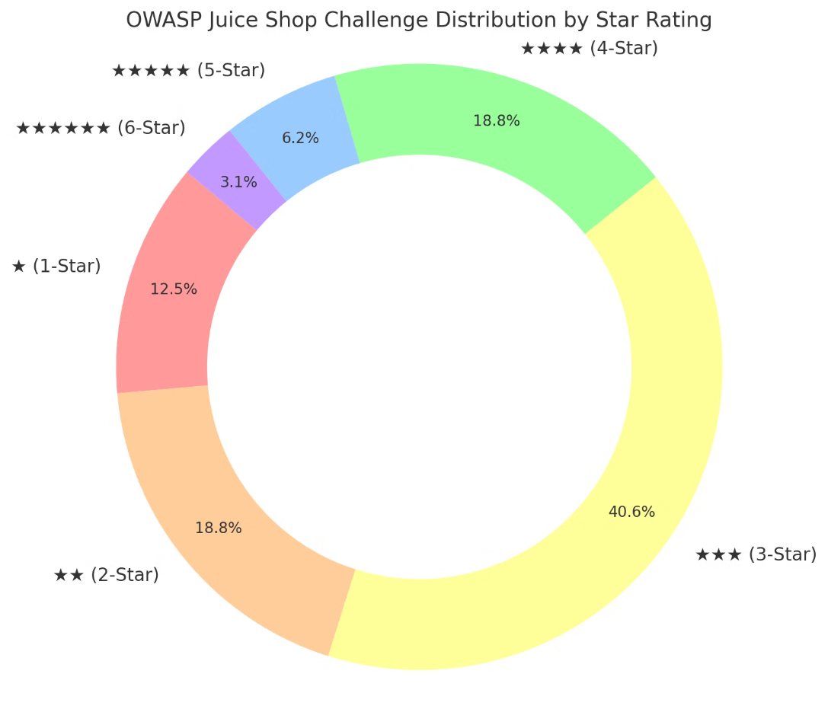

Slide 14
Recommendations
1-Authentication:
Enforce MFA, strong password policies, and rate-limiting.
2-Input Validation:
Sanitize user inputs to prevent XSS/SQLi.
3-Access Controls:
Implement role-based access control (RBAC).
4-Logging & Monitoring:
Monitor unusual activities (e.g., multiple failed logins).
5-Secure APIs:
Validate requests, use anti-CSRF tokens.

Slide 15
Conclusion
The OWASP Juice Shop assessment reveals a broad spectrum of vulnerabilities ranging from low to critical severity. While some issues present minor risks, several critical and high-severity challenges pose significant threats to the security, privacy, and integrity of your application and data.
Addressing these vulnerabilities is essential to safeguard against potential data breaches, unauthorized access, and compliance violations. Prioritizing remediation efforts on critical and high-severity issues will dramatically improve your security posture and reduce the risk of exploitation.
By implementing the recommended fixes and adopting strong security practices, your organization can enhance trust with users, ensure regulatory compliance, and build a resilient, secure application environment. We are ready to support you throughout this process to help achieve these goals efficiently and effectively.

