Slide 1

OWASP Juice Shop Security Assessment Findings Presentation

Slide 2

Prepared for: DEPI grad project
Team:
Habiba hosam
Sohila mohamed
Mohamed Ayman
Mohamed AbdelBasit

Slide 3
1. Introduction
Overview of OWASP Juice Shop
A deliberately insecure web application designed for security training & testing.
Contains a wide range of vulnerabilities (OWASP Top 10, API flaws, business logic bugs).
Used for penetration testing, CTFs, and security awareness.
Objective of This Assessment
Identify security weaknesses in authentication, authorization, data exposure, and business logic.
Demonstrate real-world attack scenarios.

Slide 4
Key Findings & Exploits
A. Authentication & Authorization Issues
Admin Account Compromise Finding: Default admin credentials (admin@juice-sh.op:admin123) were guessable.
Impact: Full control over the application, user data access, and privilege escalation.
Exploit:
Logged in as admin and accessed sensitive functionalities.
Weak Password Reset Mechanism Finding: Password reset for Jim & Bender could be abused without SQLi.
Impact: Account takeover via insecure reset logic.
Exploit:
Used Forgot Password feature with manipulated parameters.
CSRF (Cross-Site Request Forgery) Finding: Actions (e.g., password change, reviews) lacked anti-CSRF tokens.
Impact: Attackers could force users to perform unintended actions.
User Enumeration Finding: Different error messages for valid/invalid users during login.
Impact: Attackers could identify registered emails (e.g., bender@juice-sh.op).

Slide 5
B. Injection & Data Exposure
DOM-Based XSS Finding: Unsanitized user input in search fields led to JavaScript execution.
Impact: Session hijacking, defacement, malware delivery.
SQL Injection (SQLi) Bypass Finding: Login bypass via ' OR 1=1 -- payload.
Impact: Unauthorized access to any account.
Data Leakage (Confidential Documents & Email Leaks) Finding:
Exposed /ftp directory with sensitive files (e.g., acquisitions.md).
Developer backup file (www.zip) leaked source code.
Impact: Source code analysis → More vulnerabilities discovered.
SSRF (Server-Side Request Forgery) Finding: Manipulated requests to fetch internal server data.
Impact: Internal network reconnaissance, AWS metadata access.

Slide 6
C. Business Logic Flaws
Deluxe Fraud Finding: Modified API requests to upgrade account to "Deluxe" for free.
Exploit: Changed POST request parameter ("isDeluxe": true).
Basket Manipulation Finding: Negative quantities or pricing manipulation in cart.
Impact: Free purchases, revenue loss.
Repetitive Registration Finding: Multiple accounts with the same email (e.g., test@test.test).
Impact: Spam, abuse of promotions.
GDPR Violations Finding:
Access to user feedback without consent.
Forgotten /administration panel exposed PII.
Impact: Legal repercussions under GDPR.

Slide 7
D. Miscellaneous Vulnerabilities
CAPTCHA Bypass Exploit: Reused CAPTCHA tokens or disabled JavaScript.
File Upload Bypass Finding: Uploaded malicious files via Poison Null Byte (shell.php%00.jpg).
Impact: Remote code execution (RCE).
Security Misconfigurations Deprecated APIs (/encryptionkeys).
Exposed access.log → Leaked user IPs & activities.
Easter Egg & Bjoern’s Pet Finding: Hidden features (e.g., /#/score-board) exposed internal scoring.

Slide 8
Risk Impact
Low Severity (★) Challenges
Examples: View Basket, Error Handling, GDPR Request, Easter Egg, Security Policy
Impact: These issues generally represent minor weaknesses or informational exposures.
May lead to slight usability issues or small privacy concerns.
Potentially helpful for attackers in reconnaissance but unlikely to cause direct harm.
GDPR request handling weaknesses could cause minor compliance risks if personal data is mishandled.

Slide 9
Medium Severity (★★) Challenges
Examples: Login Bender, Forgot Password, Repetitive Registration, CAPTCHA Bypass, Upload Type
Impact: These vulnerabilities pose moderate risks that could allow unauthorized access or abuse.
Login weaknesses or repetitive registrations can enable account enumeration or brute force attacks.
CAPTCHA bypass and upload type flaws could allow bots or malicious files to enter the system, increasing the chance of further exploitation or denial of service.
Forgotten password weaknesses risk account takeover.

Slide 10
High Severity (★★★) Challenges
Examples: DOM XSS, Admin Login, CSRF, Email Leak, Deluxe Fraud, SSRF, Poison Null Byte
Impact: These are serious security flaws that can lead to significant compromise of application and user data.
DOM XSS and CSRF allow attackers to run malicious scripts or perform actions on behalf of authenticated users, potentially stealing credentials or changing sensitive data.
Admin login weaknesses could let attackers gain privileged access.
Email leaks can lead to phishing or social engineering attacks.
SSRF (Server-Side Request Forgery) can enable attackers to access internal systems not normally exposed.
Poison Null Byte attacks can bypass input validation and security controls.

Slide 11
Critical Severity (★★★★) Challenges
Examples: SQL Injection (Reset Bender), Database Schema, Access Log, Admin Registration, GDPR Data Theft
Impact: Critical vulnerabilities that can cause complete system compromise or severe data loss.
SQL Injection allows attackers to manipulate the database, potentially exposing or modifying all stored data.
Flaws in database schema and access logs can leak sensitive information or hinder audit processes.
Poor admin registration controls risk unauthorized creation of privileged accounts.
GDPR Data Theft breaches expose personal data, leading to regulatory fines and loss of customer trust.

Slide 12
OWASP Juice Shop Challenges Severity Distribution
Severity Level
Stars (Difficulty)
# of Challenges Solved
Example Challenges
Low (★)
★
5
View Basket, Error Handling, GDPR Request, Easter Egg, Security Policy
Medium (★★)
★★
12
Login Bender, Forgot Password, Repetitive Registration, CAPTCHA Bypass, Upload Type
High (★★★)
★★★
15
DOM XSS, Admin Login, CSRF, Email Leak, Deluxe Fraud, SSRF, Poison Null Byte
Critical (★★★★)
★★★★
8
SQLi (Reset Bender), Database Schema, Access Log, Admin Registration, GDPR Data Theft
Critical+ (★★★★★)
★★★★★
4
MC SafeSearch Bypass, Payback Time, Bjoern’s Pet, Deprecated Interface

Slide 13
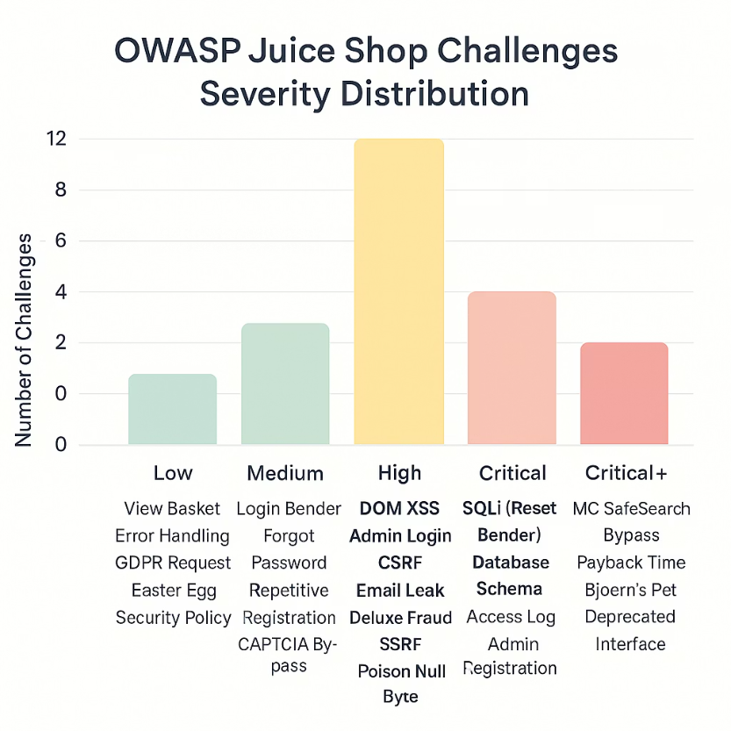
Graph of our findings :

Slide 14
Recommendations
1- Authentication:
Enforce MFA, strong password policies, and rate-limiting.
2- Input Validation:
Sanitize user inputs to prevent XSS/SQLi.
3- Access Controls:
Implement role-based access control (RBAC).
4- Logging & Monitoring:
Monitor unusual activities (e.g., multiple failed logins).
5- Secure APIs:
Validate requests, use anti-CSRF tokens.

Slide 15
Conclusion
The OWASP Juice Shop assessment reveals a broad spectrum of vulnerabilities ranging from low to critical severity. While some issues present minor risks, several critical and high-severity challenges pose significant threats to the security, privacy, and integrity of your application and data.
Addressing these vulnerabilities is essential to safeguard against potential data breaches, unauthorized access, and compliance violations. Prioritizing remediation efforts on critical and high-severity issues will dramatically improve your security posture and reduce the risk of exploitation.
By implementing the recommended fixes and adopting strong security practices, your organization can enhance trust with users, ensure regulatory compliance, and build a resilient, secure application environment. We are ready to support you throughout this process to help achieve these goals efficiently and effectively.

