Slide 1
H20logy water intake website
ROLL NO:22SW007 (SADAF)
ROLL NO:22SW119(HABIBA)
ROLL NO:22SW125(AIZAH)

Slide 2
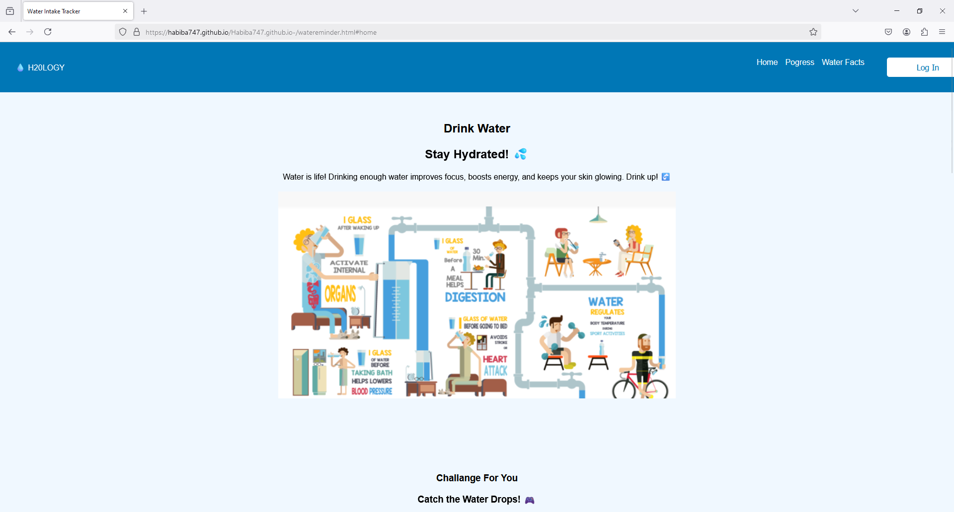

H2OLOGy is an online platform designed to help programmers, coders, and anyone who spends long hours in front of a laptop stay hydrated. It features a water intake tracker to monitor your daily hydration, a fun "Catch the Water Drops Challenge" to keep you engaged, in insightful content and to keep your water intake goal according to the challenge it also includes benefits of staying hydrated. The website also offers fascinating water facts and personalized hydration tips to help you stay on track. While H2OLOGy is optimized for desktop use , it provides a simple and enjoyable way for those who spend long hours at their computers to stay hydrated and improve their overall well-being.

Slide 3

The Login Page of H2OLOGy allows users to securely access their personalized hydration tracking features. Simply enter your username and password to log in. Once logged in, you can start tracking your water intake, join challenges, and access all the hydration resources .

Slide 4
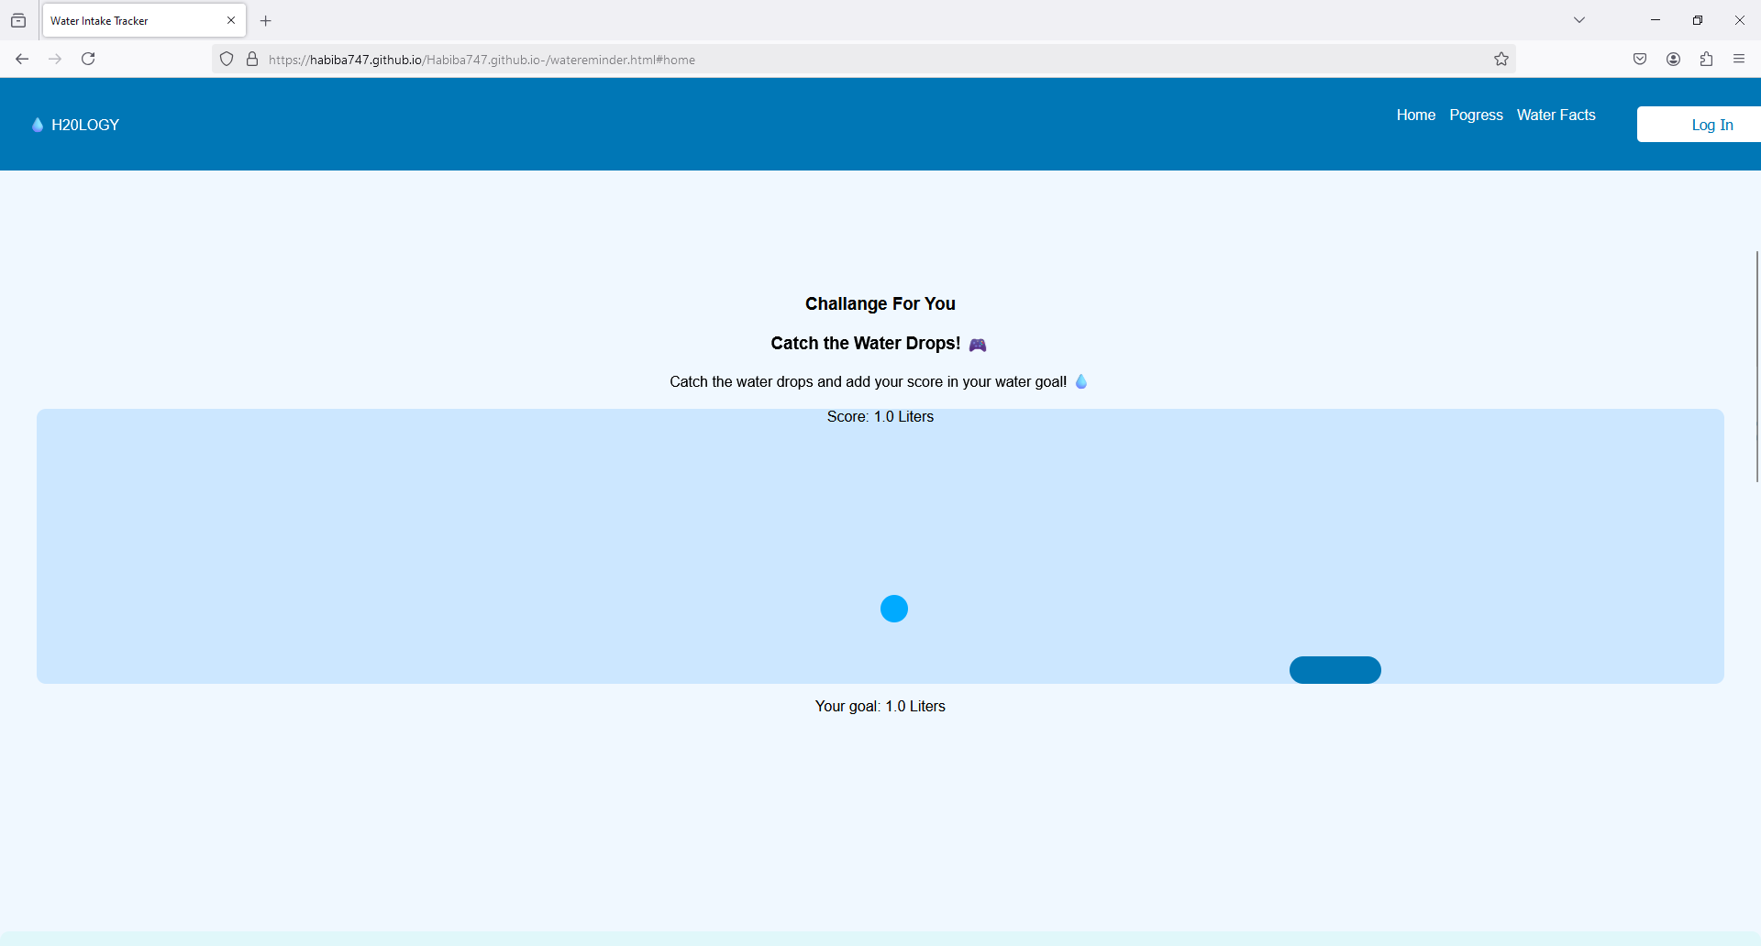
Catch the Water Drops Challenge is a fun and interactive 30-second game on H2OLOGy designed to motivate you to stay hydrated. In this challenge, you have 30 seconds to collect as many water droplets as you can. The number of droplets you catch during the challenge sets your hydration goal for the day. For example, if you collect droplets that equal 1 liter of water, that becomes your daily water intake target. It's a quick, engaging way to stay on track with your hydration while having fun!
Catch the water droplets challenge

Slide 5
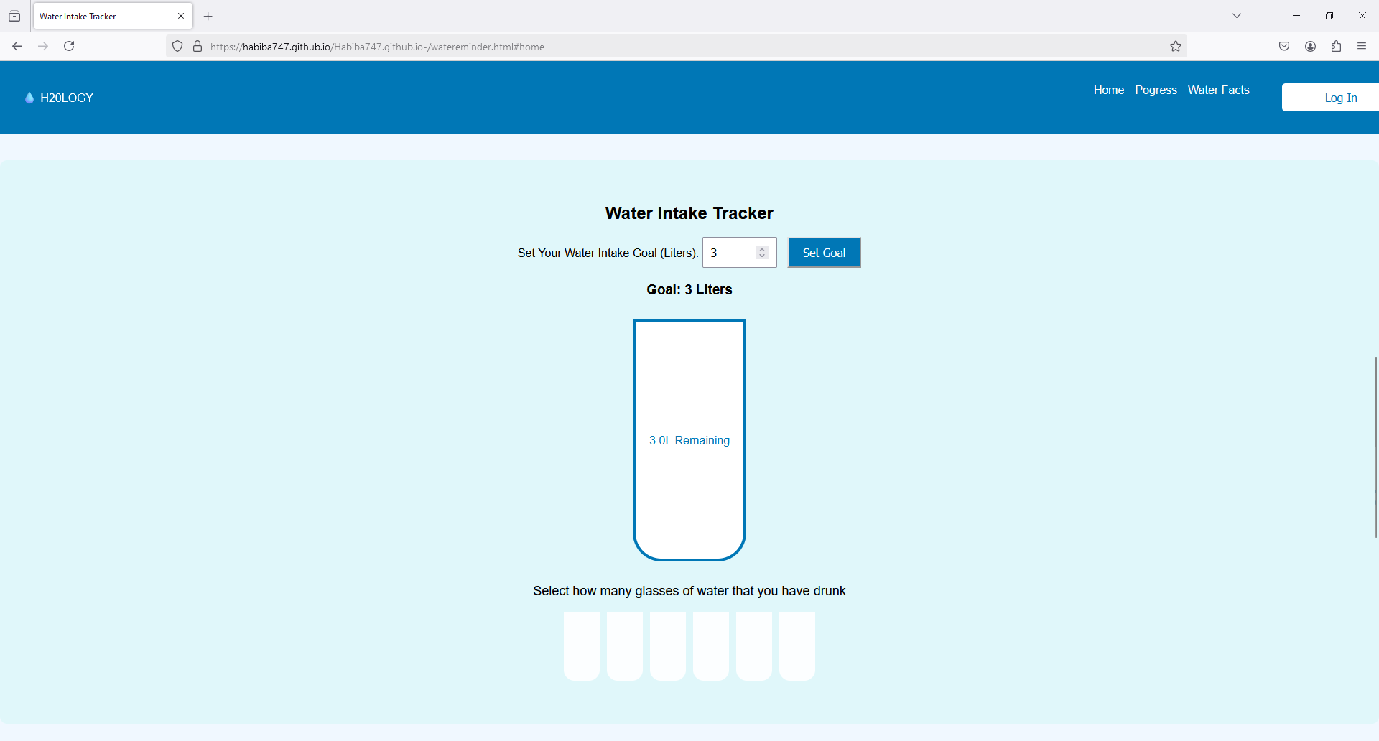
The Water Intake Tracker on H2OLOGy helps you stay on top of your hydration goals effortlessly. When you set a daily water intake target, like 3 liters, the tracker automatically calculates how many glasses that equals and displays them for you. As you log your water intake throughout the day, the tracker updates in real-time, showing your progress toward reaching your goal. You can easily adjust your target based on your needs, whether you're aiming for more or less, and the tracker will adapt to keep you on track. It’s a simple, automated way to ensure you hit your hydration goals each day!

Slide 6
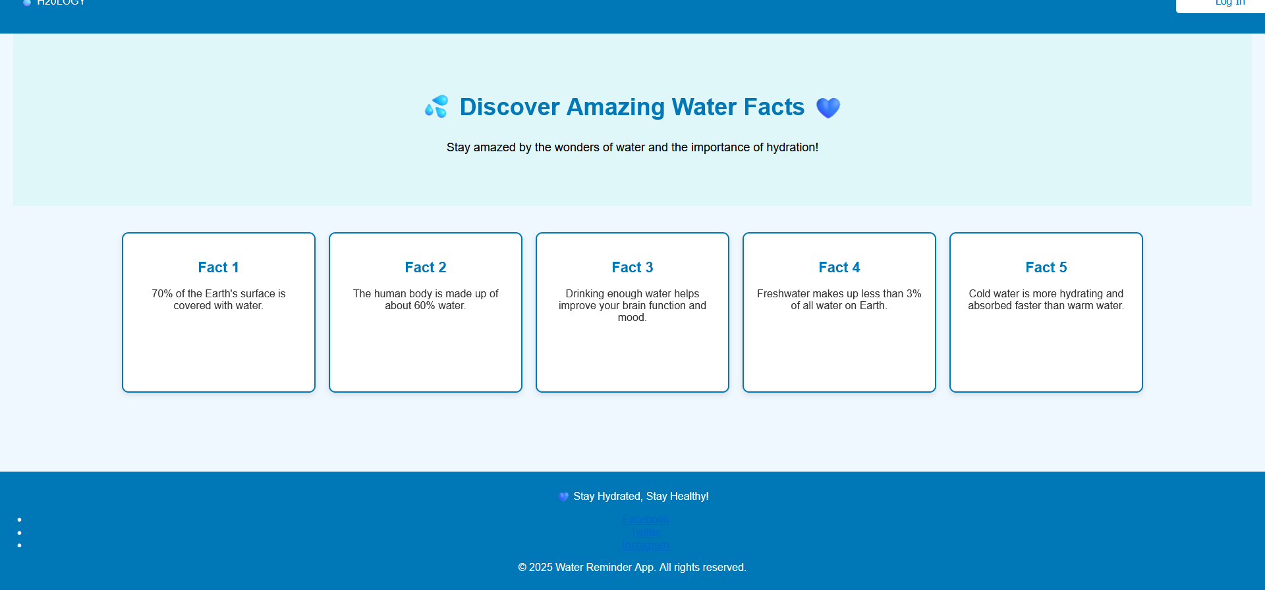
On H2OLOGy, we highlight 5 Amazing Facts About Water to emphasize the importance of staying hydrated
These fascinating water facts remind us how crucial hydration is to keeping our bodies and minds in top shape!

