Slide 1

Carbon Footprint Calculator
By Habiba Begum
21312966@stu.mmu.ac.uk

Slide 2
Contents
Introduction
Aims and objectives
Current Solutions
Project
Design
Implementation – challenges
Evaluation
Future Improvements

Slide 3
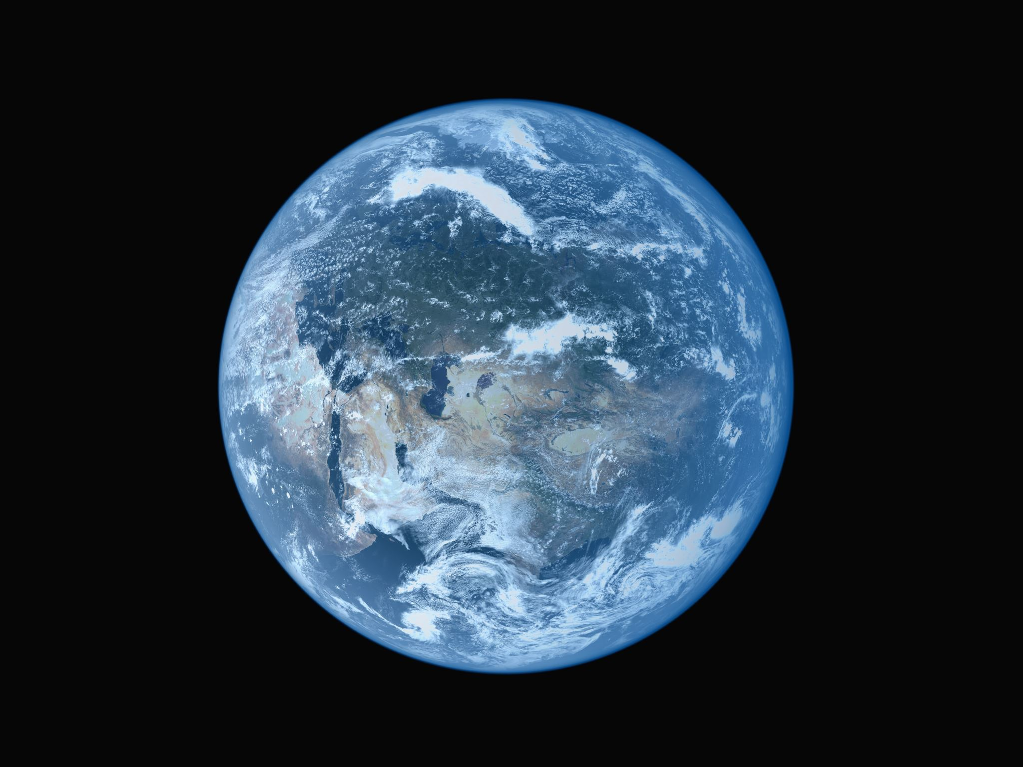

Introduction
People are becoming more conscious of their carbon footprint as this impacts the environment.
Reason: The biggest impact of carbon emission is Global Warming!
Projections in the latest IPCC report indicate that the global surface temperature is likely to rise a further 1.1 to 6.4 °C during the 21st century.
Kumar, S.S.K.H., Himanshu, S.K. and Gupta, K.K., 2012. Effect of global warming on mankind-a review. Int Res J Environ Sci, 1(4), pp.56-59.

Slide 4
Aims and Objectives
Aim
complete a software solution that can be used to help people reduce their carbon footprint by tracking, visualising, and understanding their carbon usage.
Objectives
Conduct a literature survey to evaluate the effectiveness and user interfaces of existing carbon tracking apps. Investigate the specifications necessary for a carbon tracker.
Identify the most advantageous features of other carbon calculators.
Design the user interface with the target audience in mind.
Implement and test the user interface.
Develop and test the system's backend using R Shiny and R.
Perform testing to gather feedback from end users and ensure the system meets requirements.
Adjust the system based on test findings.
Analyse performance to evaluate the system and generate a report.

Slide 5
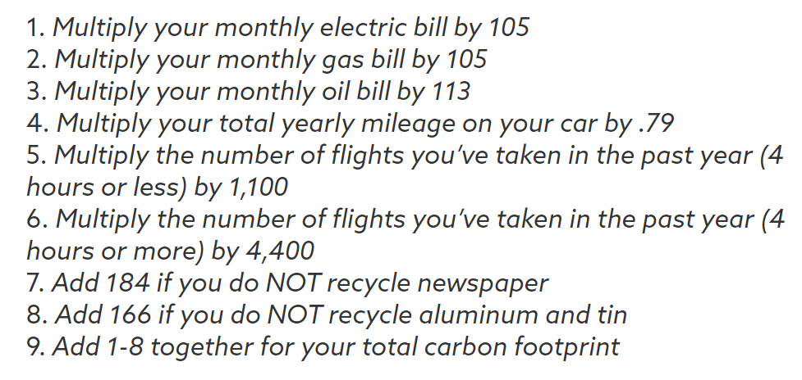
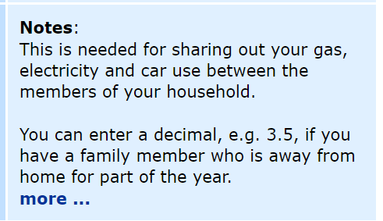
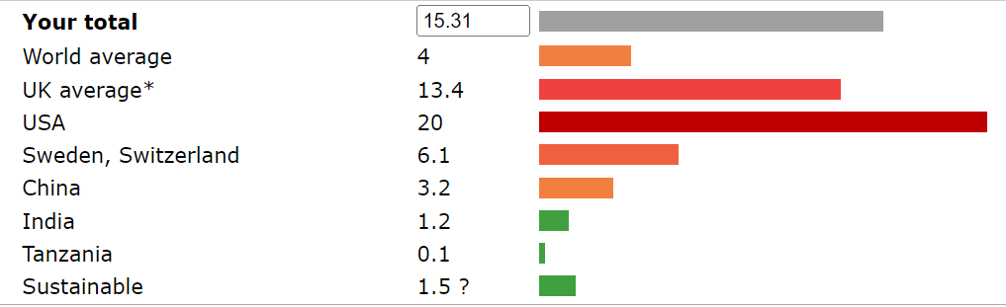
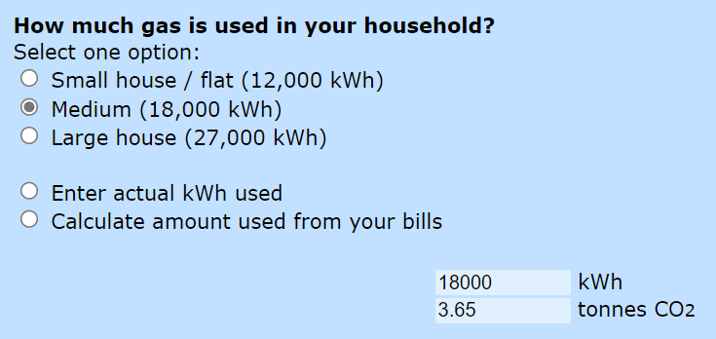
Current Solutions
Calculating your carbon footprint (justenergy.com)
Carbon footprint calculator (carbonindependent.org)
Carbon Footprint Calculator - version 3 (2008) Carbon Footprint Calculator. Available at: https://www.carbonindependent.org/index_v3.html#more%20notes (Accessed: 03 May 2024).
Calculating your carbon footprint (2013) How To Calculate Your Carbon Footprint. Available at: https://justenergy.com/blog/how-to-calculate-your-carbon-footprint/ (Accessed: 03 May 2024).
Advantage:
Compares the users value against countries averages
Shows the amount of CO2 produced from some questions
Has notes to help the users with the inputs.
Disadvantage:
Not all information is known by everyone and the options for some questions are vague with no help from notes
Advantage:
Simple calculation that anyone can do
Disadvantage:
Not all information is known by everyone
Doesn’t have a calculator where the user can just use instead of doing the calculation themself

Slide 6
Project
Decided to make a carbon calculator that didn’t ask questions that required information that some people didn’t have the answer to, for example how much energy their houses used.
R shiny language – one of the objectives was to help users to visualise their carbon footprint, r shiny offers graphs which would make it easier for them to visualise and understand.
Basic layout so that novice/older users wouldn’t find it difficult to navigate.

Slide 7
Design
User inclusivity - Chose a blue colour theme rather than green due to colour blind people being unable to see the colour green.
User guide – help with older/ novice users who will need help to navigate around the system.

Slide 8

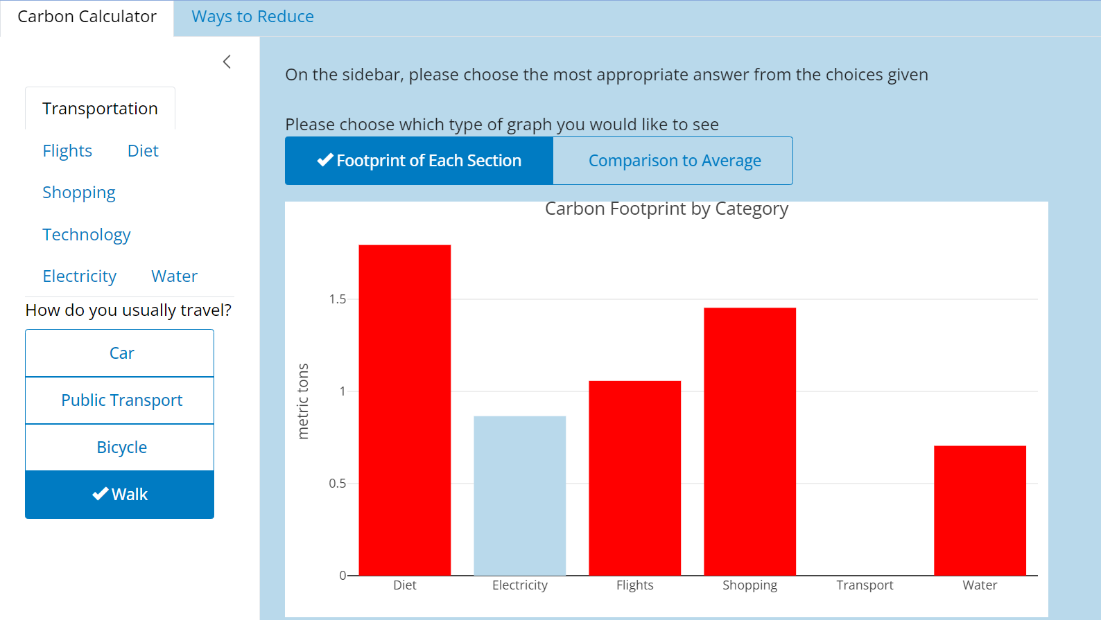
Implementation and Challenges
R is a new language so I had to learn how to use it so there were lots of errors.
The UI was made user friendly by having tab panels that have appropriate names to describe the page they are linked to.
The server was created to take the inputs from the UI and display graphs for the calculated footprints.

Slide 9
Evaluation
Does this project meet the aim identified at the beginning?
Reminder of the aim:
complete a software solution that can be used to help people reduce their carbon footprint by tracking, visualising, and understanding their carbon usage.
They can calculate their carbon footprint and visualise it through the graphs shown.
The colour of the bars on the graph helps the users to understand their footprint.
The user can’t track.
So, it partially solves the problem.

Slide 10

Future Improvements
Have a user login system so the users can track their carbon footprint over time.
Embedding the app – so the wider audience can have access to it.

