Slide 1
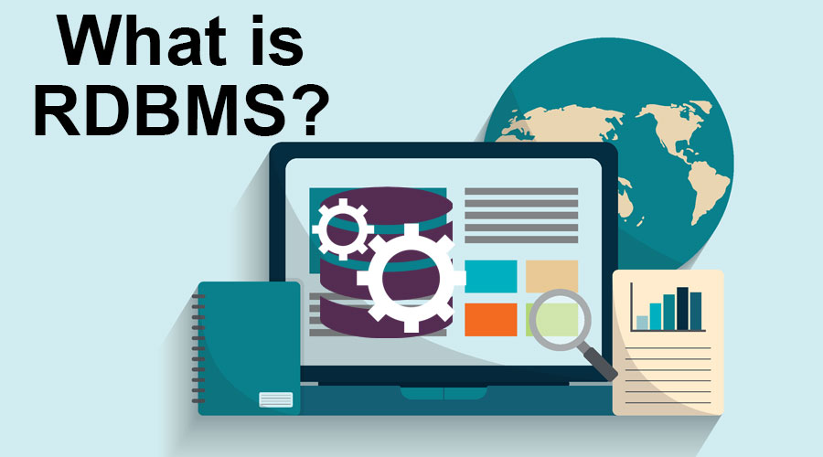
Habiba El Aggoun

Slide 2
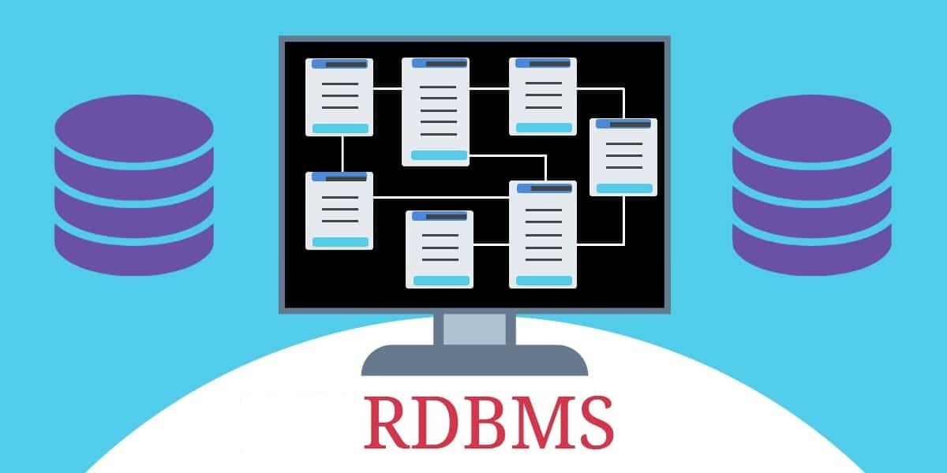
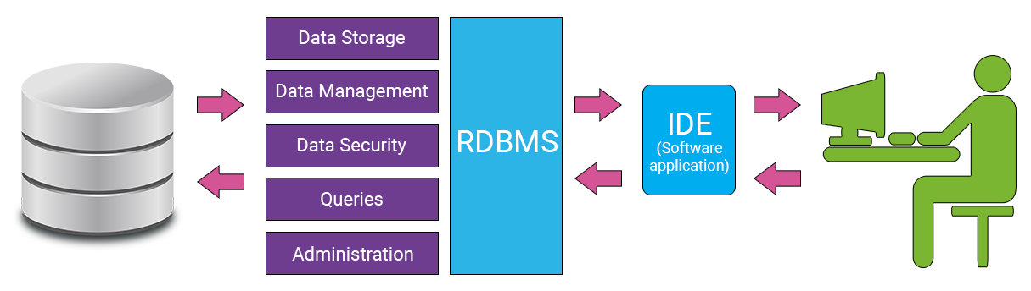
What is RDBMS ?
A relational database management system (RDBMS) is a program that allows you to create, update, and administer a relational database.

Slide 3
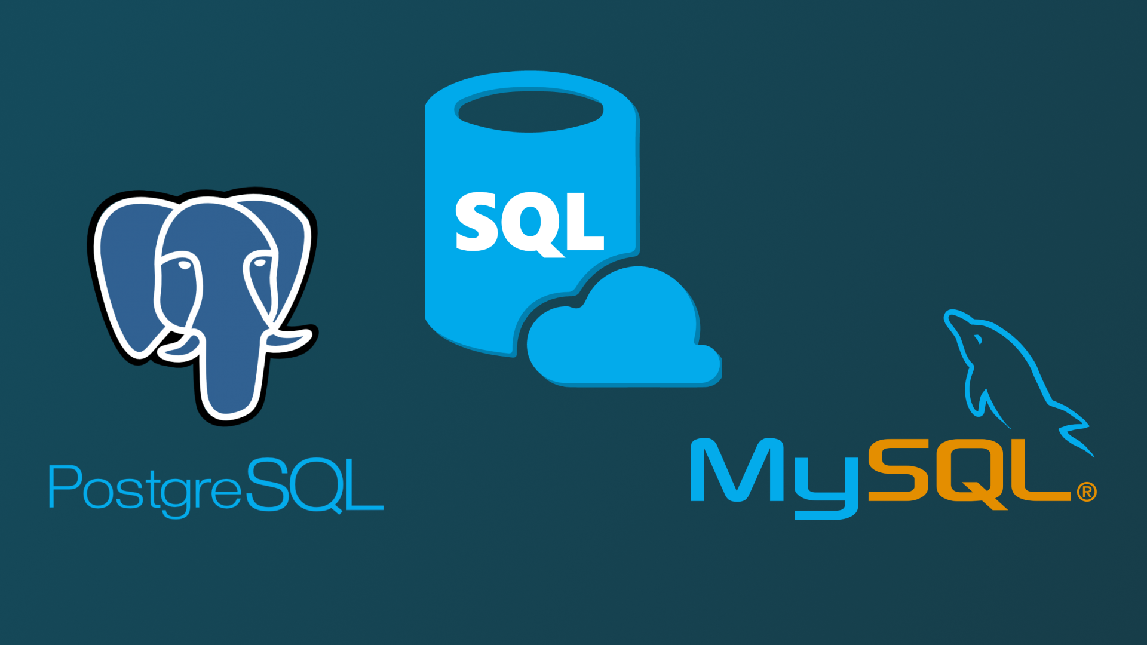
Relational Database Management Systems:
MySQL
PostgreSQL
SQL Server

Slide 4
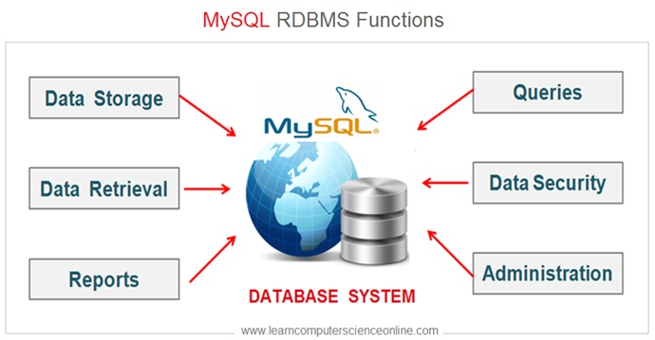
What is MySQL ?
MySQL is the most popular open source SQL database. It is typically used for web application development, and often accessed using PHP. The main advantages of MySQL are that it is easy to use, inexpensive, reliable (has been around since 1995), and has a large community of developers who can help answer questions.
Some of the disadvantages are that it has been known to suffer from poor performance when scaling, open source development has lagged since Oracle has taken control of MySQL, and it does not include some advanced features that developers may be used to.

Slide 5
What is PostgreSQL ?
PostgreSQL is an open source SQL database that is not controlled by any corporation. It is typically used for web application development.
PostgreSQL shares many of the same advantages of MySQL. It is easy to use, inexpensive, reliable and has a large community of developers. It also provides some additional features such as foreign key support without requiring complex configuration.
The main disadvantage of PostgreSQL is that it can be slower in performance than other databases such as MySQL. It is also slightly less popular than MySQL.
For more information about PostgreSQL including installation instructions.

Slide 6
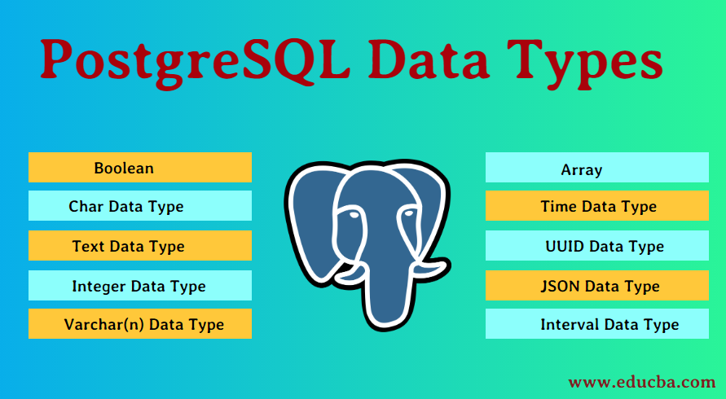

Slide 7
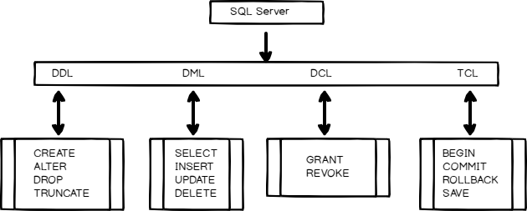
What is SQL Server ?
Microsoft owns SQL Server. Like Oracle DB, the code is close sourced.
Large enterprise applications mostly use SQL Server.
Microsoft offers a free entry-level version called Express but can become very expensive as you scale your application.

Slide 8
PostgreSQL vs MySQL
Why use MySQL?
Here, are some important reasons for using MYSQL:
Supports features like Master-Slave Replication, Scale-Out
It supports Offload Reporting, Geographic Data Distribution, etc.
Very Low overhead with MyISAM storage engine when used for read-mostly applications
Support for Memory storage engine for frequently used tables
Query Cache for repeatedly used statements
You can easily learn and troubleshoot MySQL from different sources like blogs, white papers, and books
Why use PostgreSQL?
Main reasons for using PostgreSQL are:
Offers useful features like Table partitioning, Point in Time Recovery, Transactional DDL, etc.
Ability to utilize 3rd party Key Stores in a full PKI infrastructure
Developers can modify open source code as it is licensed under BSD without the need to contribute back enhancements
Independent Software Vendors can redistribute it without the fear of being “infected” by an open source license
Users and Roles can be assigned Object level privileges
Supports AES, 3DES and other data encryption algorithms.

Slide 9
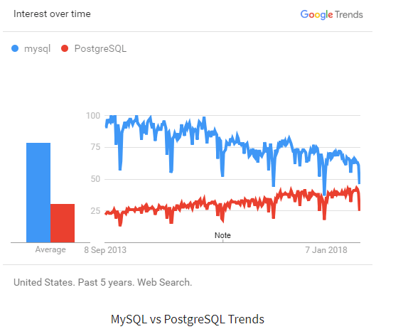

Slide 10
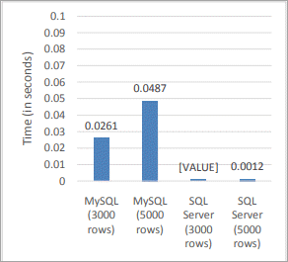
MySQL vs SQL Server
Both MySQL and SQL Server, both are relational database management systems or RDBMS. MySQL is open source and is free to use whereas SQL Server is licensed product of Microsoft.
Following are the important differences between MySQL and SQL Server.

Slide 11
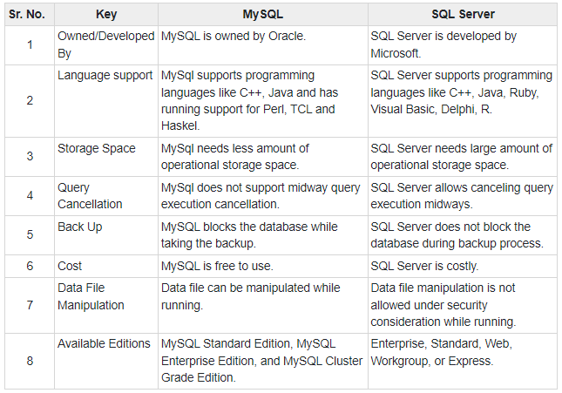

Slide 12
PostgreSQL vs SQL Server
PostgreSQL is a powerful, open-source, Object-relational database system. It provides good performance but needs fewer maintenance efforts as of its high stability.
It was the first Database Management System that implemented the multi-version concurrency control (MVCC) feature. It is known for supporting a lot of data types, intuitive storage of schemaless data.
SQL Server is a Relational Database Management System. It is platform-dependent and it supports both Command Line Interface (CLI) and Graphical User Interface (GUI).
It is a commercial solution and is preferred by most of the companies who are dealing with large traffic workloads on daily basis. It supports a wide variety of tools like reporting services, integration systems, transaction processing, business intelligence, and analytics in the IT environment.

Slide 13
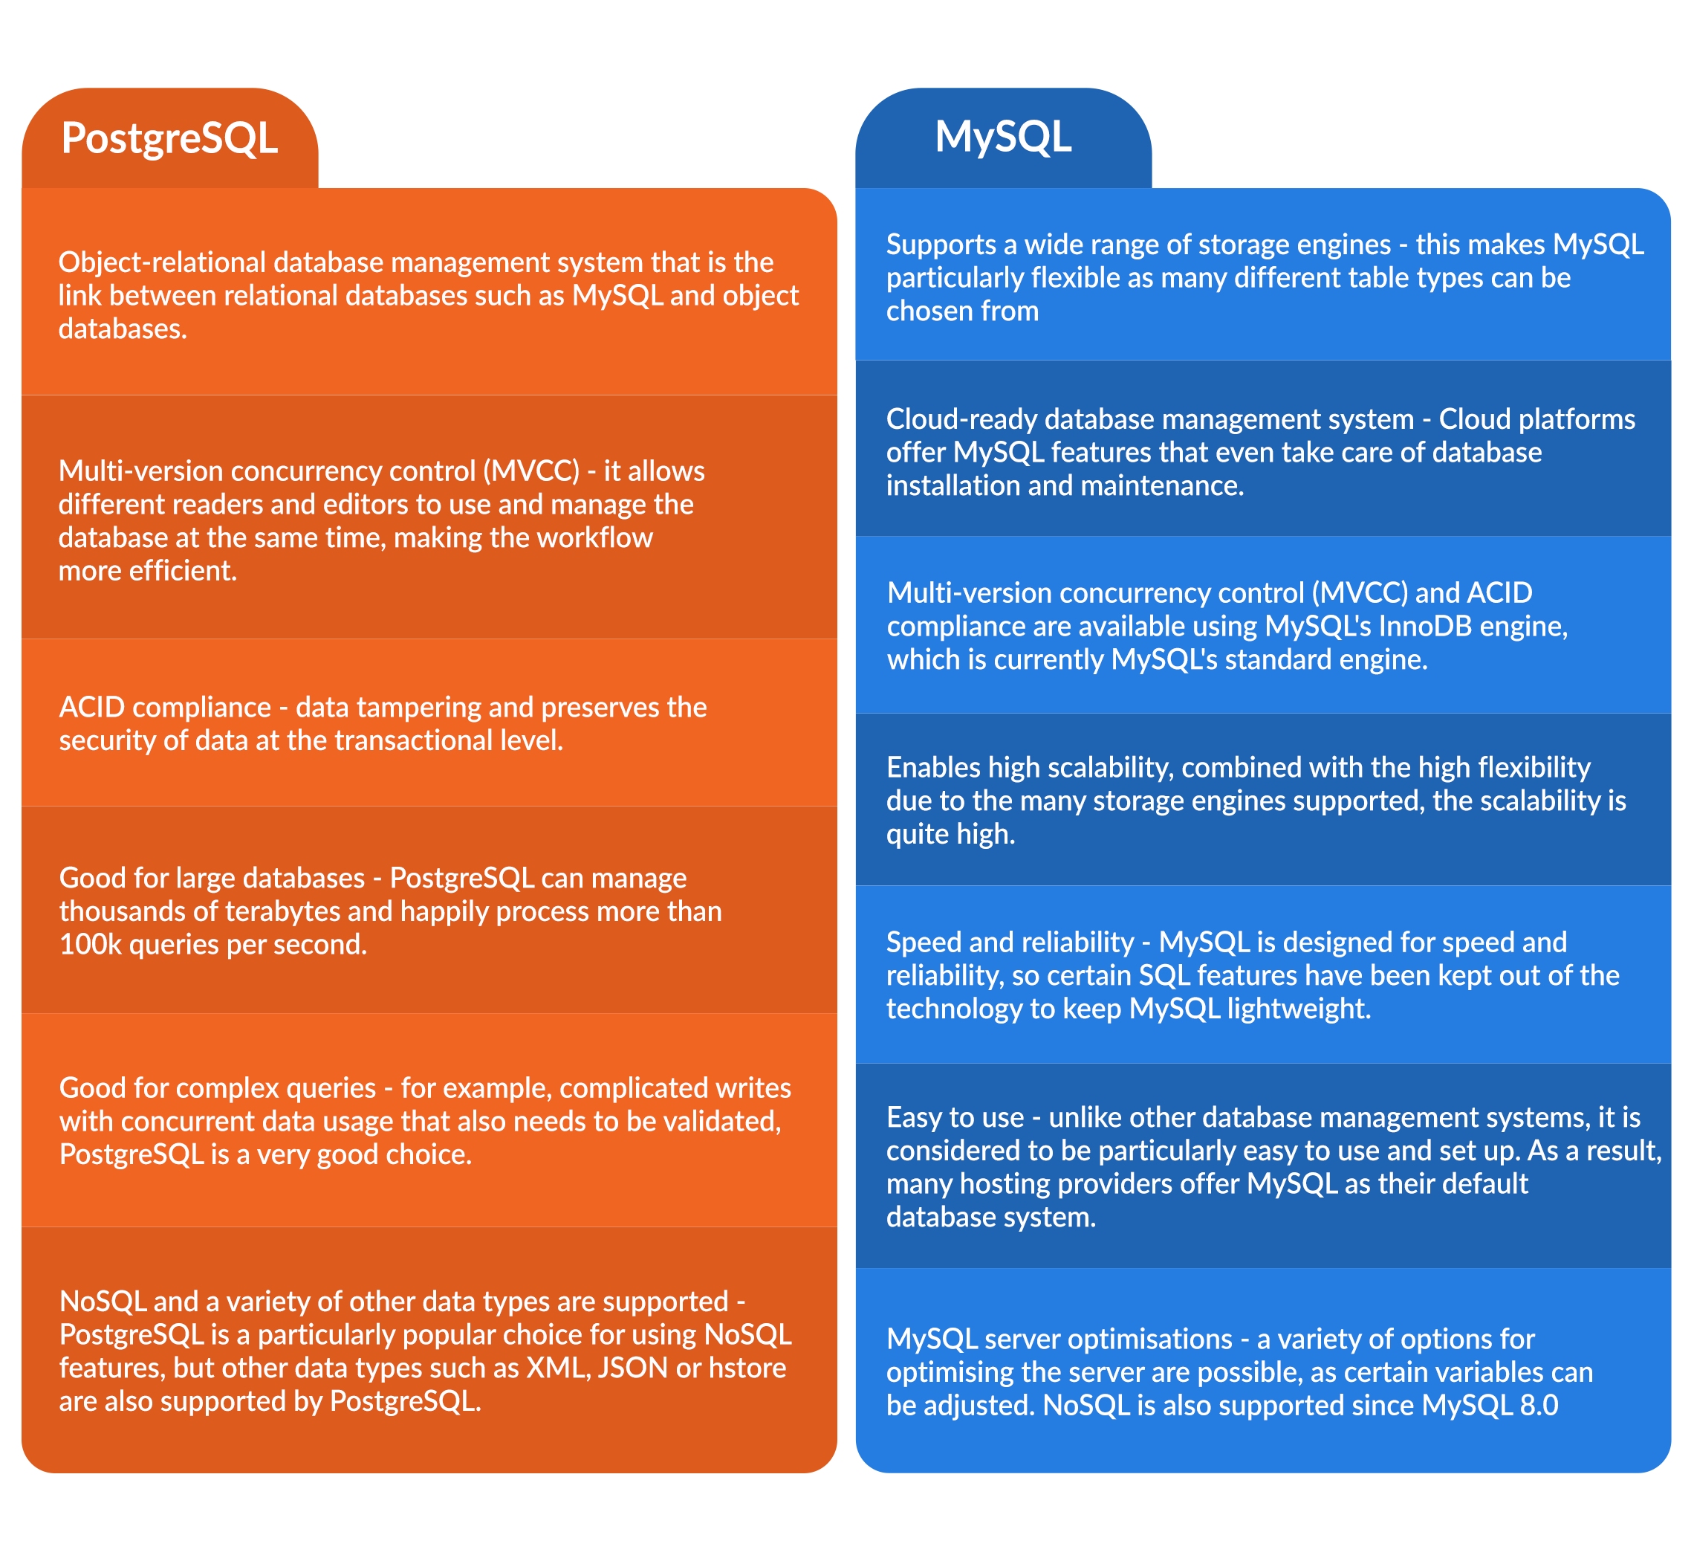

Slide 14
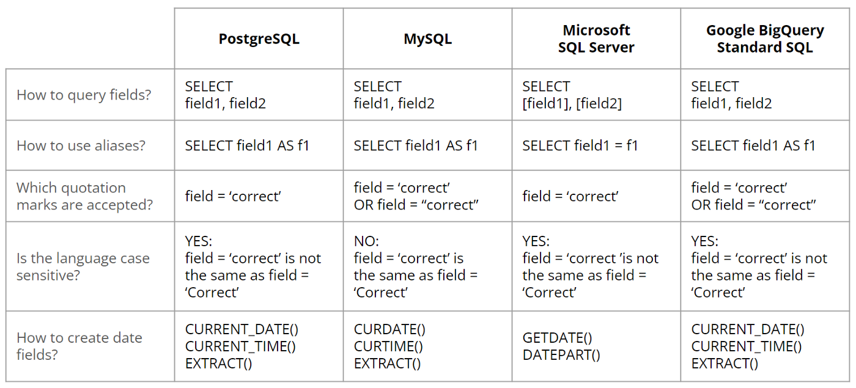

Slide 15
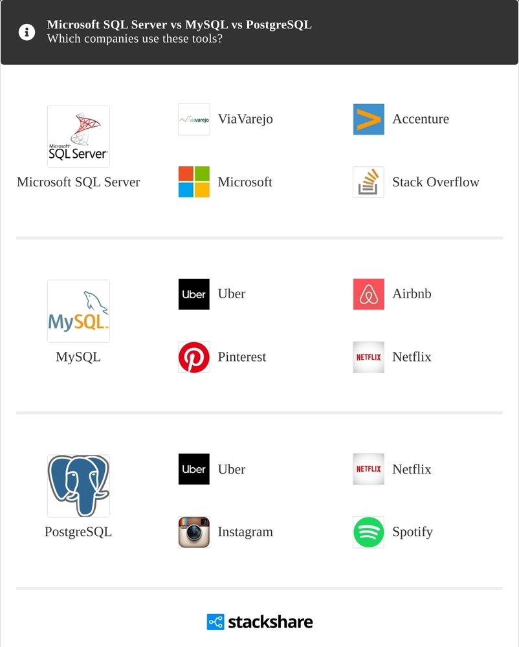

Slide 16
