Slide 1


Multi-Omics Meta-Analysis
Tamim Alaa – 211002002
Hana Mohamed Hikal – 231000300
Asmaa Ragab – 221001773
Habiba Farag - 221001888

Slide 2
Abstract and Overview
STUDY PURPOSE
This study explores molecular connections between COVID-19 and Alzheimer’s Disease, emphasizing their shared pathways and biological implications.
KEY FINDINGS
The analysis revealed 20 shared DEGs, with 7 genes regulated similarly between both diseases, indicating significant molecular overlap.
COMMON PATHWAYS
Identified pathways include mitochondrial dysfunction, oxidative phosphorylation, and neuroinflammation, highlighting critical links between the two diseases' mechanisms.

Slide 3

Background Overview
SARS-COV-2
ALZHEIMER’S DISEASE
CLINICAL LINK
SARS-CoV-2 primarily impacts the respiratory system but also leads to systemic and neurological effects, complicating patient recovery and health.
Alzheimer's Disease is a progressive neurodegenerative disorder characterized by cognitive decline, memory loss, and amyloid-beta plaque accumulation in the brain.
Evidence suggests COVID-19 may accelerate neurodegeneration or exacerbate existing Alzheimer’s symptoms, raising significant concerns for affected individuals and healthcare systems.

Slide 4
Neurological Implications
LONG COVID
NEUROINFLAMMATION
CYTOKINE STORM
Long COVID often includes cognitive impairment, memory loss, and brain fog, significantly impacting daily functioning and quality of life.
Neuroinflammation is a key mechanism in COVID-19, leading to increased brain inflammation and contributing to neurological symptoms post-infection.
The cytokine storm triggered by COVID-19 results in excessive immune responses, which can damage brain tissue and worsen neurological outcomes.

Slide 5
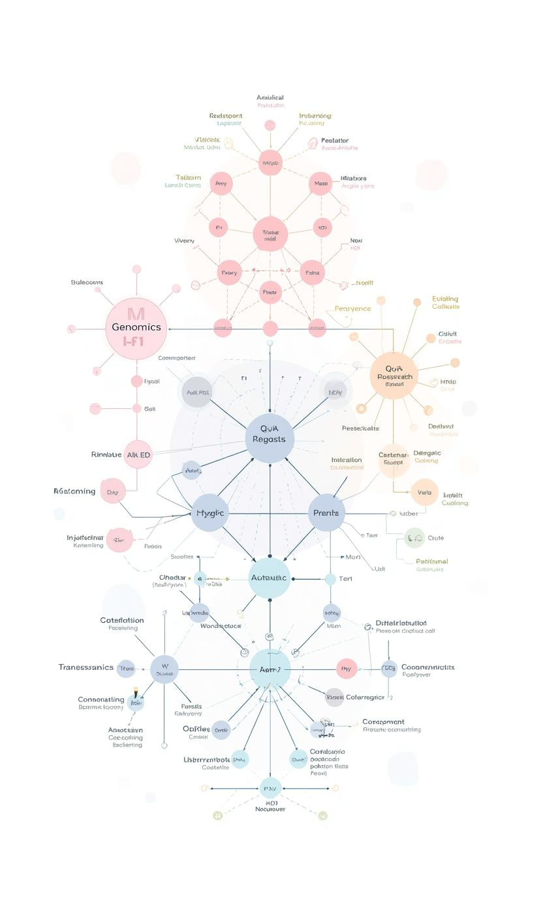
Rationale for Utilizing Multi-Omics Meta-Analysis
INTEGRATIVE BIOINFORMATICS APPROACH
The challenge of individual studies is their limited sample size; hence, integrating datasets allows for the discovery of shared molecular patterns using WGCNA.

Slide 6
Research Objectives
IDENTIFY DEGS
FIND SIGNATURES
DETERMINE PATHWAYS
The study aims to identify differentially expressed genes (DEGs) in both COVID-19 and Alzheimer’s Disease datasets, enhancing understanding of molecular connections.
By analyzing the datasets, we will find shared molecular signatures that reveal both concordant and discordant gene expression patterns between the diseases.
Key biological pathways common to COVID-19 and Alzheimer’s Disease will be determined, providing insights into their interconnected mechanisms and implications for treatment.

Slide 7
Data Sources and Analysis
COVID-19
ALZHEIMER’S DISEASE
ANALYSIS PIPELINE
The dataset GSE157103 comprises blood RNA-seq samples from COVID-19 patients, facilitating insights into immune responses and gene expression changes.
GSE5281 contains brain microarray data from Alzheimer’s patients, providing critical information about neurodegenerative changes and molecular signatures in AD.
The analysis involved preprocessing, differential expression analysis using limma, and functional enrichment assessments through Gene Ontology and KEGG pathways.

Slide 8
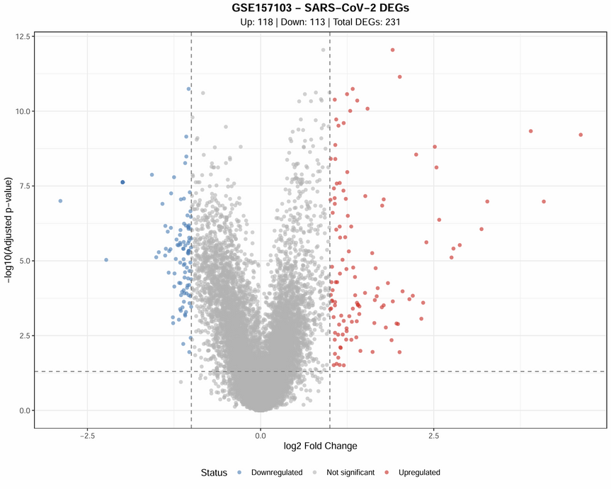
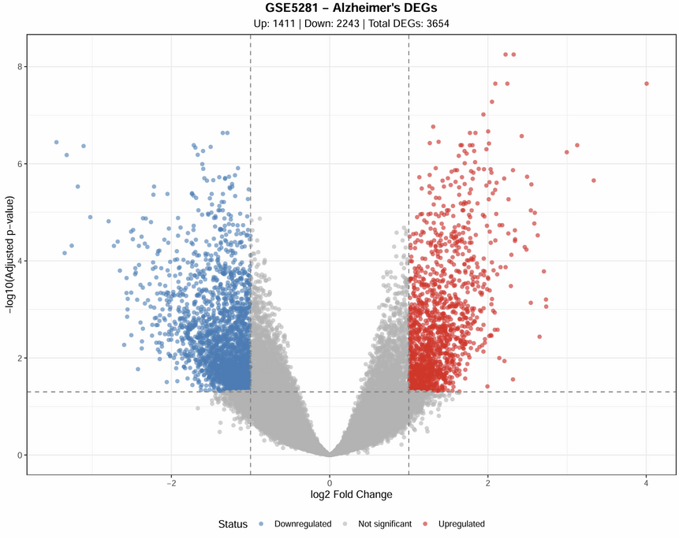
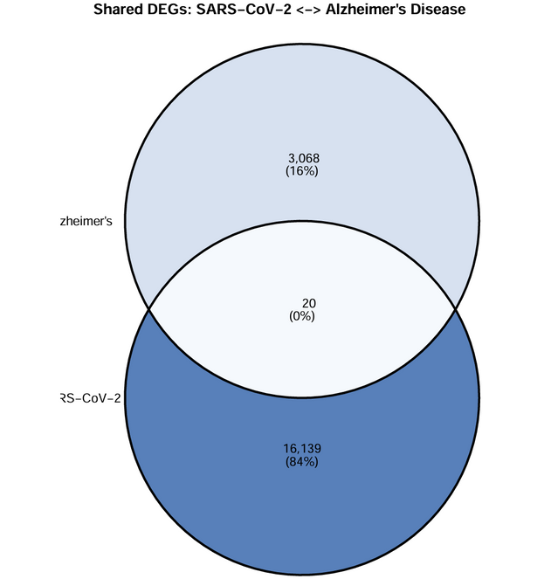
Differential Expression Results
COVID-19
ALZHEIMER’S
OVERLAP
A total of 231 differentially expressed genes (DEGs) were identified in COVID-19 samples, with 118 genes upregulated and 113 downregulated.
In Alzheimer’s disease, 3,654 DEGs were detected, comprising 1,411 upregulated genes and 2,243 downregulated genes, highlighting extensive molecular changes.
The meta-analysis revealed 20 shared DEGs between the two conditions, including 7 genes that are concordantly regulated, indicating significant molecular intersections.

Slide 9
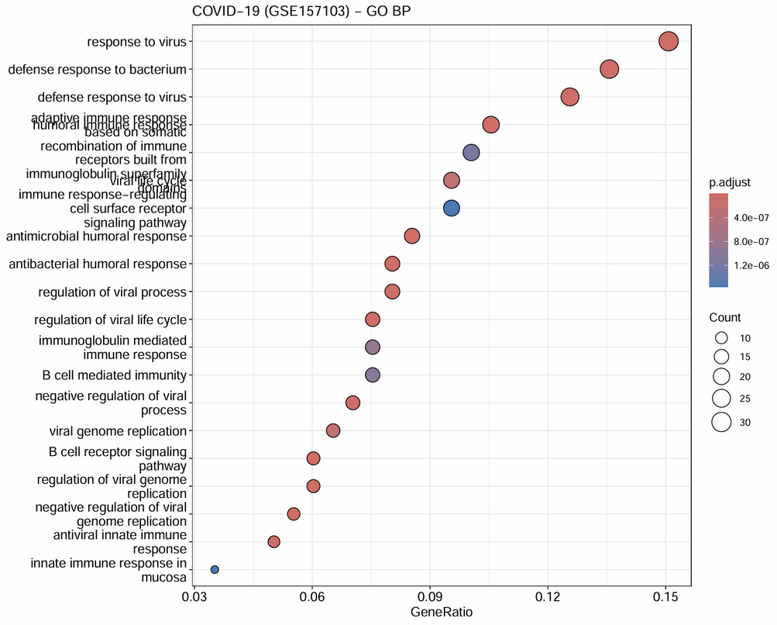
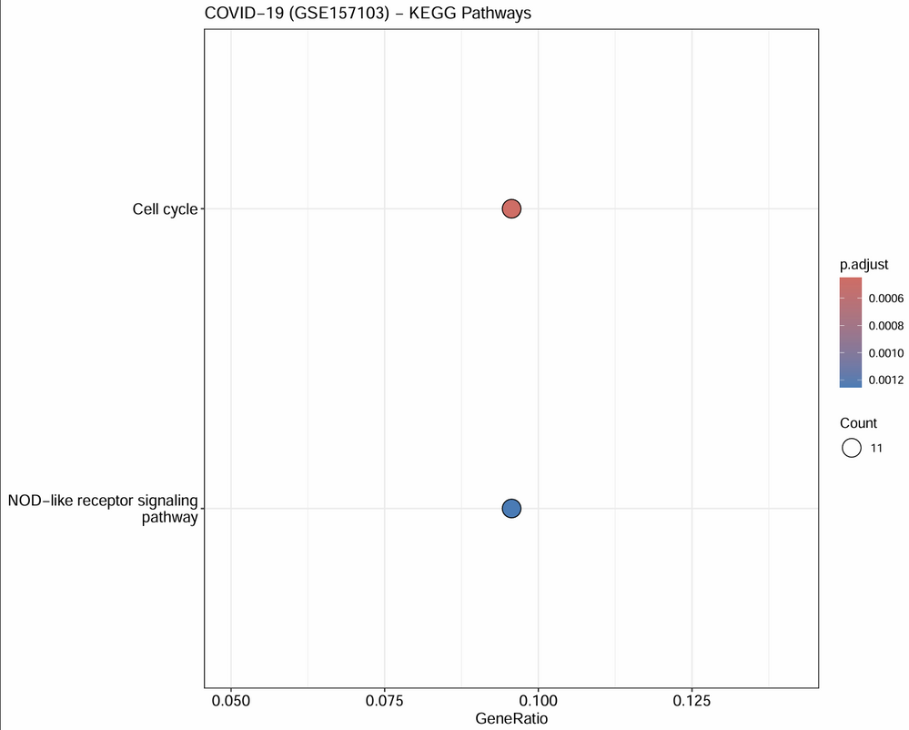
Shared Biological Pathways
COVID-19
ALZHEIMER’S DISEASE
COMMON THEMES
COVID-19 is characterized by robust inflammatory pathways, which can lead to significant immune system activation and systemic effects on health.
Energy metabolism disruption is a hallmark of Alzheimer’s Disease, affecting neuronal function and contributing to the progression of cognitive decline.
Both conditions demonstrate mitochondrial dysfunction, linking cellular energy deficits to neuroinflammation, which may exacerbate cognitive impairments in affected individuals.

Slide 10
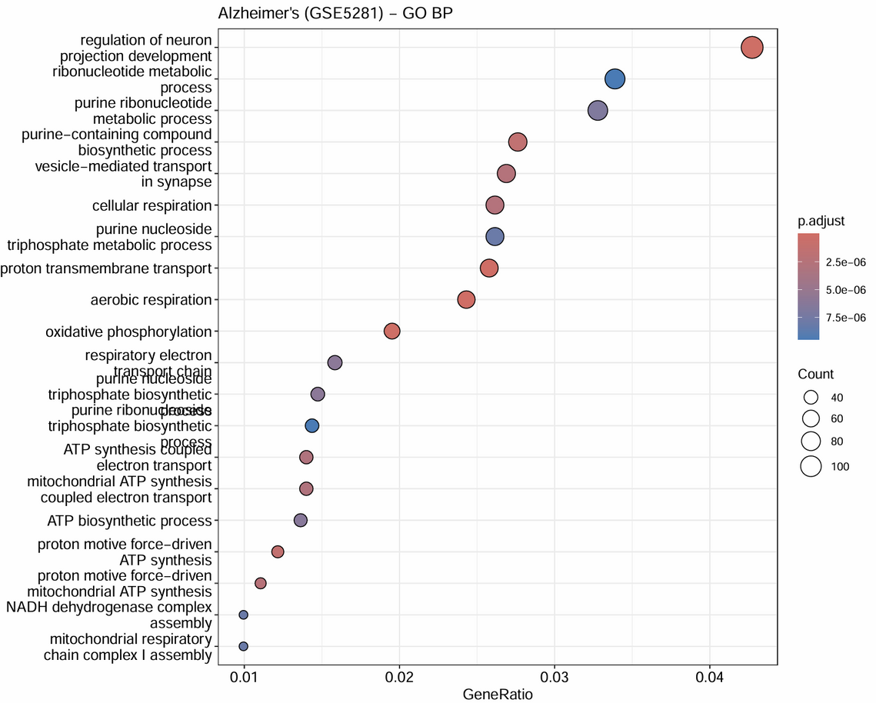
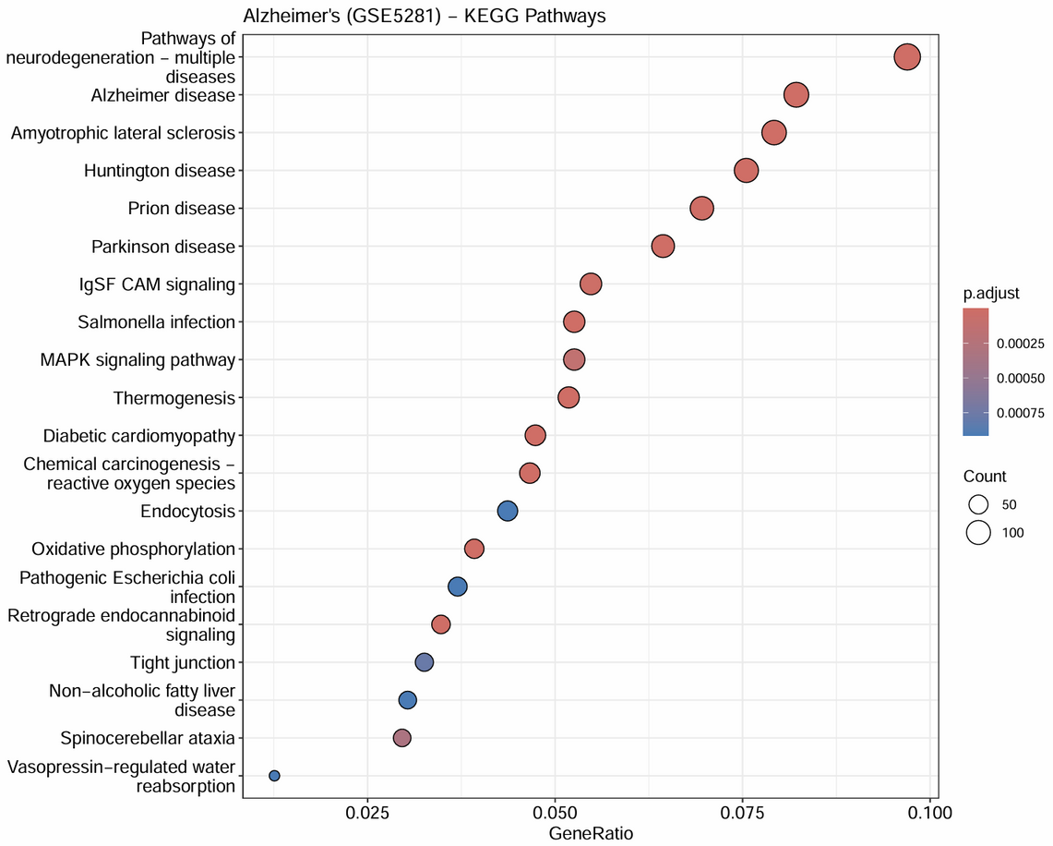
Shared Biological Pathways
COVID-19
ALZHEIMER’S DISEASE
COMMON THEMES
COVID-19 is characterized by robust inflammatory pathways, which can lead to significant immune system activation and systemic effects on health.
Energy metabolism disruption is a hallmark of Alzheimer’s Disease, affecting neuronal function and contributing to the progression of cognitive decline.
Both conditions demonstrate mitochondrial dysfunction, linking cellular energy deficits to neuroinflammation, which may exacerbate cognitive impairments in affected individuals.

Slide 11
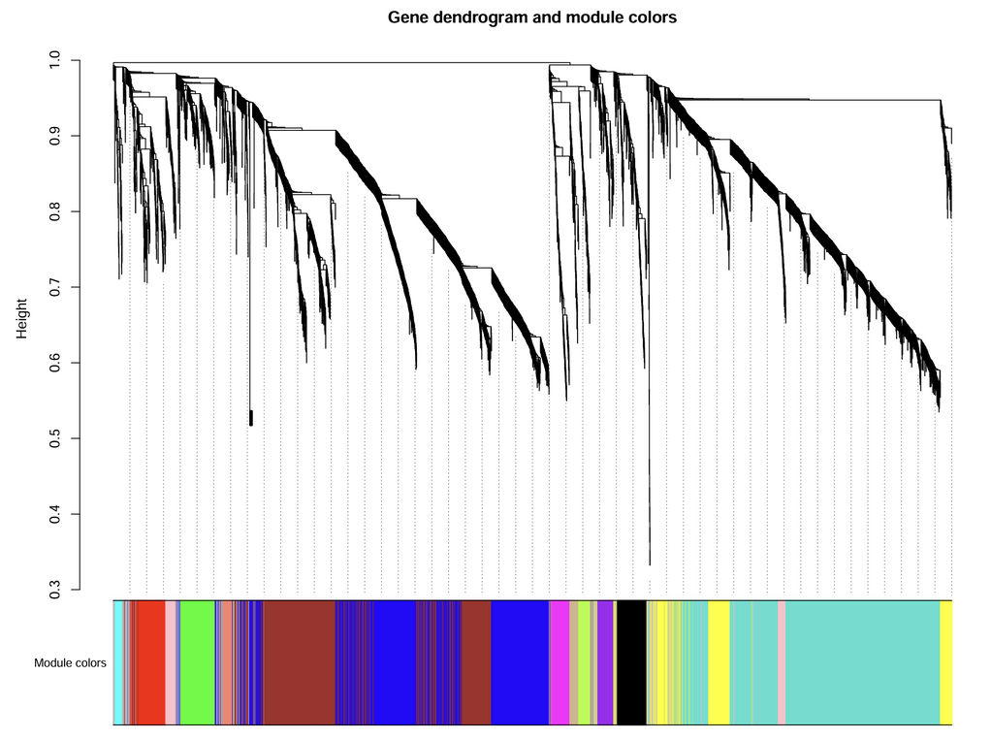
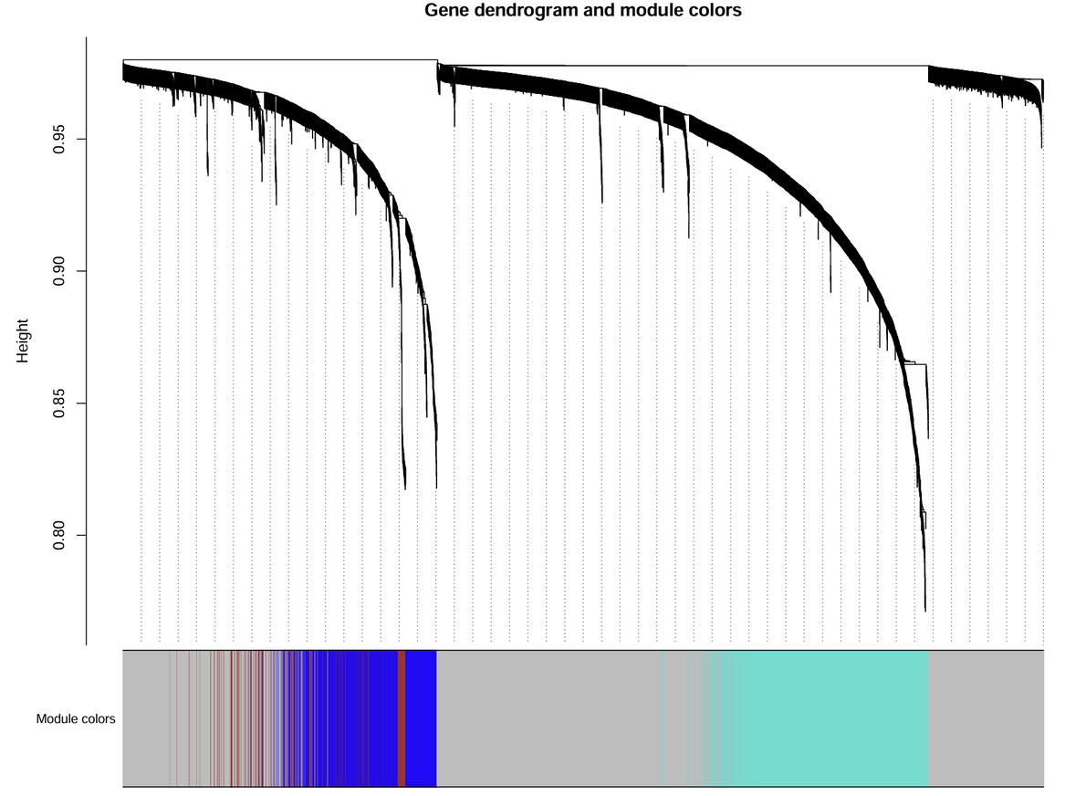
WGCNA and Hub Genes
COVID-19 MODULES
AD MODULES
HUB GENES
The COVID-19 network consists of 14 distinct modules, highlighting various co-expressed gene groups associated with the disease's pathology.
The Alzheimer’s Disease network comprises 3 modules, indicating specific gene co-expression patterns relevant to neurodegenerative processes and disease progression.
Within the COVID-19 network, 7 shared DEGs were identified as hub genes, suggesting they play critical roles in overlapping molecular mechanisms.

Slide 12
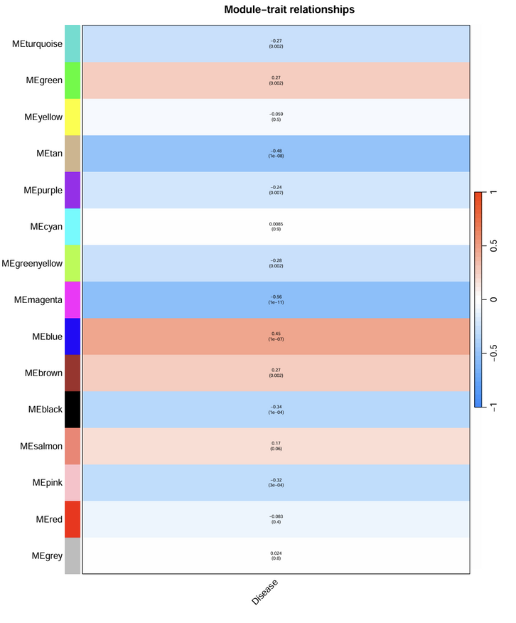
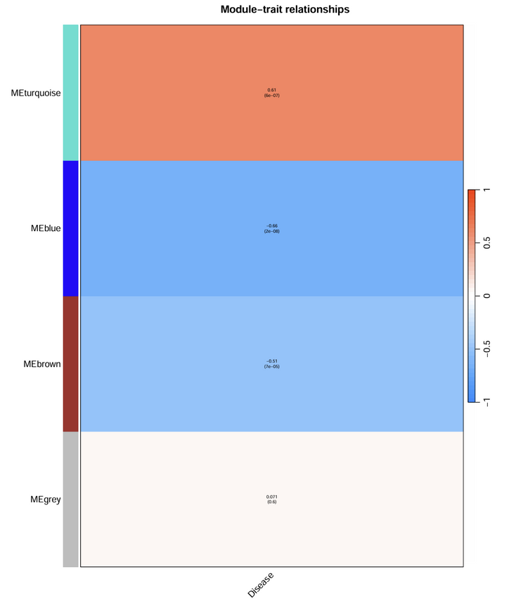
WGCNA and Hub Genes
COVID-19 MODULES
AD MODULES
HUB GENES
The COVID-19 network consists of 14 distinct modules, highlighting various co-expressed gene groups associated with the disease's pathology.
The Alzheimer’s Disease network comprises 3 modules, indicating specific gene co-expression patterns relevant to neurodegenerative processes and disease progression.
Within the COVID-19 network, 7 shared DEGs were identified as hub genes, suggesting they play critical roles in overlapping molecular mechanisms.

Slide 13
Discussion Highlights
MITOCHONDRIAL DYSFUNCTION
NEUROINFLAMMATION
HUB GENES
The study reveals disruption in energy metabolism, indicating that mitochondrial dysfunction may play a significant role in disease progression.
Common immune activation linked to neuroinflammation suggests a shared pathway in both SARS-CoV-2 infection and Alzheimer’s Disease.
Identifying hub genes offers insights into how viral infection may influence neurodegeneration, potentially guiding future therapeutic strategies.

Slide 14
Clinical Significance
RISK STRATIFICATION
THERAPEUTIC POTENTIAL
BIOMARKERS
Identifying patients at risk for cognitive decline post-COVID enables targeted monitoring and early interventions to improve long-term outcomes.
Repurposing existing Alzheimer’s disease medications could enhance treatment options for patients experiencing cognitive effects due to COVID-19 infection.
The seven hub genes identified may serve as potential diagnostic indicators for cognitive impairments associated with COVID-19 and Alzheimer’s disease.

Slide 15
Limitations and Future Work
LIMITATIONS
CROSS-SECTIONAL
FUTURE DIRECTIONS
Different tissue sources can introduce variability, complicating comparisons and limiting the generalizability of findings between COVID-19 and AD studies.
Cross-sectional data limits causal inferences, underscoring the need for longitudinal studies to better understand disease progression and relationships over time.
Future research should focus on longitudinal studies to track disease evolution and experimental validation of hub genes identified in the analysis.

Slide 16
Conclusion
MOLECULAR OVERLAP
HUB GENES
CLINICAL IMPLICATIONS
COVID-19 and Alzheimer's Disease share significant molecular signatures, indicating common pathways that may underlie their interconnectedness.
The seven hub genes identified may serve as critical mediators, linking viral infection effects to neurodegenerative processes in patients.
These findings support clinical observations of cognitive decline post-COVID-19 and highlight the need for further investigations into therapeutic interventions.

Slide 17


Thank You for Your Attention

