Slide 1
SIC Workshops and Learning Events Planner
SIC 8
CP - 801 Course
Team 12
Notes:
Note:

Slide 2
Agenda
Team
Problem Statement
Introduction
Methodology
Key Tasks
Results and Insights
Conclusion
Q&A
Notes:
Note:

Slide 3
Meet The Team
Ahmed Mahmoud
Steven Ayman
Habiba Ibrahim
Notes:
Note:

Slide 4
Agenda
Team
Problem Statement
Introduction
Key Tasks
Methodology
Results and Insights
Conclusion
Q&A
Notes:
Note:

Slide 5
Problem Statement
Fragmented Learning Opportunities: Learners and professionals struggle to discover, filter, and organize programming, AI, and design workshops in a single unified platform.
Manual Calculation Inefficiencies: Lack of automated mechanisms to accurately compute total registration fees, cumulative learning durations, and transportation costs across multiple selected events.
Data Persistence & Role Management Challenges: The need for secure user authentication, distinct role segregation (Admin vs. User), and persistent JSON-based data storage to prevent information loss.
Navigation & Search Overhead: The absence of structured data models like Stacks for page-history management and efficient manual sorting algorithms (Merge Sort) for quick price and rating evaluation.
Notes:
Note:

Slide 6
Agenda
Team
Problem Statement
Introduction
Methodology
Key Tasks
Results and Insights
Conclusion
Q&A
Notes:
Note:

Slide 7
Introduction
System Overview: Developed the Workshops & Learning Events Planner as a comprehensive Python application designed to help users discover, filter, and organize educational events across categories like Programming, AI, and Design.
Core Functionalities: Enables users to manage personalized learning plans, search events by name or trainer, and evaluate options through manual sorting and calculations.
Architecture & Data Management: Built using Object-Oriented Programming (OOP) principles, featuring persistent JSON storage for events and users, alongside role-based access control for Admins and standard Users.
Financial & Duration Calculations: Integrates robust summary functions to compute total registration fees, cumulative learning durations, and associated costs for the user's plan.
Notes:
Note:

Slide 8
Agenda
Team
Problem Statement
Introduction
Methodology
Key Tasks
Results and Insights
Conclusion
Q&A
Notes:
Note:

Slide 9
Methodology
Object-Oriented Programming (OOP) Design: Structured the system architecture using class-based modeling (e.g., Event, EventManager, LearningPlan) to promote modularity and clean code.
Persistent Data Storage: Implemented local JSON-based serialization and deserialization (events.json, users.json) to maintain state and ensure data persistence across sessions.
Authentication & Role-Based Access Control: Developed robust input validation routines and access control measures to separate permissions between regular users and system administrators.
Manual Algorithmic Sorting: Integrated a custom Divide-and-Conquer MergeSort algorithm to manually organize events by price or rating without relying on built-in sorting functions.
Recursive Summary Computation: Built recursive calculation functions within the learning plan logic to compute cumulative event fees and total learning hours efficiently.
Notes:
Note:

Slide 10
Agenda
Team
Problem Statement
Introduction
Methodology
Key Tasks
Results and Insights
Conclusion
Q&A
Notes:
Note:

Slide 11
Key Tasks Implemented
User Authentication & Role Management: Implemented secure login and registration modules with strict input validations and segregated permissions for standard users and administrators.
Event Management System: Developed core operations for administrators to add, update seats, modify pricing, and remove events, coupled with dynamic filtering and keyword search for users.
Personalized Learning Plan Integration: Created a dedicated plan builder enabling users to add or remove workshops, automatically update available seat counts, and maintain state persistence.
Custom Merge Sort Algorithm: Built a manual Divide-and-Conquer sorting mechanism to order workshop listings efficiently by price or rating without relying on built-in language shortcuts.
Financial & Cost Summary Calculations: Integrated automated summary features to compute cumulative event fees, total learning hours, and transportation costs in a structured report.
Notes:
Note:

Slide 12
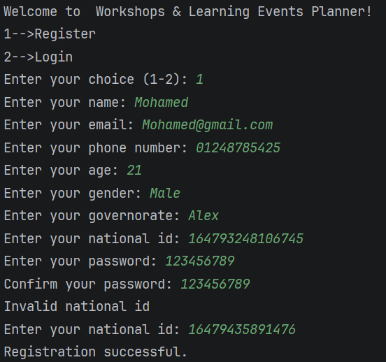
Register

Slide 13
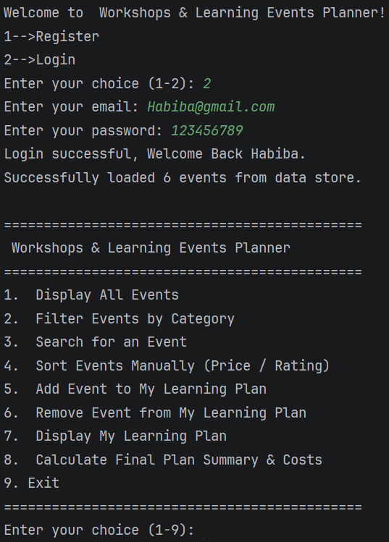
User Login

Slide 14
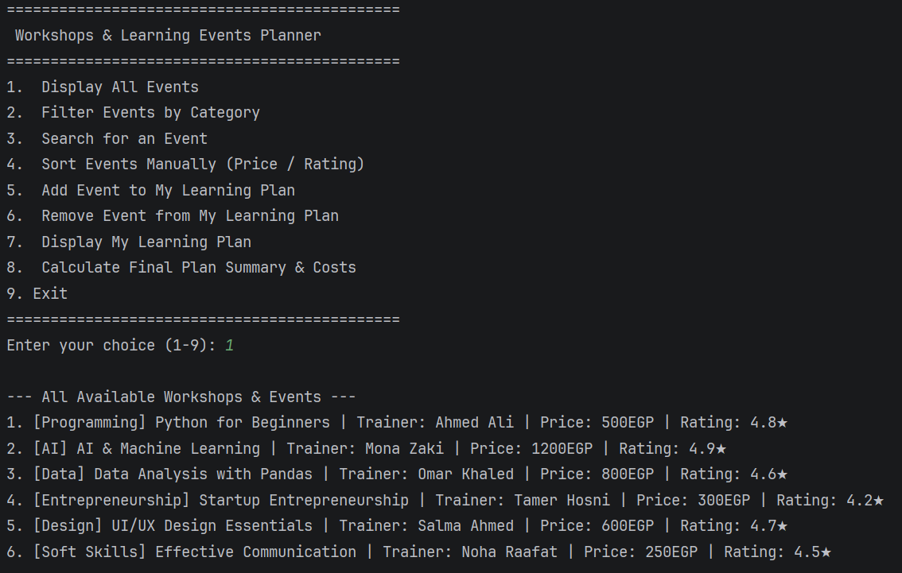
Display Events

Slide 15
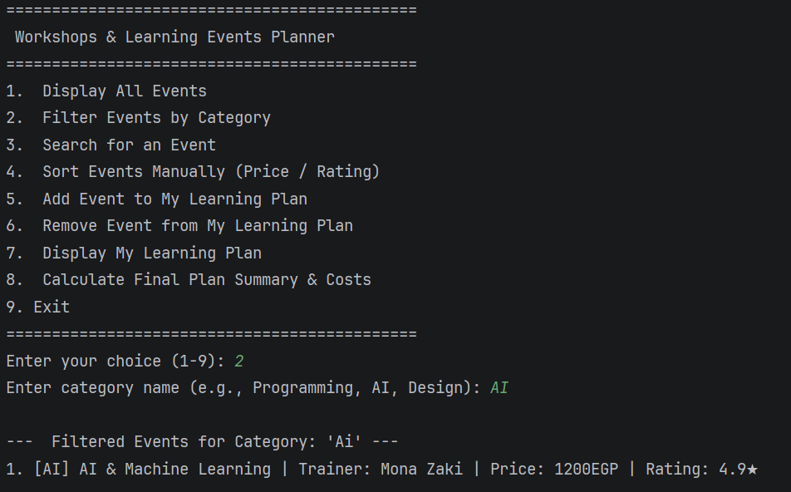
Filter Events

Slide 16
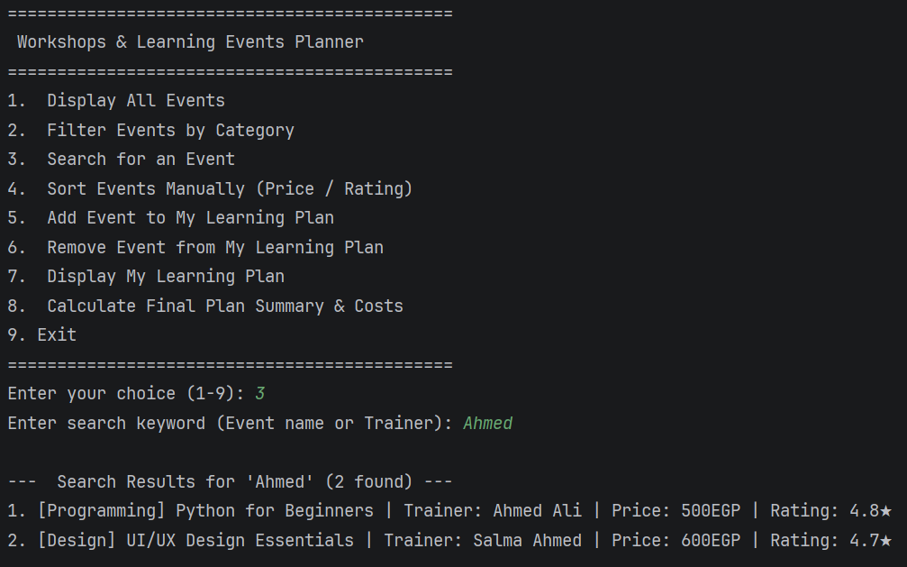
Search for an Events

Slide 17
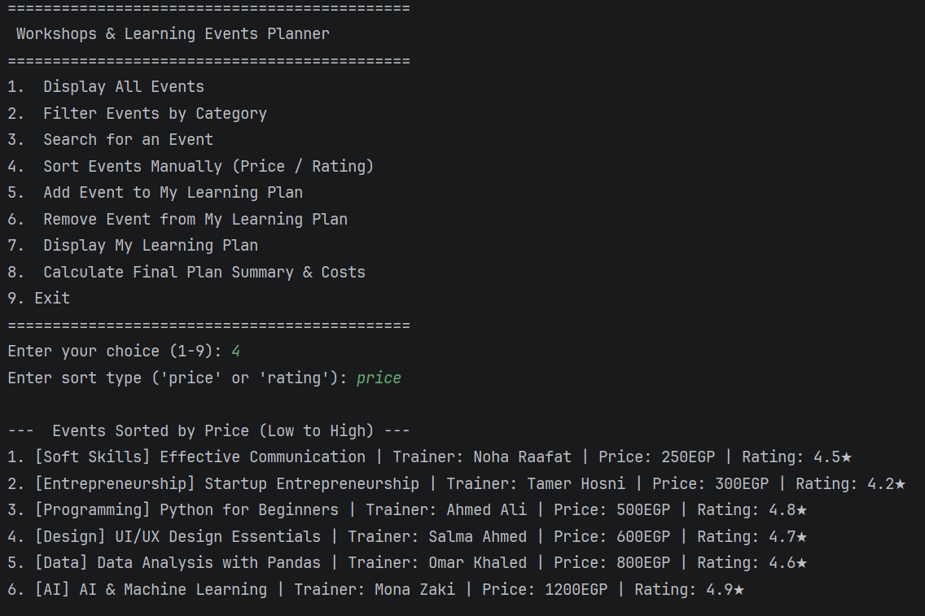
Sort Events

Slide 18
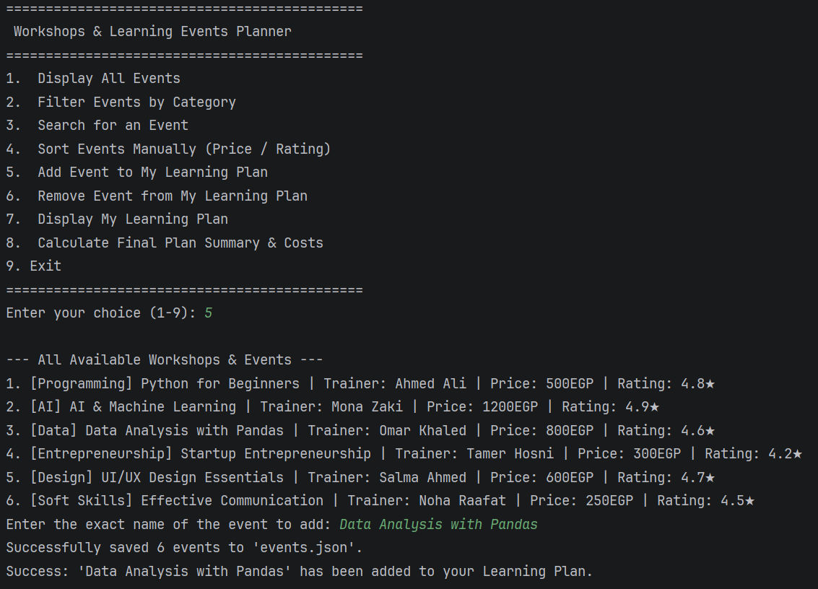
Add Event to plan

Slide 19
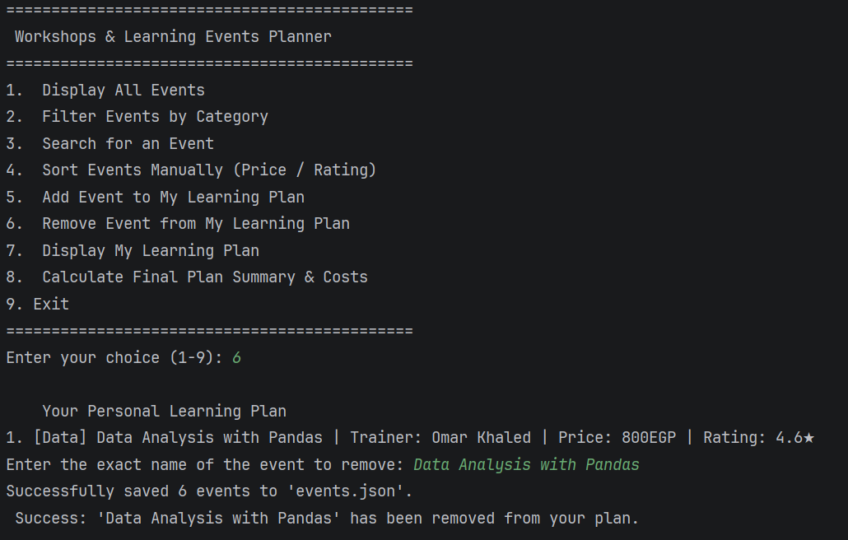
Remove Event from plan

Slide 20
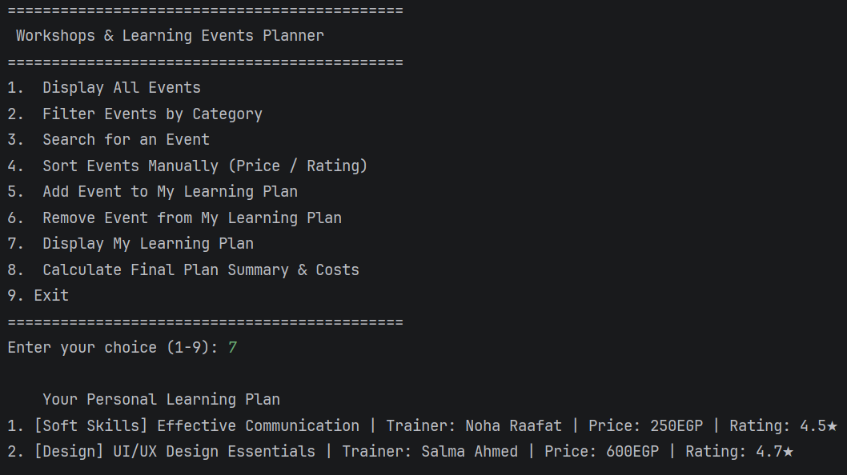
Display My Plan

Slide 21
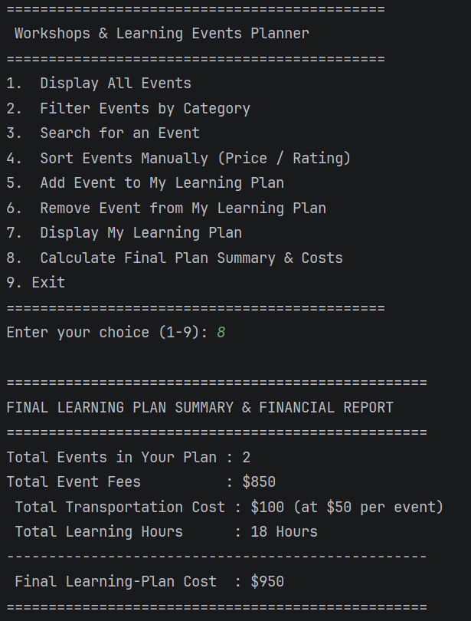
Calculate Final Plan

Slide 22
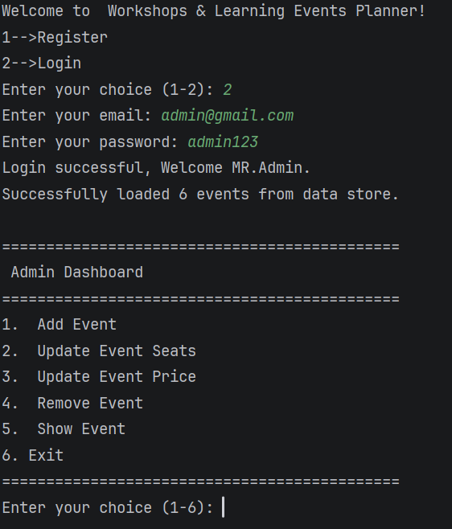
Admin Login

Slide 23
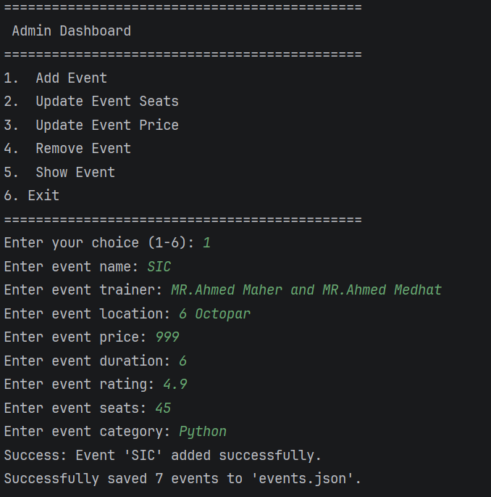
Add Event

Slide 24
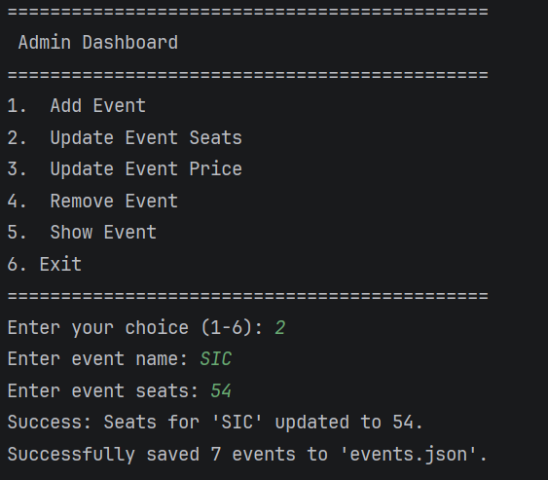
Update Event Seats

Slide 25
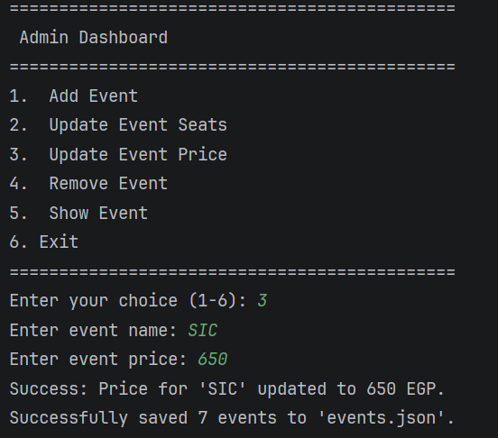
Update Event Price

Slide 26
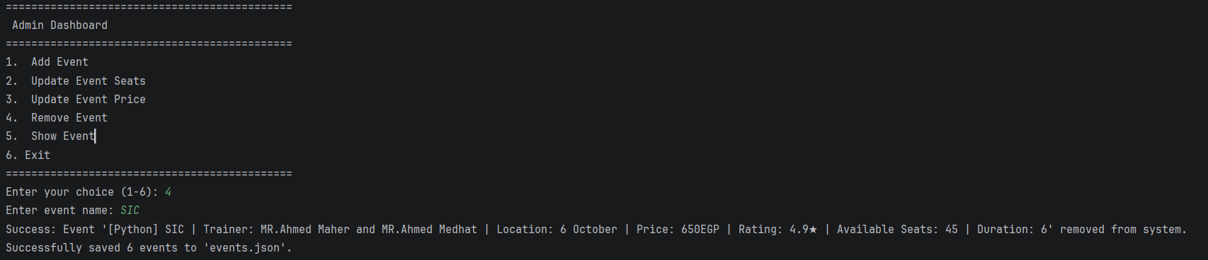
Admin Removes Event

Slide 27
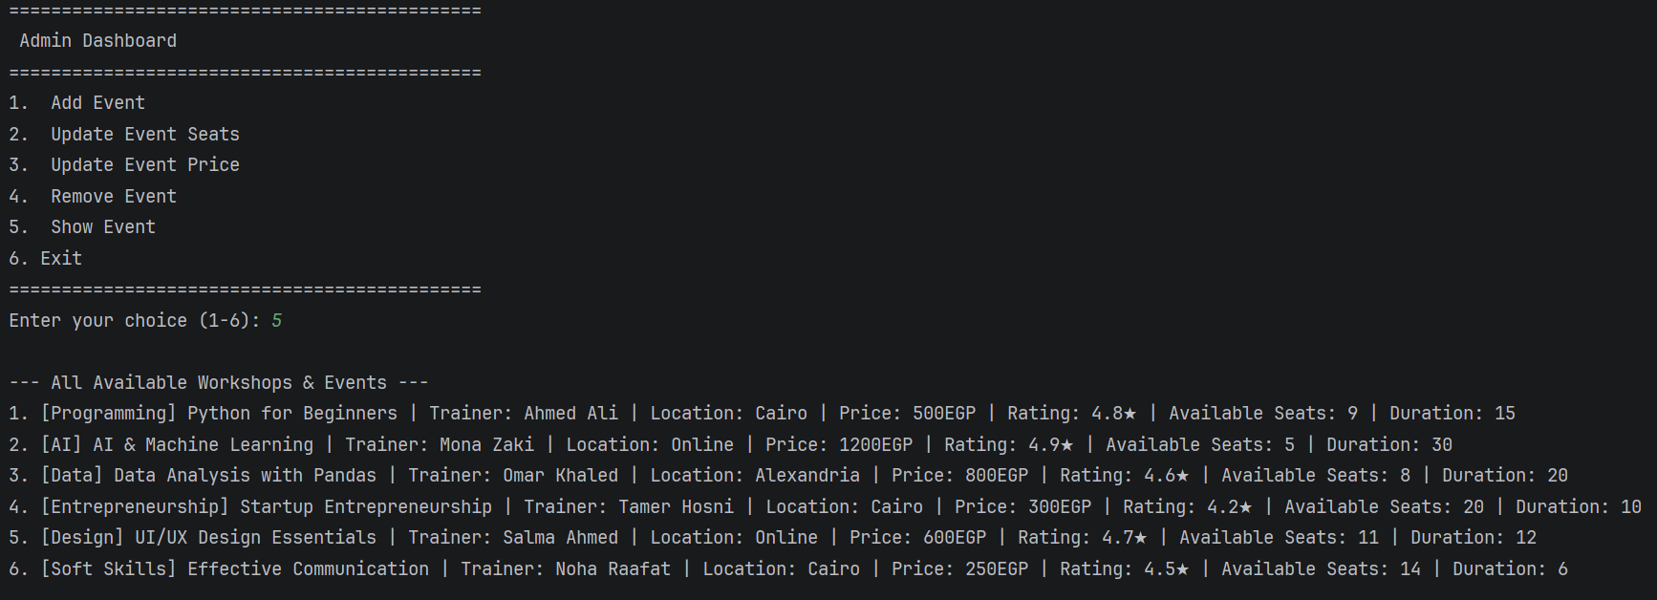
Admin Displays Events

Slide 28
Data Model
Object-Oriented Entity Structure: Designed dedicated Python classes (such as Event) to encapsulate attributes like name, trainer, location, price, duration, rating, available seats, and category.
Persistent JSON Data Stores: Utilized structured JSON files (events.json and users.json) to store and retrieve application records permanently, ensuring data integrity across sessions.
Manager & Controller Classes: Implemented dedicated logic containers like EventManager and LearningPlan to handle lists of objects, manage business rules, and execute CRUD operations.
Role-Based User Schema: Structured user records with specific attributes (name, email, phone, age, gender, governorate, national ID, password, and role) to differentiate between standard users and administrators.
Custom Navigation & Sorting Models: Handled state and ordering dynamically through dedicated algorithmic structures like the NavigationStack history tracker and the MergeSort data sorter.

Slide 29
Successful System Integration: Delivered a fully functional CLI-based platform that seamlessly integrates user authentication, administrative controls, and personalized learning plans with persistent JSON storage.
Algorithmic Efficiency: Validated the practical application of manual data structures and algorithms—specifically utilizing Merge Sort for quick event organization and recursive logic for instant financial summaries.
Enhanced User Experience: Streamlined event discovery and navigation through category filtering, keyword searches, and dynamic seat management, providing a robust tool for educational planning.
Results and Insights

Slide 30
Conclusion
Successful Project Delivery: The application successfully provides a comprehensive and reliable platform for workshop discovery and learning path planning, streamlining how users organize their educational journeys.
Practical Engineering Implementation: The project successfully demonstrates the real-world value of Object-Oriented Programming (OOP) principles, manual sorting algorithms, and persistent data storage in building robust software.

Slide 31
Q&A
Thank you for listening — questions are welcome

