Slide 1
Paper Title: Data Poison Detection Schemes for Distributed Machine Learning
Name: Habiba Mahrin
ID:20301339
Department: CSE
Course: High Performance Computing (Cse449)
Paper: https://ieeexplore.ieee.org/abstract/document/8943404

Slide 2
Summary
This paper discusses data poison detection schemes for Distributed Machine Learning (DML) and classifies DML into basic-DML and semi-DML. In basic-DML, a novel data poison detection scheme is proposed using a cross-learning mechanism to identify poisoned data, with the optimal number of training loops determined mathematically. In semi-DML, an improved data poison detection scheme is presented to enhance learning protection with central resource support, including an optimal resource allocation approach for efficient resource utilization. Simulation results indicate significant accuracy improvements in basic-DML (up to 20% for support vector machine and 60% for logistic regression) and resource savings in semi-DML (20-100% reduction in wasted resources).

Slide 3
purpose
Introduction of a data poison detection scheme for basic-DML, utilizing a cross-learning mechanism to generate training loops and establish a mathematical model for optimal security.
Presentation of a practical method for identifying abnormal training results, aiding in the detection of poisoned datasets.
Classification of DML into basic-DML and semi-DML, depending on the sharing of resources by the central entity in dataset training tasks.
Emphasis on the need for a widely applicable DML protection mechanism.
Prior mention of specific efforts using game theory to secure distributed support vector machine (DSVM) and collaborative deep learning but limited to specific DML algorithms.
Acknowledgment of the urgent requirement for a broadly applicable DML protection mechanism.
Validation of the proposed data poison detection schemes through experimental results.

Slide 4
contribution
This research contributes to the field of distributed machine learning by developing novel data poisoning detection schemes. These algorithms are designed to identify and mitigate malicious data injection attempts in decentralized environments, ensuring the integrity and security of machine learning models. Detecting data poisoning attacks in distributed machine learning is an important research area to ensure the integrity and security of machine learning models trained on decentralized data sources. Data poisoning attacks involve adversaries injecting malicious data into the training dataset to manipulate the model's performance.

Slide 5
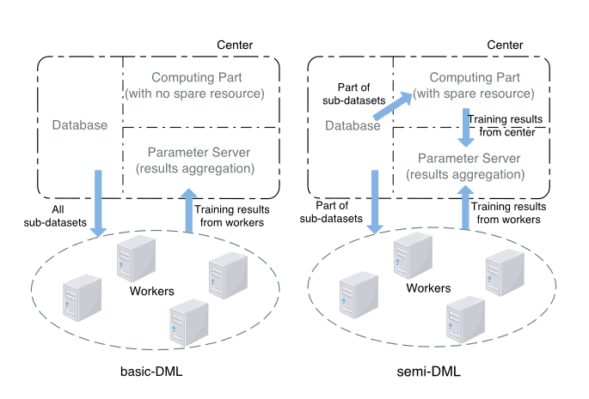
Methodology
BASIC-DML AND SEMI-DML
This paper introduces a classification of Distributed Machine Learning (DML) into two categories: basic-DML and semi-DML. Both scenarios involve a central system with a database, computing server, and parameter server, but they differ in their functions. In basic-DML, the center lacks spare computing resources and relies on distributed workers for sub-dataset training, while in semi-DML, the center has additional computing resources and can both learn from some sub-datasets itself and integrate results from both central and distributed workers.

Slide 6

DATA POISON DETECTION SCHEME IN BASIC-DML
The paper will examine data poison detection in basic-DML, where the center lacks spare computing resources for sub-dataset training. The scheme comprises parameter thresholds, cross-learning, and abnormal result detection.
DATA POISON DETECTION SCHEME IN semi-DML
In the paper ,explore the enhanced data poison detection scheme in semi-DML, where the center contributes spare resources to dataset training. This scheme adds central assistance, enabling the center to learn some or verify worker results. Efficient resource utilization is a key concern in this scenario.

Slide 7
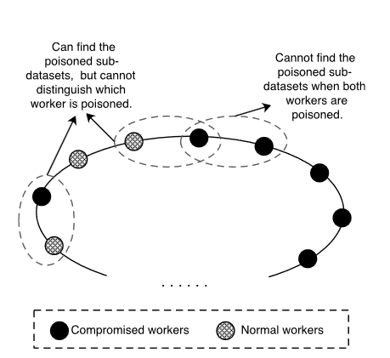
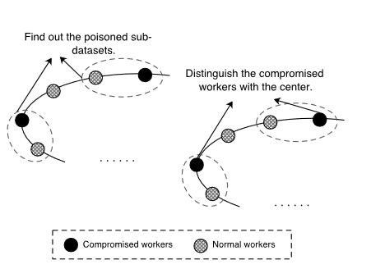



Slide 8
limitation
Data Distribution Variability: One limitation is the challenge of handling diverse and evolving data distributions across distributed sources. Detection schemes may struggle to adapt to dynamic changes, leading to potential false positives or false negatives, reducing their effectiveness in real-world scenarios.
Privacy Concerns: Privacy-preserving techniques to detect data poisoning may introduce their own limitations, such as added computational overhead and complexity. Striking a balance between effective detection and preserving individual data source privacy remains a significant challenge.

Slide 9
SUMMARY AND FUTURE WORK
This paper examines data poison detection in both basic-DML and semi-DML scenarios. It employs parameter thresholds to detect poisoned sub-datasets and presents a mathematical model for threat probability analysis. The improved detection scheme boosts model accuracy by up to 20% (SVM) and 60% (logistic regression) in basic-DML. In semi-DML, the enhanced scheme with optimal resource allocation reduces resource wastage by 20-100%. Future work should consider dynamic patterns for evolving application environments and balance between security and resource cost.

