Slide 1
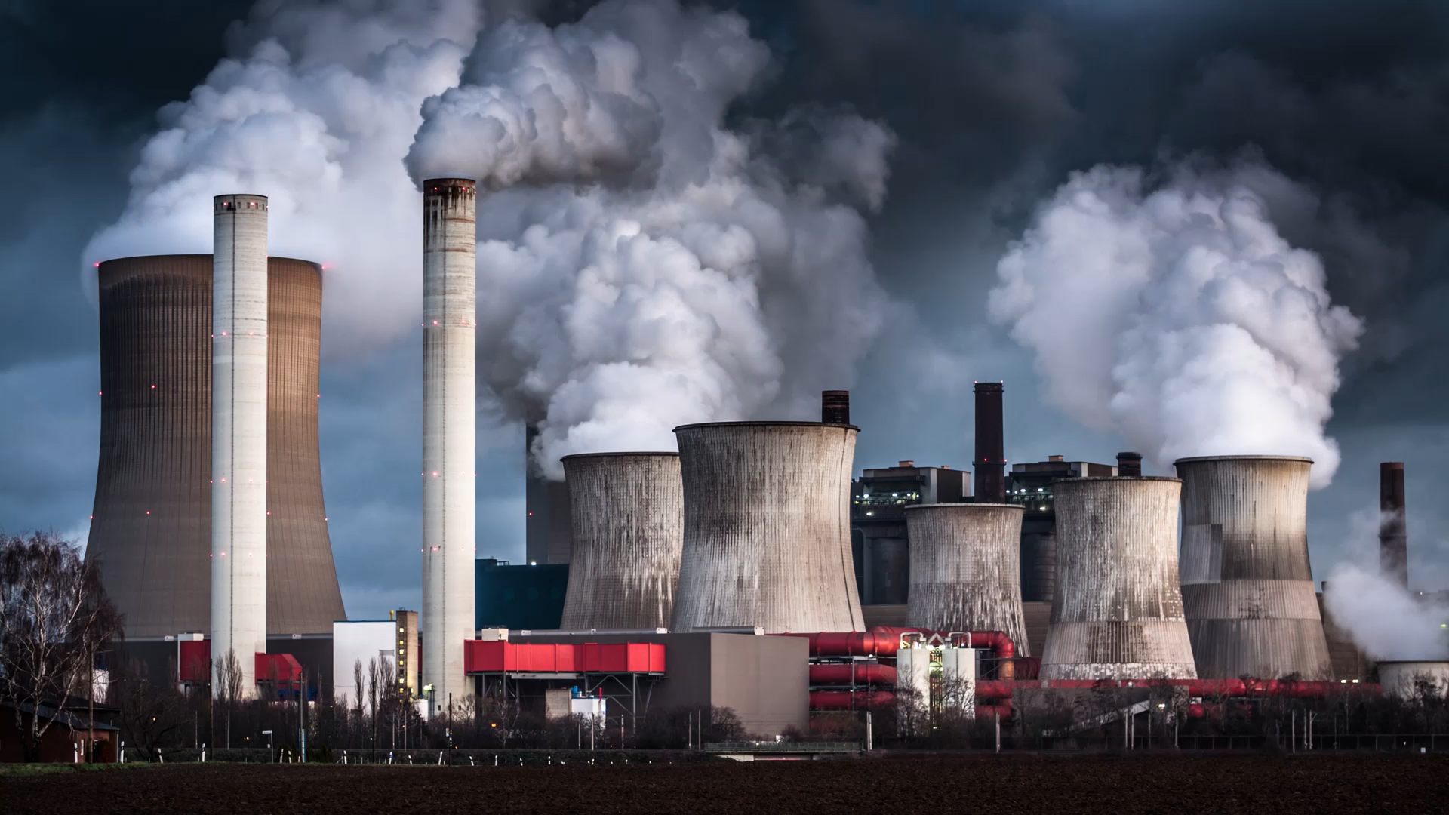
Carbon Emissions Analytics & Sustainable Finance Platform
Subtitle:
Turning Carbon Emissions Data into Sustainable Financing Decisions
Content:
A data-driven platform for monitoring and analyzing corporate carbon emissions.
Measures emissions across Scope 1, Scope 2, and Scope 3
Identifies companies with the highest environmental impact.
Supports financial institutions in making data-driven sustainable financing decisions.

Slide 2

The Problem
The Problem: Who Is Creating the Highest Environmental Impact?
Content:
Companies generate different levels of carbon emissions, but organizations may face challenges in:
Identifying the highest-emitting companies.
Understanding the main sources of their emissions.
Comparing environmental performance across companies.
Prioritizing which companies need immediate support.
Connecting environmental performance with financial decisions.

Slide 3

Our Solution
Collect emissions data.
Calculate total Carbon Emissions.
Analyze Scope 1, 2 & 3.
Rank companies based on emissions.
Identify the highest-impact companies.
Detect the major sources of emissions.
Provide actionable recommendations.

Slide 4
Identifying High-Impact Companies
The platform ranks companies according to their environmental impact using:
Total Carbon Emissions
Emissions by Scope
Emissions intensity
Historical emission trends
Industry characteristics
Environmental performance
Company | Emissions | Impact Level
Company A | 120,000 tCO₂e | 🔴 High
Company B | 75,000 tCO₂e | 🟠 Medium
Company C | 25,000 tCO₂e | 🟢 Low

Slide 5
From Emissions to Financing Decisions
Financing Opportunities:
Green financing
Sustainability-linked loans
Renewable energy projects
Energy-efficiency investments
Clean technology adoption
Content:
The platform helps financial institutions prioritize financing and support based on environmental impact
High Emissions
↓
High Priority
↓
Assessment & Recommendations
↓
Targeted Financing / Support
↓
Emission Reduction Projects
↓
Lower Emission

Slide 6
AI & Predictive Analytics
Content:
The platform can use historical emissions data to:
Forecast future carbon emissions.
Identify companies at risk of increasing emissions.
Detect abnormal emission trends.
Estimate potential emission reductions.
Recommend priority areas for intervention.
Example:
Current Emissions:
100,000 tCO₂e
Forecast:
115,000 tCO₂e
Potential Reduction:
15–20%
Recommendation:
Invest in energy efficiency & renewable energy

Slide 7

Business & Environmental Impact
🌱 Environmental Impact
Reduce corporate carbon emissions.
Support cleaner technologies.
Encourage sustainable business practices.
Track progress toward emission reduction.
💰 Financial Impact
Better allocation of sustainable financing.
Identify high-impact investment opportunities.
Reduce financing risks.
Support long-term sustainable growth.
.
🏦 Strategic Impact
Data-driven decision making.
Environmental risk assessment.
Corporate sustainability monitoring.
Better ESG performance.
Support sustainable finance strategy

Slide 8
Name:Hania Hussein
​Tooling Stack: Excel, Power Query, Pivot Tables & PivotCharts
Data Cleaning (2010–2017)

Slide 9
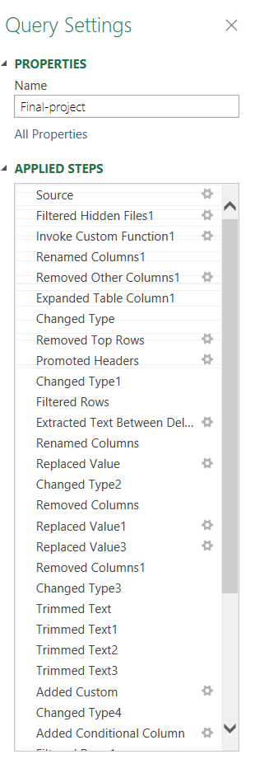
Comprehensive Power Query Data Cleaning Pipeline ​Source File & Metadata Handling:
1-Filtered hidden files (Filtered Hidden Files),
2- removed redundant metadata (Removed Other Columns),
3-promoted table headers (Promoted Headers).
​4-Null & Structural Error Removal: Excluded unmapped records ([FRS Id] <> null and [Facility Id] <> null) and eliminated location extraction errors (Removed Errors). ​
5-Text Normalization & Standardizing: Executed Trim and Clean transformations across Facility Name, City, Address, and State to strip whitespace and unify state codes.
6- ​Strict Data Type Mapping: ​Integers: year, Facility Id, FRS Id ​
Decimals: emissions, predicted_emissions, latitude, longitude, zip_code
​Text: Facility Name, City, State, Address, industry_type

Slide 10
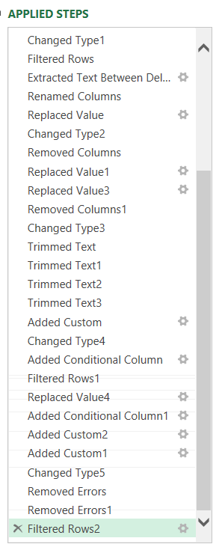
7-​Feature Engineering & Custom Logic: ​Added Emission Category Breakdown (Custom conditional intensity levels).
​Added Gas Composition Category (CO2 Heavy vs. Methane/Other Heavy).
​Added State Standardized for seamless Slicer interactions.
Clean Dataset Inventory (15 Attributes)
1- ​year — Recorded calendar year (2010–2017 historical, 2018–2020 predicted)
​2-Facility Id — Unique facility tracking identifier
​3-FRS Id — Federal Registry System identifier
4- ​Facility Name — Standardized facility entity name
5- ​City — Facility municipality location ​
6-State — Standardized 2-letter state
7-Industrial sector classification
8- ​emissions — Actual recorded
9- emissions volume (MT CO2e)
10-Calculated intensity category (High/Medium/Low) ​Gas Composition Category — CO2 Heavy (96%) vs. Methane/Other Heavy (4%)

Slide 11
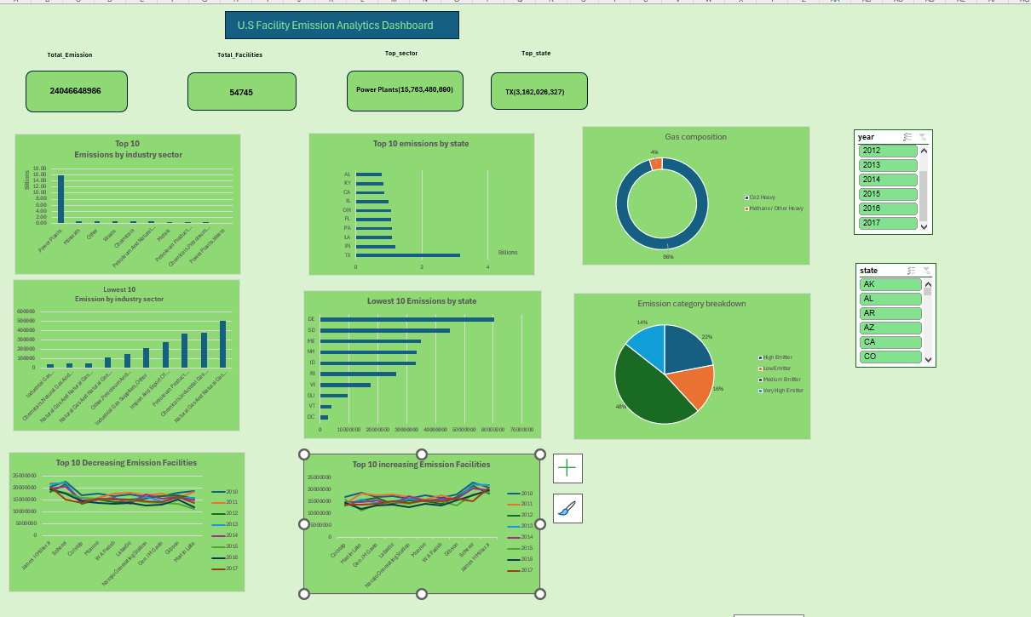
Interactive Dashboard Historical ard Analysis (2010–2017)

Slide 12
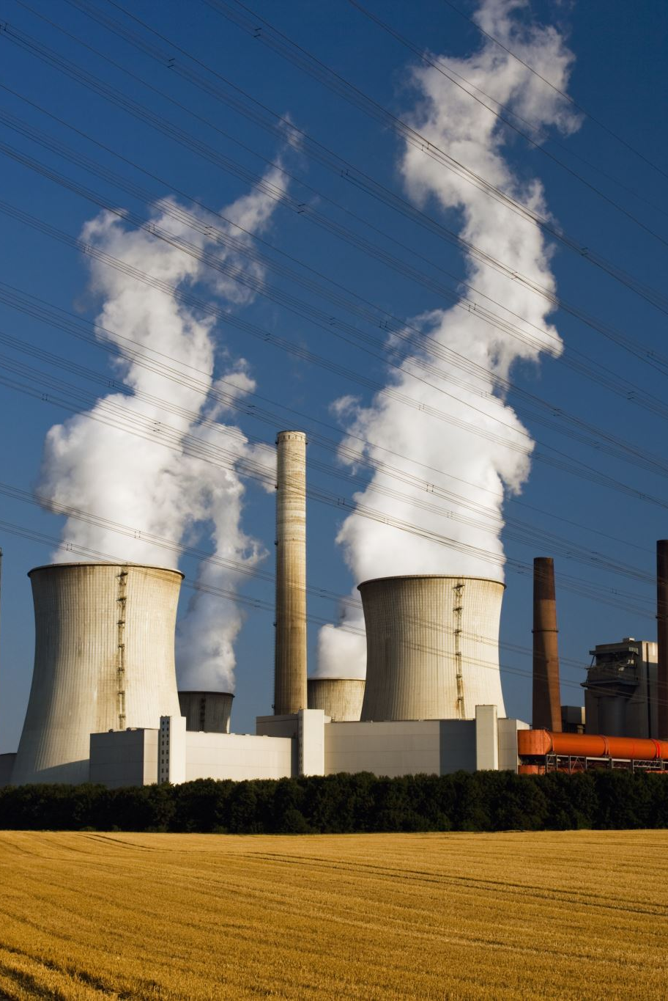
Executive KPI Cards (Top Metrics):
​​
1-Total Emissions: 24,060,868,986 MT CO2e
2-​Total Facilities: 34,745 active sites tracked ​
3-Top Sector Contributor: Power Plants (15.70B MT CO2e) ​
4-Top State Contributor: Texas (5.18B MT CO2e)
​Sector & Geographic Visuals: ​
1-Top 10 vs. Lowest 10 Industry Sectors: Column charts analyzing sector volume spread. ​
2-Top 10 vs. Lowest 10 States: Horizontal bar charts comparing state output.
​Composition & Facility Dynamics: ​
1-Gas & Intensity Breakdown: Doughnut (96% CO2 Heavy) & Pie charts for emission category splits. ​
2-Facility Trajectories: Line charts tracking Top 10 Increasing and Top 10 Decreasing facilities over time.
​Interactivity & Aesthetics:
Synchronized Year and State Slicers with a unified, transparent green design (No Fill, No Outline).

Slide 13
Habiba mohamed
Machine Learning
(data forecasting)

Slide 14

Machine Learning & Emission Forecasting Pipeline
Problem Formulation
Supervised Time-Series Regression: Transformed historical facility emission logs into a structured time-series supervised learning problem to predict future emission levels.

Slide 15

Advanced Feature Engineering & Data Preparation
Temporal Lag Features: Created lag_1 and lag_2 historical emission features for each facility to capture previous-year emission patterns and trends.
Rolling Window Aggregation: Calculated a 2-year rolling mean of previous emissions to capture the facility’s recent emission behaviour and smooth short-term fluctuations.
Categorical Feature Encoding: Applied One-Hot Encoding to categorical features such as state and industry_sector to convert them into a format suitable for machine learning.

Slide 16
Model Architecture & Selection
Algorithm: Random Forest Regressor
Why Random Forest?
Effectively captures complex, non-linear relationships across high-dimensional data.
Robust against overfitting compared to single decision trees.
Handles both continuous numerical features and encoded categorical indicators seamlessly.
Evaluation Metrics
R2 Score : Evaluates the overall variance in total direct emissions explained by the model.
Root Mean Squared Error(RMSE) : Measures prediction error magnitude while heavily penalizing larger forecasting deviations.
Mean Asolute Error(MAE) : Quantifies the average absolute error margin in metric tons of emissions.
Recursive Forecasting : Generated sequentialfacility level emission predictions for 2018-2020 where each year’s forecast was fed back into the model to predict the subsequent year

Slide 17

Abdelrahman
Mohamed
MySql:
(Database → Relationships → Queries → Emissions Analysis)
Power BI:
(Data Visualization)

Slide 18
MySQL & Database Implementation
Designed and created the project database.
Created tables for Companies, Emissions, Emission Sources, and Emission Factors.
Used Primary Keys and Foreign Keys to establish relationships.
Used SQL queries to retrieve and analyze data.
Applied JOIN, WHERE, GROUP BY, SUM, and ORDER BY.
Calculated and ranked companies based on total emissions.

Slide 19
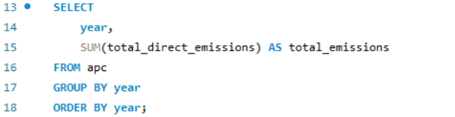
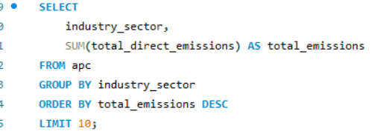
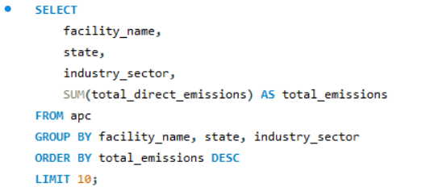
Yearly Emissions Analysis
Industry Emissions Ranking
Highest-Emission Facilities

Slide 20
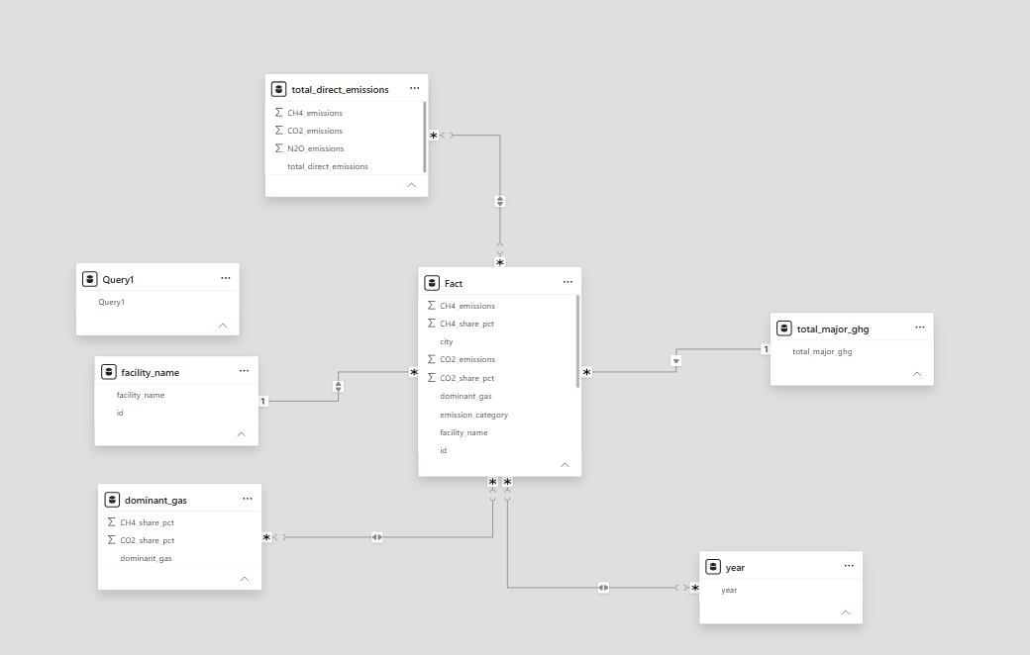
Data Model Structure
Organizing emissions data into related tables to support analysis and reporting.

Slide 21
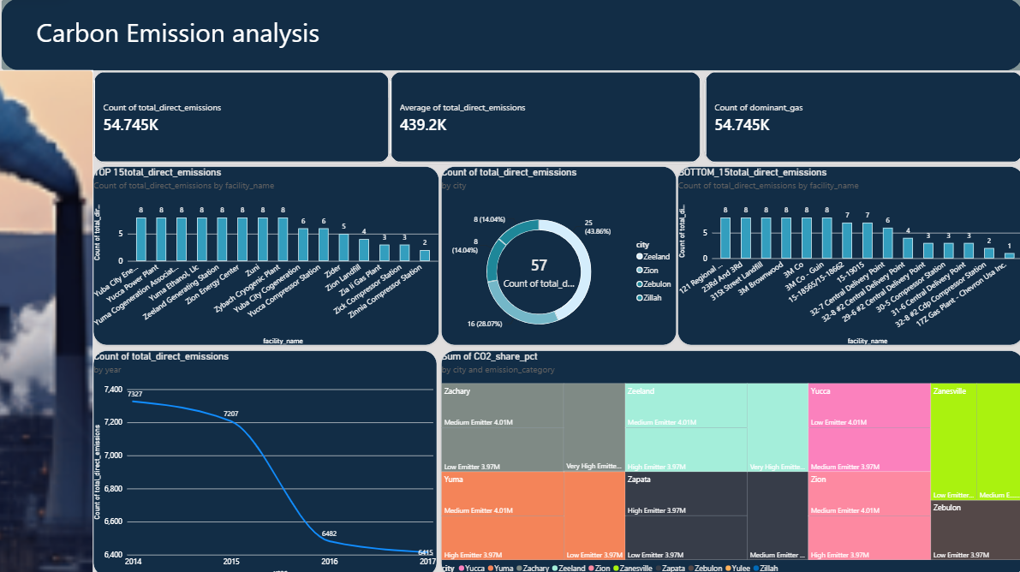
Interactive Carbon Emissions Dashboard

Slide 22
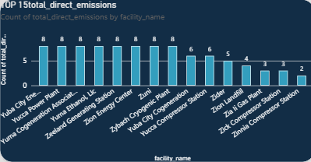
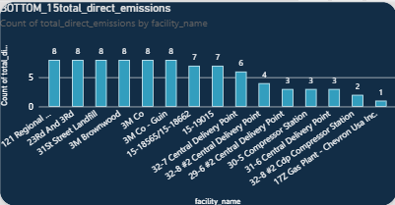
Top 15 facility in DE
Bottom 15 facility in DE

Slide 23
Python : Data Cleaning & Analysis

Slide 24
Data cleaning
Data Cleaning is a crucial step in any data Analysis project. Real-world data is often messy, containing missing values, duplicates, and inconsistencies. Using Python, we systematically clean and prepare our dataset—handling anomalies and ensuring high data integrity—to build accurate and reliable analytical models.

Slide 25
The raw dataset we have is completely unorganized and messy. It requires major preprocessing, such as handling missing values, removing duplicates, and properly organizing text columns, alongside other adjustments that we will explore together in the upcoming slides.

Slide 26

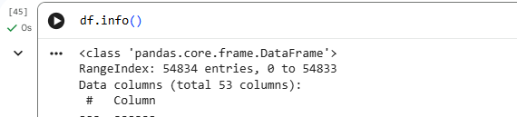
Importing Pandas & NumPy Libraries and Loading the CarbonIQ Dataset
Inspecting DataFrame Structure Using df.info() (54,834 Entries and 53 Columns)

Slide 27
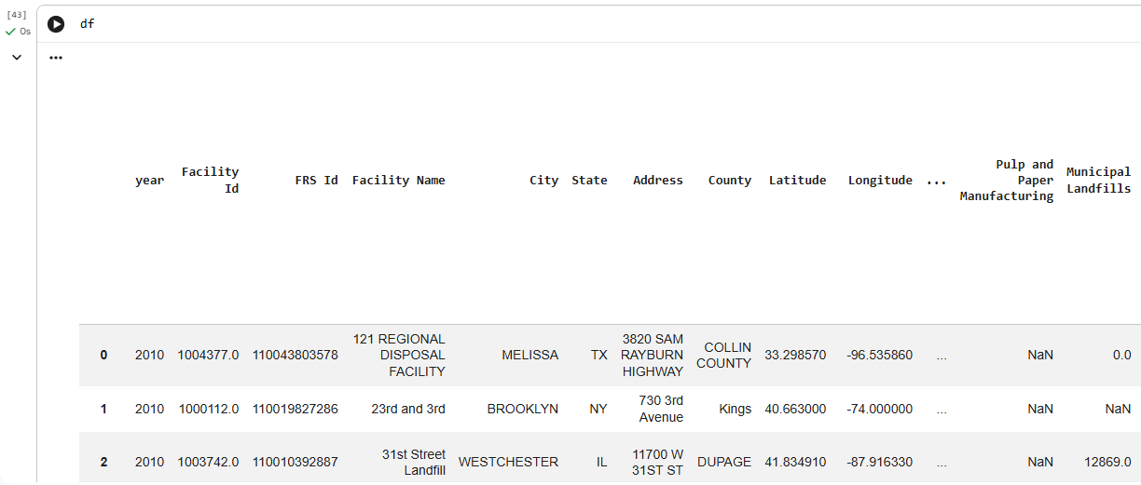
Displaying Raw Data Preview using df (Showing Unstructured Rows, Missing Values, and Messy Formats)

Slide 28
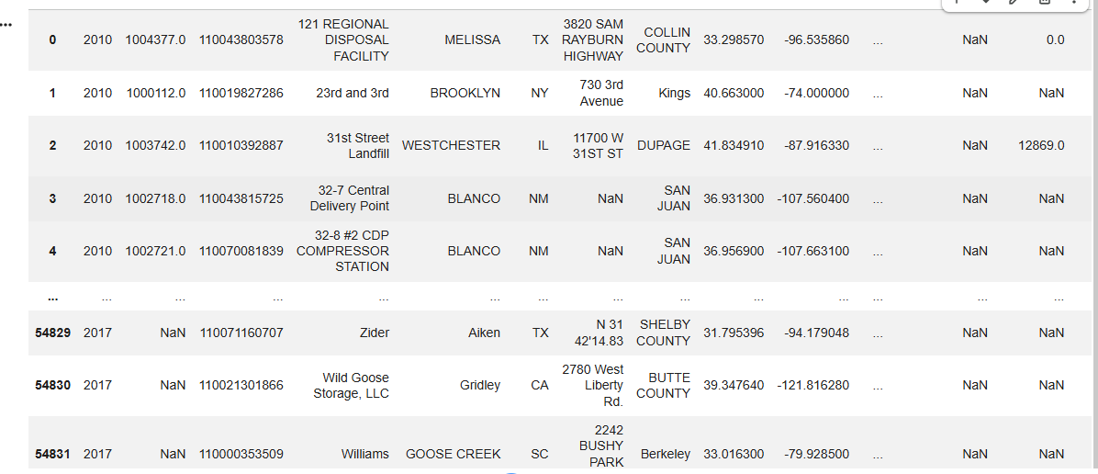
Raw Data Inspection: Widespread Null Values, Irregular Formatting, and Data Quality Issues

Slide 29

Zero Duplicate Rows Verified: Complete Absence of Redundant Records in the Dataset
Eliminating Columns with Complete or Near-Complete Missing Values and Discarding Irrelevant Variables for the Analysis

Slide 30
Standardizing column names by stripping trailing whitespace, converting all characters to lowercase, and replacing spaces with underscores.

Slide 31
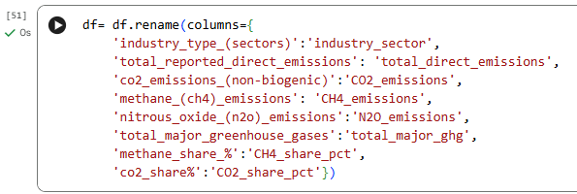
Renaming specific columns to concise, professional, and standardized identifiers for better clarity and analysis.

Slide 32
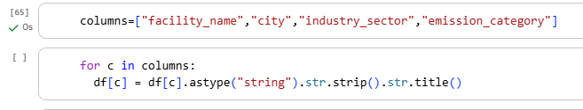
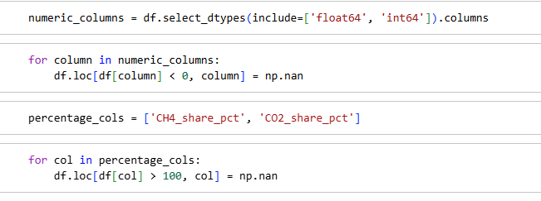
Removing whitespace and capitalizing the first letter of each word
Converting negative values and percentages greater than 100 to null within the context of data cleaning.

Slide 33

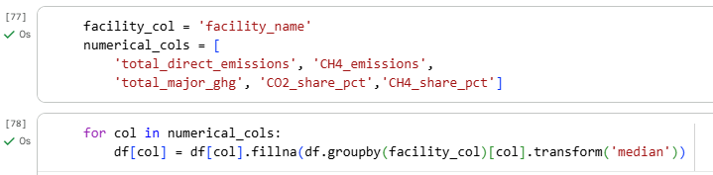
Dropping rows containing logical errors.
Imputing missing (null) values for numeric columns with the median of each respective facility.

Slide 34
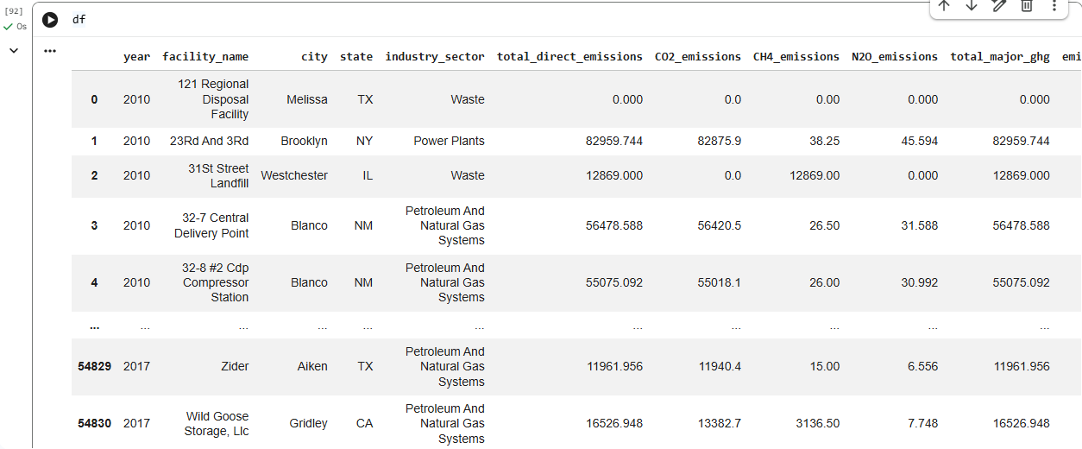
After Cleaning

Slide 35
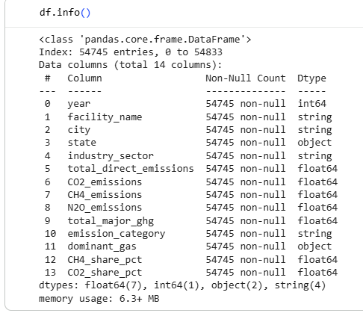
After Cleaning

Slide 36
Analysis with Python
To explore the temporal trajectory of total emissions over the years and understand their proportional distribution, we leverage Python to visualize the patterns through line and pie charts.

Slide 37
Creating a line chart to illustrate the relationship between time and total emissions

Slide 38
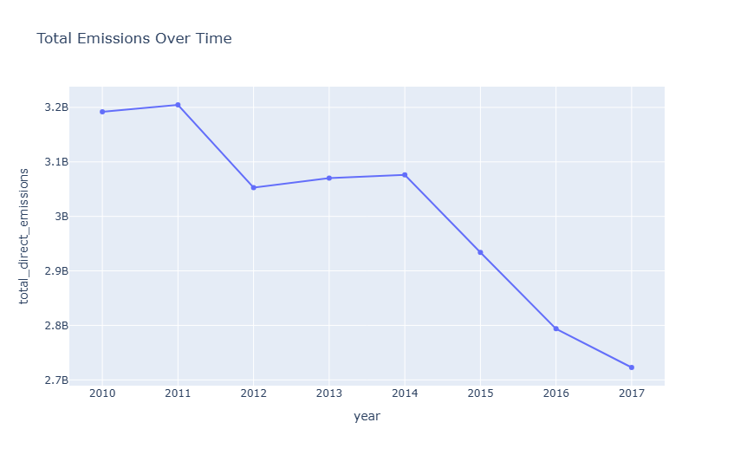

Slide 39
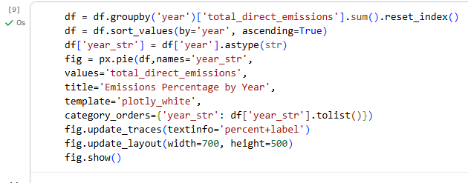
Creating pie chart illustrating the emission proportions for each year

Slide 40
