Slide 1


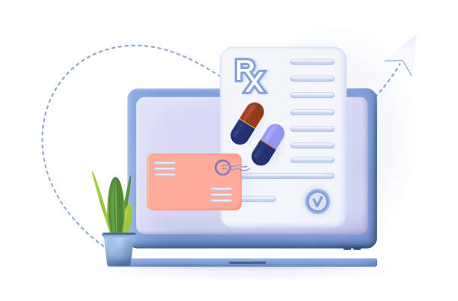


PEN TO PILL
Your Health, Clearly Written

Slide 2

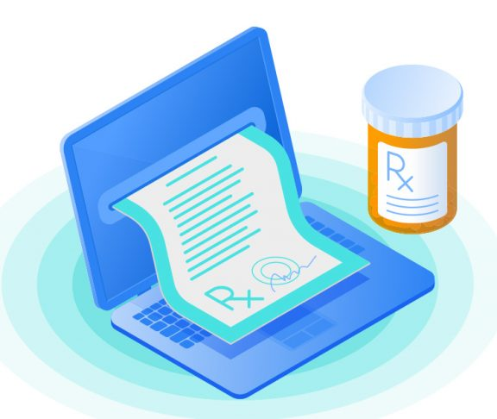

Vision
To become a foundational step toward fully digitized, AI-assisted healthcare in the MENA region and beyond where patients receive accurate treatment instructions, pharmacies minimize errors, and medical data becomes accessible, searchable, and integrable into electronic health records.

Slide 3
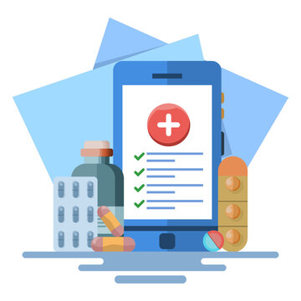
Mission
To leverage advanced deep learning models—YOLO for handwritten region detection, TrOCR for text extraction, and BART for natural language correction and parsing—to build a robust pipeline that digitizes prescriptions into structured medicine-dosage pairs, aiding patients, pharmacists, and healthcare systems.

Slide 4
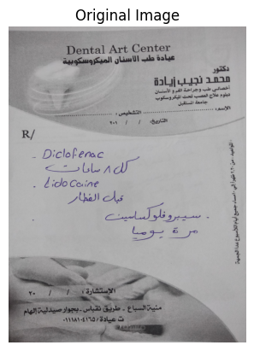
Tour Behind The scene
1
The Original Prescription

Slide 5
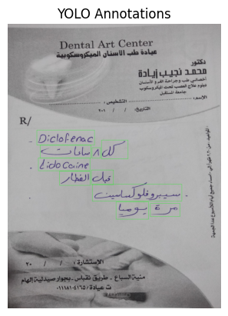
Tour Behind The scene
2
YOLO word Annotation

Slide 6
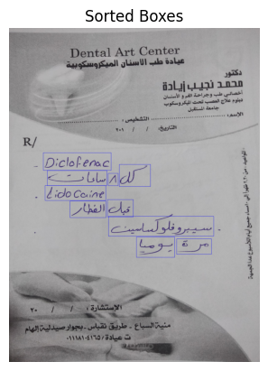
Tour Behind The scene
3
YOLO word Annotation
After removing duplicates: 10 boxes

Slide 7
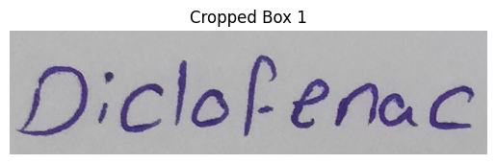
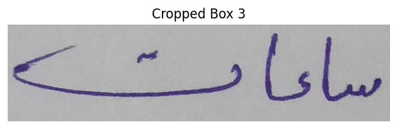
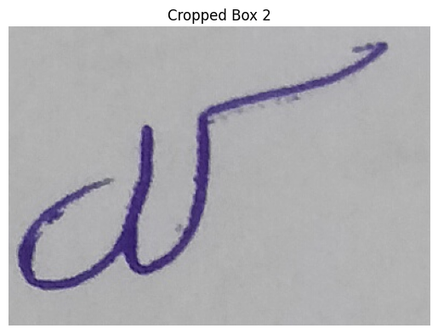
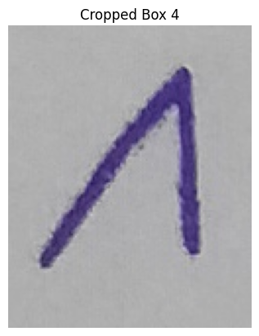
4
Croping and TrOCR extraction
Tour Behind The scene
4
TrOCR result for box 1: Diclofenac
TrOCR result for box 3: ساعات
TrOCR result for box 2: كل
TrOCR result for box 4: 8

Slide 8
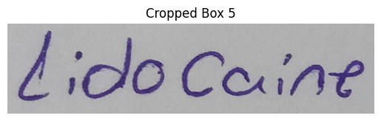
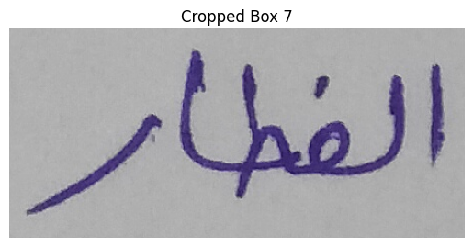
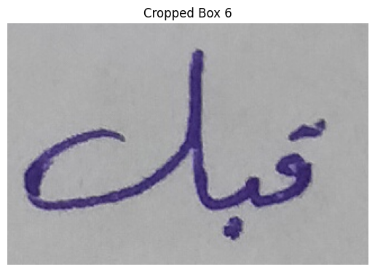
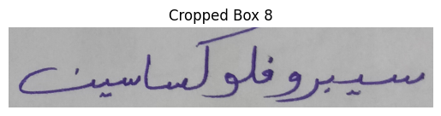
4
Croping and TrOCR extraction
Tour Behind The scene
4
TrOCR result for box 5: Lidocce
TrOCR result for box 7: الفطار
TrOCR result for box 8: سيبروفلوكساسين
TrOCR result for box 6: قبل

Slide 9
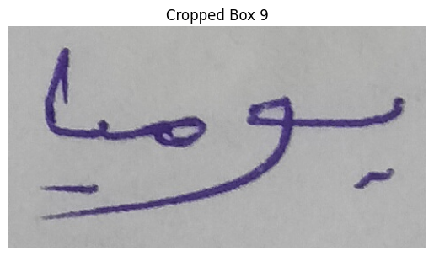
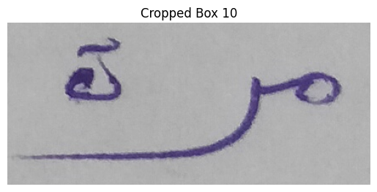
4
Croping and TrOCR extraction
Tour Behind The scene
4
TrOCR result for box 9: يوميا
TrOCR result for box 10: مرة

Slide 10
Tour Behind The scene
5
Full extracted text:
Diclofenac كل ساعات 8 Lidocce قبل الفطار سيبروفلوكساسين يوميا مرة
6
Reordered text (BART 1):
Diclofenac كل ٨ ساعات , Lidocaine قبل الفطار , سيبروفلوكساسين مرة يومياً
7
Extracted Medicine Names (BART 2):
Diclofenac , Lidocaine , سيبروفلوكساسين
8
Extracted Dosages (BART 3):
كل ٨ ساعات , قبل الفطار , مرة يومياً

Slide 11
AND FINALLY
Final Medicine-Dosage Pairs:
[('Diclofenac', 'كل ٨ ساعات'), ('Lidocaine', 'قبل الفطار'), ('سيبروفلوكساسين', 'مرة يومياً')]

Slide 12
WAIT A SECOND
DOES THAT MEANS THAT THE MODEL IS PERFECT

Slide 13
THATS WHAT WE ARE AIMIG FOR THE FUTURE

Slide 14



THANK YOU!

