Slide 1

EXCEL FORMULAS AND FUNCTIONS:FROM BASIC LEVEL
Presented by
Habibatul Tamanna
Student ID: 21CHE032
Department of Chemistry
University of Barishal

Slide 2
Outline
Introduction
Basic Terms in Excel
Basic Excel Formulas For Workflow
PIVOT TABLE
PIVOT CHART
SLICERS
Conclusion

Slide 3
INTRODUCTION
Microsoft Excel enables users to format, organize and calculate data in a spreadsheet. By organizing data using software like Excel, data analysts and other users can make information easier to view as data is added or changed. Excel contains a large number of boxes called cells that are ordered in rows and columns.

Slide 4
Basic Terms in Excel
1. Formulas
In Excel, a formula is an expression that operates on values in a range of cells or a cell. For example, =A1+A2+A3, which finds the sum of the range of values from cell A1 to cell A3.
2. Functions
Functions are predefined formulas in Excel. They eliminate laborious manual entry of formulas while giving them human-friendly names. For example: =SUM(A1:A3). The function sums all the values from A1 to A3

Slide 5
Basic Excel Formulas For Workflow
SUM
The SUM function is the first must-know formula in Excel. It usually aggregates values from a selection of columns or rows from your selected range.
=SUM(number1, [number2], …)
AVERAGE
The AVERAGE function should remind you of simple averages of data, such as the average number of shareholders in a given shareholding pool.
=AVERAGE(number1, [number2], …)
COUNT
The COUNT function counts all cells in a given range that contain only numeric values.
=COUNT(value1, [value2], …)

Slide 6
COUNTA
Like the COUNT function, COUNTA counts all cells in a given rage. However, it counts all cells regardless of type. That is, unlike COUNT that only counts numerics, it also counts dates, times, strings, logical values, errors, empty string, or text.
=COUNTA(value1, [value2], …)
IF
The IF function is often used when you want to sort your data according to a given logic. The best part of the IF formula is that you can embed formulas and functions in it.
=IF(logical_test, [value_if_true], [value_if_false])
MAX & MIN
The MAX and MIN functions help in finding the maximum number and the minimum number in a range of values.
=MIN(number1, [number2], …)
=MAX(number1, [number2], …)

Slide 7
VLOOKUP and HLOOKUP
The formula of VLOOKUP=VLOOKUP (lookup_value, table_array, col_index_number, ), and the formula of HLOOKUP is =HLOOKUP (lookup_value, table_array, row_index_number, ). There is only one difference between these formulas: row and column.
COUNTIFS
The COUNTIFS function is a premade function in Excel, which counts cells in a range based on one or more true or false condition. It is typed COUNTIFS : =COUNTIFS(criteria_range1, criteria1, [criteria_range2, criteria2], ...)
SUMIF and AVERAGEIF
=SUMIF(range, criteria, sum range)
=AVERAGEIF(range, criteria, sum range)
SUMIFS and AVERAGIFS
SUMIFS : =SUMIFS(sum_range, criteria_range1, criteria1, [criteria_range2, criteria2] ...)
AVERAGEIFS : =AVERAGEIFS(average_range, criteria_range1, criteria1, ...)

Slide 8
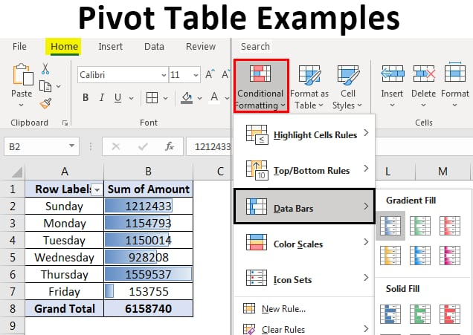
PIVOT TABLE
Select a cell in the source data or table range. Go to Insert > PivotTable. Choose where you want the PivotTable to be placed. Select Insert on new sheet to place the PivotTable in a new worksheet or select the cell where you want the new PivotTable placed in the Destination field. Select Insert. You can use a PivotTable to summarize, analyze, explore, and present summary data.

Slide 9
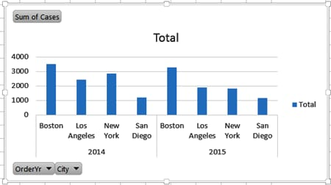
PIVOT CHART
Create a chart from a PivotTable · Select a cell in your table. · Select Insert and choose PivotChart. · Select a chart. · Select OK. PivotCharts provide graphical representations of the data in their associated PivotTables.

Slide 10
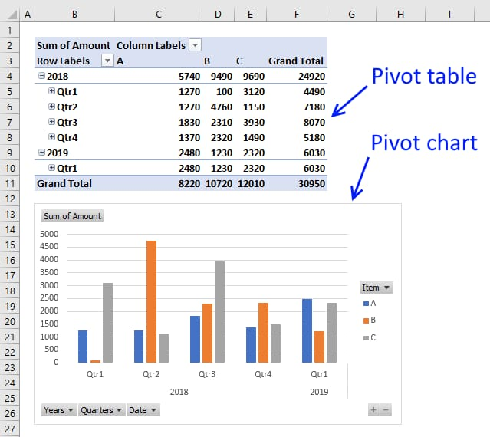
PIVOT TABLE and PIVOT CHART

Slide 11
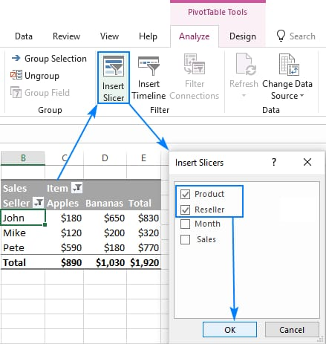
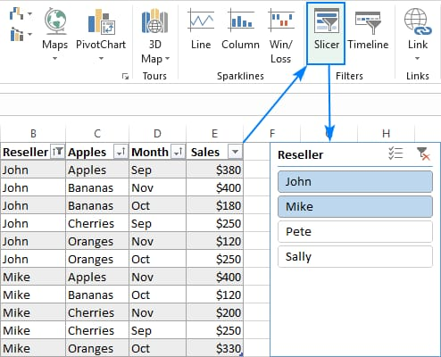
SLICERS
Slicers in Excel make tables appear interactive and can help you visualize the same data with different criteria. The pivot table summarizes the entire table in a report, and slicers help you to visualize slices of the whole table.

Slide 12
CONCLUSION
Microsoft Excel is a powerful and easy-to-use application for data analysis and reporting. In this post, we have learned the importance of basic Excel formulas and how they provide us extra ability to perform complex calculations. Furthermore, we have learned about various ways of adding formulas to worksheets and looked in detail at the essential basic Excel formulas.

Slide 13
THANK YOU

