Slide 1
DevFest Samsun 2026
MedInspect AI
AI-assisted surgical instrument inspection
Person One: AI and dataset
Person Two: application and deployment
Research prototype with human review
Notes:
Source: team-supplied technical development plan. Team names were not provided. This deck reflects application-stage work. The team must supply genuine model and evaluation evidence before submission.

Slide 2
Visible instrument inspection
Inspection context
A reviewable record
for each image
The operator identifies the batch, instrument, and supported class before screening.
Human assessment
The operator reviews suspicious regions and records a decision with the model evidence.
Notes:
Source: MedInspect_AI_Technical_Development_Plan.docx supplied by the team. Application evidence: app.py, src/, tests/, docs/person_two_status.md in this repository. Status: application stage, real model integration and public demo pending.

Slide 3
Application and model boundary
Person Two
Person One
Upload and metadata
Artifact verification
Heatmap and operator review
Session CSV export
Saved PatchCore memory bank
Cached loading and transforms
Real score and aligned map
Validation threshold and evaluation
Shared API: inspect_image(PIL RGB image)
Notes:
Source: MedInspect_AI_Technical_Development_Plan.docx supplied by the team. Application evidence: app.py, src/, tests/, docs/person_two_status.md in this repository. Status: application stage, real model integration and public demo pending.

Slide 4
Dataset and PatchCore
Planned approach
Person One's evidence
Purdue surgical instrument dataset
One supported class for the prototype
PatchCore normal feature memory bank
Selected class and split counts
Usage restrictions and simulated defects
Saved artifact and calibrated threshold
Dataset preparation and real model integration remain pending in this branch
Notes:
Planned dataset: https://huggingface.co/datasets/purdueviperlab/Surgical_Instruments_Unsupervised_Defect_Detection
PatchCore reference: https://anomalib.readthedocs.io/en/latest/markdown/guides/reference/models/image/patchcore.html
No dataset downloads, class selection, model training, or measured performance are claimed by Person Two.
Source: MedInspect_AI_Technical_Development_Plan.docx supplied by the team. Application evidence: app.py, src/, tests/, docs/person_two_status.md in this repository. Status: application stage, real model integration and public demo pending.

Slide 5
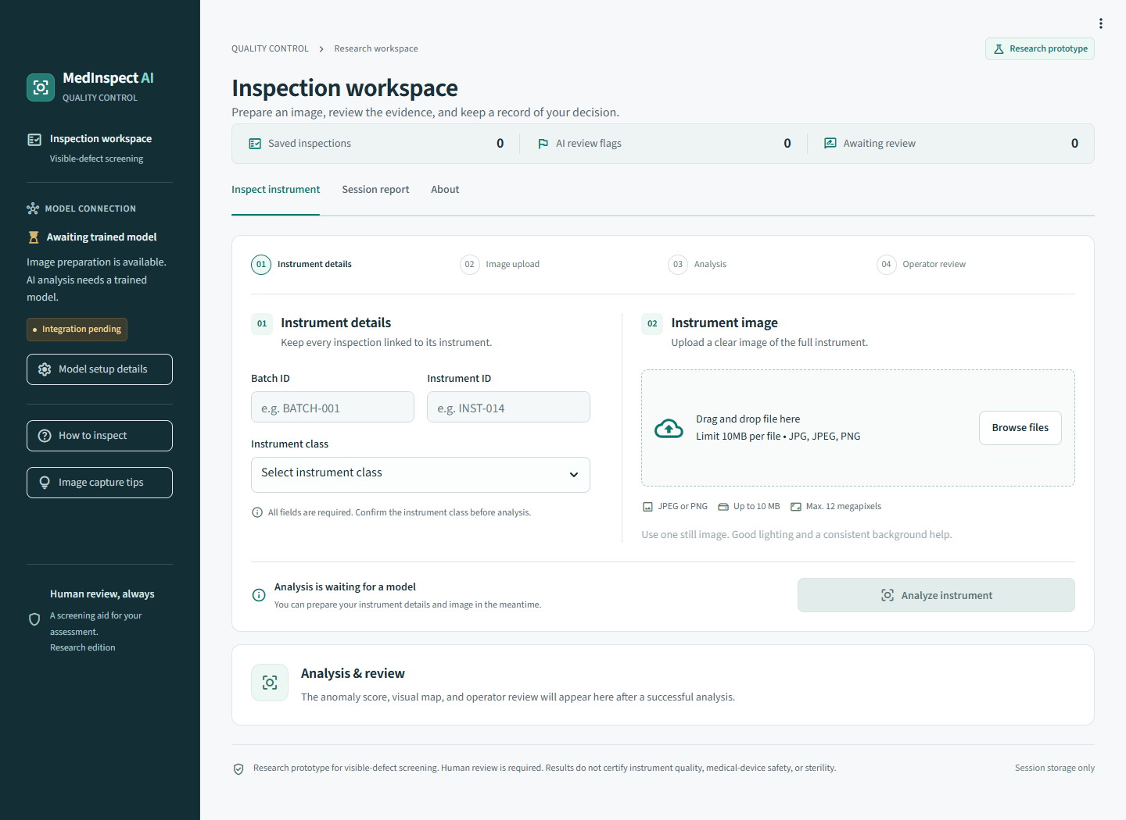
Inspection workflow
1 Identify the instrument
2 Upload and analyze
3 Review the score and map
4 Record a human decision
5 Export the session CSV
Actual app UI while model integration is pending
Notes:
Screenshot: actual local app in its awaiting-model state, captured by scripts/check_browser.cjs. The screenshot does not demonstrate a trained model or anomaly prediction.
Source: MedInspect_AI_Technical_Development_Plan.docx supplied by the team. Application evidence: app.py, src/, tests/, docs/person_two_status.md in this repository. Status: application stage, real model integration and public demo pending.

Slide 6
Evaluation status
Model results pending
Application checks
Required from held-out images
Workflow tests cover uploads, API validation, overlays, review, and CSV. Launch, readiness, and source packaging tools are ready.
TP / FP / TN / FN, recall, precision, F1, false-positive rate, AUROC, localization, and measured latency.
UI fixtures establish application behavior. Real inference and accuracy await Person One's model.
Notes:
Source: MedInspect_AI_Technical_Development_Plan.docx supplied by the team. Application evidence: app.py, src/, tests/, docs/person_two_status.md in this repository. Status: application stage, real model integration and public demo pending.

Slide 7
Release gates and limits
Before a public demo
Limits to communicate
Integrate the real model and dependencies
Verify unseen-image inference and reload
Deploy and check the complete review flow
Record the actual app and export
Lighting and background can affect results
Only the supported class can be screened
History lasts for the current session
No safety or sterility certification
The current branch has no verified public inference link
Notes:
Source: MedInspect_AI_Technical_Development_Plan.docx supplied by the team. Application evidence: app.py, src/, tests/, docs/person_two_status.md in this repository. Status: application stage, real model integration and public demo pending.

