Slide 1


Menu
About Us
@rnagarnirrman
NagarNirman
A Smart City Issue Reporting
& Management System
A Complete End-to-End Project Built with Python and Streamlit.
Live Demo

Slide 2

Menu
About Us
@rnagarnirrman
The Problem : Barriers to Civic Engagement
Difficulty in Digital Reporting
Lack of Transparency & Tracking
Citizens lack user-friendly, centralized platforms to digitally report civic issues like potholes, poor lighting, or sanitation problems.
Once reported, there is no proper mechanism for tracking the status of the issue, leading to citizen frustration and distrust.
Manual System Inefficiency
Communication Gap
Traditional manual reporting processes result in significant delays, high operational costs, and often, issues falling through the cracks.
A persistent divide between the concerns of the community and the awareness/response of municipal authorities hinders effective city management.

Slide 3

Menu
About Us
@rnagarnirrman
Project Objectives: Enhancing Transparency and Accountability
Issue Tracking Capability
Enable real-time tracking for every submitted issue, from submission to resolution.
Authority Dashboard
Develop a dedicated administrative interface for efficient issue monitoring and management.
User-Friendly Platform
Ensure Accountability
Design and deploy a simple, intuitive platform for citizens to submit reports quickly.
Foster greater transparency in the city management process, holding responsible parties accountable.

Slide 4


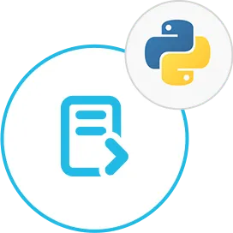

Menu
About Us
@rnagarnirrman
Technology Stack: Modern and Efficient Tools
Our project leverages a robust and efficient technology stack chosen for rapid development and maintainability.
Python
Streamlit
JSON
Streamlit Community Cloud
The core programming language, utilized for all application logic and data handling.
The web application framework used for fast prototyping and creating the interactive user interface.
Selected for its lightweight structure and ease of use in storing application data and configurations.
The platform chosen for seamless, continuous deployment and hosting of the application.

Slide 5

Menu
About Us
@rnagarnirrman
System Architecture Overview
Streamlit UI
app.py Router
Views & Utils
JSON Files
The front-end interface where citizens and administrators interact with the system.
The main controller handling routing, application initialization, and user sessions.
Modular separation: Views handle the presentation layer (UI pages), and Utils encapsulate core business logic (authentication, data management).
Serve as the lightweight data persistence layer for all reports and user information.

Slide 6

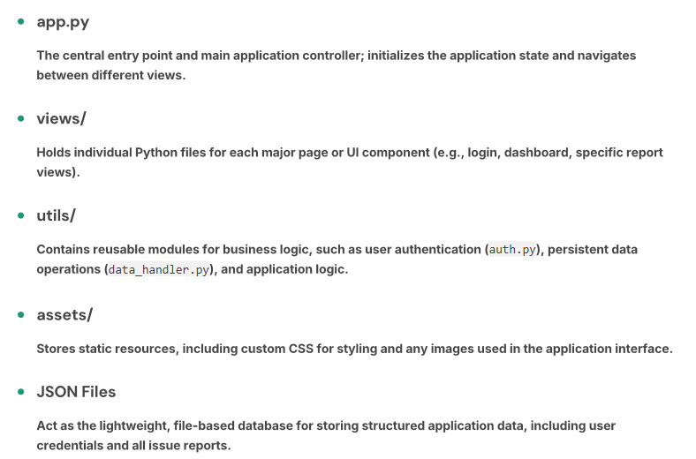
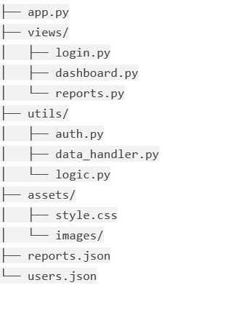
Menu
About Us
@rnagarnirrman
Folder Structure

Slide 7

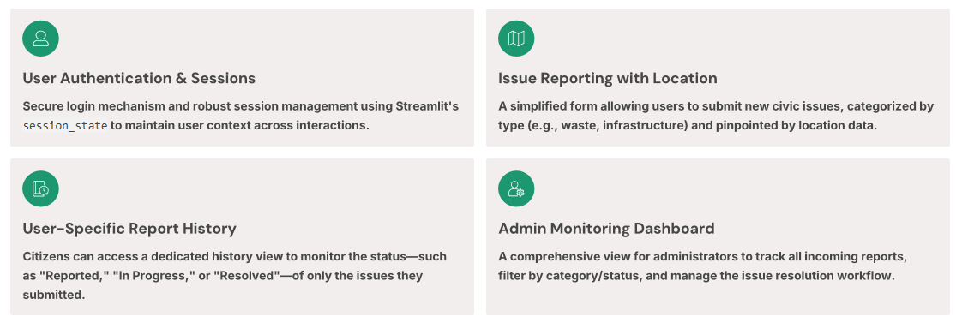
Menu
About Us
@rnagarnirrman
Core Functionalities: A Citizen-Centric Approach

Slide 8
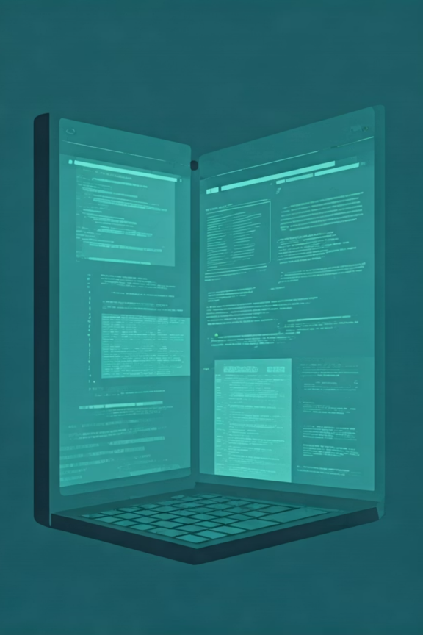
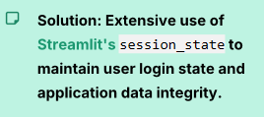
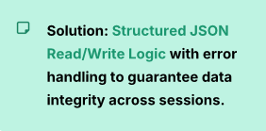
Menu
About Us
@rnagarnirrman
Challenges and Engineering Solutions
Addressing key technical hurdles during development ensured the application's stability and reliability.
Data Persistence
Session Management
Ensuring the JSON data was reliably saved and loaded, especially given the ephemeral nature of cloud-hosted applications after restarts.
The default behavior of Streamlit often results in the loss of user session data upon browser refresh or widget interaction.

Slide 9

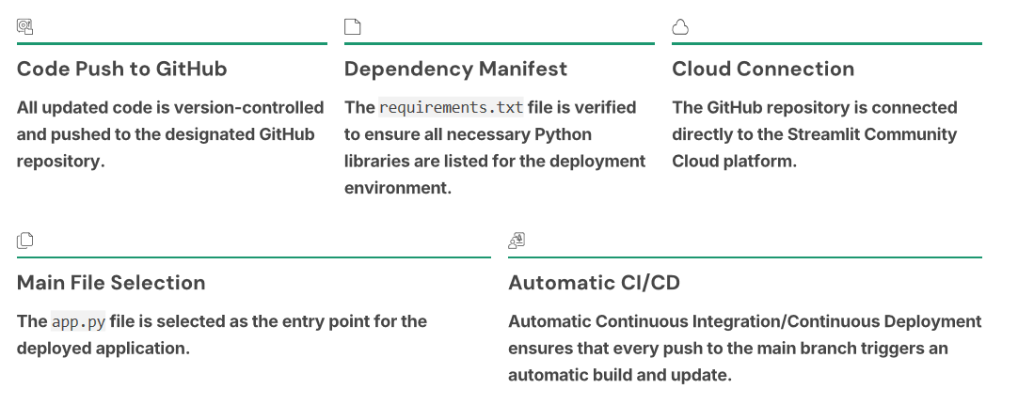
Menu
About Us
@rnagarnirrman
Deployment Process: Continuous Integration

Slide 10




Menu
About Us
@rnagarnirrman
Meet the NagarNirman Development Team
Habibur Rahman Zihad
Saimon Uddin Imam
Rohit Ahemed
Minhajun Noor Miraj
ID: E241024
ID: E241014
ID: E241013
ID: E241027

Slide 11

@rnagarnirrman
python beta version
thank you
If you have any question..........................
please keep it for yourself......I’m not chatgpt😑

