Slide 1

Hospital Management
System
C++ Object Oriented Programming Project
Submitted By
Roll Number
Course
Habib ur Rehman
BSCS25085
OOP — Spring 2026
BSCS — Object Oriented Programming

Slide 2
Table of Contents
01
Project Overview
02
System Modules
Introduction & Problem Statement
8 Core Functional Modules
03
OOP Concepts
04
UML Class Diagram
Inheritance, Polymorphism, Encapsulation
Complete System Architecture
05
File Structure
06
Exception Handling
Source Files & Data Storage
Custom Exceptions & Validation
07
Expected Output
08
Conclusion
System Features & Advantages
Summary & Takeaways

Slide 3
Project Overview
Introduction
Problem Statement
A console-based C++ Hospital Management System that automates core hospital operations including patient management, doctor management, appointment booking, billing, and report generation.
Manual systems cause data loss, appointment conflicts, billing errors, and inefficient record management. This system provides a digital solution using OOP principles.
Key Objectives
Implement OOP concepts: Inheritance, Polymorphism, Encapsulation, Abstraction
Secure authentication for Admin, Doctor, and Patient roles
Manage appointments, billing, prescriptions, and generate reports
File handling with .txt files for permanent data storage
Modular project using multiple .cpp and .h files (~2500–3500 lines of code)

Slide 4









System Modules
Authentication
Patient Mgmt
Doctor Mgmt
Appointments
Login for Admin, Doctor & Patient
Add, update, search, remove records
Manage details & availability
Book, cancel & manage slots
Billing
Prescriptions
Reports
File Handling
Generate bills & payment records
Store medicines & treatment notes
Daily & monthly hospital reports
Save & retrieve from .txt files

Slide 5

OOP Concepts Demonstrated
1
Inheritance
2
Polymorphism
3
Encapsulation
Person → Patient, Doctor, Admin
Base class provides common attributes: ID, name, password, contact
Runtime via virtual functions
virtual void displayMenu()
virtual void generateReport()
All data members are private
Accessed via public getters and setters
4
Abstraction
5
Operator Overloading
6
Exception Handling
Abstract classes with pure virtual functions
Hide implementation, expose essential functionality
+= add balance
-= bill deduction
== compare objects
<< display info
Custom exceptions for invalid input, login errors, slot conflicts, insufficient balance, file errors

Slide 6
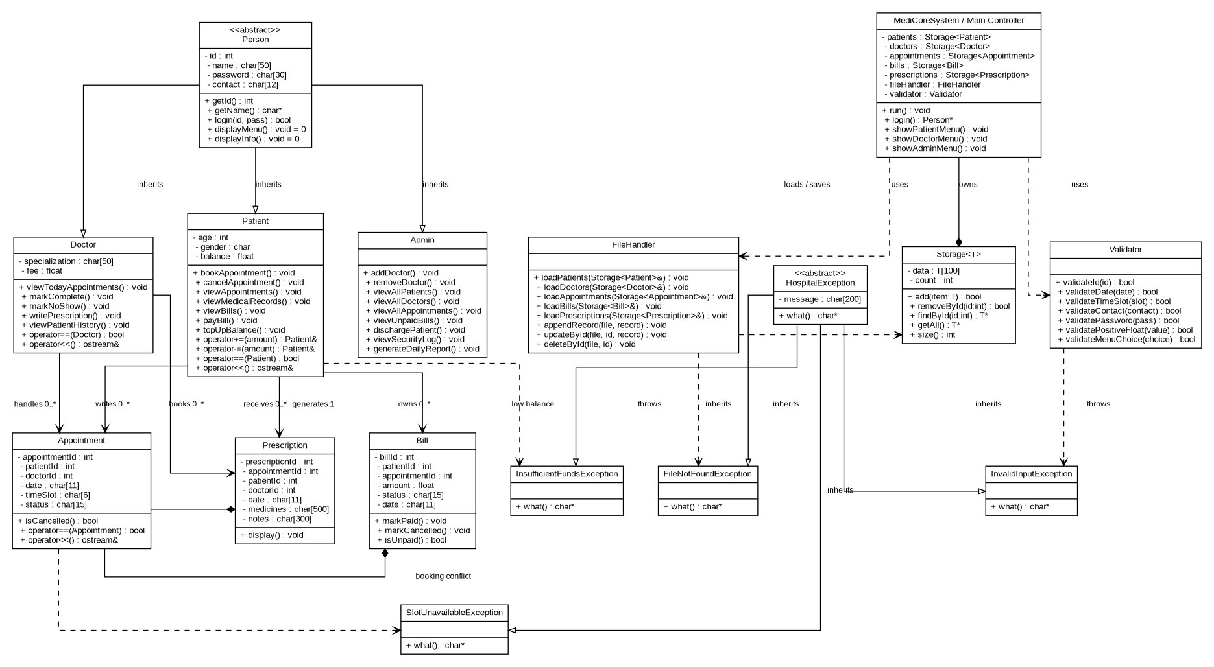
UML Class Diagram
MediCoreSystem — Full UML diagram showing class hierarchy, associations, and relationships

Slide 7

Project File Structure
Source Files (.cpp)
Header Files (.h)
Data Files (.txt)
main.cpp
Person.h
patients.txt
Person.cpp
Patient.h
doctors.txt
Patient.cpp
Doctor.h
admin.txt
Doctor.cpp
Admin.h
appointments.txt
Admin.cpp
Appointment.h
bills.txt
Appointment.cpp
Bill.h
prescriptions.txt
Bill.cpp
Prescription.h
reports.txt
Prescription.cpp
FileManager.h
security_log.txt
FileManager.cpp
Validator.h
Validator.cpp
Menu.h
12–15 Header Files
12–15 CPP Files
~3000 Lines of Code
8 Data Files

Slide 8

Exception Handling & Validation
Custom Exception Classes
Validator Class Methods
HospitalException
validateId(id) : bool
Abstract base exception class
validateDate(date) : bool
InsufficientFundsException
Triggered on low patient balance
validateTimeSlot(slot) : bool
FileNotFoundException
validateContact(contact) : bool
Triggered on missing data file
validatePassword(pass) : bool
SlotUnavailableException
Triggered on appointment conflict
validatePositiveFloat(val) : bool
InvalidInputException
Triggered on bad user input
validateMenuChoice(choice) : bool

Slide 9

Expected Output & Advantages
System Output
Key Advantages
Patient registration & management
Organized & efficient hospital management
Doctor management system
Reduced manual workload and errors
Appointment booking & cancellation
Faster access to patient & doctor records
Billing & payment management
Better appointment scheduling
Prescription management
Strong OOP concepts in practice
Report generation (daily/monthly)
Real-world software development experience
File-based permanent data storage
Permanent data via file-based storage

Slide 10
Conclusion
The Hospital Management System is a medium-scale OOP project that automates hospital operations efficiently. It demonstrates inheritance, polymorphism, abstraction, encapsulation, operator overloading, exception handling, and file handling — providing practical experience of real-world C++ software development.
Inheritance
Polymorphism
Encapsulation
File Handling
Exception Handling
Habib ur Rehman • BSCS25085 • OOP Spring 2026

