Slide 1
NETWORK FAULT DETECTION AND DIAGNOSIS OVER A NETWORK
AND NETWORK INFRASTRUCTURES
A PROJECT WORK WAS CARRIED OUT
BY
RAJI-SHITTU Abdulwaheed Babatunde
03-05-AV-01018
BEING A RESEARCH PROJECT SUBMITTED TO THE DEPARTMENT OF COMPUTER SCIENCE, FACULTY OF SCIENCES. IN PARTIAL FULFILLMENT OF THE REQUIREMENTS FOR THE AWARD OF (M.Sc) COMPUTER SCIENCE
LAGOS STATE UNIVERSITY, OJO
OCTOBER, 2023

Slide 2
Agenda
01
Background
02
Aim and Objectives
03
Research Methodology
04
Results and Discussions
05
Conclusion
06
Recommendations
07
References

Slide 3
Background to the Study
Networks and network infrastructures are the backbone of modern information technology systems. They facilitate the seamless flow of data and communication, underpinning critical functions in various domains, including telecommunications, finance, healthcare, and manufacturing. Ensuring the reliability, availability, and security of these networks is paramount to maintaining uninterrupted operations and safeguarding sensitive information.
However, network faults and disruptions are an inherent challenge in network management. These faults can manifest in various forms, including hardware failures, software glitches, security breaches, and performance degradation. When left unaddressed or detected too late, these faults can lead to network downtime, service interruptions, data breaches, and financial losses.
To mitigate the impact of network faults and enhance network resilience, organizations rely on fault detection and diagnosis methodologies. These methodologies encompass a wide range of techniques and tools designed to identify, categorize, and, in some cases, predict network issues. The ultimate goal is to minimize downtime, reduce the mean time to repair (MTTR), and maintain the integrity and availability of network services.
The field of fault detection and diagnosis over networks has witnessed significant advancements in recent years. Traditional methods, such as active monitoring through ping-based approaches and threshold-based techniques, have been augmented and, in some cases, supplanted by more sophisticated methods, including machine learning-based models and anomaly detection algorithms. These newer approaches promise higher accuracy, adaptability to evolving network conditions, and the ability to identify subtle and complex faults.
However, the selection and optimization of fault detection and diagnosis methods remain complex tasks. The effectiveness of these methods can vary significantly depending on the specific characteristics of the network, its operational goals, and the nature of potential faults. Furthermore, the trade-offs between detection accuracy, false positives, and adaptability need to be carefully considered.
The research presented in this study addresses these challenges by conducting a comprehensive investigation into various fault detection and diagnosis methodologies. Through a series of controlled experiments and data analysis, we aim to evaluate the performance, strengths, and weaknesses of different methodologies in diverse network scenarios. By aligning the study with real-world network management challenges, we seek to provide practical insights and recommendations that can guide network administrators, operators, and researchers in making informed decisions about fault management strategies.

Slide 4
Aim and Objectives
Aim: The primary purpose of this study is to conduct a comprehensive investigation into fault detection and diagnosis methodologies within network and network infrastructure management, by providing practical insights and recommendations, so as to empower network administrators, operators, and researchers in their pursuit of efficient and effective fault detection and diagnosis strategies.
Objectives:
To evaluate and assess the performance and effectiveness of various fault detection and diagnosis methods, including active monitoring, passive monitoring, threshold-based techniques, and machine learning-based approaches, in diverse network scenarios.
To identify the strengths and weaknesses of each methodology in terms of detection accuracy, false positive rates, adaptability to changing network conditions, and other relevant performance metrics.
To explore and examine the variability in the performance of fault detection and diagnosis methods across different experimental scenarios, highlighting the importance of tailoring approaches to specific network characteristics and operational goals.
To provide and offer practical insights and recommendations for network administrators, operators, and researchers to make informed decisions about the selection and optimization of fault management strategies in real-world network environments.
To contribute to the ongoing network resilience efforts so as to enhance the reliability and resilience of network infrastructures, ultimately supporting uninterrupted operations, minimizing downtime, and protecting sensitive data.

Slide 5
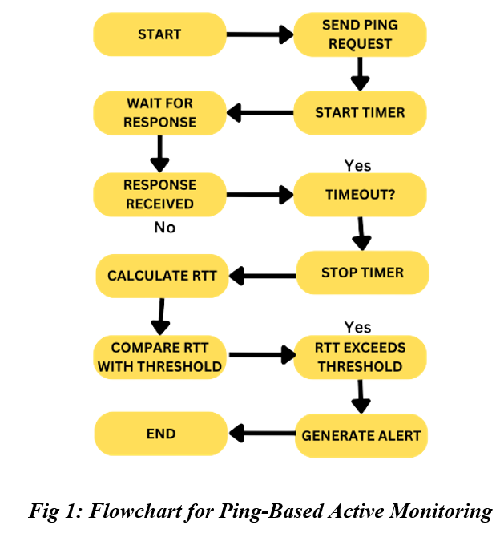
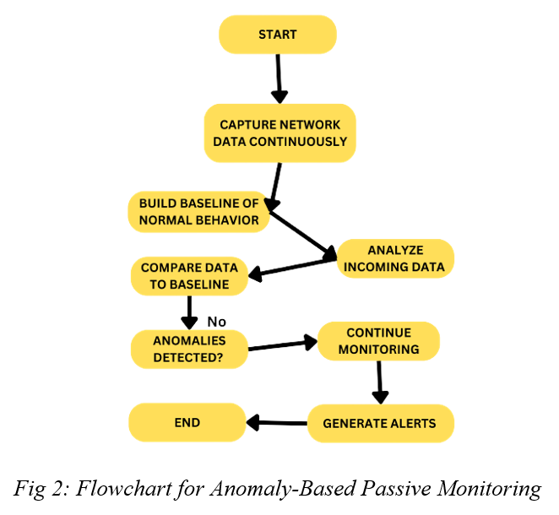
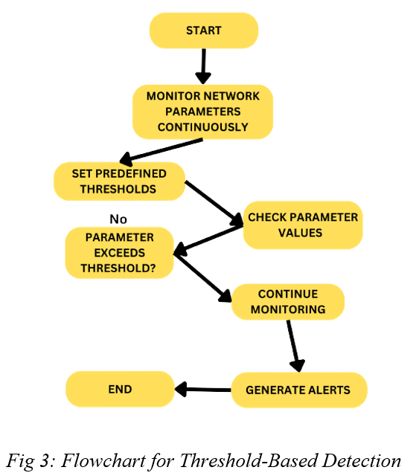
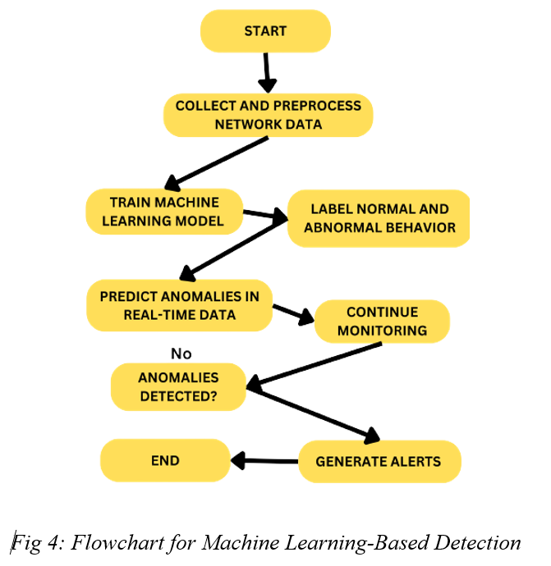
Research methodology
Chapter Focus: Delving into fault detection methods, diagnosis techniques, and visualization tools. The Objective of this chapters are to: Explore various fault detection methodologies, examine fault diagnosis techniques and Use structured visuals to aid understanding.
Methodologies for Fault Detection
Active Monitoring Active monitoring involves the proactive generation of test traffic or requests to assess the responsiveness and performance of network devices and services. | Passive Monitoring Passive monitoring involves the continuous analysis of network traffic and logs to identify abnormal patterns or deviations. This methodology is especially useful for detecting issues that may not trigger active monitoring alerts.
Threshold-Based Detection Threshold-based detection involves setting predefined thresholds for specific network parameters, such as CPU utilization, bandwidth usage, or error rates. When these thresholds are exceeded, alerts are generated to indicate potential issues. | Machine Learning-Based Detection Machine learning-based detection leverages advanced algorithms to detect anomalies in network behavior by analyzing large datasets. These algorithms can identify complex patterns and deviations from normal network behavior.

Slide 6
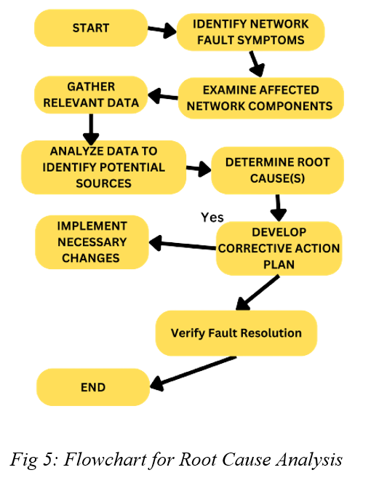
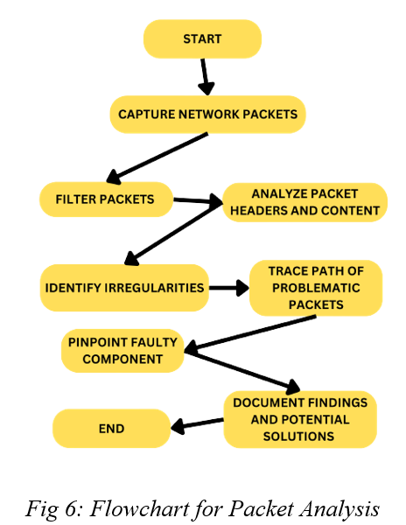
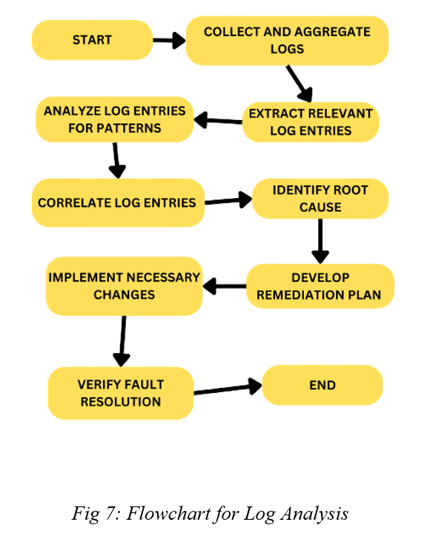
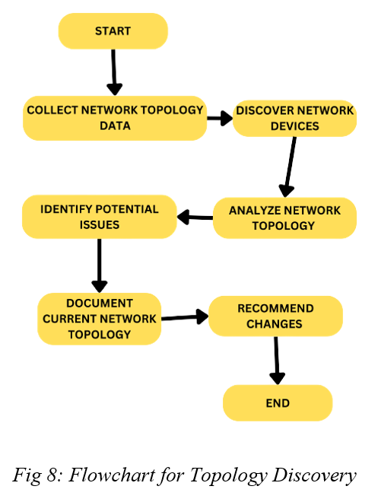
Research methodology Cont’d
Fault diagnosis is a crucial aspect of network management and maintenance that involves identifying and resolving the root causes of detected network faults. In this section, we explore various methodologies and algorithms used for fault diagnosis, each offering a unique approach to understanding and addressing network issues. These methodologies include root cause analysis, packet analysis, log analysis, and topology discovery.
Methodologies for Fault Diagnosis
Root Cause Analysis Root cause analysis is a methodical process for identifying the underlying causes of network faults, allowing for targeted solutions and preventing future occurrences. | Packet Analysis Packet analysis involves the detailed examination of network packets to trace the source of network issues, including packet loss, delays, or abnormal behavior.
Log Analysis Log analysis involves the examination of logs generated by network devices and servers to identify errors, warnings, or patterns indicative of network issues. | Topology Discovery Topology discovery methods assist in understanding network structure and identifying potential bottlenecks or misconfigurations.

Slide 7
Literature review
2.1.1 Definition of Faults in Network Systems
In the context of network systems and infrastructure, faults refer to abnormal conditions, errors, or deviations from the expected or desired behavior of the network. Understanding the precise definition of network faults is fundamental to the process of fault detection and diagnosis. In this subsection, we will delve into the concept of network faults, examining various aspects that help us grasp their nature.
2.1.2 Importance of Fault Detection and Diagnosis
In the realm of network management and operation, fault detection and diagnosis stand as pillars of resilience, performance, and security. This section sheds light on the critical significance of effectively identifying and addressing faults within network systems and infrastructures. The importance of Fault Detection and Diagnosis were that it:
Ensuring Network Reliability and Availability
Enhancing Network Performance
Preventing Escalation of Issues
Ensuring Network Security
Compliance and Regulatory Requirements
Proactive Network Management

Slide 8
Literature Review Cont’D
2.2 Types of Network Faults
2.2.1 Hardware Faults
Hardware faults refer to problems or issues that occur within the physical components of a computer network or an IT infrastructure. These faults can lead to disruptions in network operations, degraded performance, and, in some cases, complete network outages. Hardware faults can affect various network devices and components, including servers, routers, switches, cables, and more. Here are some common types of hardware faults:
2.2.2 Software Faults
Software faults are problems, defects, or issues that occur within the software components of a computer network or an IT infrastructure. These faults can lead to various disruptions, including application crashes, system errors, and security vulnerabilities. Identifying and addressing software faults is critical for maintaining the stability, security, and performance of networked systems. Here are some common types of software faults:
2.2.3 Configuration Faults
Configuration faults, often referred to as configuration errors or misconfigurations, are issues that occur when the settings or parameters of network devices, software applications, or IT infrastructure components are incorrectly set or do not align with the intended or desired configuration. These faults can lead to a wide range of problems, including network disruptions, security vulnerabilities, and performance degradation. Here are some common types of configuration faults:

Slide 9
Data Collection, Experiment, and Results
DATA SOURCES AND ACQUISITION
The reliability and comprehensiveness of our dataset are fundamental to the success of our research in fault detection and diagnosis over network and network infrastructures. In this subsection, we delve into the sources from which we have procured our network and infrastructure data, shedding light on the diversity and significance of these sources.
Data Sources: Our dataset draws from a multifaceted array of data sources, each contributing unique insights into network behavior and performance. These sources include: Network Logs, Traffic Monitoring Tools, Device Configurations, Synthetic Data Generation
Data Acquisition Methodologies: The acquisition of data from these sources is a carefully orchestrated process to ensure data quality, integrity, and relevance. Our data acquisition methodologies include: Data Extraction, Real-time Monitoring, Scheduled Data Retrieval, Data Integration
Data Preprocessing and Cleansing: The raw data collected from various sources often requires meticulous preprocessing and cleansing to ensure its quality, consistency, and suitability for analysis. In this subsection, we delve into the essential steps and practices involved in preparing our data for subsequent analysis.
Data Cleaning: Data cleaning is the initial step in the data preprocessing pipeline, aimed at identifying and rectifying errors, inconsistencies, and missing values within the dataset. Key aspects of data cleaning include: Handling Missing Values, Outlier Detection and Treatment, Data Normalization.
Data Transformation: Data transformation involves converting raw data into a more suitable format or representation for analysis. Key data transformation practices include: Aggregation, Feature Engineering, Data Encoding.
Data Integration and Harmonization: Our dataset is drawn from diverse sources, and integration is a crucial aspect of data preprocessing. This involves: Aligning Timestamps and Normalizing Data Formats
Quality Assurance and Validation: Throughout the data preprocessing phase, quality assurance measures are applied to validate the accuracy and reliability of the processed data. These measures encompass: Data Consistency Checks, Data Completeness Assessment and Validation Against Ground Truth.
Data Storage and Management: Effective data storage and management are integral components of our research infrastructure. In this subsection, we delve into the strategies and practices employed to handle the vast volume of data generated during our fault detection and diagnosis experiments.

Slide 10
Data Collection, Experiment, and Results Cont’D
Data Storage Infrastructure: Our data storage infrastructure is designed to accommodate the diverse types of data collected, ensuring its accessibility, security, and scalability. Key aspects of our data storage infrastructure include: Database Selection and File Storage.
Data Security and Privacy: Data security and privacy are paramount considerations in our data storage and management practices. We implement security measures that include: Access Control, Data Encryption and Compliance.
Data Backup and Redundancy: To mitigate the risk of data loss, we have implemented data backup and redundancy strategies. These strategies involve: Regular Backups, Redundancy.
Data Lifecycle Management: Our data management practices also encompass data lifecycle management. This involves: Data Retention Policies and Data Purging.
Data Accessibility and Retrieval: Accessibility to data is crucial for analysis and reporting. Our data storage and management practices ensure: Data Indexing and Data Retrieval Protocols.
SELECTION OF VARIABLES AND METRICS
The success of our experiments in fault detection and diagnosis over network and network infrastructures depends on the careful selection of variables and metrics. In this subsection, we elucidate the criteria and considerations guiding our choices and outline the specific variables and metrics under examination.
Criteria for Variable Selection: The selection of variables (parameters, attributes, or characteristics) is fundamental to our research. The criteria for variable selection include:
Methodology for Collecting Network Data: The process of collecting network data is a pivotal step in our research, as it forms the basis for our fault detection and diagnosis experiments. In this subsection, we elaborate on the methodologies employed to collect network data, ensuring the comprehensive capture of network behavior and performance.

Slide 11
Data Collection, Experiment, and Results Cont’D
Presentation of Raw Data and Observations : In this section, we present raw data and observations obtained from our fault detection and diagnosis experiments. The raw data offers a detailed view of network behavior under different experimental scenarios, while our observations provide initial insights into the performance of various fault detection and diagnosis methodologies.
Scenario 1: Active Monitoring with Ping-Based Method
Scenario 2: Anomaly-Based Passive Monitoring
Raw Data:
Timestamped logs of ICMP echo requests (ping) sent to network devices.
Recorded response times and packet loss rates.
Device availability status over time.
Observations:
Increased response times and packet loss observed during network stress tests.
Timely detection of device unavailability using ping-based monitoring.
Consistency in response times during normal network conditions.
Raw Data:
Captured network traffic data, including packet headers and payloads.
Timestamps of anomalies detected by passive monitoring algorithms.
Observations:
Identification of unusual traffic patterns, including sudden spikes and protocol deviations.
Timely alerts generated by anomaly-based passive monitoring.
Clear distinction between normal and anomalous network behavior in captured traffic data.
Scenario 3: Threshold-Based Detection Techniques
Scenario 4: Machine Learning-Based Detection
Raw Data:
Network parameter measurements, including CPU utilization and bandwidth usage.
Threshold values configured for each parameter.
Timestamps of parameter breaches and alerts triggered.
Observations:
Effective detection of parameter breaches when thresholds are exceeded.
Rapid alerting mechanism for threshold-based detection.
Raw Data:
Network data features used as input to machine learning models.
Timestamped predictions and classifications generated by machine learning algorithms.
Observations:
Machine learning models demonstrate the ability to capture complex patterns in network behavior.
Varied performance among different machine learning algorithms in terms of accuracy and false positive rates.

Slide 12
Data Collection, Experiment, and Results Cont’D
4.5.1 Comparative Analysis of Fault Detection and Diagnosis Methods: In this section, we conduct a comprehensive comparative analysis of the fault detection and diagnosis methods employed in our experiments. The objective is to evaluate and contrast the performance of these methods across different experimental scenarios and gain insights into their strengths and weaknesses.
Performance Metrics
Scenario-Based Comparative Analysis
Before delving into the comparative analysis, it is essential to define the performance metrics used to assess the effectiveness of the fault detection and diagnosis methods. The following metrics are considered:
Accuracy: Accuracy measures the overall correctness of fault detection and diagnosis, representing the ratio of correctly identified faults to the total cases.
False Positive Rate (FPR): FPR quantifies the proportion of false alarms generated by the methods, indicating the rate at which normal network behavior is incorrectly flagged as a fault.
Precision: Precision represents the proportion of true positive identifications among the positive predictions. It reflects the methods' ability to make accurate positive identifications.
Recall: Recall measures the proportion of actual positive cases that were correctly identified by the methods. It gauges the methods' sensitivity to detecting faults.
F1-Score: The F1-Score is the harmonic mean of precision and recall, offering a balanced measure that considers both false positives and false negatives.
We proceed to compare the performance of fault detection and diagnosis methods within each experimental scenario:
Scenario 1: Active Monitoring with Ping-Based Method
Ping-Based Method: The ping-based method demonstrates high accuracy in detecting device unavailability but may generate false positives during network congestion.
Scenario 2: Anomaly-Based Passive Monitoring
Anomaly-Based Passive Monitoring: Passive monitoring excels in detecting unusual traffic patterns but may require fine-tuning to minimize false positives.
Scenario 3: Threshold-Based Detection Techniques
Threshold-Based Techniques: Threshold-based techniques perform effectively in identifying parameter breaches with a low false positive rate, but they may struggle to adapt to dynamic network conditions.
Scenario 4: Machine Learning-Based Detection
Machine Learning-Based Models: Machine learning models exhibit the capability to capture complex patterns but may vary in performance depending on the specific algorithm used. Fine-tuning hyper parameters can enhance accuracy.

Slide 13
Data Collection, Experiment, and Results Cont’D
In this section, we delve into the interpretation of the results obtained from our fault detection and diagnosis experiments. The analysis aims to provide insights into the performance of different methodologies and shed light on their implications for network fault detection and diagnosis in various scenarios.
Interpretation of Results
Scenario 1: Active Monitoring with Ping-Based Method
Interpretation: The ping-based method demonstrates a strong ability to detect device unavailability promptly, making it suitable for scenarios where device uptime is critical. However, its reliance on ICMP echo requests may result in false positives during network congestion, requiring careful tuning of alerting thresholds.
Implications: For environments with stringent device availability requirements, the ping-based method can offer effective fault detection. Nevertheless, it should be complemented with additional methods to reduce false positives during high traffic periods.
Scenario 2: Anomaly-Based Passive Monitoring
Interpretation: Anomaly-based passive monitoring excels in detecting unusual traffic patterns and is less prone to false positives compared to active methods. However, fine-tuning of anomaly detection algorithms may be necessary to achieve optimal results.
Implications: In scenarios where subtle or unexpected anomalies are a concern, passive monitoring can provide valuable insights. Continuous monitoring and periodic adjustment of anomaly detection algorithms can help maintain accuracy.
Scenario 3: Threshold-Based Detection Techniques
Interpretation: Threshold-based techniques offer precision in identifying parameter breaches with a low false positive rate. However, they may struggle to adapt to dynamic network conditions, making them less suitable for rapidly changing environments.
Implications: In stable network environments with well-defined operational thresholds, threshold-based techniques can offer reliable fault detection. However, they may require periodic adjustment to accommodate changing network conditions.
Scenario 4: Machine Learning-Based Detection
Interpretation: Machine learning-based models exhibit the capacity to capture complex patterns and adapt to diverse network conditions. The choice of algorithm plays a significant role in performance, with fine-tuning opportunities to improve accuracy.
Implications: Machine learning-based detection methods are versatile and effective in scenarios where network behavior is complex or rapidly changing. Careful selection of the machine learning algorithm and optimization of hyper parameters can yield superior results.

Slide 14
Data Collection, Experiment, and Results Cont’D
Summary of Findings: In summary, our comparative analysis reveals that each fault detection and diagnosis method has its unique strengths and limitations. The choice of method depends on the specific network characteristics, objectives, and trade-offs involved. It is essential to consider factors such as detection accuracy, false positive rates, and adaptability to dynamic network environments when selecting an appropriate method.
Performance Metrics
Experimental Outcome: Performance Variability across Scenarios
Cross-Scenario Insights
Interpretation: Across scenarios, no single method emerges as universally superior. Instead, the choice of method depends on the specific network characteristics and objectives. Consideration of detection accuracy, false positive rates, and adaptability to network dynamics is crucial.
Implications: Network administrators and operators should assess the trade-offs between different fault detection and diagnosis methods based on their network's unique requirements. Combining multiple methods may provide a comprehensive fault management strategy.
Future Directions
Interpretation: The experimental results highlight the potential for further research and refinement of fault detection and diagnosis methodologies, particularly in the context of machine learning-based approaches and anomaly detection algorithms.
Implications: Future research efforts can focus on optimizing machine learning models, exploring ensemble techniques, and enhancing anomaly detection algorithms to address evolving network challenges effectively.
One prominent observation is the variability in the performance of fault detection and diagnosis methodologies across different experimental scenarios. This variability underscores the importance of considering the specific characteristics and operational requirements of the network when selecting an appropriate methodology. For instance:
In Scenario 1 (Active Monitoring with Ping-Based Method), the ping-based method excels in detecting device unavailability but may generate false positives during high traffic periods. Its suitability for scenarios with strict device uptime requirements is evident.
Scenario 2 (Anomaly-Based Passive Monitoring) highlights the strengths of passive monitoring in identifying unusual traffic patterns while maintaining a lower false positive rate. However, the need for periodic fine-tuning is evident to optimize detection accuracy.
Scenario 3 (Threshold-Based Detection Techniques) demonstrates the precision of threshold-based techniques in identifying parameter breaches. Nevertheless, their adaptability to rapidly changing network conditions may pose challenges.
In Scenario 4 (Machine Learning-Based Detection), machine learning-based models show promise in capturing complex patterns and adapting to diverse network conditions. The choice of machine learning algorithm and hyper parameter optimization significantly impacts their performance.

Slide 15
Conclusion
In this study, we embarked on a comprehensive exploration of fault detection and diagnosis methodologies within network and network infrastructure management. Our research objectives were to assess the effectiveness of various fault detection and diagnosis methods, identify their strengths and weaknesses, explore performance variability across diverse network scenarios, and provide practical insights and recommendations for improved fault management.
The key takeaways from our study can be summarized as follows:
Methodological Diversity: We observed a wide range of fault detection and diagnosis methodologies, including active monitoring, passive monitoring, threshold-based techniques, and machine learning-based approaches.
Scenario-Specific Adaptability: The variability in method performance across different experimental scenarios highlighted the importance of tailoring fault detection and diagnosis approaches to specific network characteristics and operational goals.
Machine Learning Potential: Machine learning-based models showed promise in achieving high detection accuracy and adaptability to changing network conditions. However, these models require thorough optimization and continuous monitoring to realize their full potential.
Passive Monitoring Advantages: Passive monitoring, particularly anomaly-based methods, exhibited reduced false positive rates compared to active methods.
Threshold-Based Precision: Threshold-based techniques demonstrated precision in identifying parameter breaches, making them well-suited for stable network environments with well-defined operational thresholds.
Hybrid Approaches for Comprehensive Fault Management: Combining multiple fault detection and diagnosis methods in hybrid approaches emerged as a strategy to enhance fault management.

Slide 16
Recommendation
Based on the findings of this study, the following recommendations were made categorically as follows;
Tailor Method Selection:
Carefully evaluate the specific characteristics and operational goals of your network environment before selecting a fault detection and diagnosis methodology.
Consider a hybrid approach that combines multiple methods to leverage their respective strengths and provide redundancy.
Machine Learning Optimization:
Prioritize thorough optimization and fine-tuning when employing machine learning-based methods.
Continuously monitor the performance of machine learning models and adjust them as network conditions evolve.
Passive Monitoring and Anomaly Detection:
Emphasize passive monitoring and anomaly detection techniques when minimizing false positives is a priority.
Regularly fine-tune anomaly detection algorithms to optimize detection accuracy and reduce false negatives.
Threshold-Based Techniques:
For networks with stable operational thresholds, continue to use threshold-based techniques for precise fault detection.
Implement automated alerting mechanisms when threshold breaches occur to ensure timely response to parameter violations.
Data-Driven Decision-Making:
Establish a culture of data-driven decision-making in network management.
Regularly analyze performance metrics and data trends to inform operational decisions and adjustments.

Slide 17
References
Al-Shaer, E., & Latif, S. (2013). Challenges in network fault detection and diagnosis. IEEE Communications Magazine, 51(12), 138-145.
Al-Shaer, E., Latif, S., & Al-Safadi, M. (2019). Network fault detection and diagnosis using machine learning: A survey. IEEE Communications Surveys & Tutorials, 21(2), 1954-1983.
Arpaci-Dusseau, R. H., & Arpaci-Dusseau, A. C. (2018). Operating systems: Three easy pieces (1st ed.). Arpaci-Dusseau Books LLC.
California Attorney General's Office. (2018). California Consumer Privacy Act (CCPA).
Cisco Systems. (2022). Network troubleshooting guide (14th ed.). Cisco Press.
Citrix Systems, Inc. (2022). Application performance management: A critical component of digital transformation.
End-User Computing. (2022). 2022 user experience expectations report.
European Union. (2016). General Data Protection Regulation (GDPR).
Gartner, Inc. (2022). Gartner predicts that AIOps will save organizations $57 billion in IT costs by 2025.
Hewlett Packard Enterprise. (2022). The business value of AIOps.
IBM Corporation. (2022). Watson AIOps: A new era of IT operations management.
International Organization for Standardization. (2013). ISO/IEC 27001:2013.
Juniper Networks. (2021). JUNOS troubleshooting guide (19th ed.). Juniper Networks.
Kessler, R. (2009). Software bugs in network applications: A case study. IEEE Security & Privacy, 7(3), 44-53.
Khan, M. S., Zeb, K., Ullah, S., Shah, M. A., & Rehman, A. (2020). A survey of network fault detection and diagnosis techniques: Taxonomy, trends, and challenges. IEEE Access, 8, 84625-84647.
Kurose, J. F., & Ross, K. W. (2013). Computer networking: A top-down approach (6th ed.). Addison-Wesley Professional.
Microsoft Corporation. (2023). Software troubleshooting guide (10th ed.). Microsoft Press.
National Institute of Standards and Technology. (2022). Cybersecurity framework.
Oracle Corporation. (2023). Oracle software troubleshooting guide (12th ed.). Oracle Press.
Payment Card Industry Security Standards Council. (2004). Payment Card Industry Data Security Standard (PCI DSS).
Ponemon Institute. (2022). Cost of a data breach report.
Riverbed Technology, Inc. (2022). The digital experience imperative: How to meet and exceed user expectations.
Service Now, Inc. (2022). The future of IT operations management.
Somani, S., & Jain, N. (2008). Network hardware failures: A survey. IEEE Communications Surveys & Tutorials, 10(4), 13-32.

Slide 18
THANKS FOR LISTENING ....…….

