Slide 1

Uncertainty Quantification for OOD Detection:
A Comparative Study with Focus on Conformal Prediction
University of Computer Studies, Yangon
Presented by : Mg Aung Kaung San
Roll No. : 6CS-18 (BIS)

Slide 2
Outline
Abstract
Problem
Solution
Objective
Introduction
Data
Data Preprocessing
Small CNN Architecture
Evaluation Metrics
Results / Comparison
Robustness Under Shift
Conclusion
References

Slide 3
Abstract
Compares 4 UQ methods: Softmax, MC-Dropout, Deep Ensembles, Conformal Prediction (APS)
ID dataset: CIFAR-10
OOD dataset: SVHN
Evaluated on calibration, OOD detection, and robustness under shift
Deep Ensembles → best OOD detection; Conformal → best coverage guarantee

Slide 4
Problem
Neural networks can be confidently wrong on unfamiliar inputs
Risky for safety-critical systems (medical, driving, industry)
Models need to “know when they don’t know”

Slide 5
Solution
Use Uncertainty Quantification (UQ) methods to get reliable confidence
Compare 4 approaches under one common protocol
Focus on conformal prediction for guaranteed coverage

Slide 6
Objective
Compare 4 UQ methods fairly
Measure OOD detection performance
Measure calibration quality
Evaluate conformal coverage & set size
Test robustness under distribution shift

Slide 7
Introduction
DNNs may face inputs far from training distribution
Aleatoric uncertainty = data noise
Epistemic uncertainty = model’s lack of knowledge (key for OOD)
Research Question: Which UQ method best detects OOD + gives reliable confidence?

Slide 8
Data
CIFAR-10 (ID): 10 classes, 32×32 RGB, 50,000 train / 10,000 test.
SVHN (OOD): 32×32 RGB house-number images, disjoint label semantics, test split used for OOD evaluation.
Same resolution and channels
Split: 20% of CIFAR-10 test set used for conformal calibration; remaining 80% for evaluation.

Slide 9
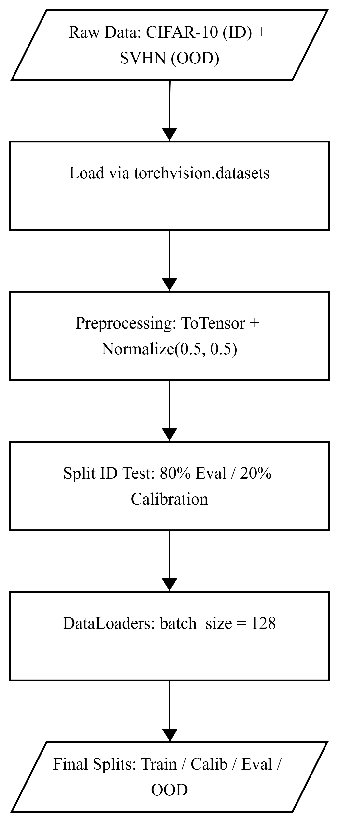
Data Preprocessing

Slide 10
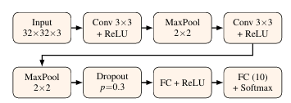
Small CNN Architecture

Slide 11
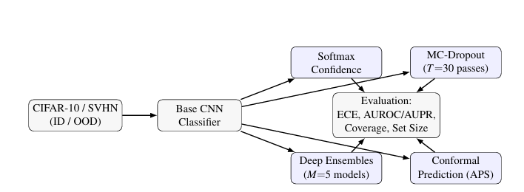
Overall methodology pipeline

Slide 12
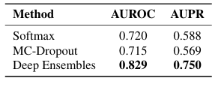
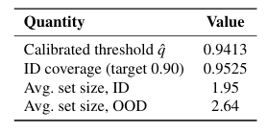
Results / Comparison
Deep Ensembles: AUROC 0.829 (best)
Softmax: AUROC 0.720
MC-Dropout: AUROC 0.715
Softmax ECE = 0.0461 (overconfident)
Conformal: 95.25% coverage (target 90%), avg set size 1.95 (ID) → 2.64 (OOD)

Slide 13
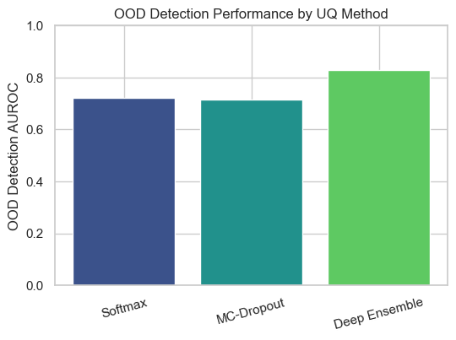
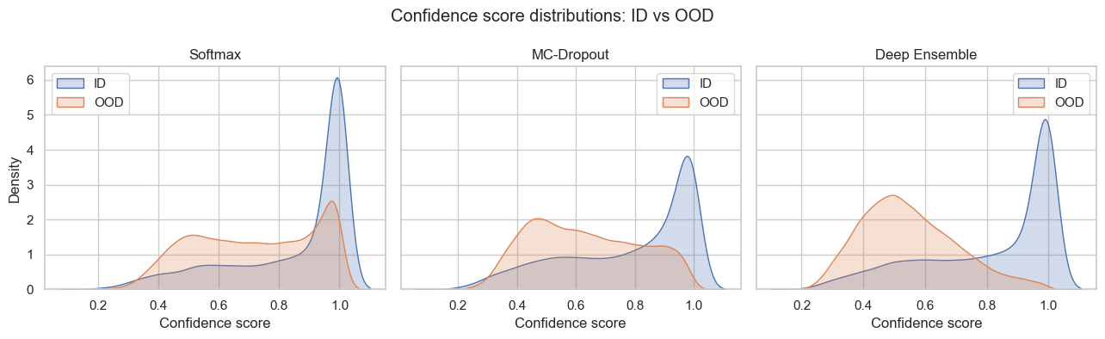
Results / Comparison (Cont’d)

Slide 14
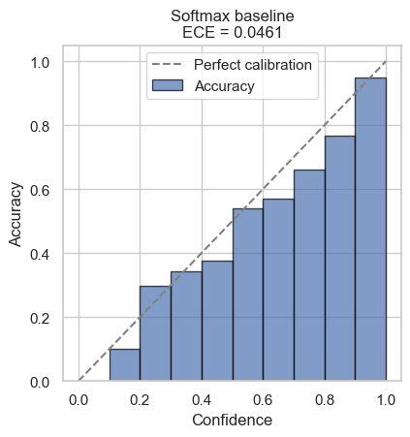
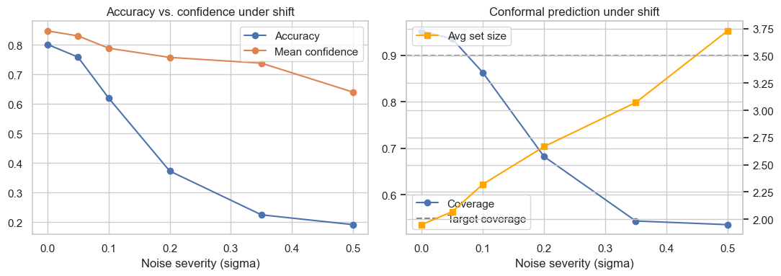
Results / Comparison (Cont’d)

Slide 15
Robustness Under Distribution Shift
Accuracy drops 0.801 → 0.192 as noise increases
Confidence drops much slower: 0.847 → 0.640
At σ=0.5: 64% confident but only 19% correct

Slide 16
Conclusion
Deep Ensembles = best OOD detector
Conformal Prediction = reliable guarantee, low cost
Confidence-based methods overconfident under shift
Future work: natural corruptions, more datasets, larger models

Slide 17
References
Gal & Ghahramani (2016) — MC-Dropout
Guo et al. (2017) — Calibration
Hendrycks & Gimpel (2017) — Softmax baseline
Kendall & Gal (2017) — Uncertainty types
Lakshminarayanan et al. (2017) — Deep Ensembles
Romano et al. (2020) — Conformal APS

