Slide 1
Perceptual Map
Like a pro

Slide 2
Perceptual Map
A Perceptual Map (also called a Positioning Map) is a visual tool used in marketing and strategy to show how customers perceive brands or products compared to competitors.
It helps you answer questions like:
“How do customers see our product in the market?”
“Which competitors are close to us?”
“Is there an open space (gap) in the market we can target?”

Slide 3
Purpose of a Perceptual Map
It helps companies:
Understand market position
See how they compare with competitors
Identify strengths, weaknesses, and opportunities
Guide decisions on branding, pricing, and features

Slide 4
How to Create a Perceptual Map
Step 1: Choose your product and competitors
Pick your product (the one you’re analyzing) and 2–4 of its main competitors.
Example: You’re comparing four coffee shop brands: Coffee A (Your Product or Service), Coffee B, Coffee C, Coffee D

Slide 5
How to Create a Perceptual Map
Step 2: Select two attributes
Choose two features that customers use to compare these products. These are usually opposites or contrasting qualities (positive vs. negative). Example: X-axis → Price (from Low [negative] to High [positive]) Y-axis → Quality (from Low [negative] to High [positive])

Slide 6
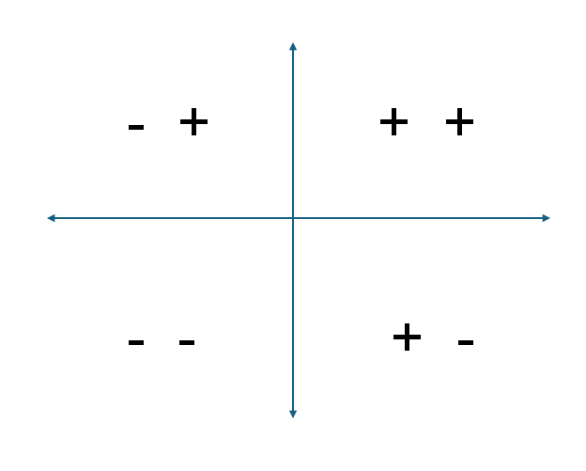
How to Create a Perceptual Map
Step 3: Create your 4 quadrants
High Quality
Low Price
High Price
Low Quality

Slide 7
How to Create a Perceptual Map
Step 4: Assign positive and negative scores
You can use a simple scale from -10 to +10 for each attribute. Negative means “low,” and positive means “high.” The lower the rating, the more negative the score and the higher the rating, the more positive the score.
Brand | Price Score (x-axis) | Quality Score (y-axis)
Coffee A | +8 | +9
Coffee B | −6 | +8
Coffee C | +6 | −4
Coffee D | −7 | −6

Slide 8
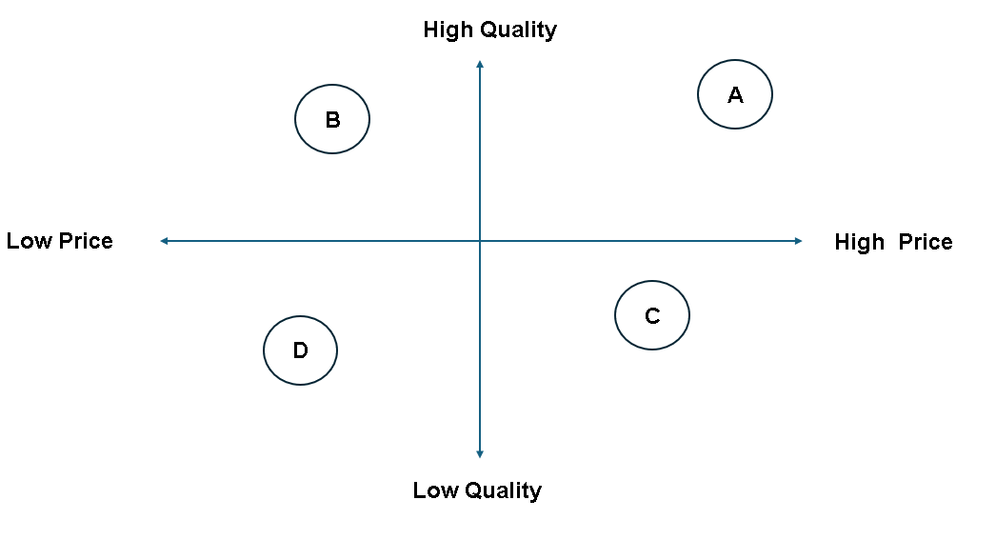
How to Create a Perceptual Map
Step 5: Plot the brands

Slide 9
How to Create a Perceptual Map
Step 6: Conclusion
The perceptual map shows that Coffee A holds a premium market position, while Coffee B competes as an affordable high-quality option. The bottom-right quadrant remains unattractive due to poor value perception, while the top-left quadrant may offer opportunities for balanced pricing and quality.

