Slide 1
Business Model Canvas
As easy as 123

Slide 2
What is the Business Model Canvas (BMC)?
The Business Model Canvas is like a map for businesses. It helps us see how a company works, makes money, and delivers value — all in one simple page.
Think of it as a big picture tool where instead of writing a long business plan, you organize ideas into 9 building blocks.

Slide 3
Why use it?
• Easy to visualize how a business runs.
• Helps spot strengths, weaknesses, and opportunities.
• Saves time compared to long reports.
• Encourages teamwork since everyone can see the same canvas.

Slide 4
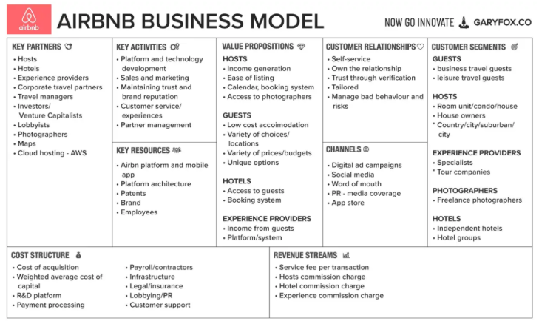
The 9 Building Blocks :
Customer Segments – Who are we serving? (e.g., students, gamers, small businesses)

Slide 5
The 9 Building Blocks :
Value Proposition – What problem are we solving? Why should customers choose us?

Slide 6
The 9 Building Blocks :
Channels – How do we reach customers? (stores, apps, websites)

Slide 7
The 9 Building Blocks :
Customer Relationships – How do we keep them happy? (support, loyalty programs, personalization)

Slide 8
The 9 Building Blocks :
Revenue Streams – How do we make money? (sales, subscriptions, ads)

Slide 9
The 9 Building Blocks :
Key Resources – What important things do we need? (staff, tech, brand)

Slide 10
The 9 Building Blocks :
Key Partners – Who helps us? (suppliers, investors, collaborators)

Slide 11
The 9 Building Blocks :
Cost Structure – What do we spend money on? (rent, salaries, materials)

