Slide 1
ZigBee?
10 minutes of ZigBee, a lifetime to remember

Slide 2


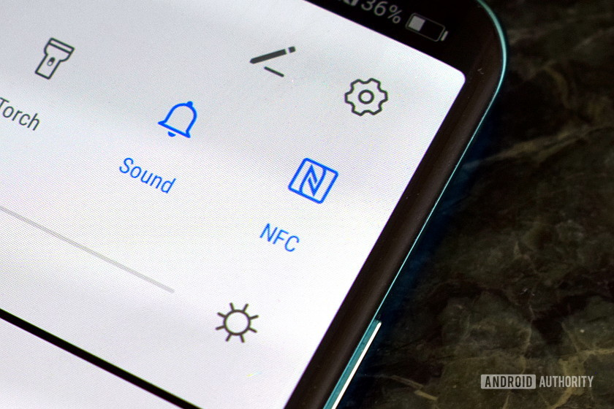
Wireless
WiFi
Bluetooth
Near-field communication (NFC)

Slide 3
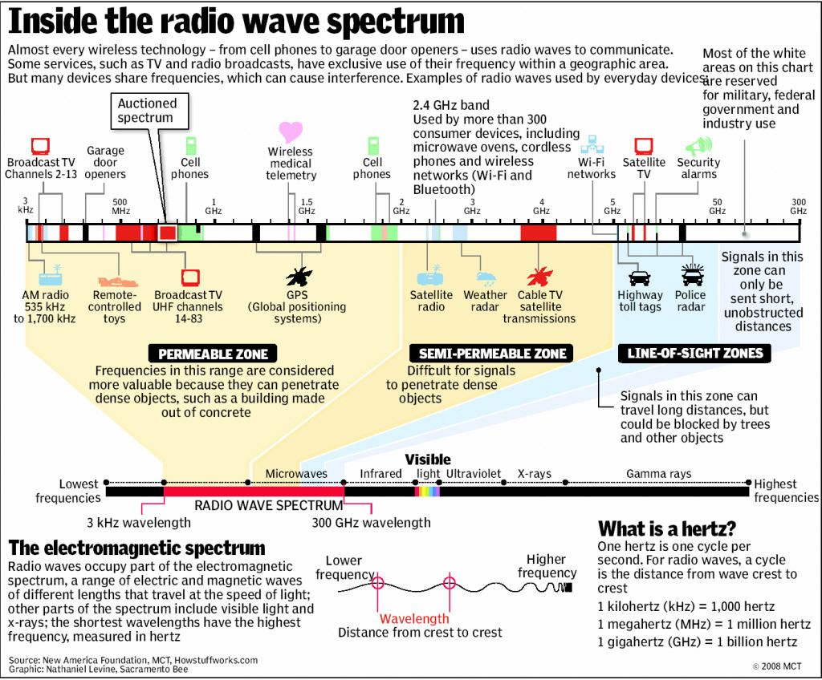
What are they in common?

Slide 4
What are they in common?

Slide 5
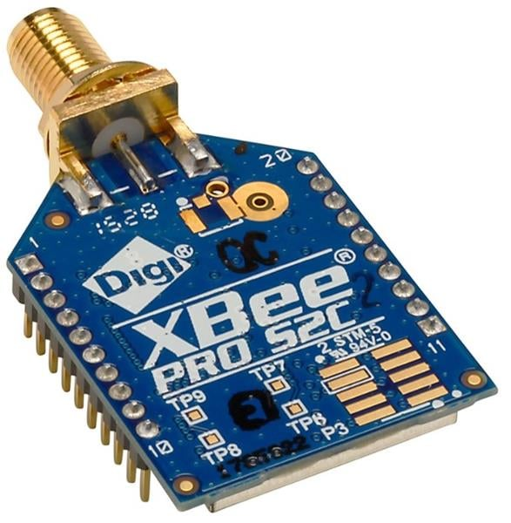
ZigBee in a nutshell
Low Powered
Cheap
Open wireless standard

Slide 6
The Zigbee tech stack
Application
Network
Medium Access Control
Physical

Slide 7
The Zigbee tech stack
Application
Network
Medium Access Control
Follow IEEE 802.15.4
Physical

Slide 8
The Zigbee tech stack
Application
Network
Medium Access Control
CSMA/CA
Follow IEEE 802.15.4
Physical
Radio Bands

Slide 9
The Zigbee tech stack
Application
Follow ZigBee Spec
Network
Medium Access Control
CSMA/CA
Follow IEEE 802.15.4
Physical
Radio Bands

Slide 10
The Zigbee tech stack
Application
ZigBee App
Follow ZigBee Spec
ZigBee Security
Network
ZigBee Networking
Medium Access Control
CSMA/CA
Follow IEEE 802.15.4
Physical
Radio Bands

Slide 11
The Zigbee tech stack (TL;DR)
Application
ZigBee App
Follow ZigBee Spec
ZigBee Security
Network
ZigBee Networking
Medium Access Control
CSMA/CA
Follow IEEE 802.15.4
Physical
Radio Bands

Slide 12
The Zigbee tech stack (TL;DR)
Application
ZigBee App
Follow ZigBee Spec
ZigBee Security
Network
ZigBee Networking
Medium Access Control
CSMA/CA
Follow IEEE 802.15.4
Physical
Radio Bands

Slide 13
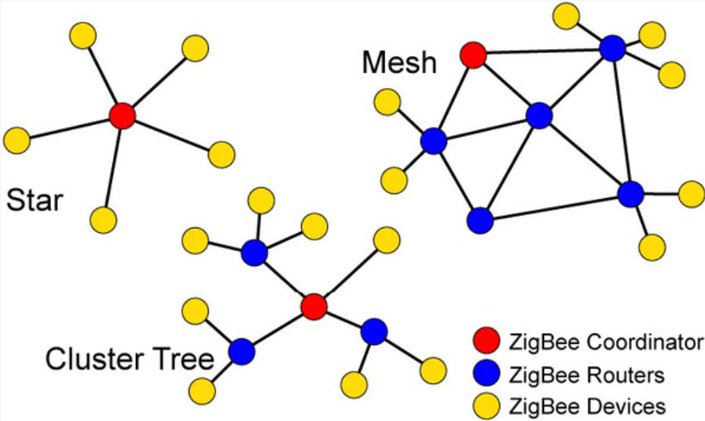
There is more!

Slide 14
There is more!

Slide 15
There is more!

Slide 16
There is more!

Slide 17
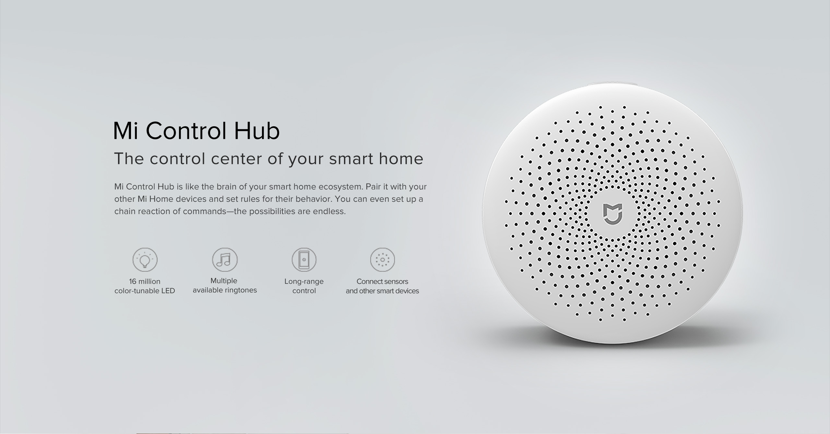
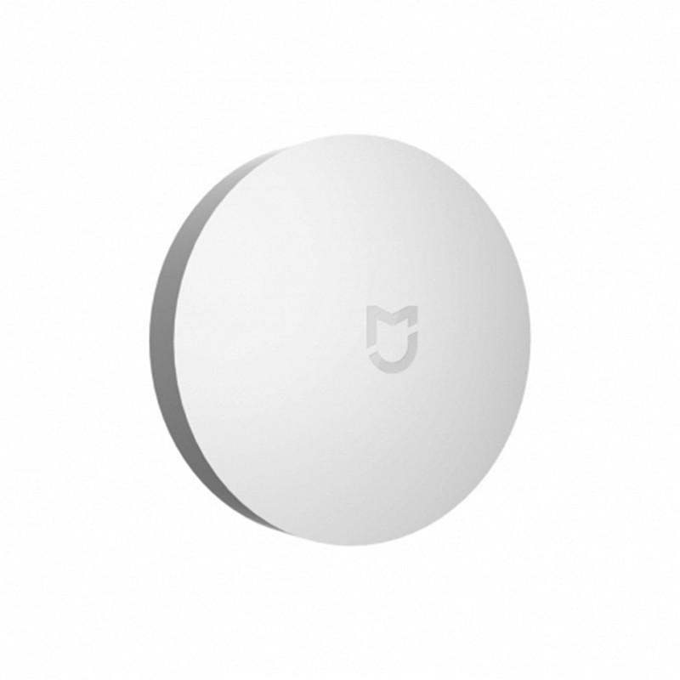
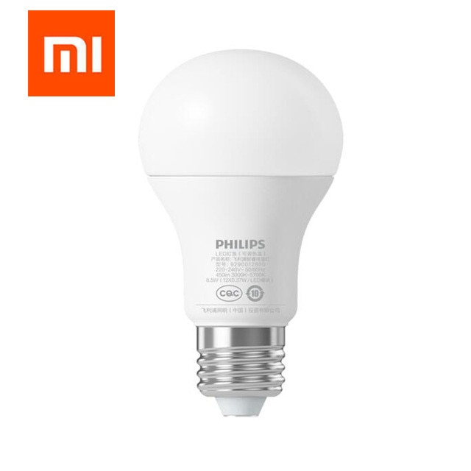
ZigBee Coordinator
ZigBee Device
ZigBee Router

Slide 18
That’s all
That’s 10 minutes, see you next time!

