Slide 1
Team Name: PAVe-ways
Vandana Prasad | 2021 | BITS Pilani
Parul Jyoti | 2021 | BITS Pilani
Ashok Kummar | 2021 |BITS Pilani

Slide 2
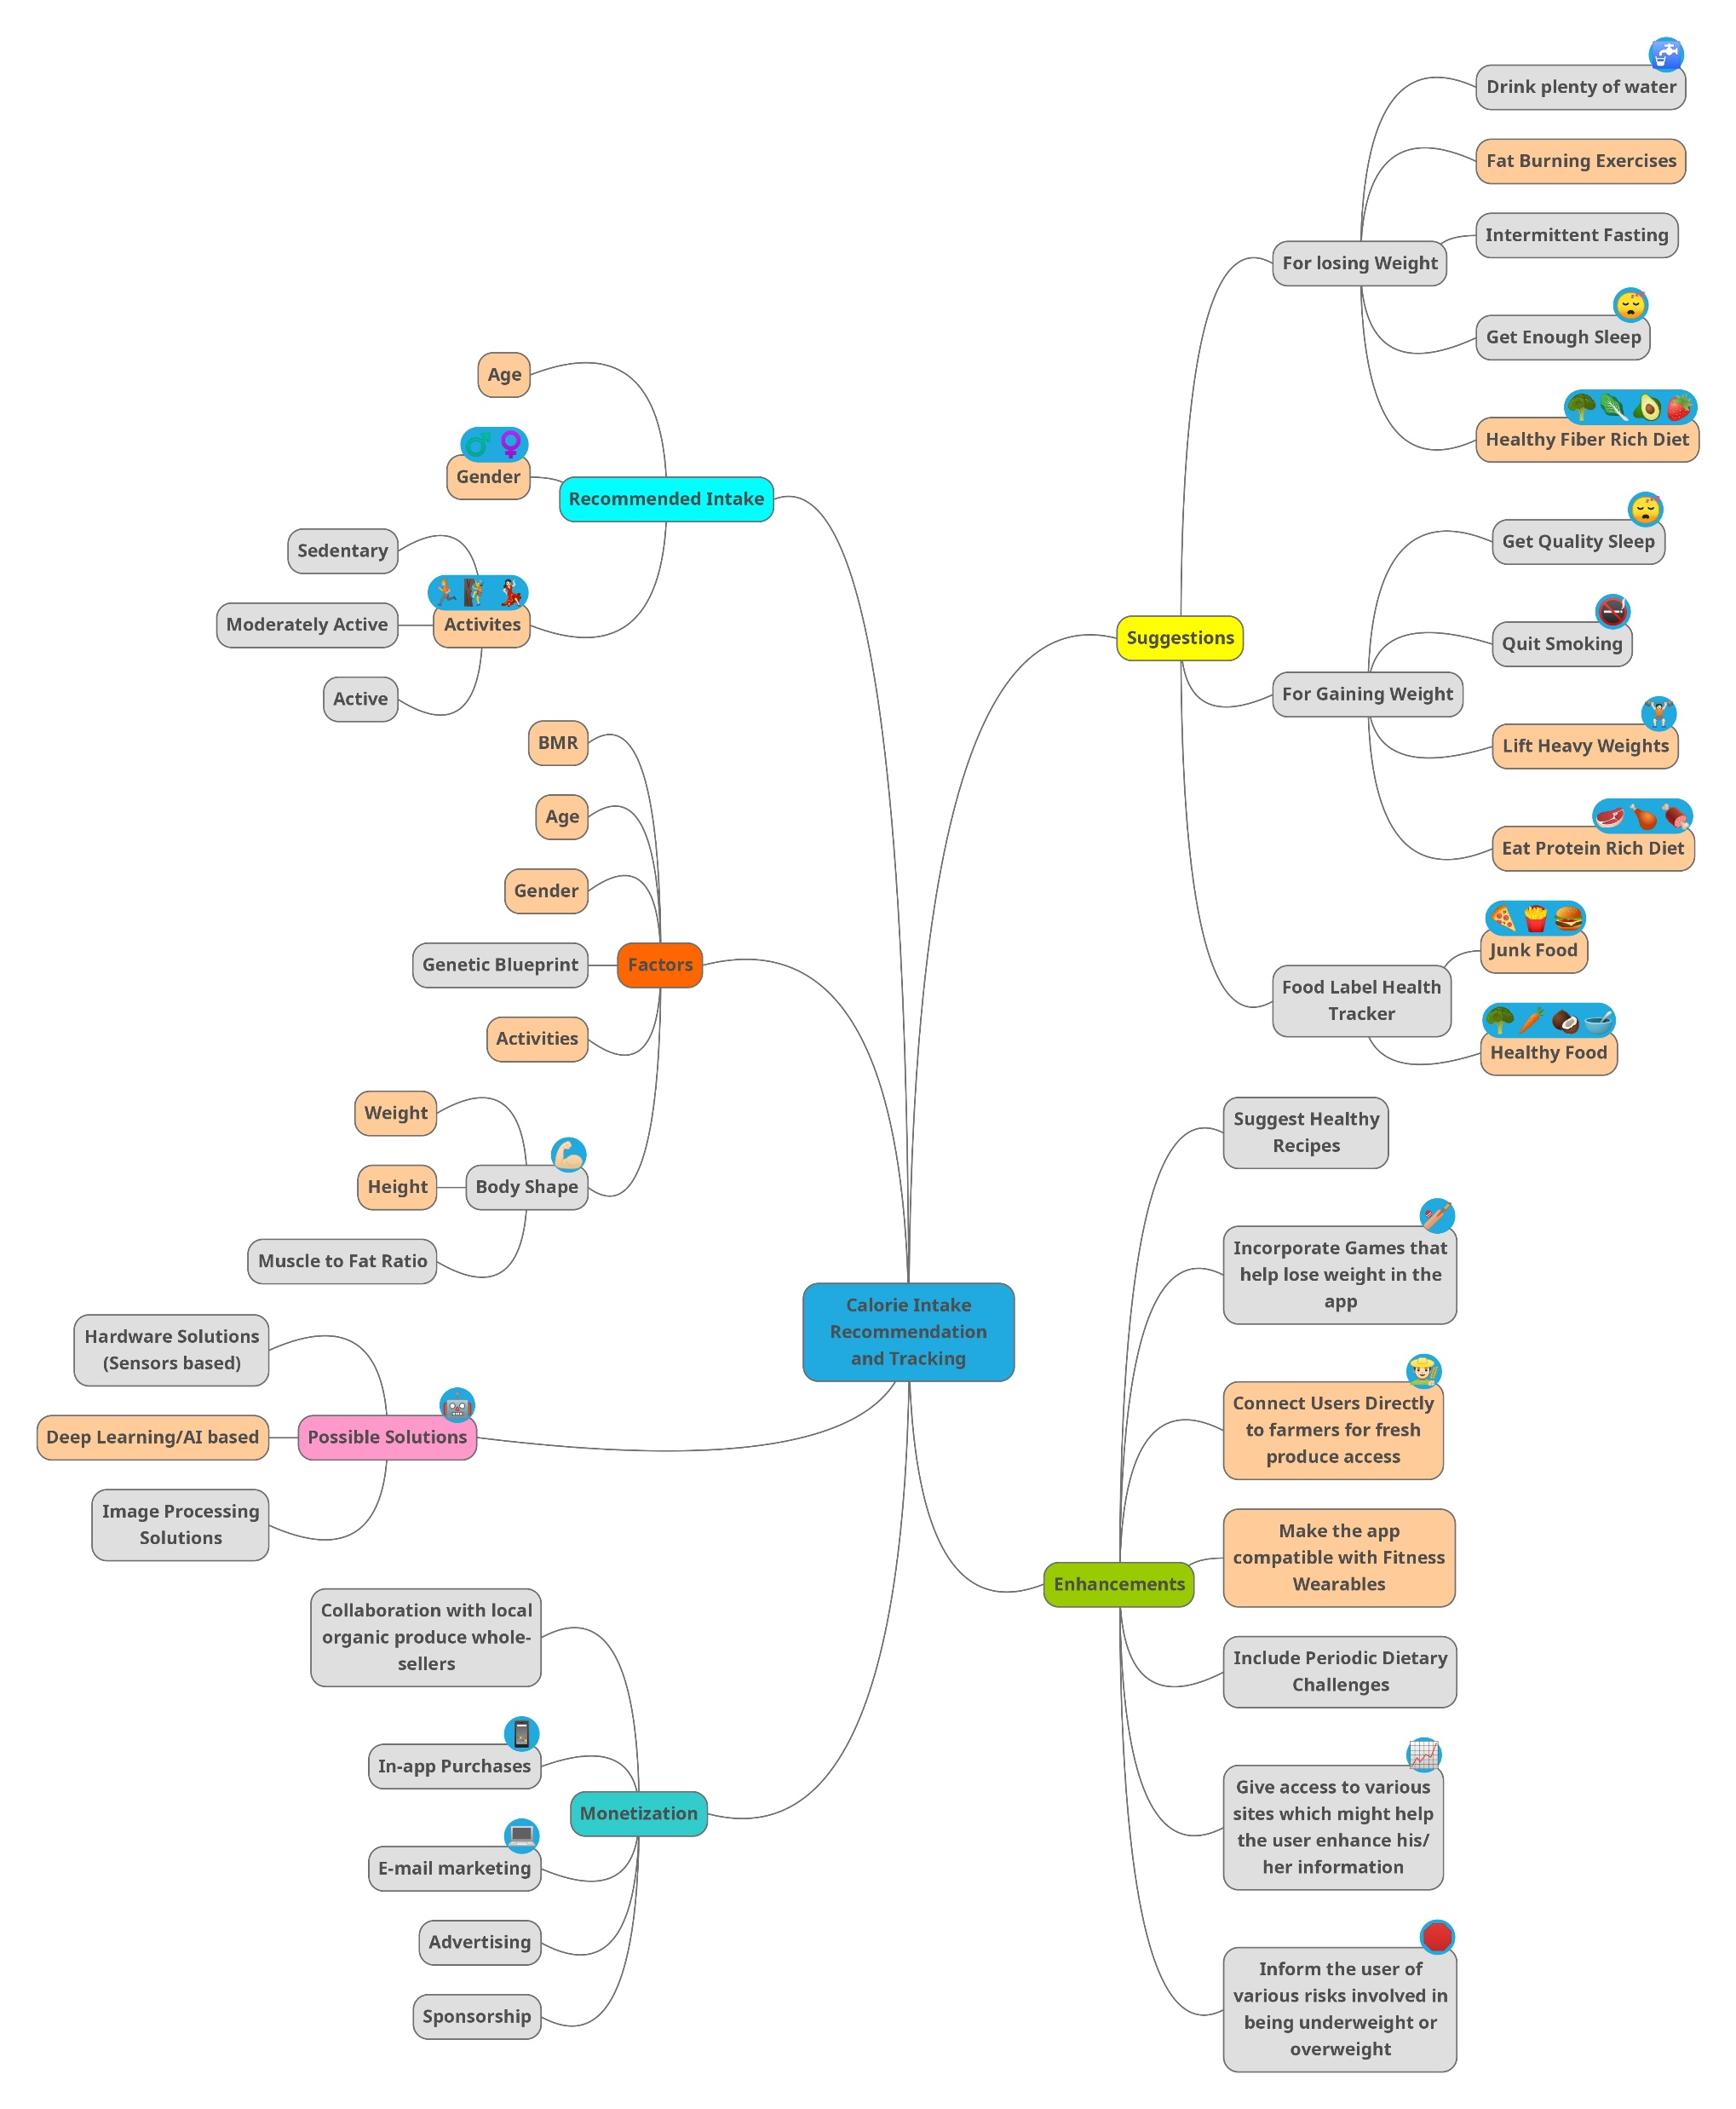
Mind Map of Our Idea

Slide 3
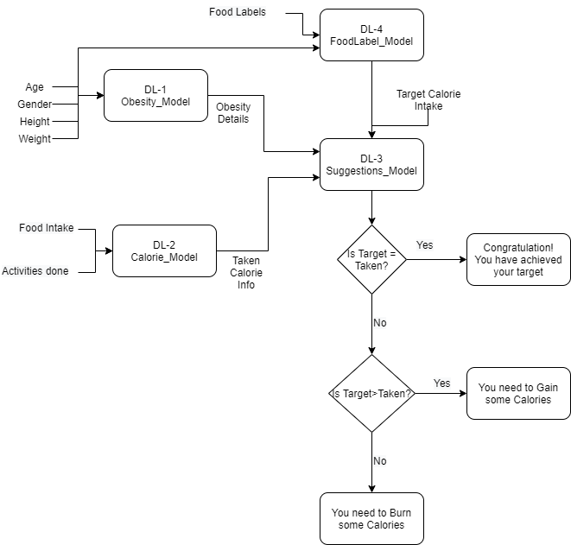
Process Flow

Slide 4
Tech Stack
Python - Backend
PyTorch / Keras - Deep learning framework
Apache Spark - Database
PyQT / Tkinter – Frontend design

