Slide 1
Team Predator
Sarthak Bansal | 2021 | BITS Pilani
Devesh Sharma | 2021 | BITS Pilani
Arkojit Chatterjee | 2021 | BITS Pilani

Slide 2
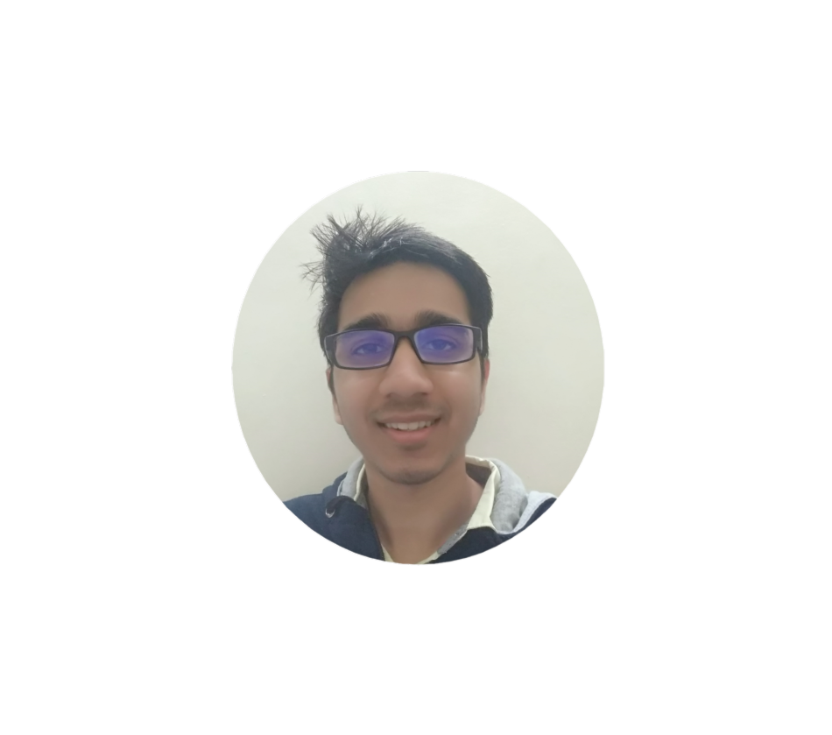
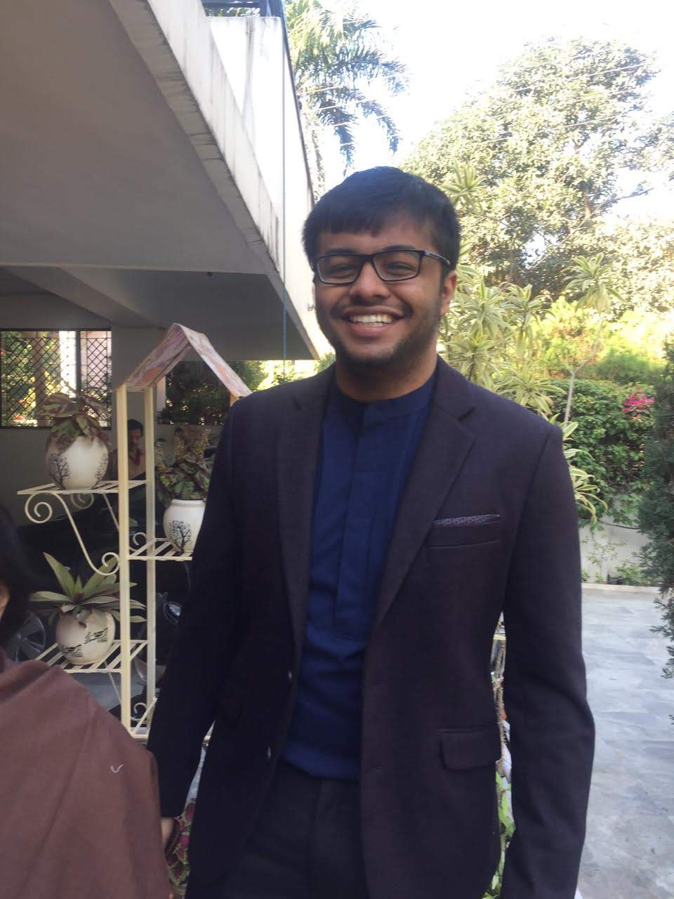
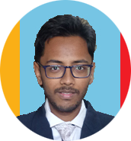
Team
Sarthak Bansal
Devesh Sharma
Arkojit Chatterjee
4th rank in TVS EPIC IT challenge out of 2000 teams and received PPO.
Top 10 in Mercedes Digital Challenge out of 1000 teams and invited to MBRDI Bangalore
Top 1% and Finalist in Deloitte Technoutsav Challenge.
Top 3% in ZS Campus Beats
43rd Out of 1000 in Hack the Crisis Hackathon
and many more….
Top 1% and Finalist in Deloitte Technoutsav Challenge.
Developed AI managed Traffic Light System
1st rank in round 1 of Crowd Strike
And many more….
4th rank in TVS EPIC IT challenge out of 2000 teams and received PPO.
Top 10 in Mercedes Digital Challenge out of 1000 teams and invited to MBRDI Bangalore
43rd Out of 1000 in Hack the Crisis Hackathon
And many more….
* Please answer for your entire team

Slide 3


Calorie Monitoring System
Web-app
Monitoring and Guiding
We are going to make an all in one web app for calorie management and Provide personalized curated exercise and diet plan.
The user could choose to monitor his daily calorie intake based on his routine meals and workout schedule. The user could also set the desired goal of the amount of weight gain or loose in specified time and the web-app would automatically suggest what is to be done

Slide 4






Process Flow of Recommender
Captures the image of food
Personal Diet plan curated
User Creates account
Neural Network Process the data
User views the calorie of the food and suggested diet and workout plans
Captures the steps
Personal Gym plan curated

Slide 5






Tech Stack
HTML 5
Django 2.2
PYTHON 3.7
IBM visual recognition
KERAS
TENSORFLOW
MySQL
Nvidia CUDA

Slide 6

So, how is our solution different?
Adaptive
Personal Trainer
Our solution is unique and adaptable to needs of the user. It not only monitors daily amount of calories taken and burned by the user it also suggests diet, food and exercise to achieve a desired goal.
Our app makes personally curated exercise and diet program according to the user to achieve desired goal. This helps in achieving result sooner , avoiding injuries and set realistic goals.

Slide 7


Future possible enhancements
Some improvements which could be made in our present proposal in future is that, we make it a self learner, i.e. by checking the BMI status of it’s multiple users and the feedback from the users on the schedule suggested by the app.
It intelligently incorporates those feedbacks in it’s future suggestions and provide the best possible experience to it’s users.
Based on the feedback it provides other alternatives which might suit the user.

Slide 8


Risks/ Challenges / Dependencies
Challenges are basically that it is a fact that there is no universal solution for everyone to either gain or loose weight, it varies from person to person. So the data and feedback collected from one person may not be beneficial for the other person.
The showstopper of our app is that it is a self reliant app to provide all in one solution to maintain good body shape, even in the “Lockdown” situation.

Slide 9
Our Mission Statement
We believe in making India Healthy and Fit.

