Slide 1

Database management in Java – JDBC and ORM basics
Atanas Gardev
Georgi Gachev

Slide 2

Database

Slide 3

JDBC vs. ORM

Slide 4
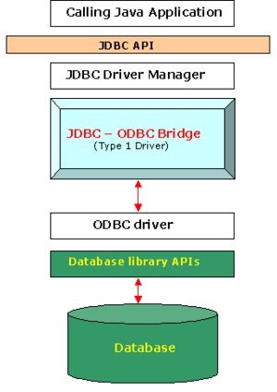
Java Database Connectivity (JDBC)
JDBC API + JDBC Driver Manager = <3

Slide 5
Java Database Connectivity (JDBC) – con’t
JDBC API + JDBC Driver Manager = <3
Connection conn = DriverManager.getConnection( "jdbc:mysql://localhost:8888/ebookshop", "myuser", "xxxx");
Statement stmt = conn.createStatement();
String query = "select title, price, qty from books";
ResultSet rset = stmt.executeQuery(query);
while(rset.next()) {
String title = rset.getString("title");
double price = rset.getDouble("price");
int qty = rset.getInt("qty");
}

Slide 6
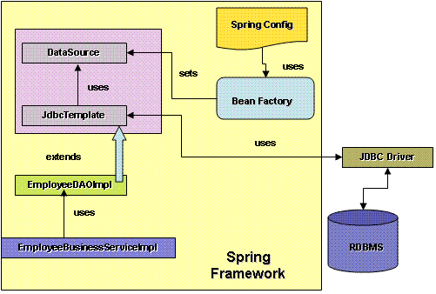
Java Database Connectivity (JDBC) – con’t
Using the JDBC Template

Slide 7
Java Database Connectivity (JDBC) – con’t
Using the JDBC Template
JdbcTemplate m_jdbcTemplate = new JdbcTemplate(dataSource);
String result = m_jdbcTemplate.queryForObject(bestQueryEver,
new Object[] { number, name }, String.class).toString();

Slide 8
Java Database Connectivity (JDBC) – con’t
JDBC methods
m_jdbcTemplate.update(updateQuery, new Object[] { name, number }); -> returns int
m_jdbcTemplate.queryForObject(query, new Object[] { number }, String.class); -> returns String
m_jdbcTemplate.query( query, new Object[]{ course }, studentResultSetExtractor); -> returns Object based on the extractor

Slide 9
Java Database Connectivity (JDBC) – con’t
ResultSetExtractor
ResultSetExtractor studentResultSetExtractor= new ResultSetExtractor() {
public Object extractData(ResultSet rs) throws SQLException, DataAccessException {
ArrayList<Student> students = new ArrayList<Student>();
while(rs.next()) {
long id = rs.getLong(“STUDENT_ID");
String name = rs.getString(“STUDENT_NAME");
long course = rs.getLong(“COURSE_ID");
students.add(new Student( id, name, course));
}
return students;
} };

Slide 10

Pros and cons
+ easy to use + easy to learn + powerful + allows connecting to a wide range of databases | - SQL knowledge needed - has its own restrictions - be careful with transactions - can’t pick up girls

Slide 11
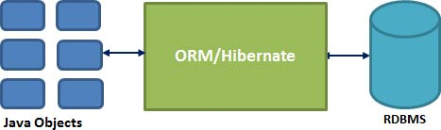
Object-relational mapping
What is it about?
Why do we need it?
Implementations: Hibernate, Spring DAO, Enterprise JavaBeans Entity Beans

Slide 12
ORM Example
@NamedQueries({
@NamedQuery(name = "getByUesername",
query = "select distinct u
from User u left join fetch u.uiLanguage
where u.username = :username")
})
@Entity
@Table(name = "users", schema = "waf3_acl")
public class User implements Serializable {
@Column(name = "email", length = 7, nullable = false)
public String getEmail() {
return this.email;
}
@ManyToOne(fetch = FetchType.LAZY)
@JoinColumn(name = "data_language_id", nullable = false)
public DataLanguage getDataLanguage() {
return this.dataLanguage;
}

Slide 13
Object-relational Impedance Mismatch
Relational Models and Objects Models do not work very well together :(
Challenges:
- granularity
- subtypes (inheritance)
- identity (equals)
- associations
- data navigation

Slide 14
Pros and cons
+ less coding + easy transactions + native date/time conversion + caching + easy DAO creation | - complex (in the beginning) - errors prone - slow and memory consuming in some cases

Slide 15
Conclusions
- Use ORM for transactional applications with light data management.
- Use plain SQL in reporting-heavy apps with large number of rows.
- Spent enough time to create a good model (DB schema) for your data! This allows you developing a robust persistence layer!
- Look around for alternatives and new frameworks fitting your needs.

Slide 16

Q & A
Questions & (probably) Answers

