Slide 1
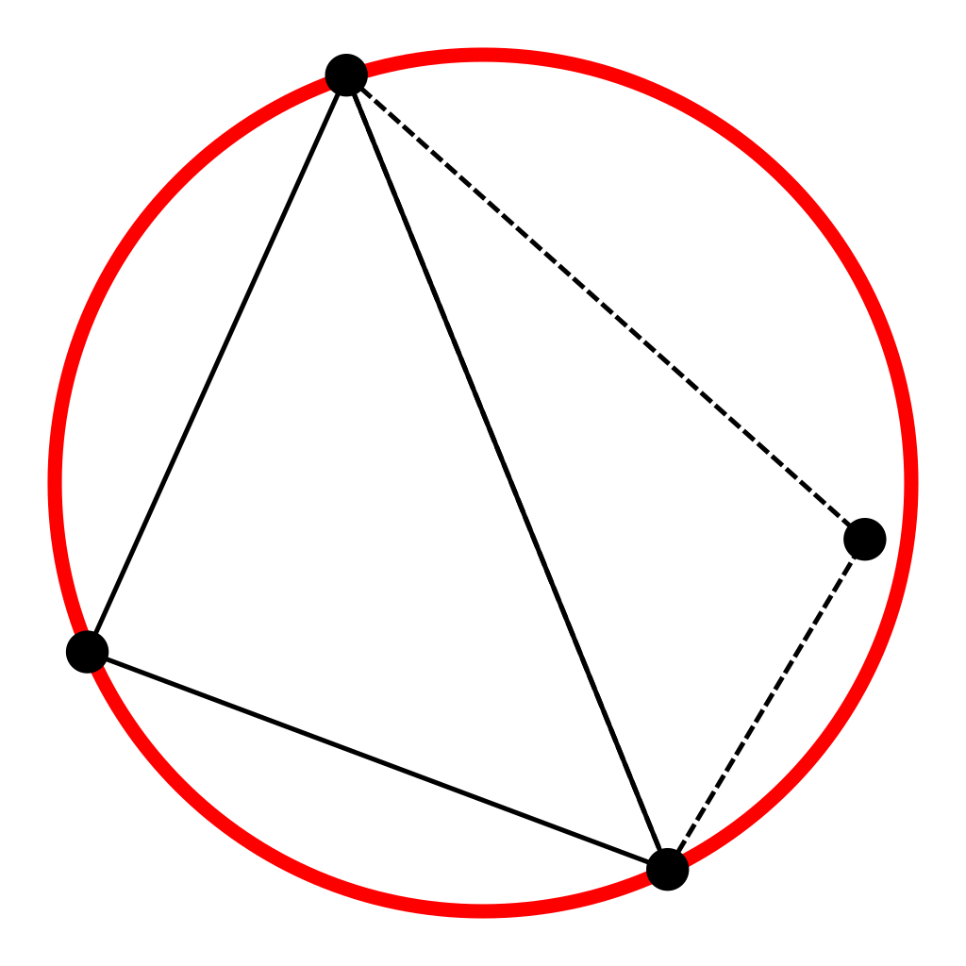
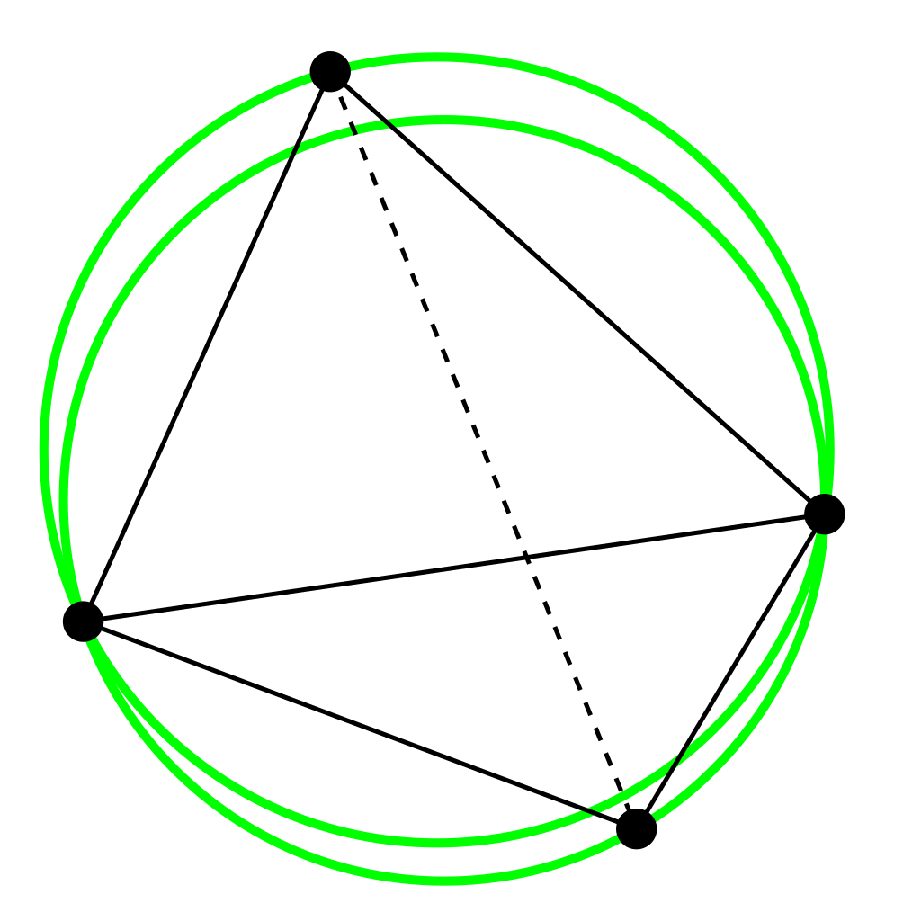
On the use of AI for Delaunay triangulation
https://upload.wikimedia.org/wikipedia/commons/8/82/Delaunay_triangulation_does_not_minimize_edge_length.gif

Slide 2
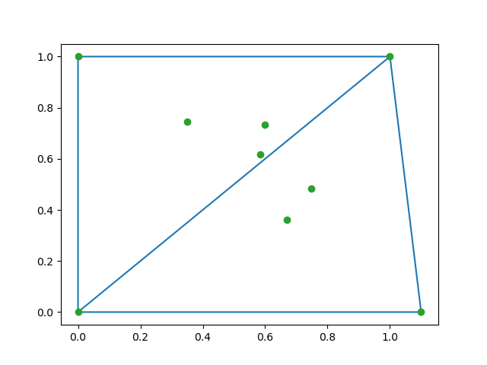




Chalenge #XX
What:
find the optimal insertion sequence of 5 random points inside the square [0, 1]
Input:
2 starting triangles (Delaunay triangulation)
5 points (generated randomly inside the square)
Output:
sequence of insertion (where for each insertion the triangulation should be Delaunay)
each sequence of insertion has a penalty that is (T,max,min)
T : total number of removed triangles
max: max of triangles removed in one insertion
min : min of triangles removed in one insertion
1
$$2$$
$$5$$
$$3$$
$$4$$

Slide 3
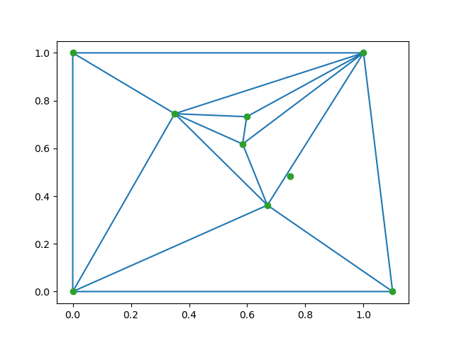
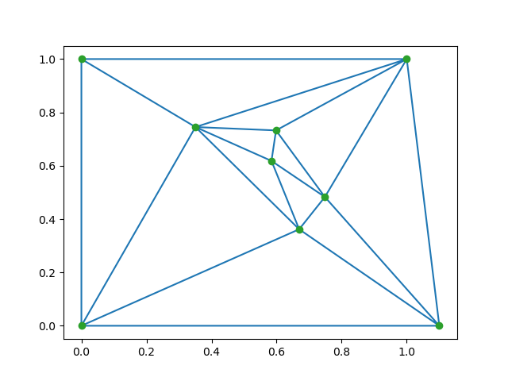
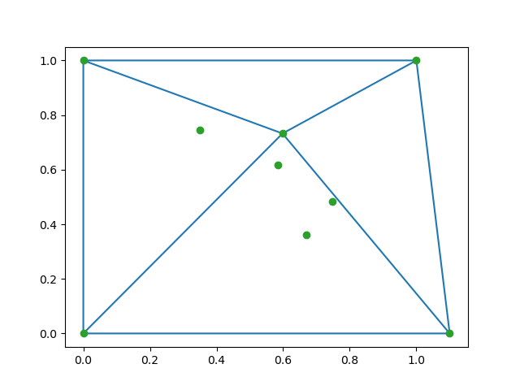
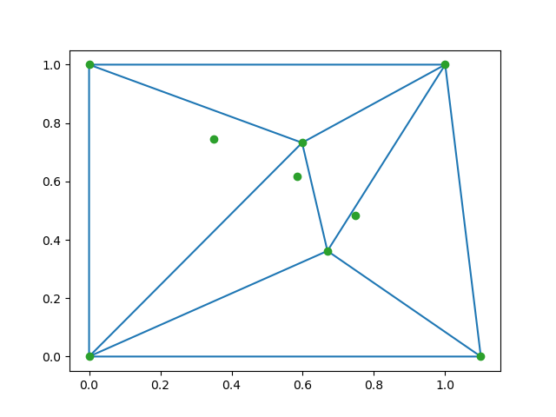
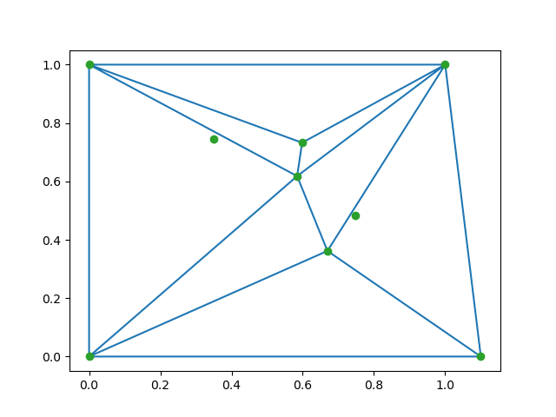

1
2
5
2 4 5 1 3
penalty=2+2+3+4+3 = (7, 3, 2)
2 4 5 1 3
penalty=2+2+3+4+3 = (4, 2, 2)
2 4 5 1 3
penalty=2+2+3+4+3 = (11, 4, 2)
2 4 5 1 3
penalty=2+2+3+4+3 = (14, 4, 2)
2 4 5 1 3
penalty=2+2+3+4+3 = (2, 2, 2)
3
4

Slide 4
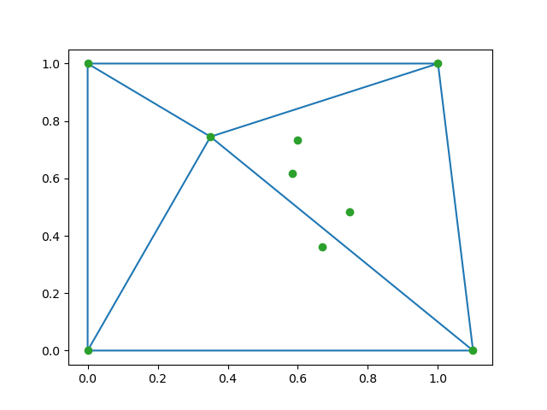
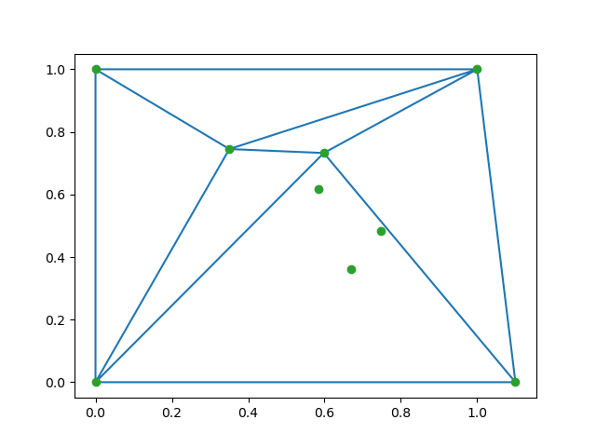
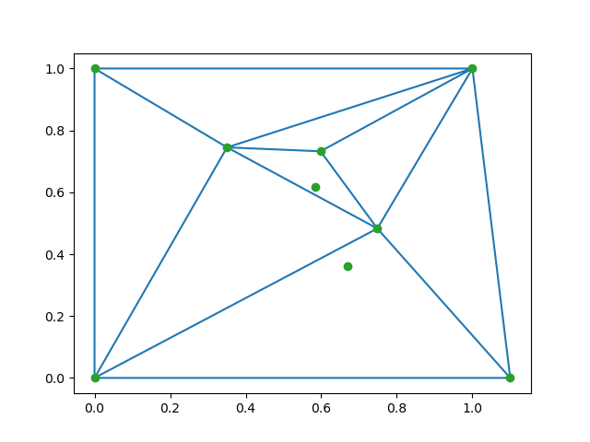
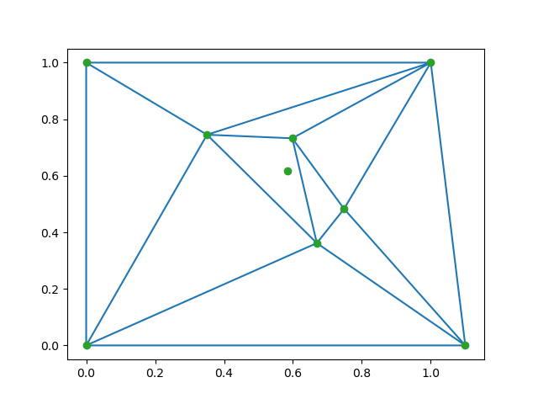

1
2
5
1 2 3 4 5
penalty=2+2+3+3+2 = (10, 3, 2)
1 2 3 4 5
penalty=2+2+3+3+2 = (12, 3, 2)
1 2 3 4 5
penalty=2+2+3+3+2 = (7, 3, 2)
1 2 3 4 5
penalty=2+2+3+3+2 = (2, 2, 2)
1 2 3 4 5
penalty=2+2+3+3+2 = (4, 2, 2)
3
4

Slide 5
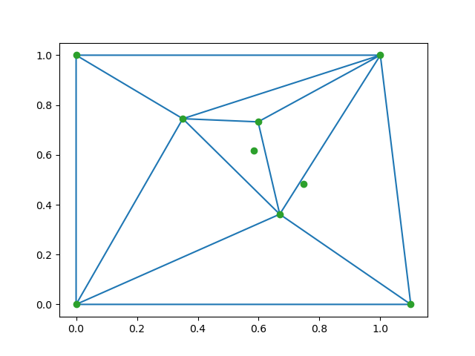
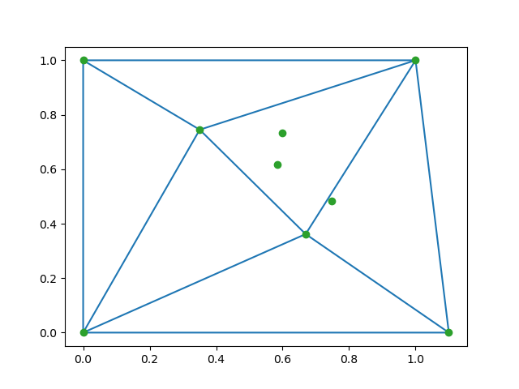

1
2
5
1 4 2 3 5
penalty=2+2+1+2+2 = (5, 2, 1)
1 4 2 3 5
penalty=2+2+1+2+2 = (7, 2, 1)
1 4 2 3 5
penalty=2+2+1+2+2 = (4, 2, 2)
1 4 2 3 5
penalty=2+2+1+2+2 = (9, 2, 1)
1 4 2 3 5
penalty=2+2+1+2+2 = (2, 2, 2)
3
4

Slide 6
Penalty Distribution
Penalty |  |  | Frequence
9 | 2 | 1 | 8
9 | 3 | 1 | 6
10 | 2 | 2 | 8
10 | 3 | 1 | 32
11 | 3 | 1 | 3
11 | 3 | 2 | 20
12 | 3 | 1 | 7
12 | 3 | 2 | 8
12 | 4 | 1 | 4
12 | 4 | 2 | 6
13 | 3 | 2 | 3
13 | 4 | 2 | 9
14 | 3 | 2 | 4
14 | 4 | 2 | 2
Total |  |  | 120
**specific to the data set of this presentation

Slide 7
Chalenge Scoring
80%
20%
Input:
100 data set (generated by SLB). For each data set, we compute (Python script) the 120=5! sequences and penalities.
the penalties are sorted from the minimum to maximum (by T then by max then by min).
Output:
for each data set the algorithm gives a sequence (that it believes optimal) ===> penalty ===> the score of this penalty = its index in the ordered list of penalties
we sum all the previous scores
smaller this sum is better is your score
The method and approach of the solution
The solution should not be based on a classic Delaunay algorithm

Slide 8
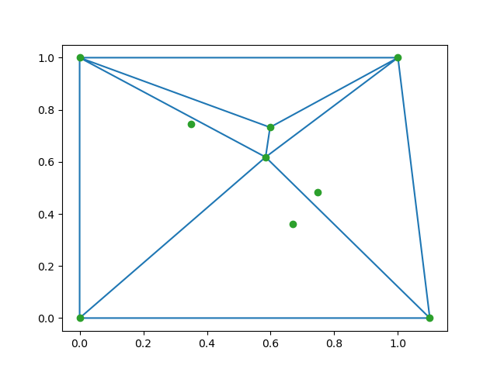
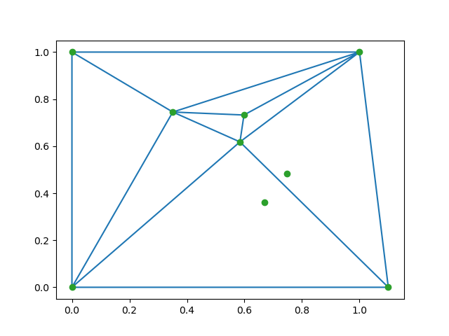
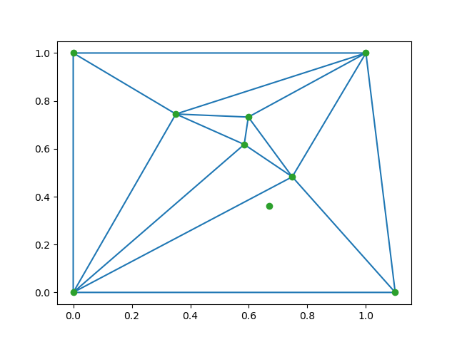
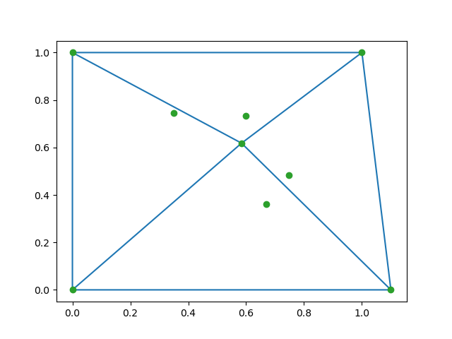
1
2
5
5 2 1 3 4
penalty=2+1+3+3+3 = (12, 3, 1)
5 2 1 3 4
penalty=2+1+3+3+3 = (3, 2, 1)
5 2 1 3 4
penalty=2+1+3+3+3 = (9, 3, 1)
5 2 1 3 4
penalty=2+1+3+3+3 = (6, 3, 1)
5 2 1 3 4
penalty=2+1+3+3+3 = (2, 2, 2)
3
4

Slide 9
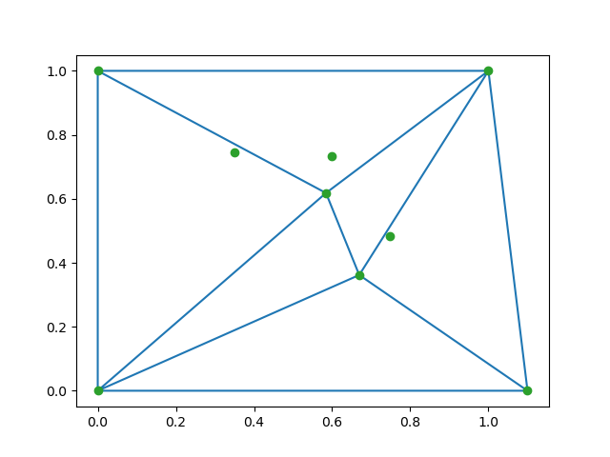
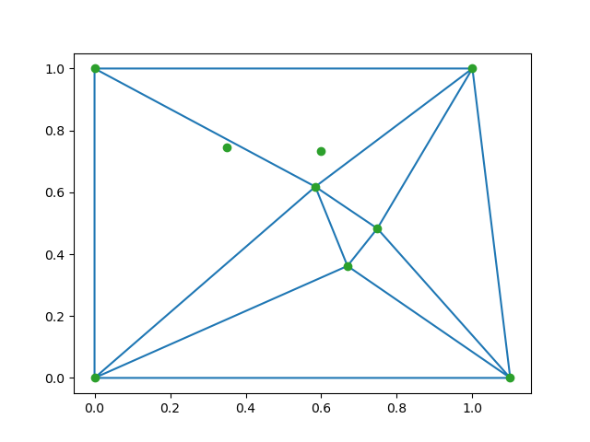
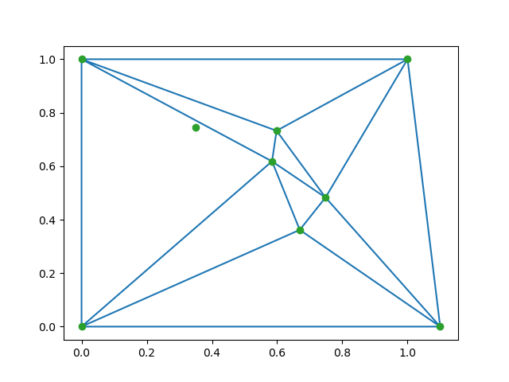
1
2
5
5 4 3 2 1
penalty=2+2+2+2+4 = (4, 2, 2)
5 4 3 2 1
penalty=2+2+2+2+4 = (6, 2, 2)
5 4 3 2 1
penalty=2+2+2+2+4 = (2, 2, 2)
5 4 3 2 1
penalty=2+2+2+2+4 = (8, 2, 2)
5 4 3 2 1
penalty=2+2+2+2+4 = (12, 4, 2)
3
4

