Slide 1


Context-Aware AI Agent for Enterprise Applications
Selected domain: Domain 5 — Enterprise Applications, Agentic AI & Dynamic Pricing
Problem statement: 5A — Context-Aware Application Agent
TEAM SAPIENS
TARGET USERS
Sl. No
Name
USN
Operations staff
Managers
Analysts
1
Karthik NHM
01FE24BCI072
2
Rakshita Kulkarni
01FE23BCS155
Anyone who runs daily work in a no-code business app: sales, operations, finance, support. They know the business, not every screen or query.
3
Vikas U B
01FE23BCI094
4
Yashas A B
01FE23BCS026
THE PROBLEM WE SOLVE
AI agents see a business app only as pixels and prose: they can click but not verify, and read pages without knowing what the numbers mean. So multi-step tasks fail, and answers cannot be traced.
Notes:
Team Sapiens, Domain 5A. Our users run daily work in no-code business apps. The problem in one line: agents see the app only as pixels and prose. Pixels can be clicked but not checked; prose says what a page looks like, not what its numbers mean.

Slide 2
Proposed Solution and Objectives
Our idea: an in-app companion that operates and analyses the whole app through one declared Application Contract, a file the app, the agent and the scorer all read.
Application Contract
pages · filters · measures · meaning
KEY OBJECTIVES → HOW WE MEASURE THEM
Right page
→
Intent-to-destination accuracy
Right filters, dates, sort
→
Final view matches exactly
The app
renders from it, so it cannot drift
The agent
acts only through it, so it cannot invent
The scorer
checks against it, so results are provable
Traceable answers
→
Every number carries evidence
No invented actions
→
Abstains when nothing fits
CORE FEATURES
Route by capability
Can say “none fits”
One state change
Whole view in the URL
Check twice
Refuse, then read back
Named measures
Screen’s own query
Score final state
Trace log → KPIs
Benefits: no need to learn the app’s layout · every figure links to its view · only legal actions · one state change, not a click chain
Notes:
Lead with the contract, not the chatbot: the app, the agent and the scorer all read the same file, so none of them can disagree. Each objective maps to a KPI in the brief. Published comparisons report 950 ms for direct calls against 3,404 ms for browser automation.

Slide 3
Innovation and Existing Alternatives
2–7%
of whole tasks finished on Mind2Web’s 137 real sites
9–19%
on multi-step enterprise workflows (UI-CUBE)
51.1%
once the element to click is handed over (SeeAct)
Our move
Name everything in a contract, so there is nothing to find
EXISTING APPROACHES AND THEIR LIMIT
HOW WE FIX IT
Browser, GUI agents
Playwright, BrowserOS
Must find and click; failures unseen
Misreads the page
→
Grain, unit declared; “none fits”
Embedded app agents
EmbeWebAgent, VACP
Declare functions, not meaning; numbers untraced
Invents a filter
→
Validator refuses illegal calls first
Typed-action proposals
Web verbs, Vector
Right direction; no prototype or KPIs
Filter silently fails
→
State read back, else undone
Text-to-SQL, chat-BI
Vanna, TA-SQL
Valid SQL, wrong meaning
Numbers contradict screen
→
The screen’s own named query
Classic RPA
ECLAIR studies
12–18 months to set up
Untraceable figures
→
Evidence ID on every number
1,506
papers cite Mind2Web
~40
touch enterprise apps
1
mentions no-code
Each fix is published. The combination, for no-code apps, is open.
Notes:
The experiment has already been run: agents finish 2-7% of Mind2Web tasks and 9-19% of enterprise workflows, and SeeAct shows success jumps to 51.1% once the element is handed over, so finding things is the bottleneck. We remove the finding. Precedents: MindAct (router), CLAIRE and web verbs (validator), Hybrid World-Model Planning (read-back), VACP (named measures), AD-Bench (evidence). Embedding an agent is not new; declared meaning, verified state changes and traced numbers are.

Slide 4
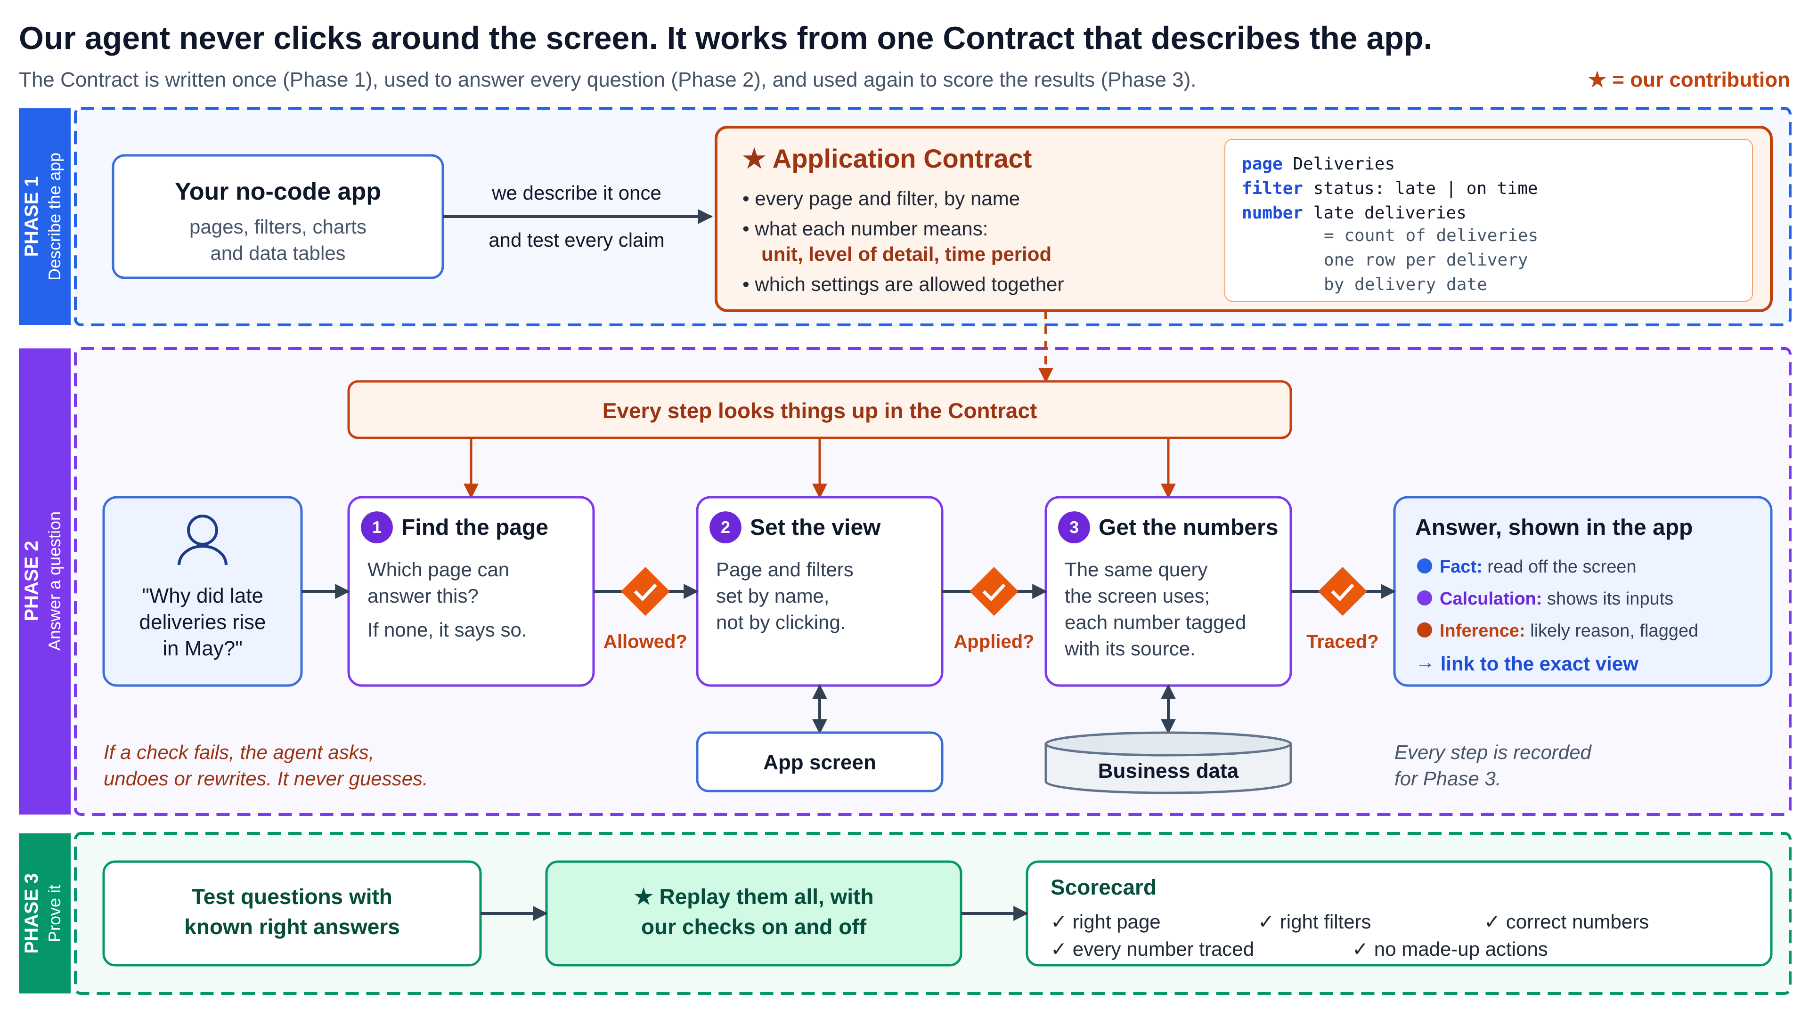
System Architecture and Workflow
Notes:
Phase 1: we describe the app once as a contract and test every claim. Phase 2: each question goes find the page, set the view, get the numbers, with a check after each step, and the answer is labelled fact, calculation or inference. Phase 3: the same contract scores the replayed questions with our checks on and off.

Slide 5
Technology Stack and Implementation Plan
TECHNOLOGY STACK · WHY IT FITS
TEAM · FOUR ROLES IN PARALLEL
Interface
React + Vite · Recharts · CopilotKit
Chat panel and live charts inside the app
A
App and data
Contract, pages, URL state, queries
Agent
LangGraph · Pydantic · RapidFuzz
Stateful tool loop; typed checks on every call
B
Agent
Router, validator, tools, context
Data
SQL Server · sample tenant · pyodbc
Read-only; the same queries the screen uses
C
Companion UI
Chat panel, fact labels, confirm card
Model
Hosted LLM with tool calling
Structured output; our only paid service
D
Evaluation
Task file, runner, trace log, KPIs
48-HOUR TIMELINE · FORMATS AGREED IN HOUR ONE · EVERY MILESTONE ENDS IN A DEMO
M1 · 0–10 h
M2 · 10–20 h
M3 · 20–28 h
M4 · 28–36 h
M5 · 36–42 h
M6 · 42–48 h
Contract, pages, URL state
Router, validator, set view
Context, names, ask or abstain
Comparisons, evidence IDs
Runner, KPIs, ablation
Rehearse, real numbers
Notes:
Why these technologies: LangGraph gives a stateful loop that can pause for a clarifying question; Pydantic turns the contract into a validator; the same SQL queries serve the screen and the agent, so numbers match. If time allows: bm25s and embeddings for the retrieval test, SQLGlot for a guarded SQL fallback, Playwright to drift-check the app against the contract. All libraries are MIT, BSD or Apache-2.0.

Slide 6
Expected Outcomes and Demo Plan
THE DEMO · ONE INVESTIGATION, FOUR TURNS, NO MANUAL CLICKS
“Late deliveries in May”
Opens, filters checked
“Why up vs April?”
Ranked contributors
“Top item’s supplier”
Uses the current selection
“Open a case for it”
Confirms the exact action
HACKATHON DELIVERABLES
FUTURE ENHANCEMENTS
• A working app rendered from one contract
• The companion: navigates, filters, compares, cites
• Task file and runner: one command, every KPI
• Evidence pack: trace log, validator on/off run
→ Any no-code platform, from its metadata export
→ Search across hundreds of pages and widgets
→ More write actions, each with approval
SUCCESS = right page · right filters · correct numbers · every number traced · no made-up actions
WHAT WE NEED · AND THE RISKS
Datasets
Wide World Importers sample (free); Mind2Web train split for a retrieval test
Equipment, paid
Team laptops; a hosted LLM API is the only paid service
External access
Model API only; EntWorld tasks if its licence allows
Risks
No URL state means Playwright; outside testers counter our phrasing
Notes:
Nothing here is measured yet: these are the deliverables we will ship and the measures we will report, all computed from the trace log. Mind2Web is used only as a retrieval stress test, because it runs on cached pages, scores one recorded click path, has no follow-ups and never asks for a number.

