Slide 1


Context-Aware AI Agent for Enterprise Applications
Automated navigation and analysis of business web apps, driven by plain-language questions
Domain 5: Enterprise Applications, Agentic AI & Dynamic Pricing · Problem 5A: Context-Aware Application Agent
TEAM SAPIENS
TARGET USERS
Sl. No
Name
USN
Operations staff
Managers
Analysts
1
Karthik NHM
01FE24BCI072
2
Rakshita Kulkarni
01FE23BCS155
People who run daily work in a no-code business app: sales, operations, finance, support. They know the business, not every screen or query, and ask in everyday words.
3
Vikas U B
01FE23BCI094
4
Yashas A B
01FE23BCS026
THE PROBLEM WE SOLVE
01
Navigation is manual. One business question must be translated into app terms (page, filters, date range, sort) and stitched together across several views by hand.
02
Screen-clicking agents are brittle. Only 9–19% of multi-step enterprise workflows succeed (UI-CUBE, 2025): they must locate every element on the page (grounding), and errors compound with each step.
03
Answers are not verifiable. Agents report a filter as applied without checking it, and AI-written SQL can mix units, levels of detail or periods, with no trace back to the view.
04
Context is lost between turns. Follow-ups like “this item” or “same period” depend on live page state that a stateless chatbot does not track.

Slide 2
Proposed Solution and Objectives
Our idea: ask in plain words; the agent opens the right page, sets filters, reads data and answers with sources.
Application Contract prepared once per app, as JSON
Every page and filter with its allowed values, and each measure as one named query with its unit, level of detail and time period.
Live page (DOM) read at every step
What is actually on screen now: the open page, the applied filters and the selected row. Used to verify that each action took effect.
OUR OBJECTIVES · HOW WE ACHIEVE THEM · HOW WE MEASURE THEM
Objective | How we achieve it | How we measure it
1 Reach the right page | Parse intent and slots (entity, measure, period, filters); shortlist only pages whose filters accept them; otherwise say “none fits”. | Top-1 page accuracy on unseen questions
2 Set the exact view | Apply page, filters, dates and sort as one validated URL state change, then read the live page back; retry once, else undo. | Requested vs applied state: exact match
3 Give faithful figures | Compute only through the Contract’s named measures (no free-form SQL); bind each figure to its measure, filters and period. | Figures correct; 100% carry a source
4 Keep context across turns | Checkpoint the page, filters, selection and past results per conversation, so “this item” resolves to a real record. | Follow-up tasks solved correctly
5 Never invent an action | Validate every call against the Contract’s allowed pages, values and dependencies; confirm any write against the exact pending change. | Invalid actions ≈ 0; no false “success”
Measure = a named calculation over business data, e.g. late deliveries = deliveries that arrived after the promised date.

Slide 3
Innovation and Existing Alternatives
9–19%
enterprise workflows finished by clicking agents (UI‑CUBE)
61%
complex tasks finished by people new to the app (UI‑CUBE)
14.8% → 38.9%
when agents call the app directly, not just click (WebArena)
~72%
best clicking agents today, but on generic websites
HOW EXISTING APPROACHES COMPARE
Approach | Operates the app | No per-app setup | Understands measures | Checks the result | Figures traced to source | Keeps context
Chat-BI, text-to-SQL | No | Partly | Partly | No | Partly | Partly
Screen-clicking agents | Yes | Yes | No | Partly | No | Partly
Embedded (EmbeWebAgent) | Yes | No | No | Partly | No | Partly
App-state protocol (VACP) | Yes | No | Partly | Yes | Partly | Yes
Ours | Yes | No | Yes | Yes | Yes | Yes
WHAT IS NEW IN OURS
1
Meaning is written down
2
Checked before and after
3
Every figure has a source
Each measure’s unit, level of detail and period is declared.
Checked against the Contract, then confirmed on the live page.
Each figure names its measure, filters and period.
Each mechanism has published precedent; our claim is the combination for business apps, tested with our checks on vs off.

Slide 4
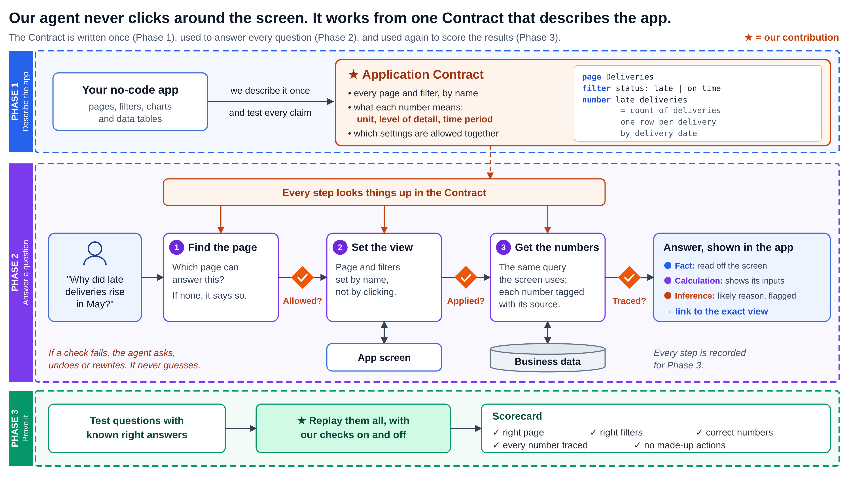
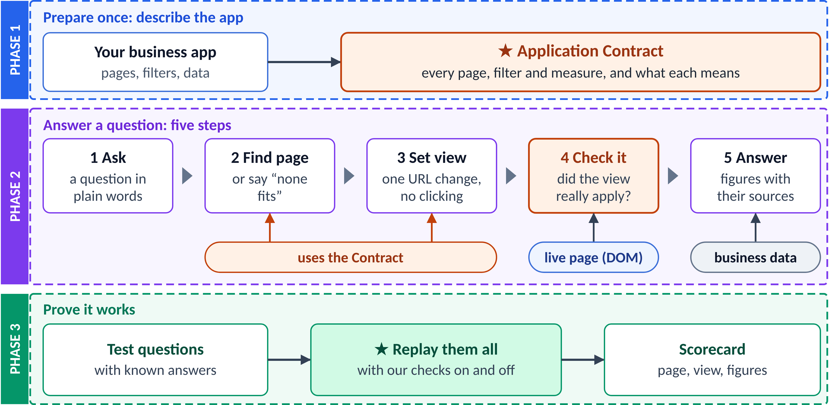
System Architecture and Workflow
PHASE 1
Prepare the Contract · offline, once per app
Platform metadata
pages, widgets,
filters, routes
Contract builder
adds unit, level of detail,
period (AI draft + review)
Claim checks
SQL tests that each
definition holds
★ Application Contract
allowed pages and filters;
measures as named queries
PHASE 2
Answer a request · online, for every question
★ reads the Application Contract: allowed pages, filters and values · named measures
1 Understand
intent, slots;
names → IDs
2 Route
matching pages
or “none fits”
Valid?
else ask
3 Act
set view: one
URL change
Applied?
else undo
4 Analyse
named measures
+ comparisons
Traced?
else redo
5 Answer
labelled facts
+ deep link
Conversation state (checkpointed)
Live page: DOM / app hooks
Business data
Evidence ledger + trace log
PHASE 3
Prove it works · evaluation on the trace log
Test set
~30 questions with expected page,
view and figures; unseen and
“no-fit” cases
★ Runner
replays every task with our
checks ON vs OFF, scoring
from the trace log
Scorecard
page accuracy · view match ·
figure correctness · false
“success” rate · steps, latency

Slide 5
Technology Stack and Implementation Plan
TECHNOLOGY STACK · WHY IT FITS
TEAM · FOUR ROLES IN PARALLEL
Interface
React + Vite · Recharts · CopilotKit
Chat panel and live charts inside the app
A
App and data
Contract, pages, URL state, queries
Agent
LangGraph · Pydantic · RapidFuzz
Step-by-step tool loop; typed checks on every call
B
Agent
Router, checks, tools, context
Live page
Playwright or app hooks
Reads the open page to confirm each action
C
Companion UI
Chat panel, fact labels, confirm card
Data
SQL Server · sample tenant · Contract (JSON)
Read-only; the same queries the screen uses
D
Evaluation
Test questions, runner, trace log, KPIs
Model
Hosted LLM with tool calling
Structured output; our only paid service
48-HOUR TIMELINE · EVERY MILESTONE ENDS IN A WORKING DEMO
M1 · 0–10 h
M2 · 10–20 h
M3 · 20–28 h
M4 · 28–36 h
M5 · 36–42 h
M6 · 42–48 h
Contract, pages; hour-4 gate: set and read back a filter
Router, checks, set view
Context, names, ask or abstain
Comparisons, sources on figures
Runner, KPIs, checks on/off run
Rehearse; real numbers into the deck

Slide 6
Expected Outcomes and Demo Plan
THE DEMO · ONE INVESTIGATION, FOUR TURNS, NO MANUAL CLICKS (scenario seeded in the sample data)
“Late deliveries in May”
Opens the page; filters checked
“Why up vs April?”
Ranked contributors, with sources
“Top item’s supplier”
Uses the current selection
“Open a case for it”
Confirms the exact action first
HACKATHON DELIVERABLES
FUTURE ENHANCEMENTS
• A working app built from one Application Contract
• The companion: navigates, filters, compares and cites
• Test questions and runner: one command prints every KPI
• Evidence pack: trace log and a checks-on vs checks-off run
→ Draft the Contract automatically from the platform’s metadata export and the live page
→ Search across hundreds of pages and widgets
→ More write actions, each needing approval
SUCCESS = right page · right view · traced figures · no made-up actions
Targets: at least 15 of 18 unseen test tasks fully correct · zero false “success” on deliberately broken cases
WHAT WE NEED · AND THE RISKS
Datasets
Wide World Importers sample (free); ~30 test questions, some written by outsiders
Equipment, paid
Team laptops; a hosted LLM API is the only paid service
External access
LLM API key; EntWorld tasks if its licence allows
Risks
Contract effort per app; no URL state means Playwright; our own phrasing bias

