Slide 1




Areas applicable - 1) Education 2) Corporate Companies
3) Banks and Other financial institutions

Slide 2


Research and development. Formulas are the essence.

Slide 3


Using Animations And Stories To teach Everyone

Slide 4
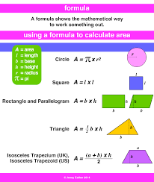
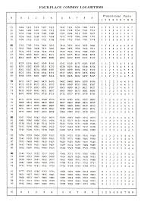
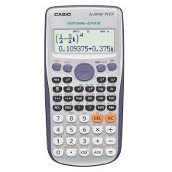
Calculators Replaced Log tables. Formula Dictionary replaces Calculators

Slide 5


From Students , Teachers, Start-ups, Broking Companies to corporate companies

Slide 6
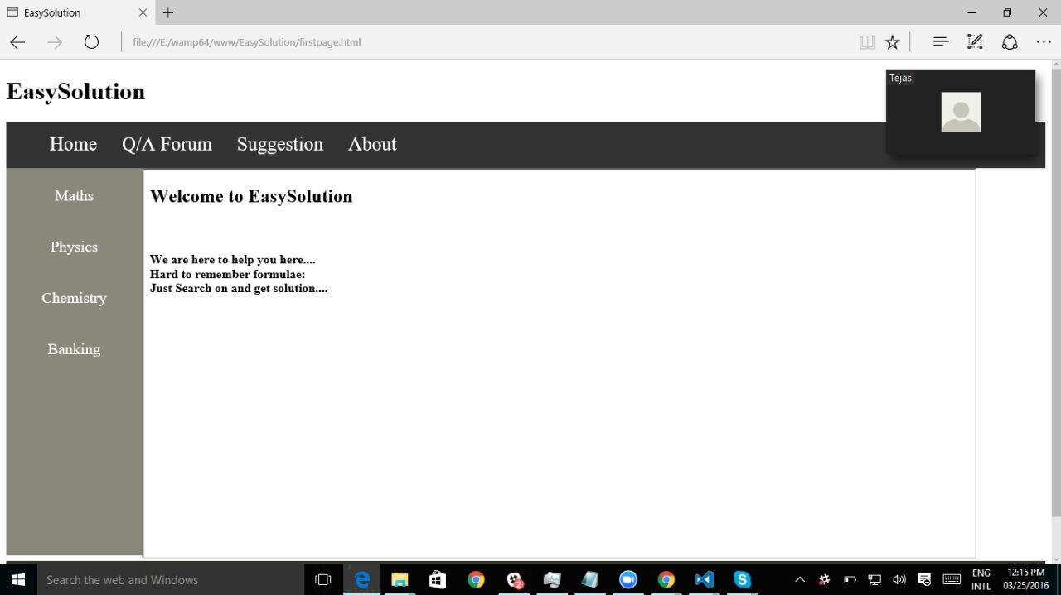
Few Screenshots of what we have implemented

Slide 7
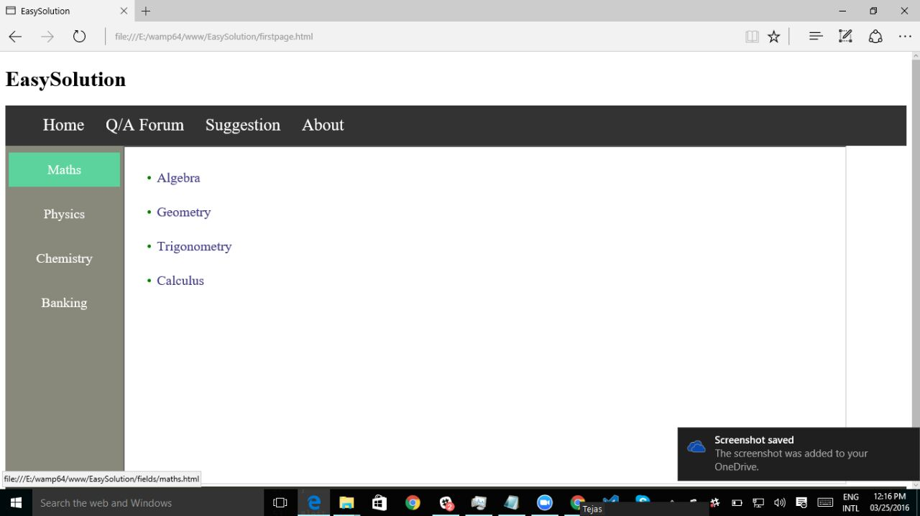
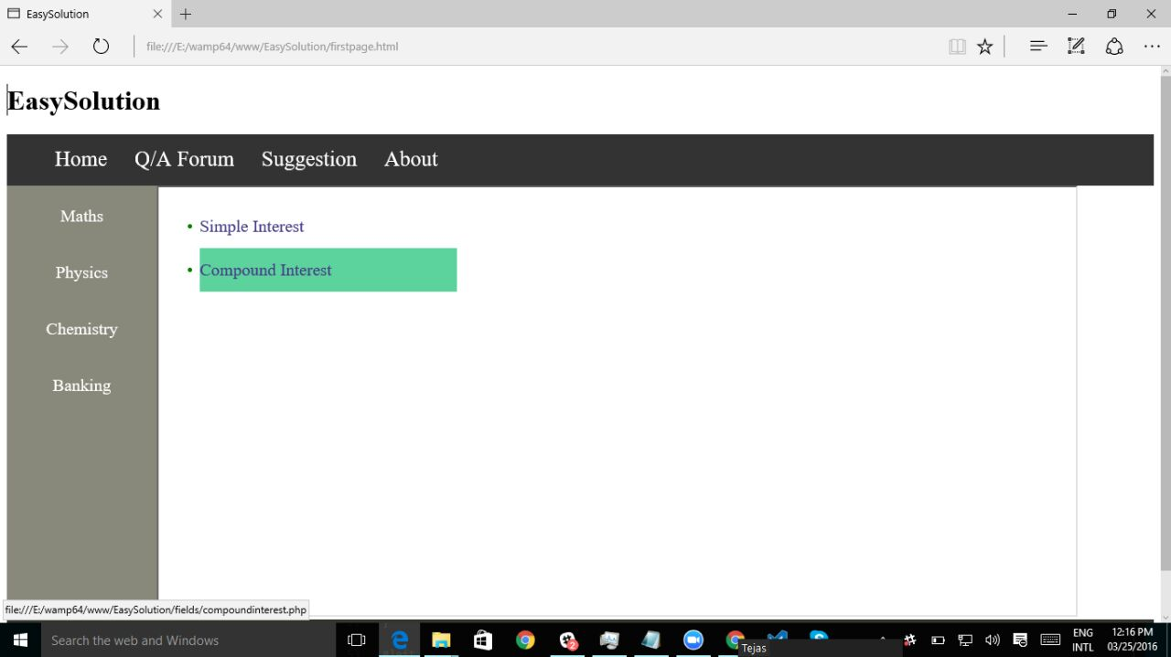
Math Tab With Couple of Formulae and various topics

Slide 8
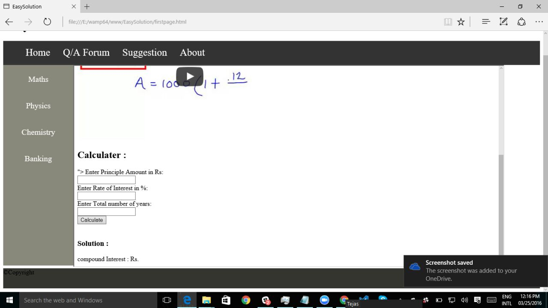
Page to accept inputs from the user and perform calculations as well as link for explanation of the concept used.

Slide 9
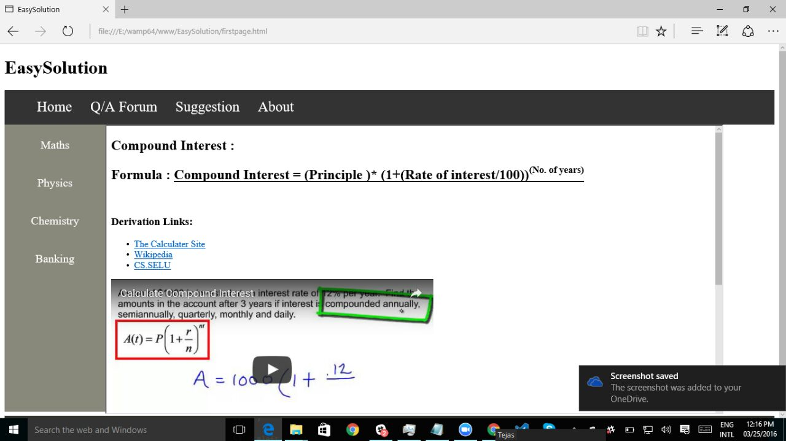
Also providing links for derivation and other related concepts.

Slide 10
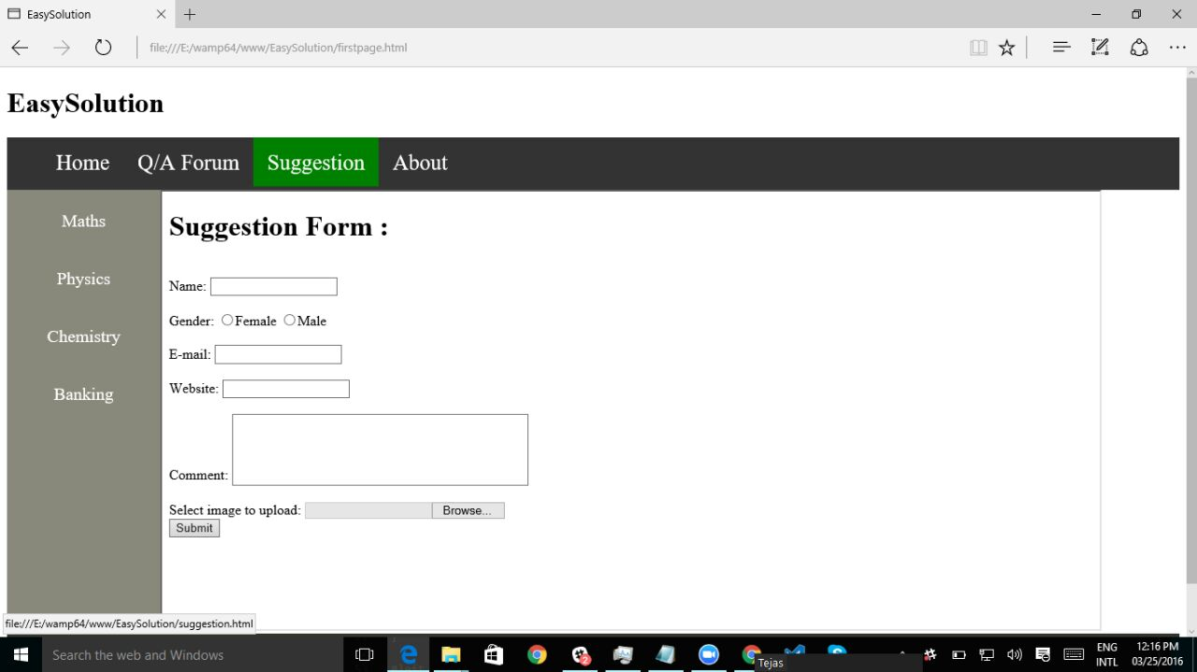
Accepting Feedback Forms from users

Slide 11
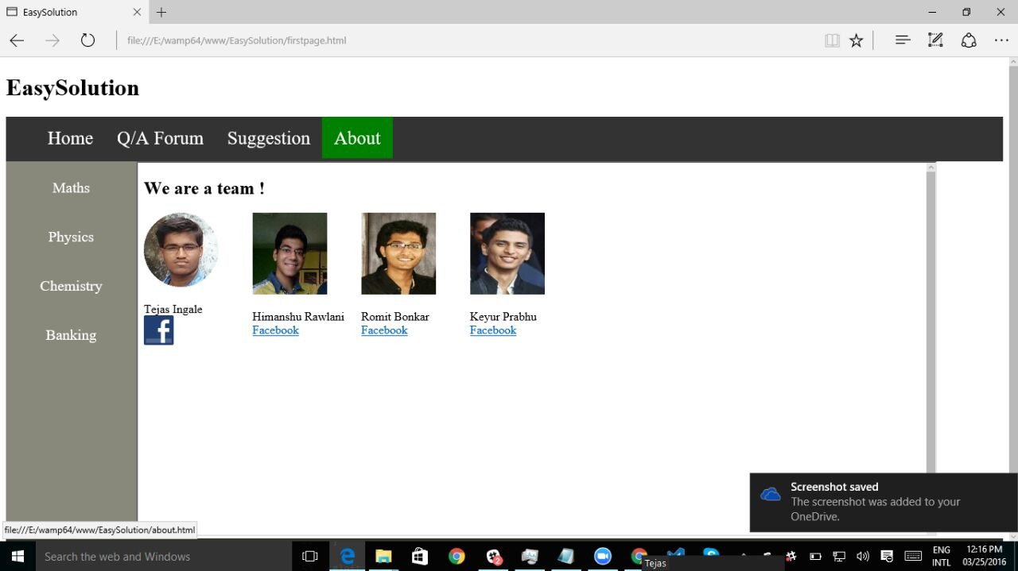
Thank You !!!

