Slide 1
notimeforcrime.tech
Hakan Gunerli, Preetham Thelluri Nachiket Hinge, Alero Adegoroye

Slide 2




Members
Hakan Gunerli
Preetham Thelluri
Alero Adegoroye
Nachiket Hinge

Slide 3
Problem Statement
Crime is unavoidable. It can be reduced, but it can’t entirely disappear.
Atlanta was the sixth most dangerous city in the US in 2012. [1]
We want to contribute to the awareness of crime by the power of visualization.
Notes:
[1] https://www.forbes.com/sites/danielfisher/2012/10/18/detroit-tops-the-2012-list-of-americas-most-dangerous-cities/?sh=35204fea2931
Although the city has done a lot to reduce crime in the recent years, we believe the importance to educate ourselves and others by informing to be the best way to further reduce the rates.

Slide 4
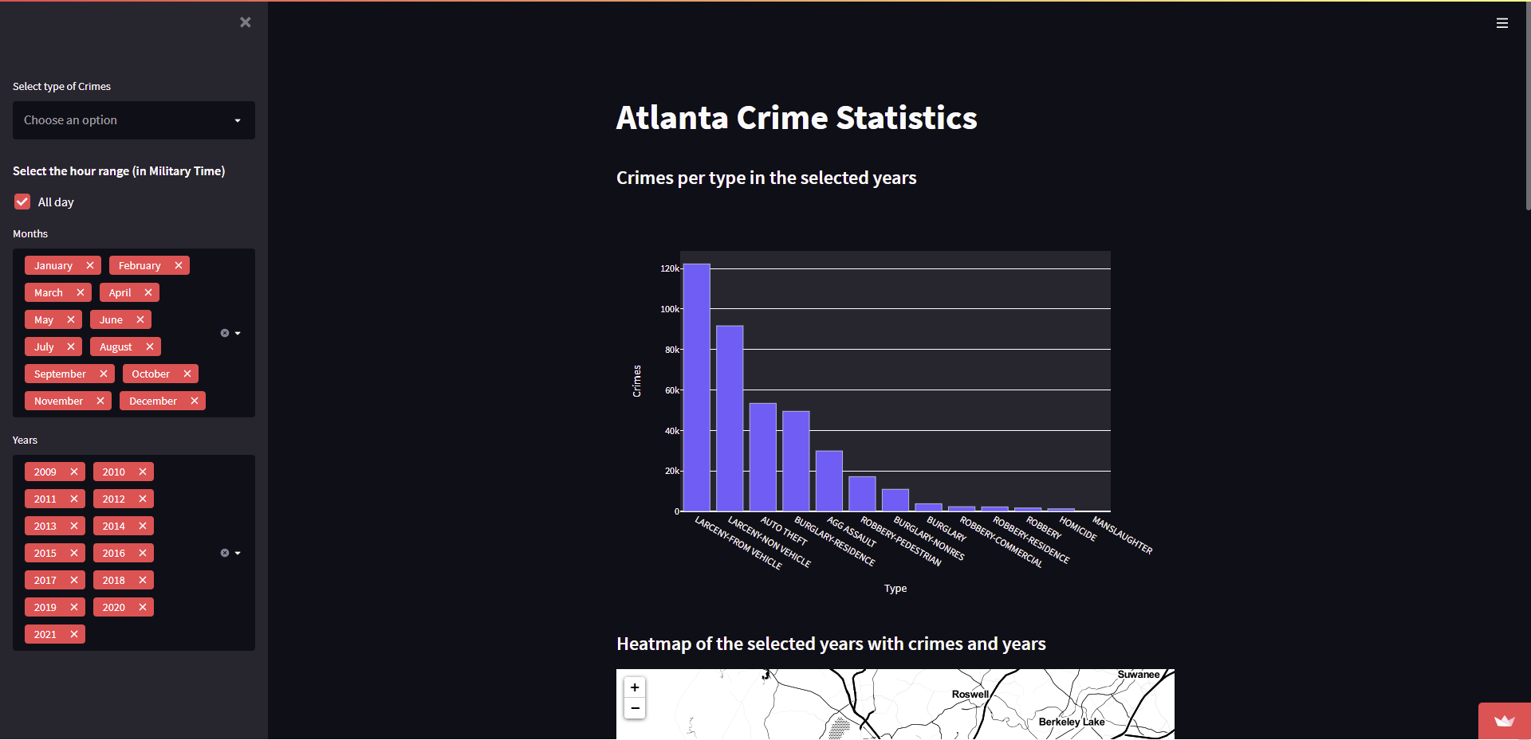
How do we tackle this problem?
A state of the art statistical crime analysis of ATL. Both mobile and desktop optimized, with usability as the focal point of the design process.

Slide 5
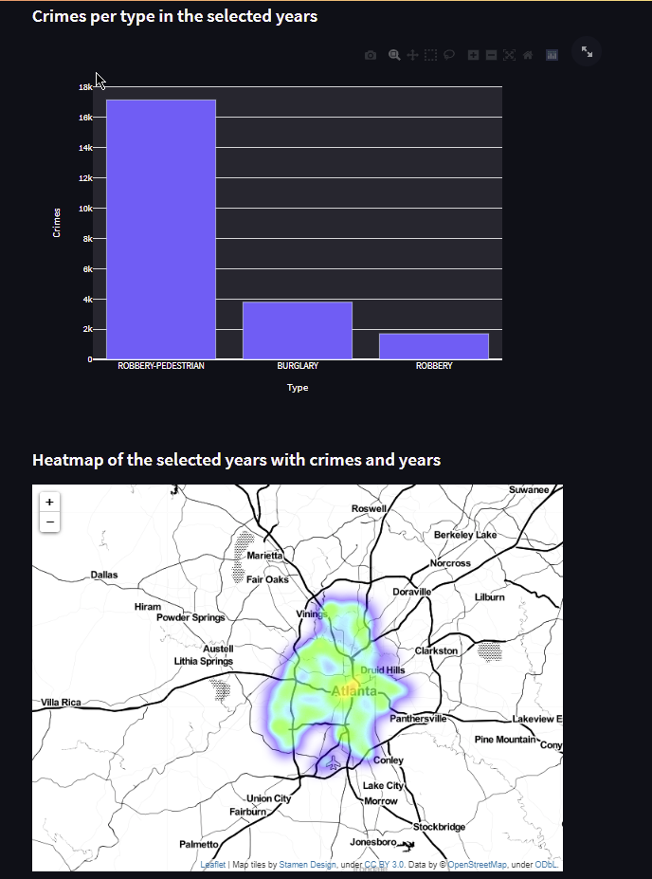
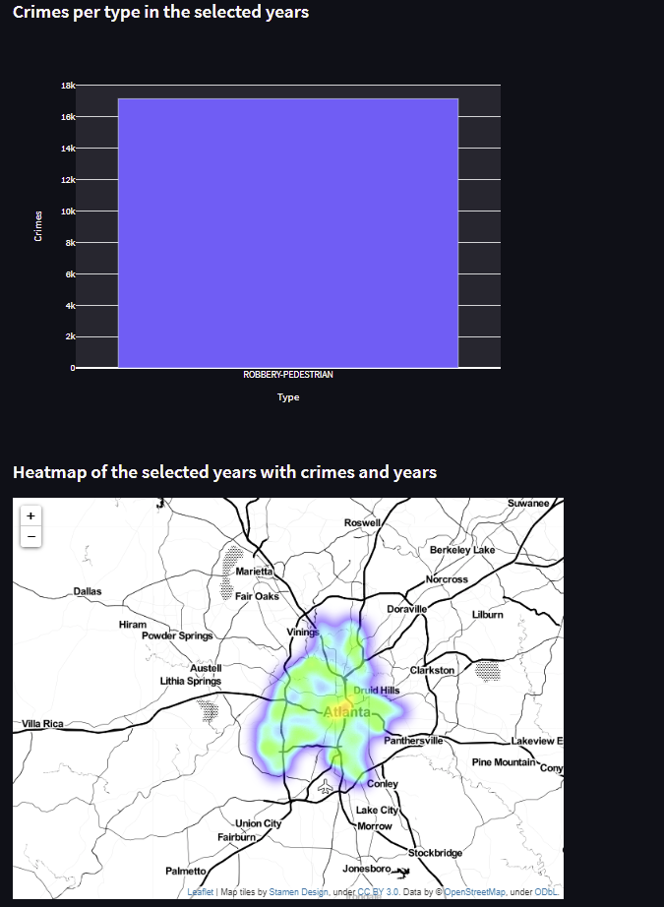
How’s our product special?
According to the research we have conducted during our design process, our product has more scalability and less downtime than any of its counterparts while maintaining a reasonable wait time.
With over 13 years of information and more than 40,000 crime data, it is able to give you every detail and events occurred in the Metro Atlanta area.
Notes:
Sort by one crime, or multiple

Slide 6
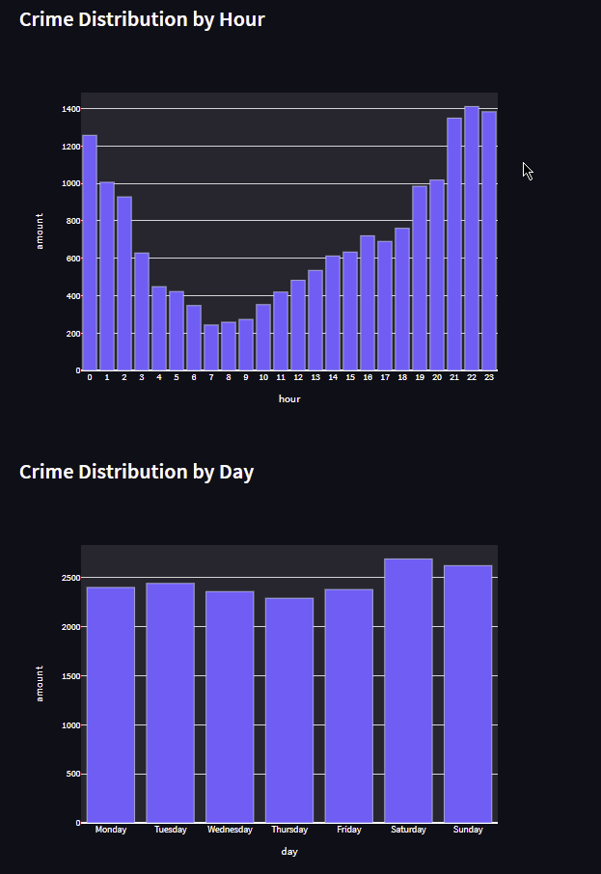
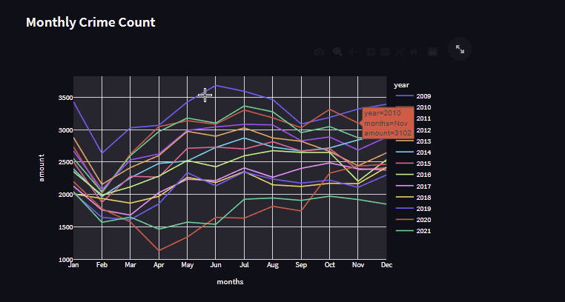
Most scalable sorting
You can sort by a whopping 3456 possible combinations of by the hour, months, or years.

Slide 7
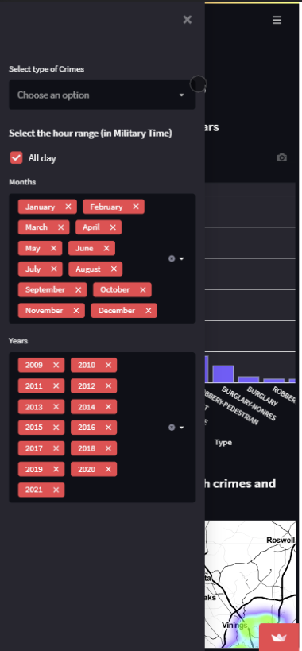
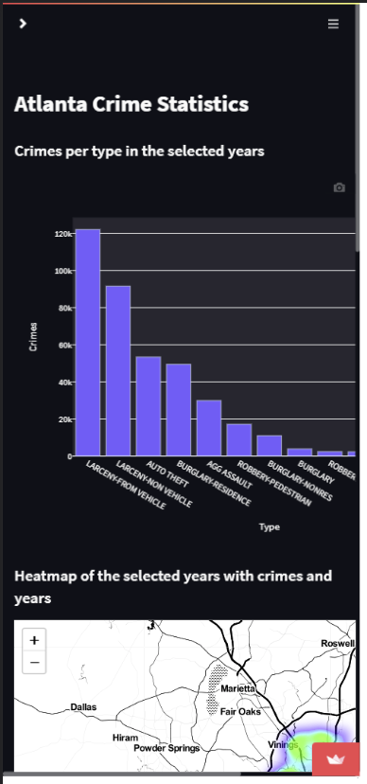
Optimized for on the go!
Using the advantages of responsive design, and the flexibility of Streamlit, the dataset and every single point in the dataset can be also accessed through our website.
Notes:
we carefully assessed the UX by contacting 10 potential users and get their opinions, and paid special attention to cross-platform usability by considering mobile users during the design process.

Slide 8
Demo
Notes:
Don’t run this on the website it’ll cache like ass, run it on your computer if possible

Slide 9
Thank you
Don’t forget, there’s no time for crime!

